Slide 1
STATS 507 Data Analysis in Python
Week11-1: Intro to Deep Learning and PyTorch
Dr. Xian Zhang

Slide 2

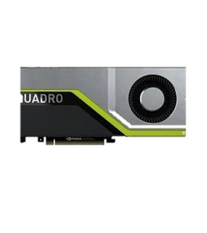

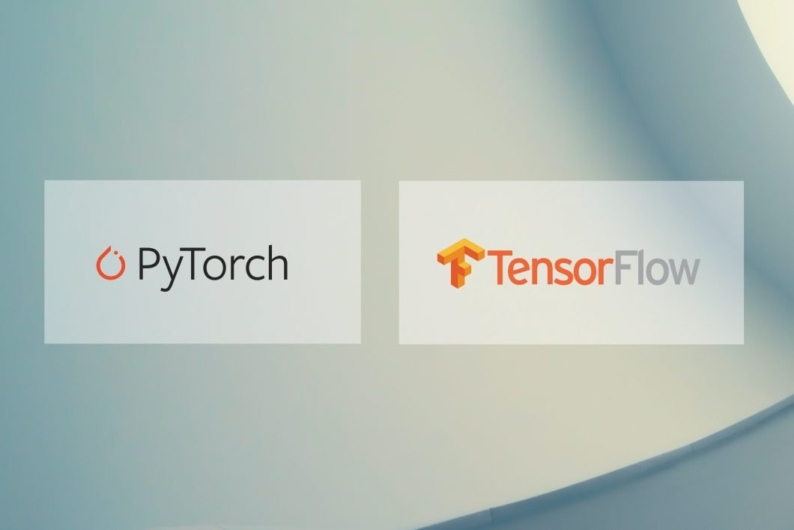


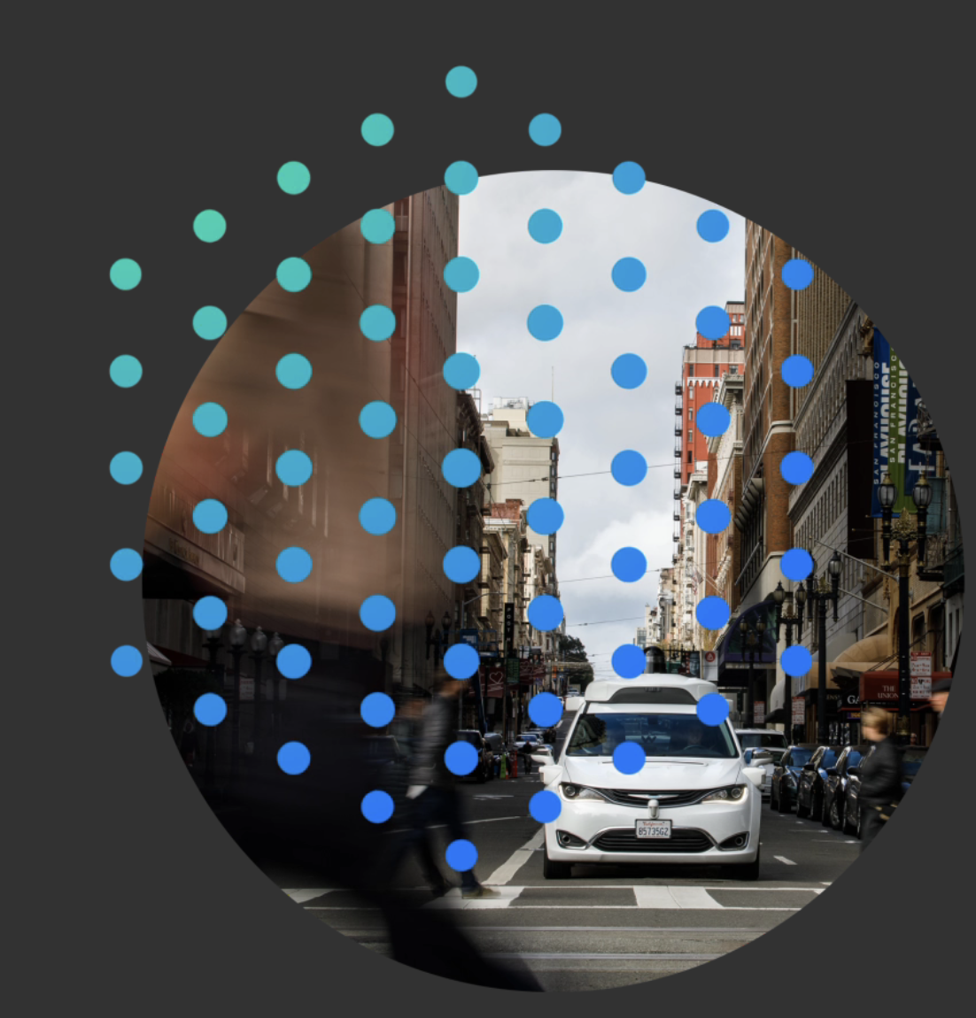
Recap: why resurgence of DL?
1. Big data
2. Hardware
3. Software
1952
Stochastic gradient descent
1958
Perceptron
Learnable weights
Larger dataset
Easier collection and storage
GPUs
Massively parallelizable
Improved techniques
New models
Toolboxes
1986
Back propagation
Multi-Layer perceptron
1995
Deep convolutional NN
ChatGPT… (why now)
Slide Credit: Alexander Amini
Modified from MIT open course: 6.S191
Notes:
Neural network actually dates a few decades back, why the resurgence now?
There have been three key advances that have occurred in the past decade.
First, Data is so much more pervasive. they are much easier to collect and store. Deep learning are hungary for data.
Secondly, we have our advancement on hardware, those algorithms are massively parallizebale and they require a lot of computes, we are now able to train those algorithms on GPUS.
At last, due to open course toolboxes and software platforms like pytorch and tensorflow, which all of you will get some experience on in this class, building and training deep learning neural network have become much easier.

Slide 3
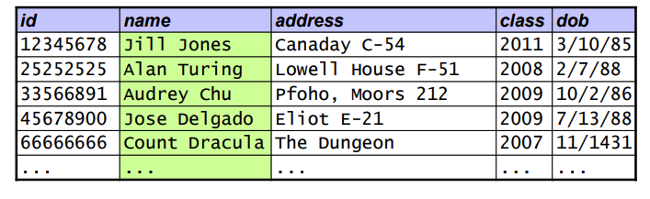
What is a (relational) Database?
Relational Database: a collection of tables (tabular data)
Each row in a table holds data that describes either:
An entity
A relationship between two or more entities
Each column in a table represents one attribute of an entity
Each column has a domain of possible values
Notes:
A database with multiple tables

Slide 4
Writing Query with SQL?
Structured Query Language: A language via which you can create, read, update, and delete data in a database.
Basic extracting: SELECT
More: https://www.w3schools.com/sql/
SELECT [column names] FROM [table]
Filter: WHERE
SELECT [column names] FROM [table] WHERE [filter]
Aggregating: GROUP BY
SELECT [column names],[agg functions] FROM [table] GROUP BY [column names]
Ordering: ORDER BY
SELECT [columns] FROM [table] ORDER BY [column] [ASC|DESC]
Notes:
Move beyond spreadsheet to database

Slide 5
Recall the scope of this class
Part 1: Introduction to Python
Data types, functions, classes, objects, functional programming
Part 2: Numerical Computing and Data Visualization
numpy, scipy, scikit-learn, matplotlib, Seaborn
Part 3: Dealing with structured data
pandas, SQL, real datasets
Part4: Intro to Deep Learning
PyTorch, Perceptron, Multi-layer perceptron, SGD, regularization, ConvNets
Slide Credit: Jeffrey Regier

Slide 6
1. Deep Learning Concepts Recap 2. Intro to PyTorch 3. Perceptron and MLP

Slide 7
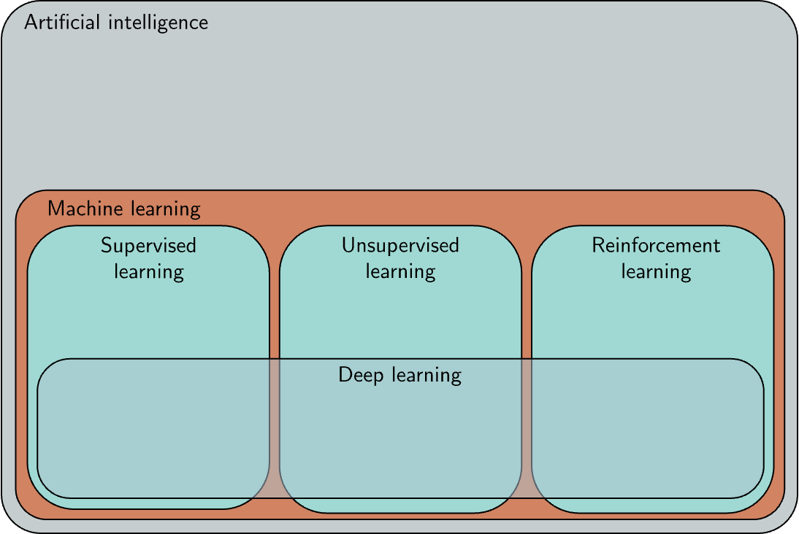
Recap: What is machine learning?
Machine learning is a subset of AI that learns to make decisions by fitting mathematical models to observed data
Has labels
No labels
Regression
Classification
Notes:
Machine learning methods can coarsely be divided into three areas:
Supervised, unsupervised and Reinforcement learning.
Supervised learning define a mapping from input data to an output prediction. Regression and classification problems. Those input/output pairs take the role of a teacher or supervisor for the training process, and this gives rise to the term supervised learning.
Unsupervised learning: the absence of output label: no supervision. The goal is to describe or understand the structure of the data. Generative unsupervised model, which learn to synthesize new data examples that are statistically indistinguishable from the training data. Explicitly describe the distribution, others generate new examples without explicitly describing their distribution
Reinforcement learning which focus on the idea of agent and its environment, policy and its reward. We will see one example as well.

Slide 8
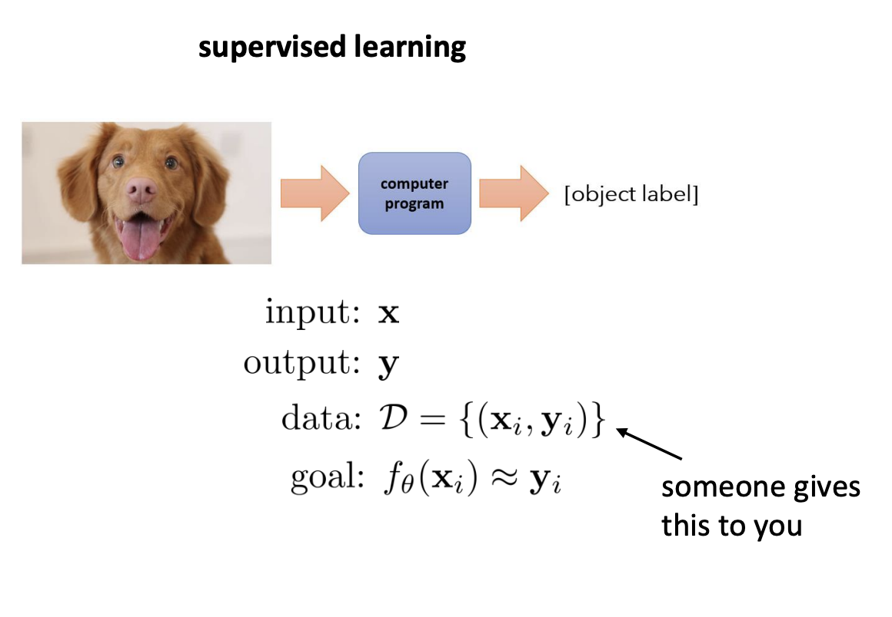
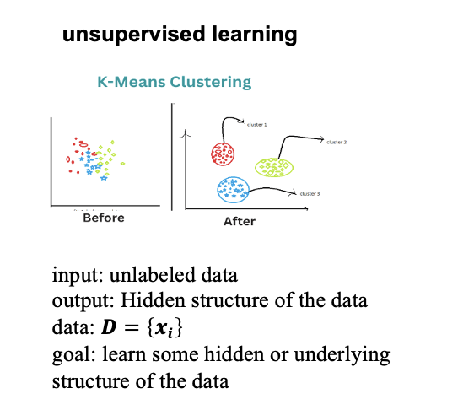
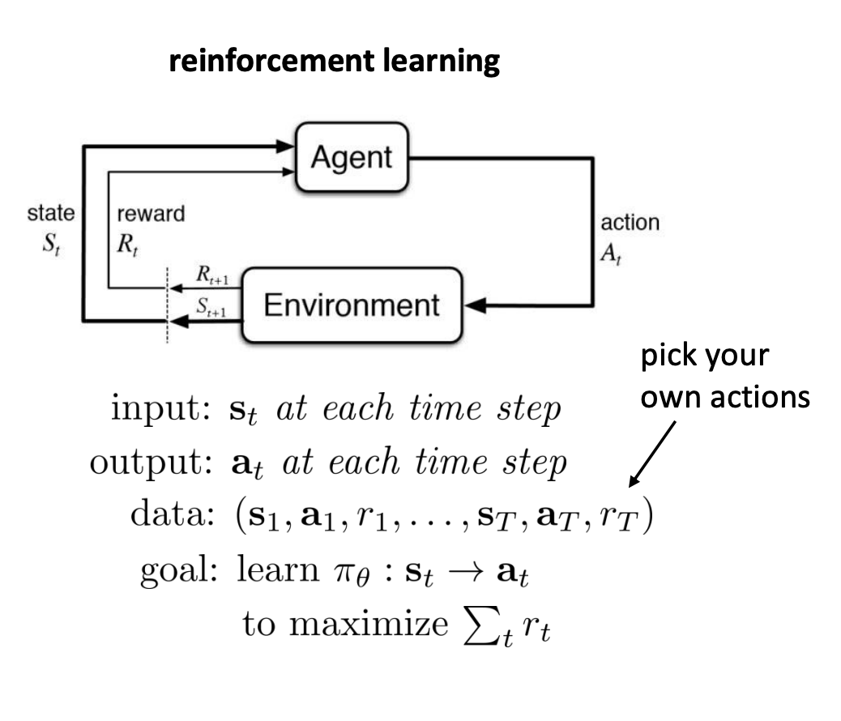
Recap: What is machine learning?
Ref: https://rail.eecs.berkeley.edu/deeprlcourse/

Slide 9
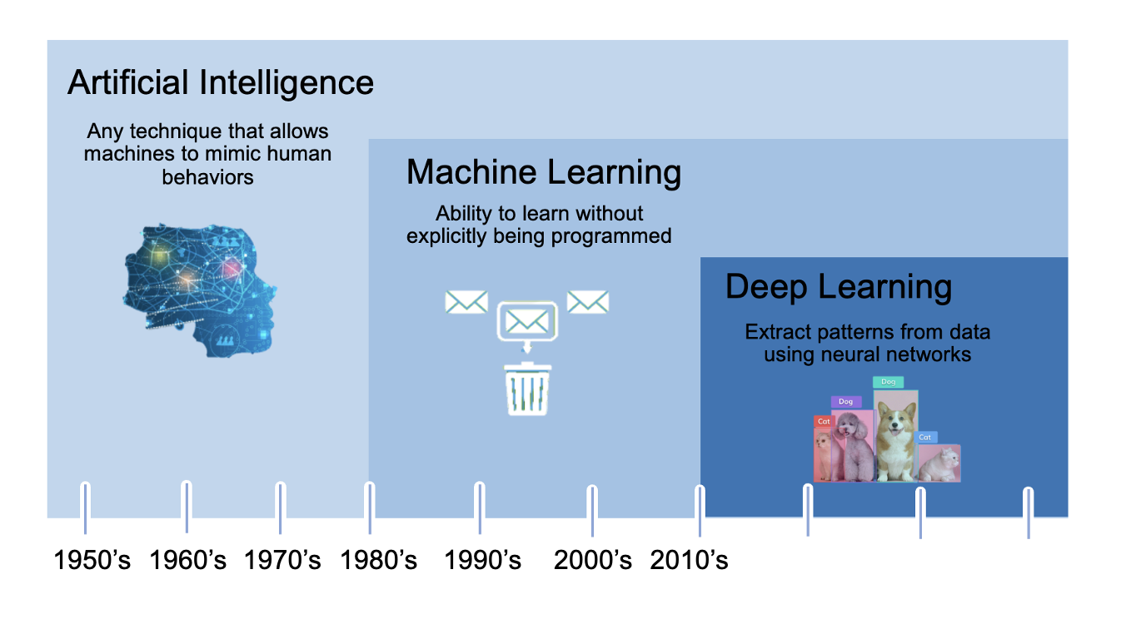
Recap: What is deep learning?
Slide Credit: Alexander Amini
Modified from MIT open course: 6.S191 and Nvidia blog
Notes:
Some of examples have just highlighted how far deep learning has come in the past few years. So what is exactly deep learning.
DL is a subset of machine learning, which is again a subset of artificial intelligence.
The definition for artificial intelligent is evolving, in general, AI refers to …
Machine learning is a subset of AI that can learn and make decisions without being specifically programmed
Deep learning is a type of machine learning model and goes one step beyond it can extract patterns from data using neural networks …
For example, for the object detection example, deep learning algorithm will be able to generate two outputs: 1) The first is the categoty of the object, in this example it is cats and dogs 2) the second the bounding box of the object

Slide 10
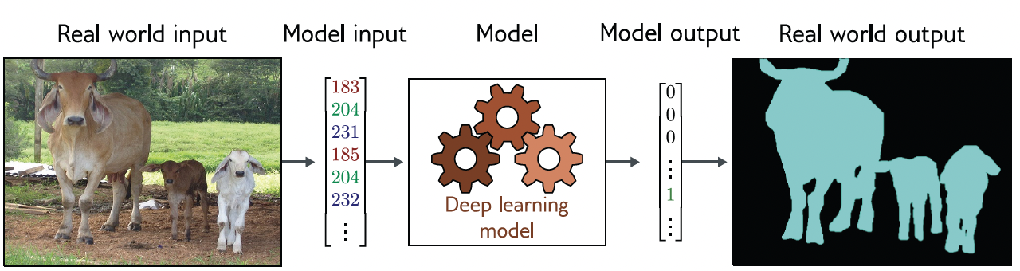
Why deep learning?
Traditional machine learning needs hand-engineered features: time-consuming, brittle, and not scalable
DP can learn the underlying feature directly from the data, little or no human intervention needed
Note: This might be a good picture for your final project
Slide Credit: Simon J.D. Prince
Notes:
So Why do we care about this topic?
To answer this question, we have to think about the history of machine learning and what deep learning can bring to the table.
Hand-engineered: a human comes into the dataset and with a lot of domain knowledge and expertise to uncover what the features could be. The key idea of deep learning is that it can directly extract patterns/features from the data. No human intervention is needed.
For example if we want to to semantic segmentation for the cows,where each pixel of the input image is assigned a binary label that indicates whether it belongs to a cow or a background. Deep learning model would be able to take the image input and directly generate the mask indicicated which pixel is a cow and which are not. No human expertise on cows would be needed.
In this case, there is a meaningful real-world input (a sentence, a sound file, an image, etc.), and this is encoded as a vector of numbers. This vector forms the model input. The model maps the input to an output vector which is then “translated” back to a meaningful real-world prediction.

Slide 11
Can we actually do it now?
1. Big data
2. Hardware
3. Software
1952
Stochastic gradient descent
1958
Perceptron
Learnable weights
Larger dataset
Easier collection and storage
GPUs
Massively parallelizable
Improved techniques
New models
Toolboxes
1986
Back propagation
Multi-Layer perceptron
1995
Deep convolutional NN
ChatGPT
Slide Credit: Alexander Amini
Modified from MIT open course: 6.S191
Notes:
Neural network actually dates a few decades back, why the resurgence now?
There have been three key advances that have occurred in the past decade.
First, Data is so much more pervasive. they are much easier to collect and store. Deep learning are hungary for data.
Secondly, we have our advancement on hardware, those algorithms are massively parallizebale and they require a lot of computes, we are now able to train those algorithms on GPUS.
At last, due to open course toolboxes and software platforms like pytorch and tensorflow, which all of you will get some experience on in this class, building and training deep learning neural network have become much easier.

Slide 12
1. Deep Learning Concepts Recap 2. Intro to Pytorch 3. Perceptron and MLP

Slide 13
What’s PyTorch
It’s a Python-based open-sourced scientific computing package targeted at two sets of audiences:
A replacement for NumPy to use the power of GPUs
A deep learning research platform that provided maximum flexibility and speed
https://pytorch.org/get-started/locally/
https://docs.pytorch.org/tutorials/beginner/basics
Notes:
For machine learning, developed by Facebook’s AI Research lab and gained popularity for its dynamic computation graph and ease of use
A replacement for NumPy to use the power of GPUs, which is a lot more efficient for matrix operations
Have a lot pre-defined modules and neural network architectures, simplifying the process of creating complex model. Widely used in both academia and industry for various machine learning and deep learning tasks

Slide 14
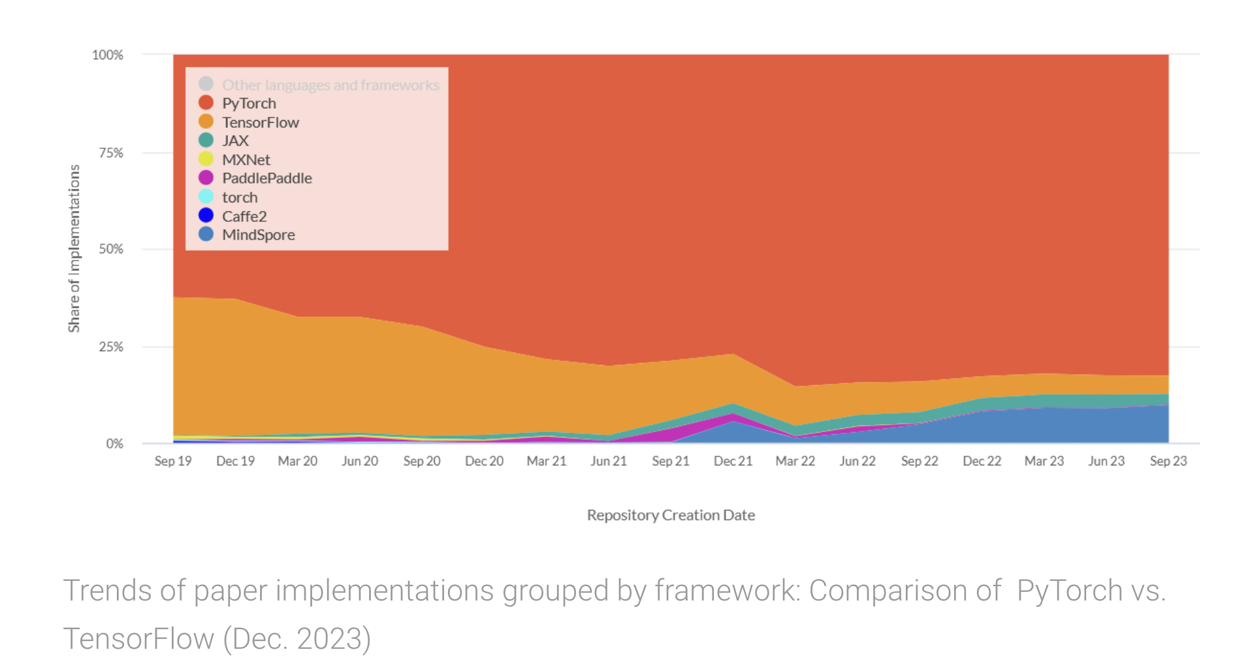
Why PyTorch
From viso.ai
Many companies (especially open-sourced community) has standardized the usage of PyTorch internally (OpenAI… )
Support varying input sizes, well-documented, favored for fast experimentational and prototyping
Notes:
PyTorch and TensorFlow are far and away the two most popular Deep Learning frameworks today.
Pytorch use dynamics computational graphs, which can support varying input sizes
Tensorflow use static computational graphs, where the graph structure is defined first, and then data is def though the graph
Debugging and Visualization, Community and Ecosystem, Deployment and Production
PyTorch and TensorFlow are continually evolving, and many differences that existed in earlier versions have become less pronounced in recent releases.

Slide 15
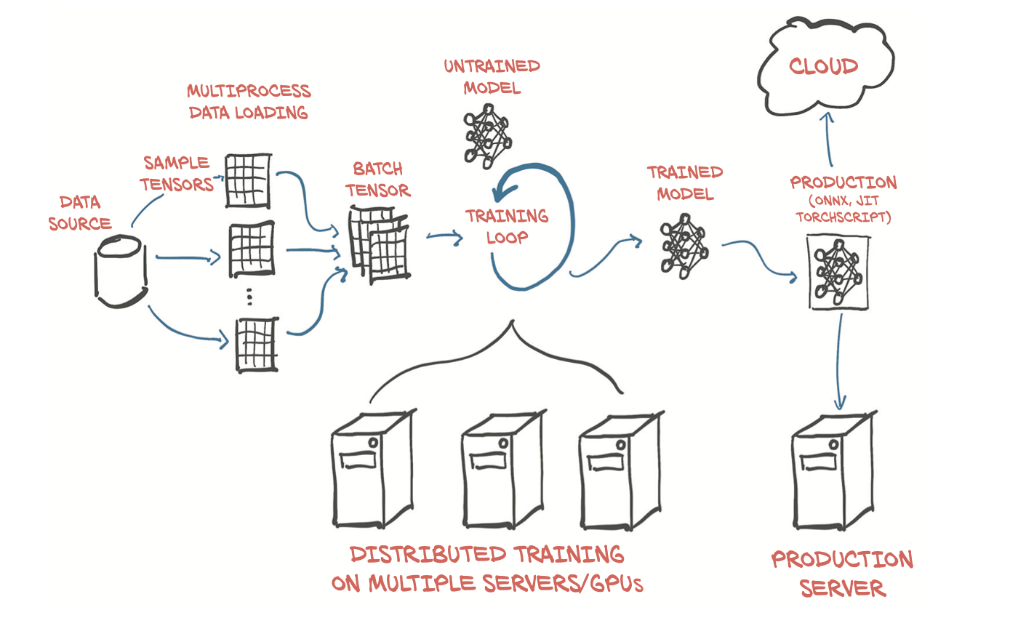
How PyTorch supports DL projects
Credit: E. Stevens, L. Antiga, and T. Viehmann. Deep Learning with PyTorch. 2020.
Notes:
Formalize a high-level map of the main components that from PyTorch.
Pytorch is a DL libeary, and as such it provides all the building blocks needed to build neural networks and train them.
The above figure shows a standard setup that loads data, trains a model and then deploys that model to production.
Quite a bit of data processing is needed before the training data even reaches out model. First we need to physically get the data, most often from some sort of storage as the data source. Then we need to convert such sample from out data into a something PyTorch can actually handle: tensors. This bridge our custom data in whatever format it can be and a standardized PyTorch tensor is the the Dataset class Pytorch procides in torch.utils data.
As data storage is often slow, in particular due to access latency, we want to parallelize data loading. We will need to multiple processes to load our data and assemble them into batches: tensors that encompass several samples. PyTorch provides all that magic in the dataLoader class. Its instances can spawn child processes to load data from a dataset in the background so that it is ready and waiting for the training loop as soon as the loop can use it.
With the mechanism for getting batches of samples in place, we can turn to the training loop itself at the center of figure 1.2. The training loop is implemented as standard Python for loop.
After the training, we are rewarded with a model whose parameters have been optimized on our task
Have a trained model is great, but in order for it to be useful,, we must put it where the work is needed. This deployment part of the process, depicted on the right in the figure, may involve putting the model on the server or exporting it to load it to a cloud engine, or we might integrate it with a larger application, or run it on a phone.

Slide 16
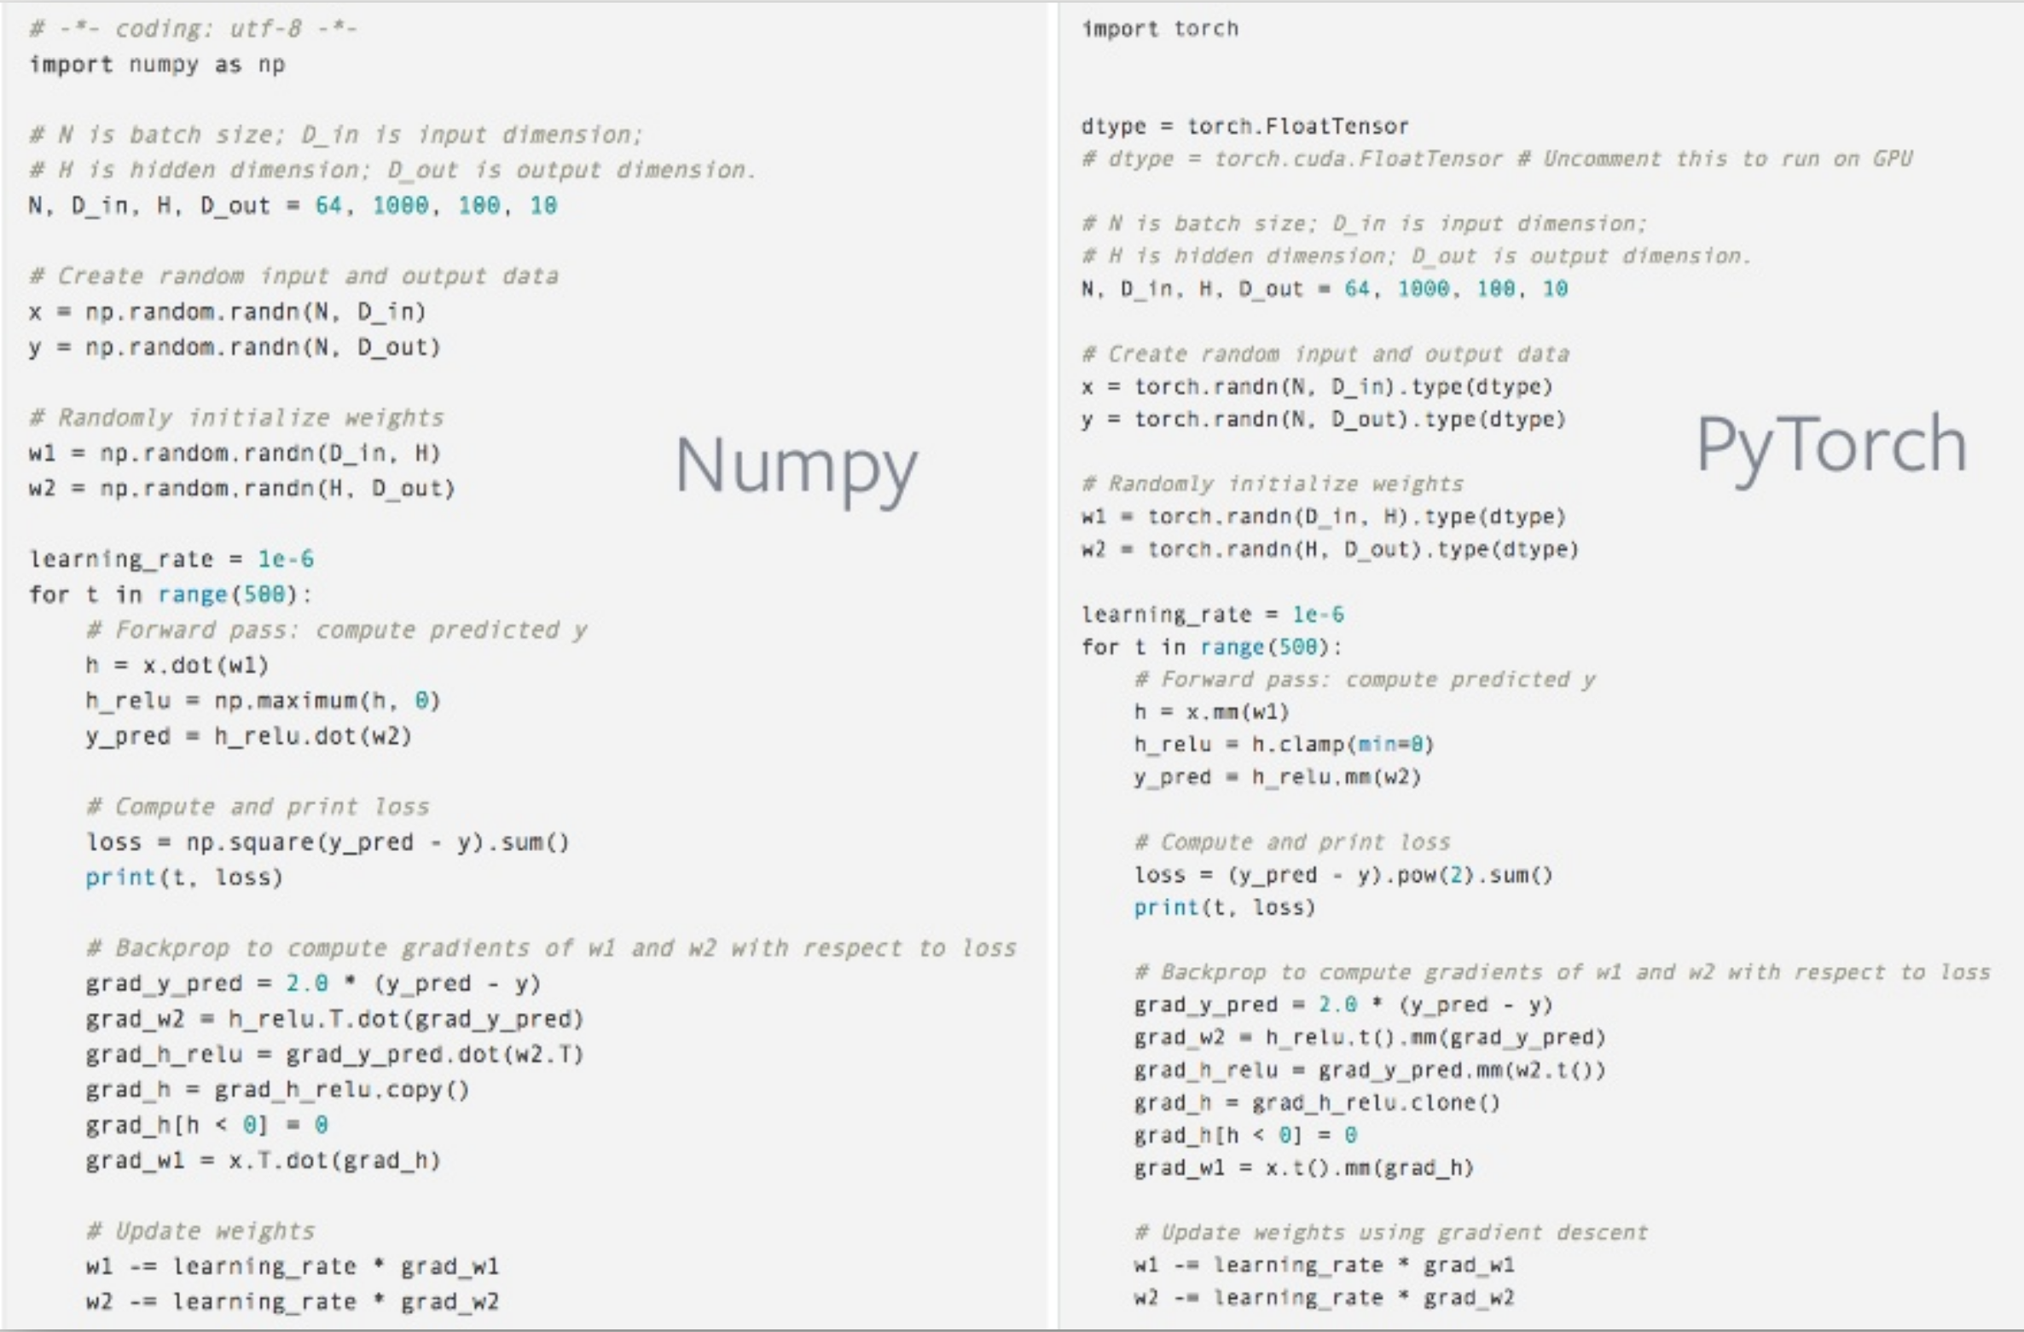
Slide Credit: Soumith Chintala
numpy and PyTorch have many similarities

Slide 17
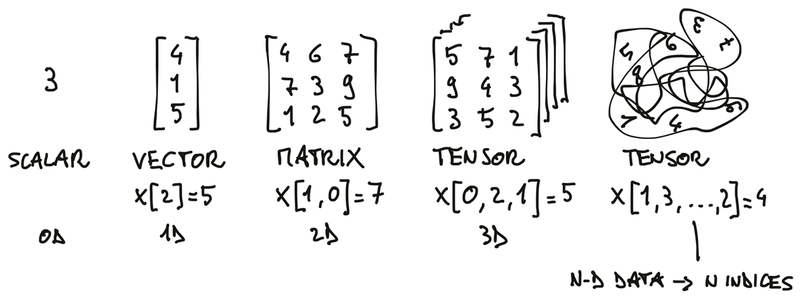
Basic Datatype: Tensors
Just like NumPy multi-dimensional array, tensors generated vector and matrix.
Tensors are the building blocks for representing data in PyTorch.
Credit: E. Stevens, L. Antiga, and T. Viehmann. Deep Learning with PyTorch. 2020.

Slide 18
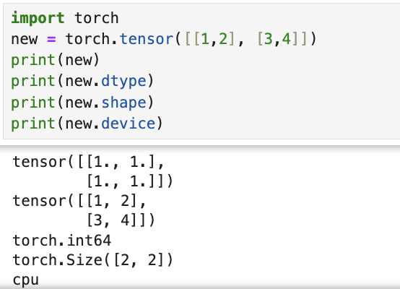
Properties of Tensors
TENSOR is a generalization of vectors and matrices. In PyTorch, they are a multi-dimensional matrix containing elements of a single data type.
Can also be supported on GPU, one superpower that PyTorch tensor

Slide 19
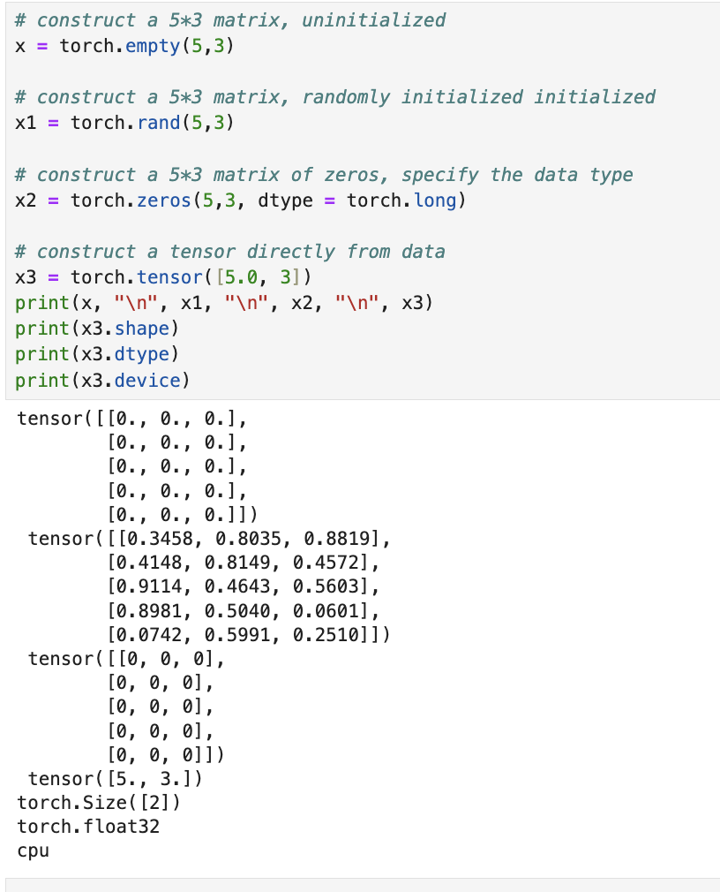
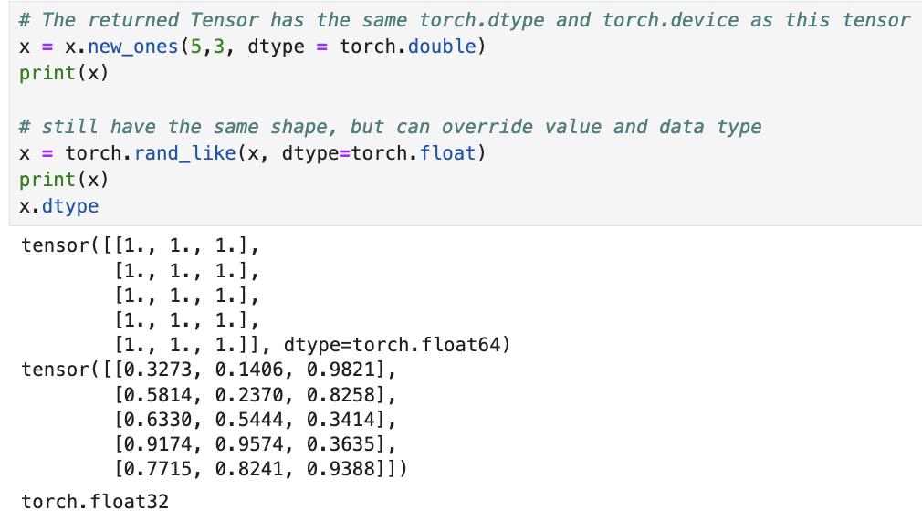
Creating Tensors
With built-in functions:
Can also be constructed based on existing tensor.

Slide 20
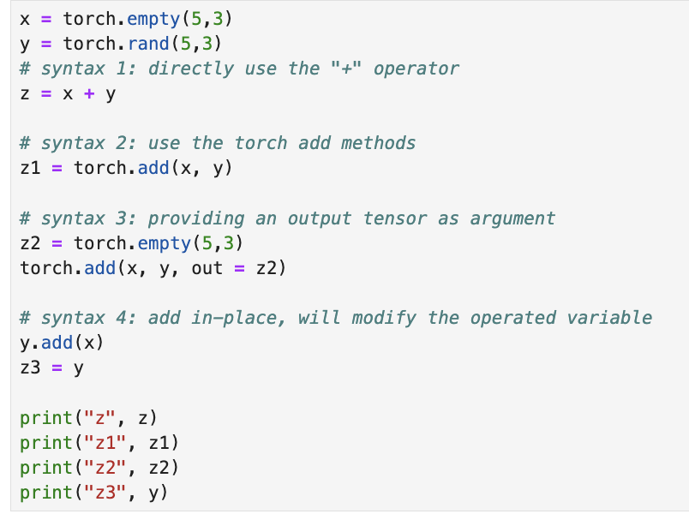
Operation examples: add
Add

Slide 21
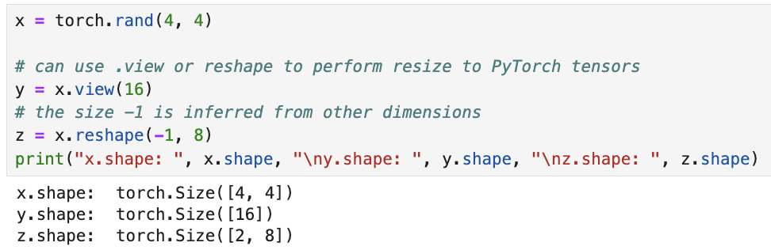
Operation examples: reshape

Slide 22
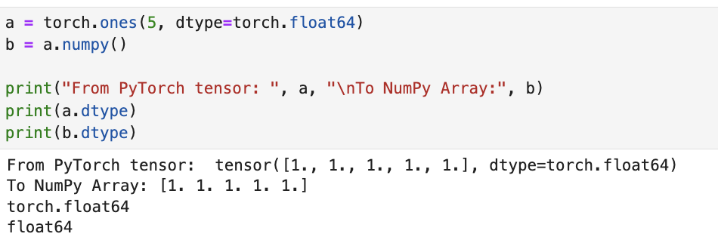
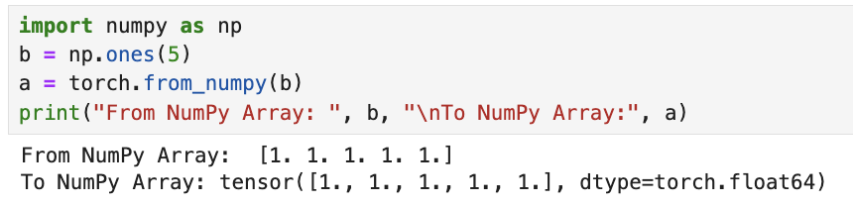
Tensor to and from a NumPy Array

Slide 23
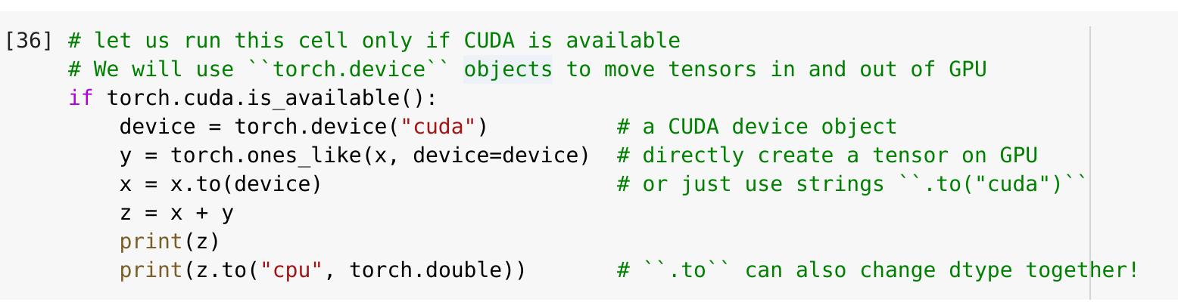
CUDA Tensors
“cuda” stands for “Compute Unified Device Architecture”. NVIDIA's parallel computing platform and programming model that allows developers to use NVIDIA GPUs for general-purpose computing.
x is now stored on the GPU
Slide credit: Christian S. Perone

Slide 24
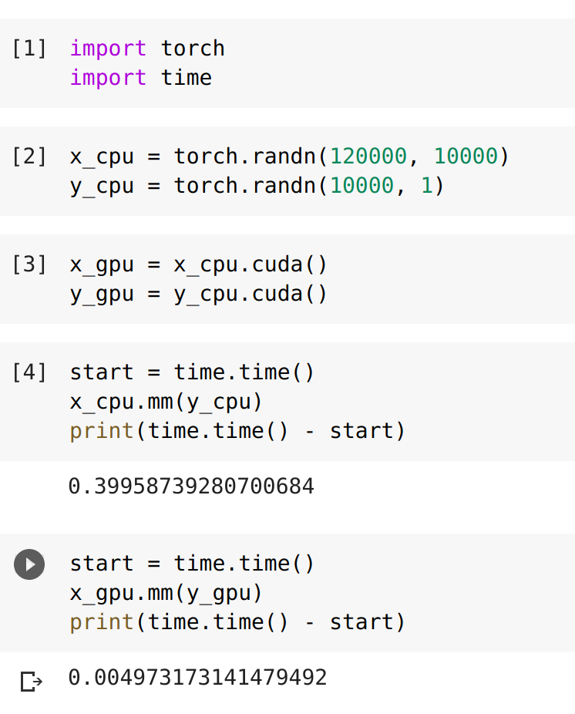
GPU speedup on Google colab
Matrix-vector multiplication on the GPU is nearly 100x faster!
Slide credit: Christian S. Perone

Slide 25
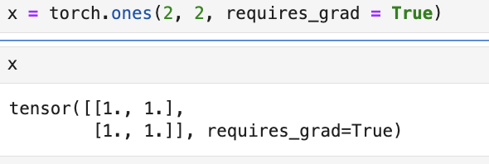
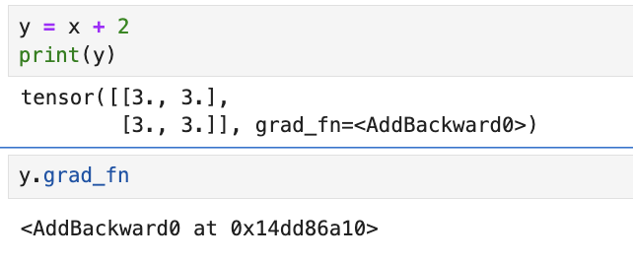
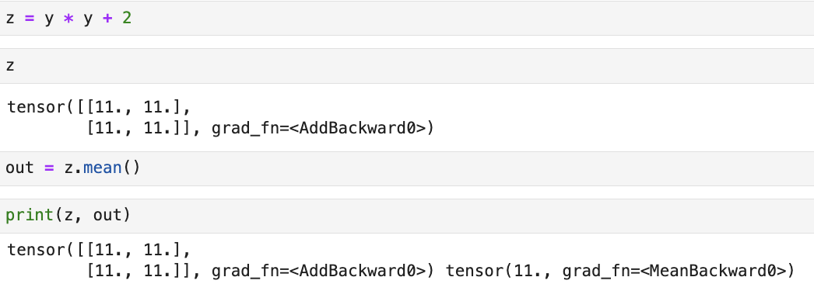
Automatic Differentiation
requires_grad=True tells PyTorch to track all operations performed on this tensor so that we can compute gradients (derivatives) with respect to it later. It's essential for automatic differentiation (autodiff).
y was created as a result of operation and it has a grad_fn
Gradient function for addition operations in PyTorch's autograd system. It tells PyTorch how to compute derivatives when going "backward" through an addition operation during backpropagation.
Can add more operations.
Slide credit: Christian S. Perone

Slide 26
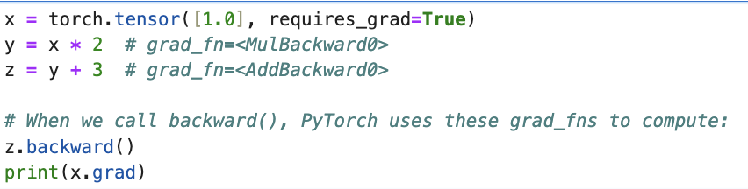

Gradients
When we call backward(), PyTorch uses these grad_fns to compute:
Results?
Reference: https://pytorch.org/tutorials/beginner/blitz/autograd_tutorial.html
Slide credit: Christian S. Perone

Slide 27
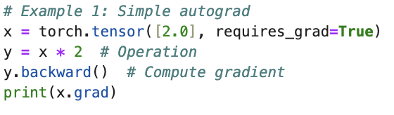
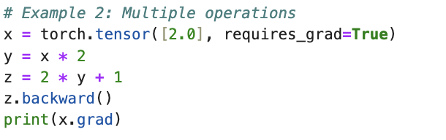
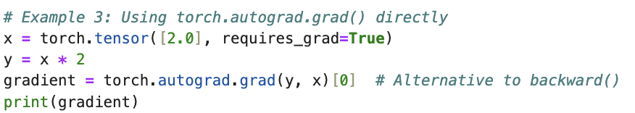
Test your understanding about autograd
2
4
2
https://pytorch.org/docs/stable/generated/torch.autograd.grad.html

Slide 28
In-class practice

Slide 29
1. Deep Learning Concepts Recap 2. Intro to Pytorch 3. Perceptron and MLP

Slide 30
The perceptron (a single neuron) The structural building block of deep learning
Notes:
1) So now we are going to take a closer look at block of deep learning and that building block is called a perceptron

Slide 31




The perceptron (forward propagation)
Inputs
Weights
Sum
Non-linear
activation function
Outputs
x₁
w₁
x₂
w₂
$$∑$$
$$g$$
$$\hat{y}$$
w_{n}
x_{n}
w₀
Bias
3
1
2
$$\hat{y}= {g(w}_{0}+\sum_{i=1}^{n}{x_{i}w_{i})=g(z)}$$
Notes:
So how does perceptron process signal
Let’s first define a perception as taking a set of inputs, on the left side, you can see, this perceptron takes n different inputs. We are denoting those inputs as xes, and the output denoted by y_hat is the processed information.
Each of those inputs are multiplied by a corresponding weights w1 to wn, and we will add the results of all of the multiplications. Now we take that single number after the addition and we pass it though this non-linear activation function. And that produce the final output of the perceptron, which denote it y_hat
How do we get from the inputs to outputs, there are essentially three operations:
We have a linear combinations all the inputs and then add them together
Then we introduce a bias term w_0 which is independent from all the x_es and add them together
By far, those are linear combinations of the inputs, at last we apply a non-linear activation function to introduce nonlinearity to the data.

Slide 32
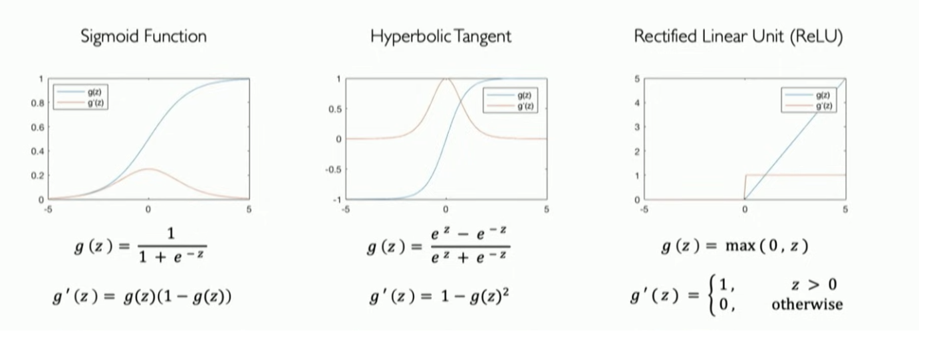
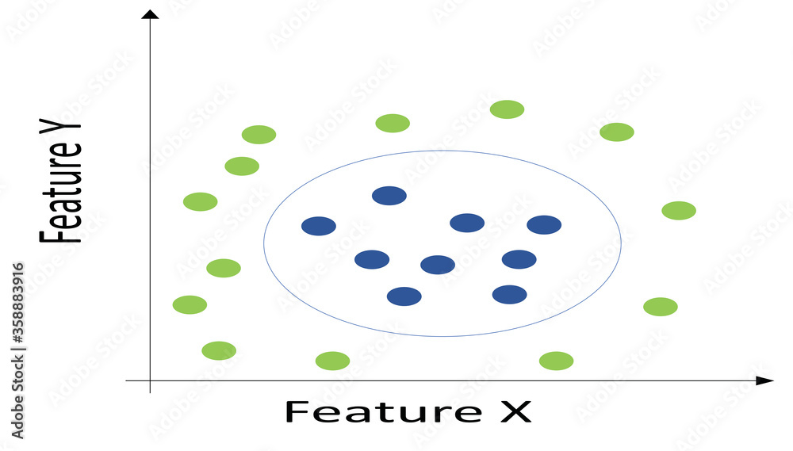

More on activation functions
It is important to introduce non-linearity when analyze data
2. Common activation functions to introduce non-linearity
torch.sigmoid(x)
torch.tanh(x)
torch.relu(x)
Notes:
Here I have listed some common active functions
Sigmoid function: it can map any real number to 0 and 1. It is very useful rspecially when you want to deal with probability distributions because probabilities live between 0 and 1.
In modern deep learning the relu (rectified linear function) function is also very popular . It is piecewise linear and very efficiently to compute, especially for derivatives.
Through out the examples, you are also going to see some of the code snippets on the bottom of the slides where we will try and actually tie in some of what you are learning with the software labs and homeworks.
Change the picture such that it is it is linear function change the title of ReLU function

Slide 33









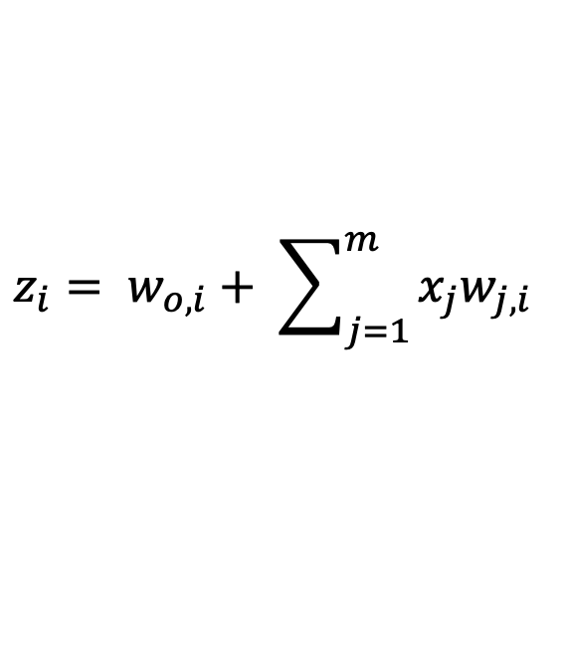

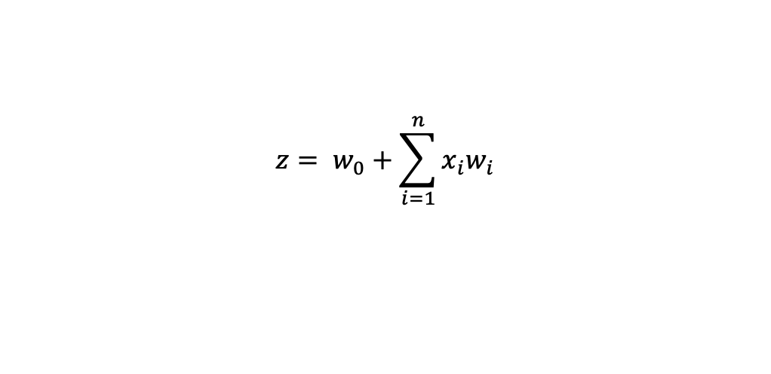


Multi-output perceptron
$$x_{1}$$
$$x_{1}$$
$$z_{1}$$
$$y_{1}=g(z_{1})$$
$$z_{1}$$
$$x_{2}$$
$$x_{2}$$
$$y_{1}=g(z_{1})$$
$$z_{2}$$
$$y_{2}=g(z_{2})$$
$$x_{3}$$
$$x_{3}$$
one simplified perceptron
$$z_{i}= w_{o,i}+ \sum_{j=1}^{m}{x_{j}w_{j,i} }$$
$${z= w}_{0}+\sum_{i=1}^{n}{x_{i}w_{i}}$$
$$z =w_{o}+xW^{T}$$
Notes:
Now if we want to define and build up a multi out neural network
If we want 2 outputs to this function for example, it is a very simple procedure, we just have to add
Another neuron, another perceptron, each perceptron will control the output for
Its associated piece. So now we have two outputs, each one is a normal perceptron, it takes all of the inputs.
With this understanding, we can start to build our first neural network entirely from sractch for a single layer

Slide 34
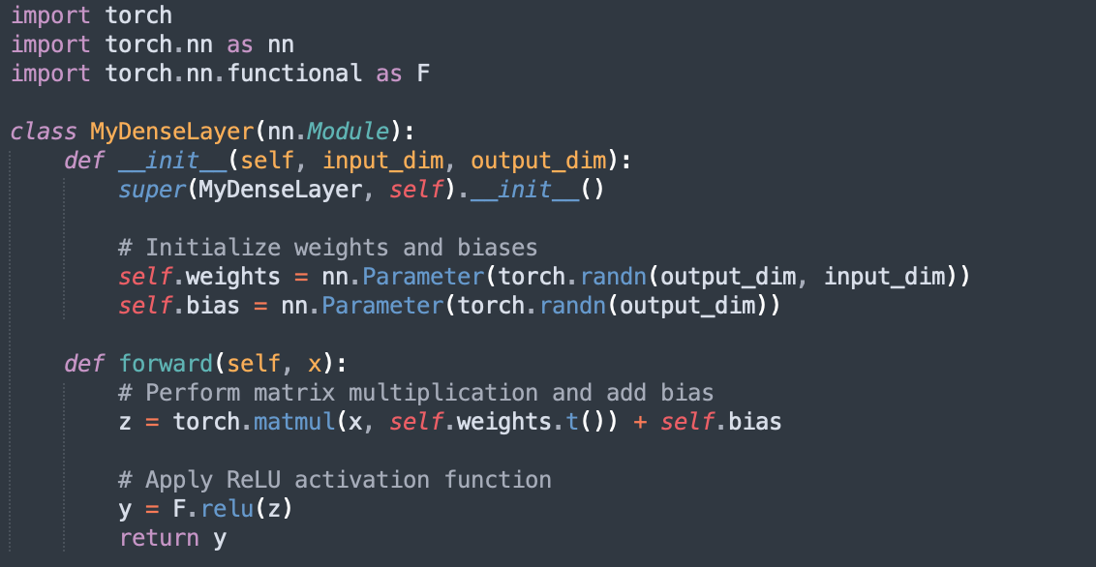


Build a single layer from scratch
$$z =w_{o}+xW^{T}$$
$$y=g(z)$$
1
2
3
Notes:
Now with this understanding, we are able to build our neural network from stacth using Pytorch
We can start by import the necessary modules, torch.nn is a module in PyTorch, a popular open-sourced machine library, here we will make use of its parameter class and activation functions.
We will first start by initializing the parameters of the layer, the weights and the bias.
The next step is to define the forward propagation of information of a layer. That’s exactly the three components
We have been talking about, multiply with weights, add the bias and apply the nonlinear activation function
We can create this forward function to do exactly that.
When we talk about learning or training a neural network, we mean that we attempt to find parameters φ that make sensible output predictions from the input
Luckily for all of us, all those code have been abstracted away by this nn module in Pytorch, you can simply call function like, which will exactly replicate that piece of code.

Slide 35








Shallow(single layer) Neural Network
$$z_{1}$$
$$x_{1}$$
$$z_{2}$$
$$y_{1}$$
$$x_{2}$$
$$z_{3}$$
$$y_{2}$$
$$x_{3}$$
$$z_{4}$$
Input layer
Hidden layer
Output layer

Slide 36








Deep(multi-layer) Neural Network
$$x_{1}$$
$$z_{1}$$
$$y_{1}$$
$$x_{2}$$
$$z_{k}$$
$$y_{m}$$
$$x_{m}$$
Input
Hidden layers
Output
Notes:
Why do we need a network structure from a single layer to multi-layer (backup slide)
Since we now have this transformation essentially from our inputs to a hidden output. You can think of transform some dimension of input into some new dimension and those transformation (the weights and bias) are going to be learned.

Slide 37
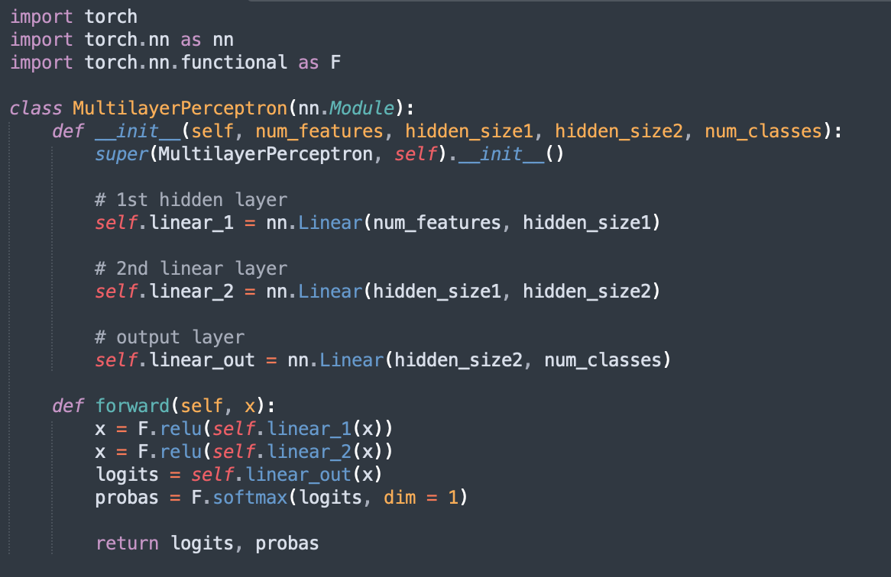
Multi-layer perceptron (a two layer DNN)
Define model parameters that will in instantiated when an object of this class is created
Define how and in what order the model parameters should be used in the forward pass
Notes:
If we want to stack those layer on top of each other, we can create what are called sequential models.
These sequential models we can define one layer after another, and they define the forward progagation.
The input of the second layer will be the output from the prior layer.
If we want to go beyond, from two layer to a deep neural network, we just need to stack more layers on top of each other.

Slide 38
Final Projects (30%)
Proposal final project guidelines can be found in Files/Final Project
on canvas (let’s go through them together today…)
Proposal (10 pts)
Final Projects (20 pts)
Key dates:
Wednesday, 11/19/25 Proposal and preliminary results due.
Wednesday, 12/03/25 Final project code and summary report due
Start Early!

Slide 39
Other things
Coming next:
Intro to DP and PyTorch

