Slide 1
STATS 507 Data Analysis in Python
Week12-1: Loss Function, Gradient, Stochastic Gradient Descent
Dr. Xian Zhang

Slide 2
Recall the scope of this class
Part 1: Introduction to Python
Data types, functions, classes, objects, functional programming
Part 2: Numerical Computing and Data Visualization
numpy, scipy, scikit-learn, matplotlib, Seaborn
Part 3: Dealing with structured data
pandas, SQL, real datasets
Part4: Intro to Deep Learning
PyTorch, Perceptron, Multi-layer perceptron, SGD, regularization, ConvNets
Slide Credit: Jeffrey Regier

Slide 3
Recap: What’s PyTorch
It’s a Python-based open-sourced scientific computing package targeted at two sets of audiences:
A replacement for NumPy to use the power of GPUs
A deep learning research platform that provided maximum flexibility and speed
https://pytorch.org/get-started/locally/
Slide Credit: Jeffrey Regier
Notes:
For machine learning, developed by Facebook’s AI Research lab and gained popularity for its dynamic computation graph and ease of use
A replacement for NumPy to use the power of GPUs, which is a lot more efficient for matrix operations
Have a lot pre-defined modules and neural network architectures, simplifying the process of creating complex model. Widely used in both academia and industry for various machine learning and deep learning tasks

Slide 4
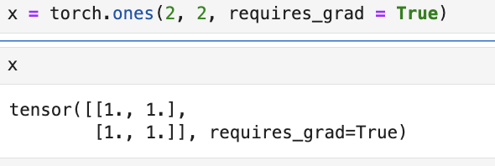
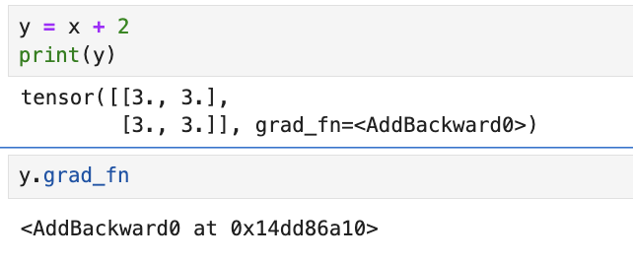
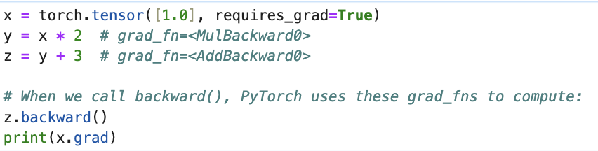
Recap: Auto differentiation in PyTorch
When we call backward(), PyTorch uses these grad_fns to compute:
Slide credit: Christian S. Perone

Slide 5
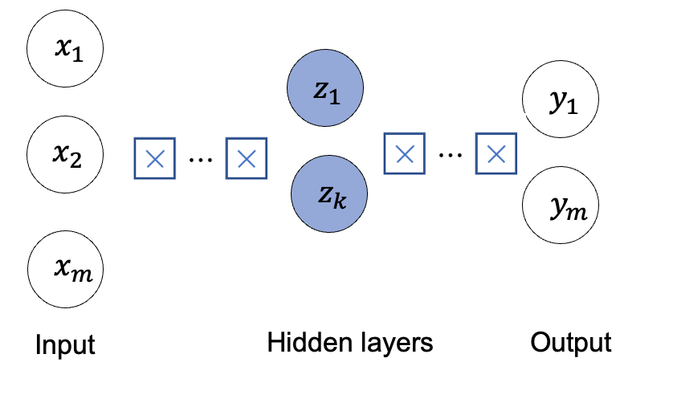
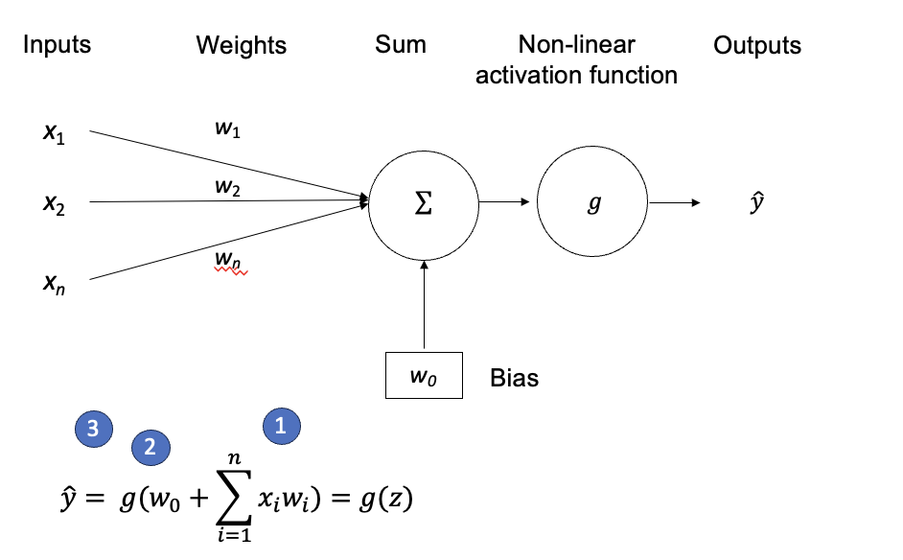
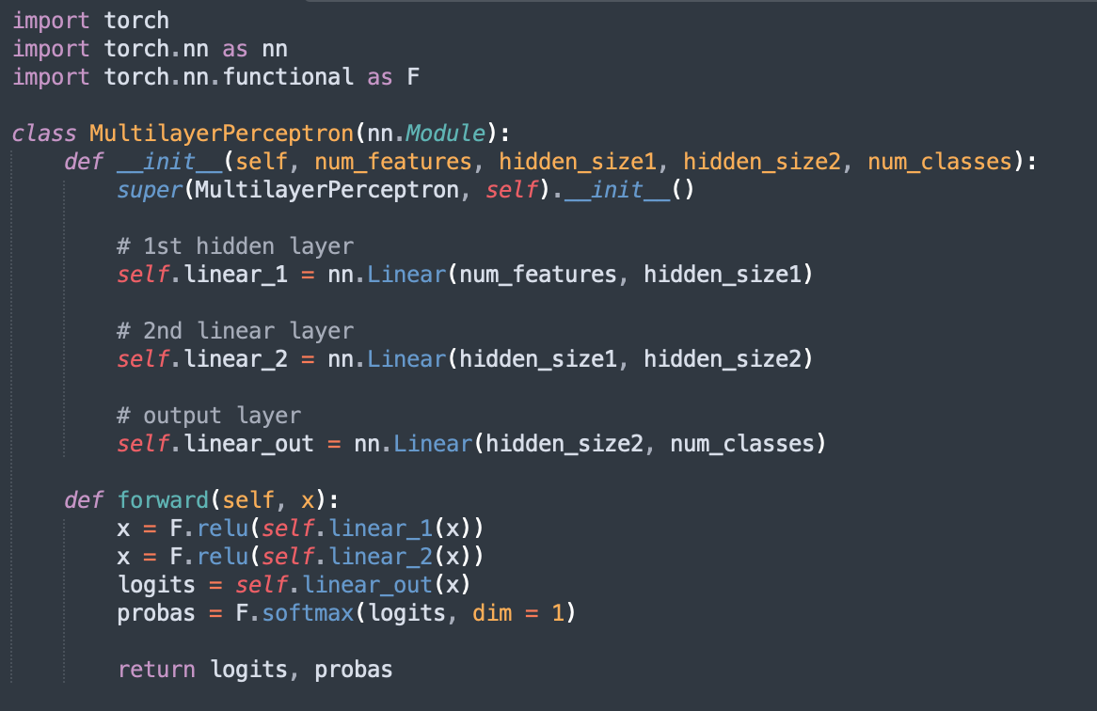
Recap: The perceptron and DNN

Slide 6
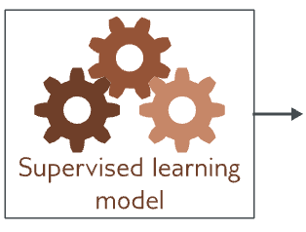
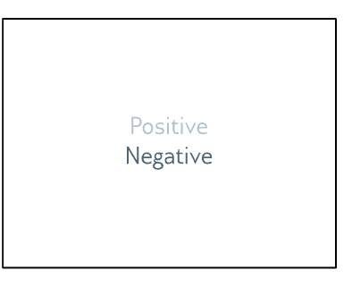
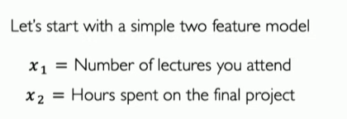


Applying DNN: Will I pass this class?
A two layer MLP
$$\left[\begin{matrix}x_{1} \\ x_{2}\end{matrix}\right]$$
two discrete classes
Classification or regression?
Two discrete class-> Binary

Slide 7
1. The Loss Function 2. Training a model 3. DNN in action (in-class practice)

Slide 8
What is loss and what is it for?
A measure of how ”correct” (how bad) the model is
Predicted :
$$f(x^{i};W)$$
Actual :
$$y^{i}$$
The empirical loss measure the total loss over our entire dataset
$J\left(W\right)$ $= \frac{1}{n}$ $\sum_{i=1}^{n}{ℒ(f\left(x^{i};W\right) ,y^{i})}$
Also known as:
objective function
cost function
empirical risk
Return a scalar that is smaller when model maps inputs to outputs better
Notes:
Now we have defined networks that can map inputs to outputs, but how can
Get the correct weights and bias to make the mapping as accurate as possible.
First, we need to come up with a metric to measure the performance of the network

Slide 9
How to construct loss
Over the entire dataset
$J\left(W\right)$ $= \frac{1}{n}$ $\sum_{i=1}^{n}{ℒ(f\left(x^{i};W\right) ,y^{i})}$
Predicted
Actual
Different learning problem has different measures and thus have different loss constructions: regression, classification, customized... (for the scope of this class)
Notes:
Now we have defined networks that can map inputs to outputs, but how can
Get the correct weights and bias to make the mapping as accurate as possible.
First, we need to come up with a metric to measure the performance of the network

Slide 10
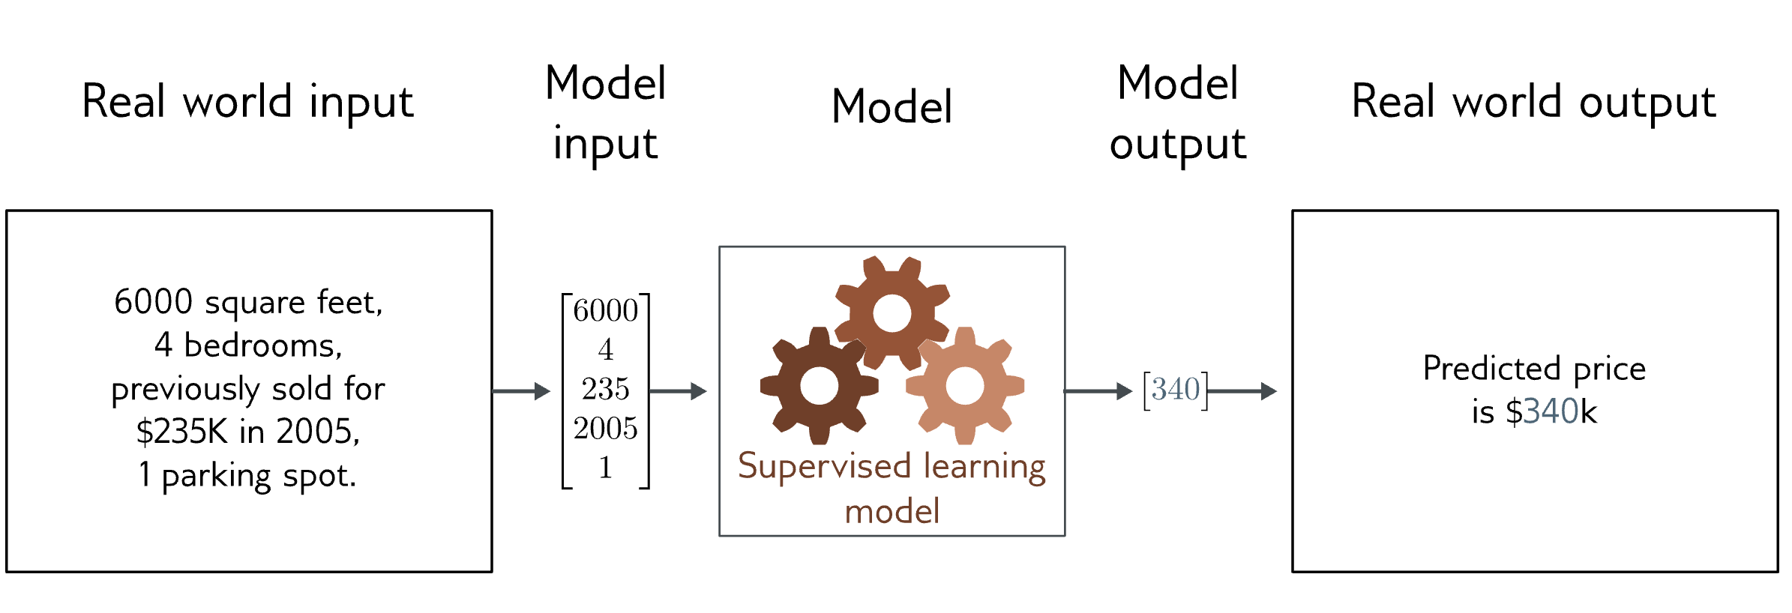


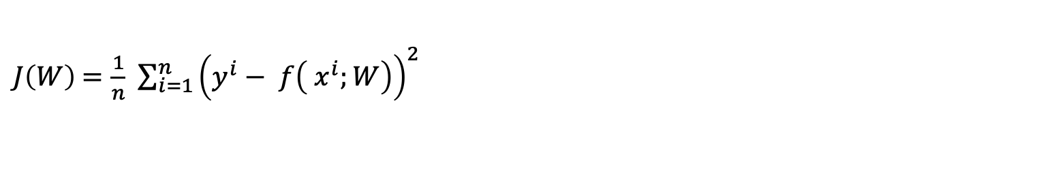
Loss for regression problem
Mean Square Error Loss
$J\left(W\right)$ $=\frac{1}{n}$ $\sum_{i=1}^{n}{{\left(y^{i}− f\left( x^{i};W\right)\right)}^{2}}$
Notes:
Now we have defined networks that can map inputs to outputs, but how can
Get the correct weights and bias to make the mapping as accurate as possible.
First, we need to come up with a metric to measure the performance of the network

Slide 11
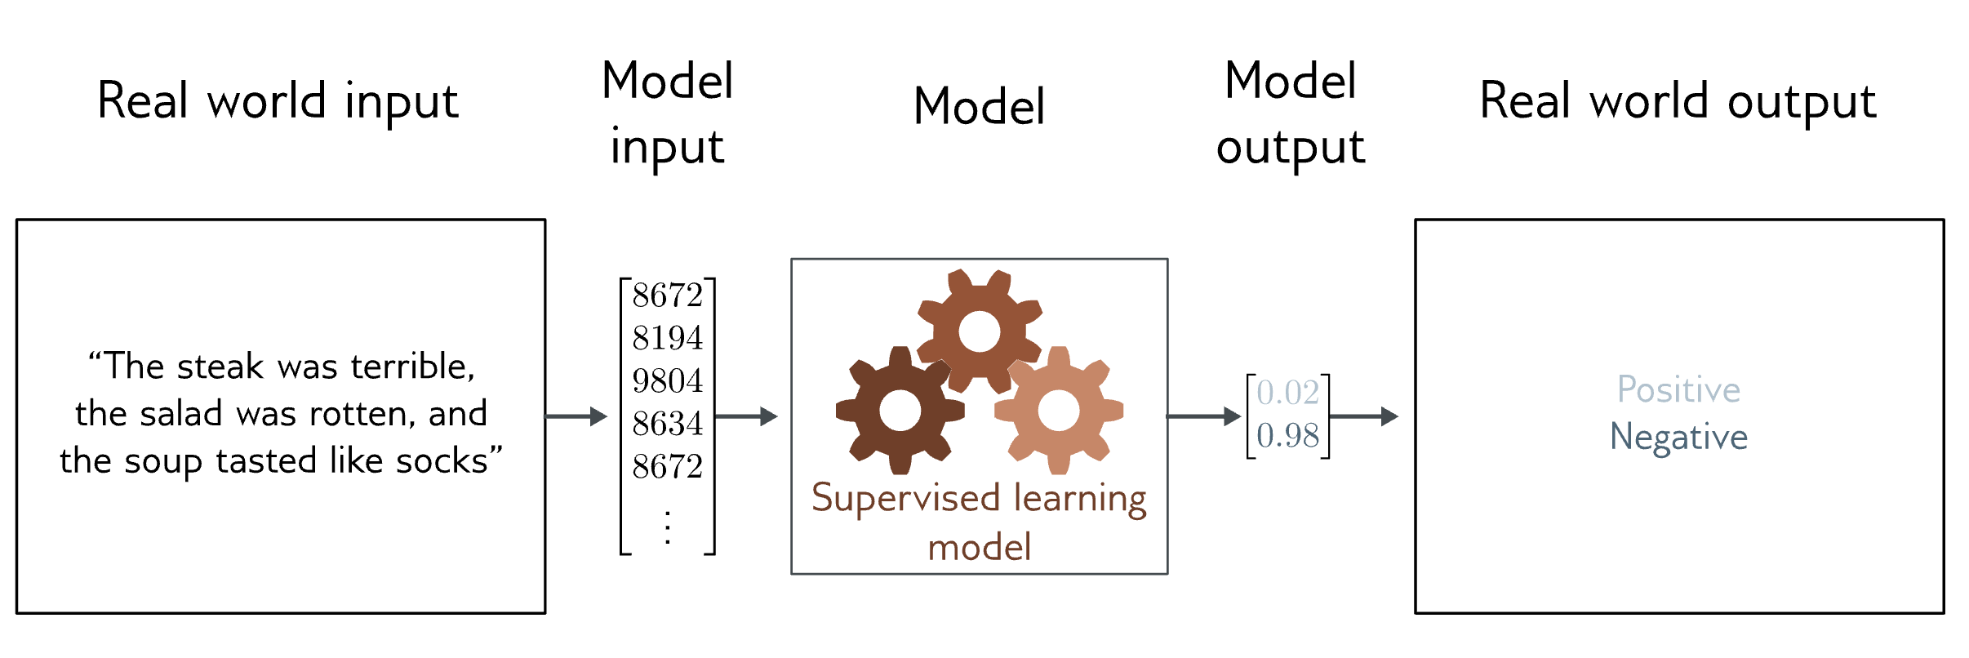

Loss for classification problem
Goal: predict which of the two classes $y∈\{0, 1\}$ the input x belongs to
Binary Cross Entropy Loss
$J\left(W\right)$ $=−\frac{1}{n}$ $\sum_{i=1}^{n}{y^{i}\log\left(f\left( x^{i};W\right)\right)+\left(1 −y^{i}\right)\log\left(1 − f\left( x^{i};W\right)\right)}$

Slide 12
Customized loss function
When standard (built-in) loss functions are not effective we need our own customized recipe to define loss functions.
1. Imbalanced data
2. More complicated problem
Input data
penalizing misclassifications of the minority class
Output data
outlier/noise
Multi-objective learning
Integrate constraints
Integrate uncertainty
Notes:
Now we have defined networks that can map inputs to outputs, but how can
Get the correct weights and bias to make the mapping as accurate as possible.
First, we need to come up with a metric to measure the performance of the network

Slide 13
1. The Loss Function 2. Training a model 3. DNN in action (in-class practice)

Slide 14
What is training
Sometimes also called: fitting the model
Essentially, finding parameters that minimize the loss:
$J\left(W\right)$ $= \frac{1}{n}$ $\sum_{i=1}^{n}{ℒ(f\left(x^{i};W\right) ,y^{i})}$
Also formatted as:
$$W^{∗}=\underset{W}{argmin}{\frac{1}{n} \sum_{i=1}^{n}{ℒ(f\left(x^{i};W\right) ,y^{i})}}$$
$$W^{∗}=\underset{W}{argmin}{J(W)}$$

Slide 15
How are we finding parameters: gradient descent
Step1. Compute the derivative of the loss with respect to the parameters
Step2. Update parameters according to the rule
$$\frac{∂L}{∂W}=\left[\begin{matrix}\frac{∂L}{∂w_{1}} \\ \frac{∂L}{∂w_{2}} \\ \begin{matrix}⋮ \\ \frac{∂L}{∂w_{n}}\end{matrix}\end{matrix}\right]$$
$$W⟵W−α\frac{∂L}{∂W}$$

Slide 16

Gradient descent as an algorithm
To find the weights:
Initialize weights randomly $\sim N\left(0, σ^{2}\right)$
Loop until convergence:
Computer gradient: $\frac{∂L}{∂W}$
Update weights: $W⟵W−α\frac{∂L}{∂W}$
Return weights

Slide 17

Backpropagation
How to compute $w_{2}$
$$x_{1}$$
$$w_{1}$$
$$z_{1}$$
$$w_{2}$$
$$\hat{y}$$
$$J(W)$$
$$\frac{∂J(W)}{∂w_{2}}=\frac{∂J(W)}{∂{\hat{y}}_{ }} ∗ \frac{∂\hat{y}}{∂w_{2}}$$

Slide 18
Backpropagation
How to compute $w_{1}$
$$x_{1}$$
$$w_{1}$$
$$z_{1}$$
$$w_{2}$$
$$\hat{y}$$
$$J(W)$$
$$\frac{∂J(W)}{∂w_{1}}=\frac{∂J(W)}{∂\hat{y}} ∗ \frac{∂\hat{y}}{∂w_{1}}=\frac{∂J(W)}{∂\hat{y}} ∗ \frac{∂\hat{y}}{∂z_{1}}∗ \frac{∂z_{1}}{∂w_{1}}$$
Repeat this for very weight in the network using later layers

Slide 19
Gradient decent as numerical optimization in PyTorch

Slide 20
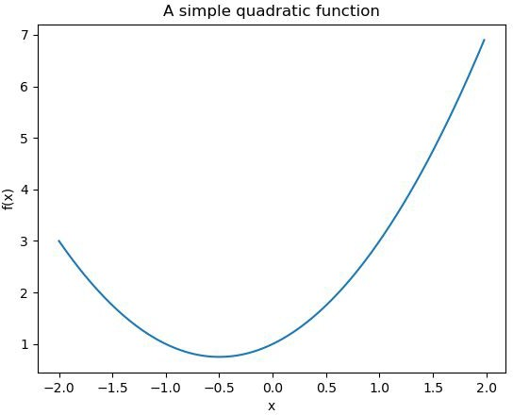

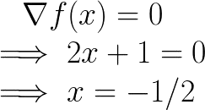
Numerical optimization
Suppose we want to minimize
Easy!

Slide 21
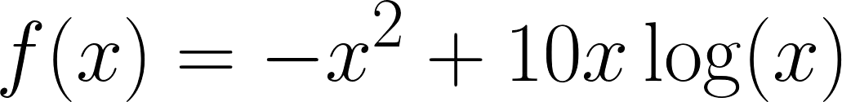
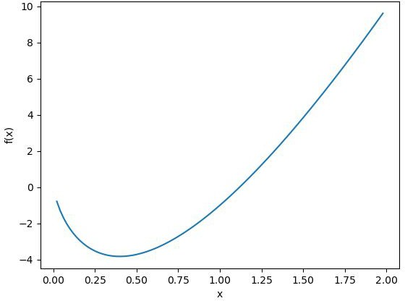

Numerical optimization
Now consider
We know
But what value of x sets

Slide 22
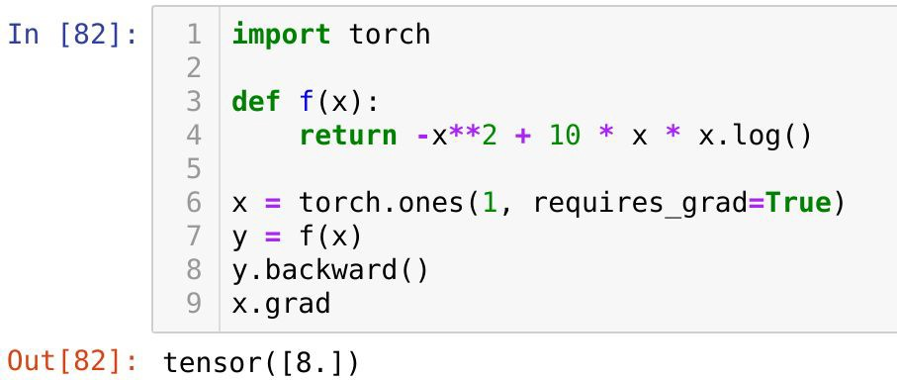
backward() evaluates gradient at current x
Use auto-differentiation of PyTorch, and the gradient is always evaluated at the current value of x.

Slide 23
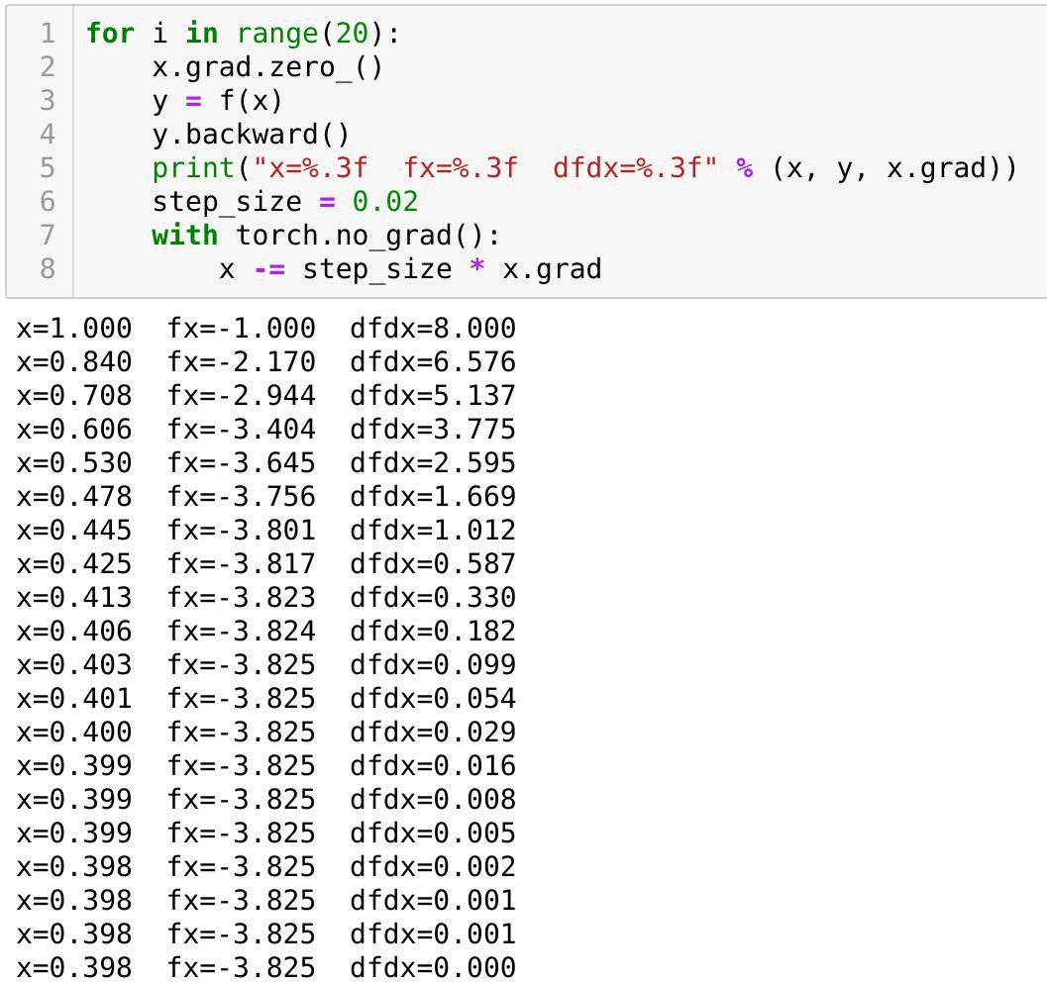
Iterative gradient-based solvers
x.grad.zero() clears (set to zero) the gradients from previous backward passes. Without clearing, gradients would accumulate (add up) across iterations
Need to make sure x.grad is not NONE.
To update x in-place, we need to temporarily disables gradient tracking

Slide 24
In-class practice
Minimizing our function with gradient descent using PyTorch

Slide 25
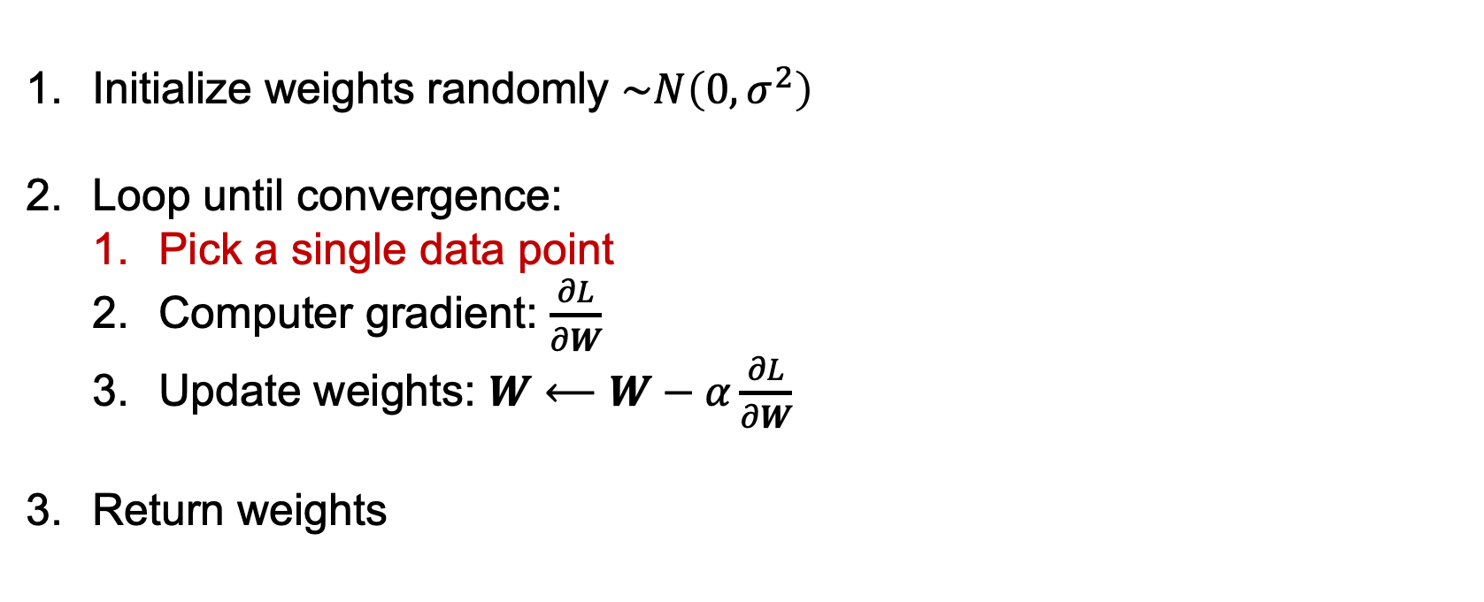
Stochastic Gradient descent
Initialize weights randomly $\sim N\left(0, σ^{2}\right)$
Loop until convergence:
Pick a single data point
Computer gradient: $\frac{∂L}{∂W}$
Update weights: $W⟵W−α\frac{∂L}{∂W}$
Return weights
$$\frac{∂L_{i}}{∂W}$$
Can be very computationally expensive
Notes:
Easy to compute since it is just one point
But also very noisy and stochastic

Slide 26

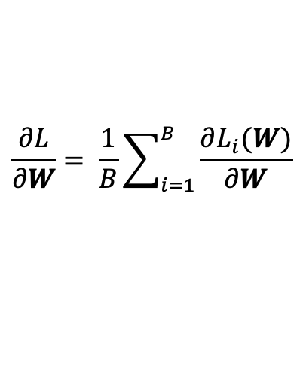
Stochastic Gradient descent
Initialize weights randomly $\sim N\left(0, σ^{2}\right)$
Loop until convergence:
Pick batch of B data points
Computer gradient: $\frac{∂L}{∂W}$
Update weights: $W⟵W−α\frac{∂L}{∂W}$
Return weights
$$\frac{∂L}{∂W}= \frac{1}{B}\sum_{i=1}^{B}{\frac{∂L_{i}(W)}{∂W}}$$

Slide 27

Setting the learning rate
Remember optimization through gradient descent:
$$W⟵W−α\frac{∂L}{∂W}$$
How can we set this learning rate?
Notes:
It is called the learning rate.
In practice, it tells about how much step/ how much step we take in our gradient

Slide 28
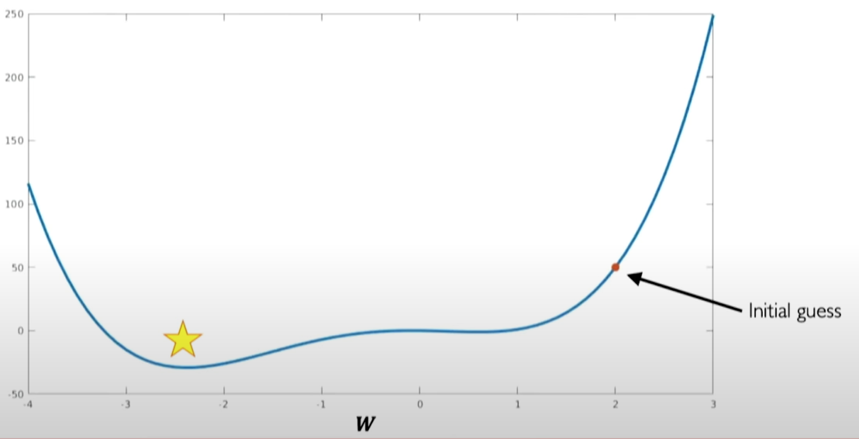
Setting the learning rate
Small learning rate converges slowly and gets stuck in false local minima
Slide Credit: Alexander Amini
Modified from MIT open course: 6.S191 and Nvidia blog

Slide 29
Setting the learning rate
Large learning rate overshoot, become unstable and diverge.
Slide Credit: Alexander Amini
Modified from MIT open course: 6.S191 and Nvidia blog

Slide 30
Setting the learning rate
Stable learning rates converges smoothly and avoid local minima
How? - You set the learning rate
1. Try lots of different learning rates and see what work “just right”
2. Something smarter: design an adaptive rate that “adapts” to the landscape.
Slide Credit: Alexander Amini
Modified from MIT open course: 6.S191 and Nvidia blog

Slide 31
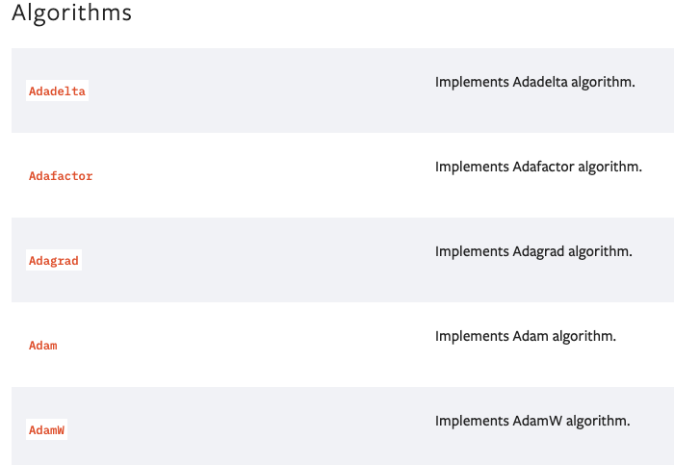
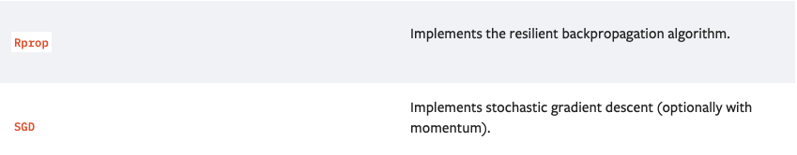
Gradient Descent Algorithms
Ref: https://www.geeksforgeeks.org/gradient-descent-algorithm-and-its-variants/
https://pytorch.org/docs/stable/optim.html#module-torch.optim
Slide Credit: Alexander Amini
Modified from MIT open course: 6.S191 and Nvidia blog
Notes:
In fact, those had been widely explored in deep learning literature and heavily published on Pytorch softewares

Slide 32
Put it all together: training our first DNN
In-class practice
Will I pass Stats 507? – A Simple DNN

Slide 33
Other things
HW7 out.
Final project guideline out. (start early)
Coming next:
Introduce batch size with DataLoader
Deep Sequential model (RNN, LSTM, Transformer…)

