Slide 1
STATS 507 Data Analysis in Python
Week13-2: Deep Sequential Modeling (LSTM, Attention)
Dr. Xian Zhang
Adapted from slides by Ava Amini
MIT Introduction to Deep Learning
Notes:
Good , everyone, my name is Xian Zhang, I am currently a software engineer in self-driving industry. Today I am very excited to give a lecture on introduction to deep learning with Pytorch.

Slide 2
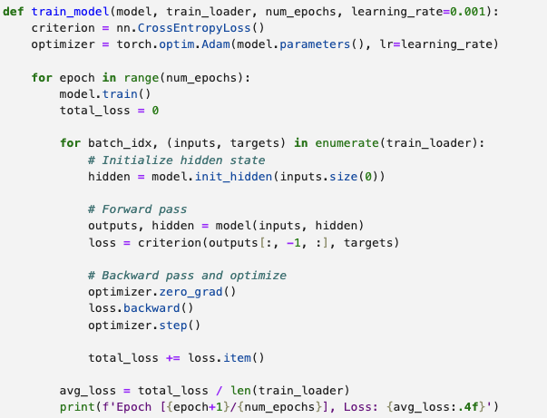
Solution for in-class practice
Training loop for each epoch
Gradient descent with mini-batches
Update both output and hidden state

Slide 3
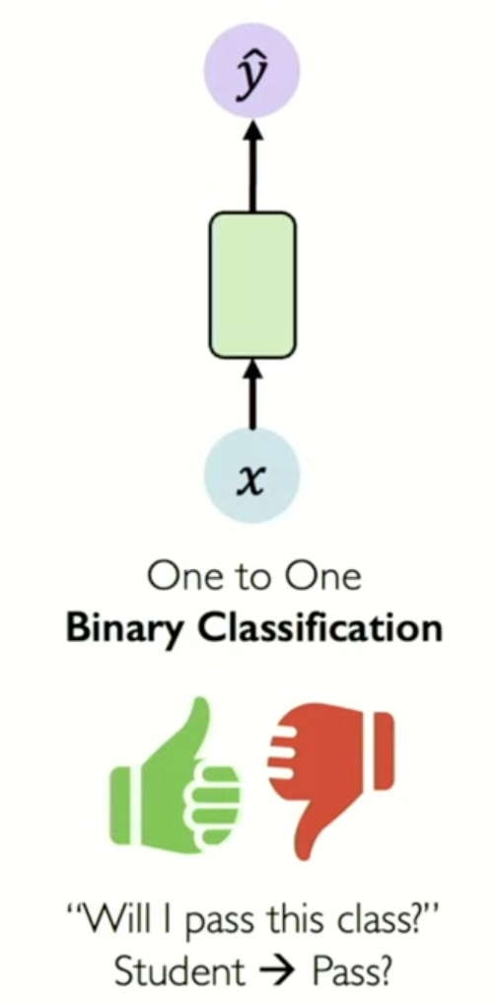
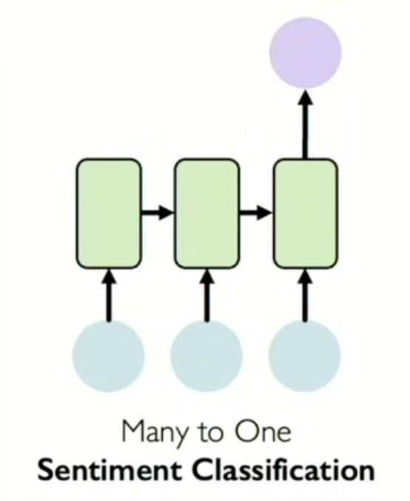
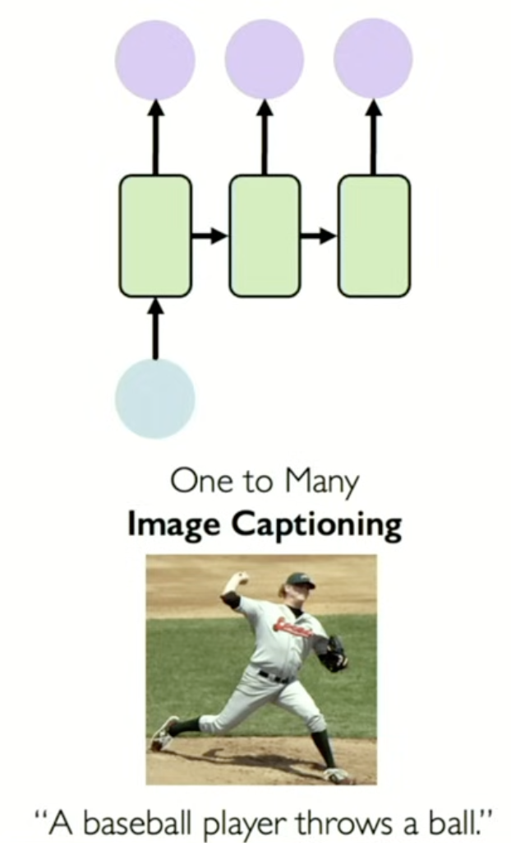
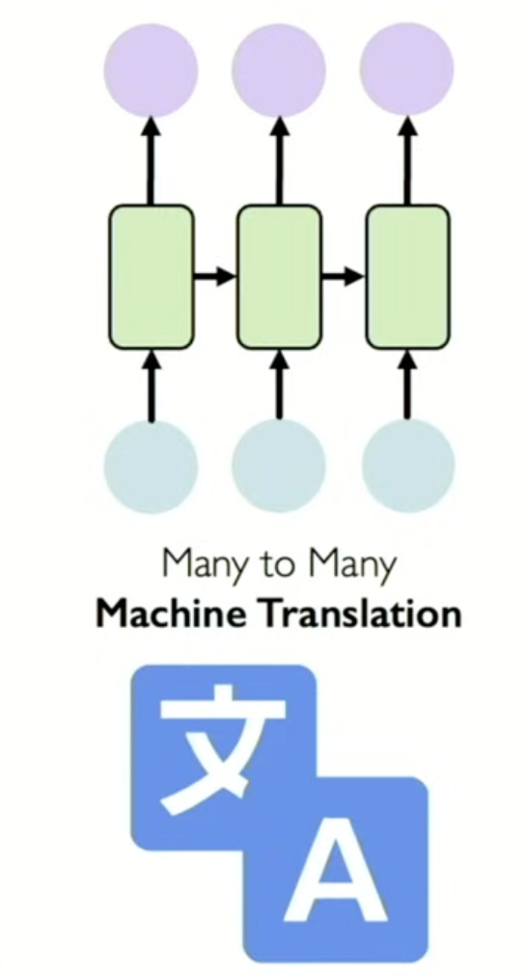
Recap: Sequence modeling
Slide Credit: Ava Amini
Notes:
Sequential data
Vanishing gradient, the time unroll the network.

Slide 4
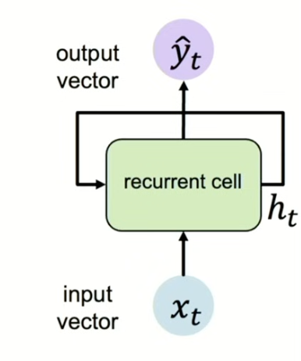
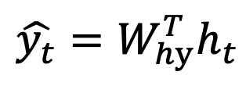
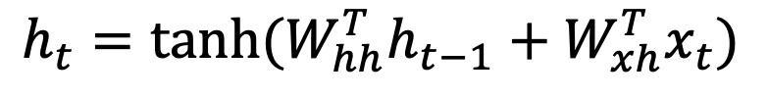
Recap: RNN (1986)
Update hidden state (cell state)
past memory
$$h_{t}=tanh(W_{hh}^{T}h_{t−1}+W_{xh}^{T}x_{t})$$
Hidden State
Activation
function
Previous
hidden state
Input vector
$$\hat{y_{t}}=W_{hy}^{T}h_{t}$$
Note: in RNN, we use the SAME function and set of parameters at every time step.
Slide Credit: Ava Amini
Notes:
Each of those features are passed through to a hidden state and the hidden state is passed through the next hidden state
That is how you form your features that will go though to your output layer.

Slide 5
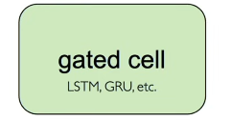
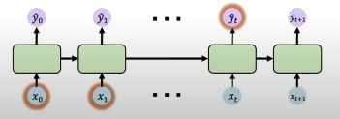
Recap: motivation of LSTM (1997)
Why is vanishing gradient is a problem?
Vanishing gradient is a problem because if we multiply many small numbers together, we would have smaller and smaller gradient, and the bias parameters are only there to capture short-term dependencies.
Gates can optionally let information
through the cell
Slide Credit: Ava Amini
Notes:
The problem with RNN however, is that they often suffer from the gradient vanishing problem so it is really difficult to get for example this x1 to influence the xt that are further down the sequence.
So the next kind of major breakthrough in NLP was to introduce the LSTM, the long term short term memory network.

Slide 6
1. More on LSTM 2. Attention and Transformers

Slide 7
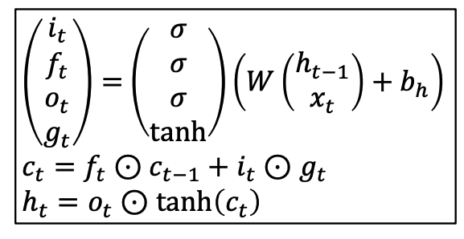


LSTM
Vanilla RNN
LSTM
Hadamard elementwise product operator
Previous hidden state
At each time step: we introduce 4 gates and a new state -> cell state
Input vector
Slide Credit: Justin Johnson
Notes:
This next network is the same thing with RNN where you have the xt come along with the hidden state
But this time, there is more inner mechanism into that hidden state to tackle this vanishing gradient descent problem.

Slide 8
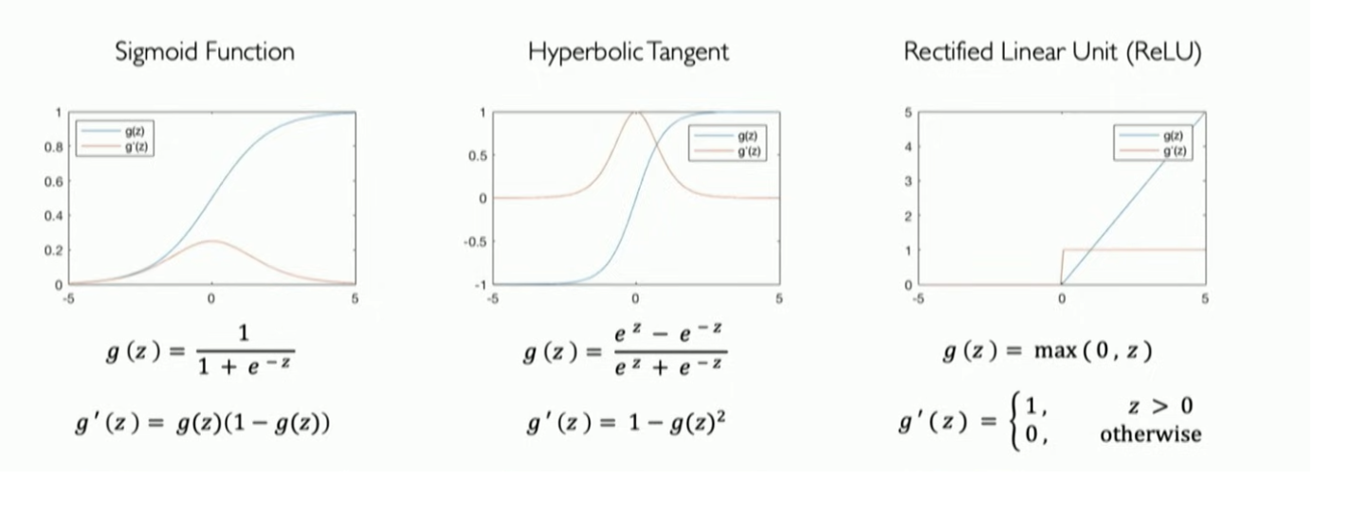
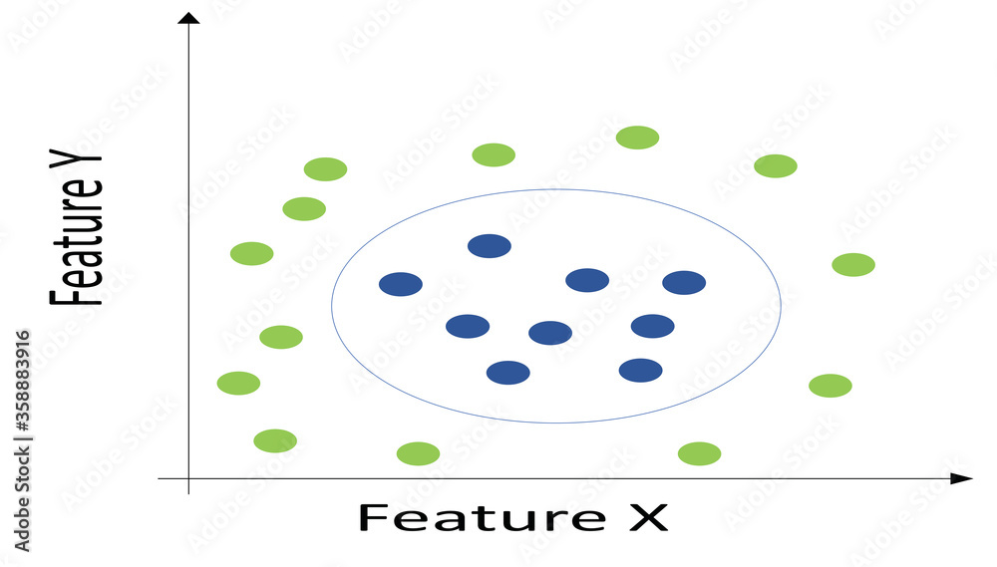

Recall: activation functions
It is important to introduce non-linearity when analyze data
2. Common activation functions to introduce non-linearity
torch.sigmoid(x)
torch.tanh(x)
torch.relu(x)
Notes:
Here I have listed some common active functions
Sigmoid function: it can map any real number to 0 and 1. It is very useful rspecially when you want to deal with probability distributions because probabilities live between 0 and 1.
In modern deep learning the relu (rectified linear function) function is also very popular . It is piecewise linear and very efficiently to compute, especially for derivatives.
Through out the examples, you are also going to see some of the code snippets on the bottom of the slides where we will try and actually tie in some of what you are learning with the software labs and homeworks.
Change the picture such that it is it is linear function change the title of ReLU function

Slide 9
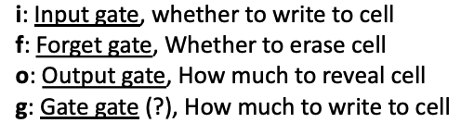




Unpack Gates in LSTM
At each time step: we introduce 4 gates and a new state -> cell state
LSTM
$$i_{t}=σ\left(x_{t}W_{xi} +h_{t−1}W_{hi}+ b_{i}\right)$$
$$f_{t}=σ\left(x_{t}W_{xf} +h_{t−1}W_{hf}+ b_{f}\right)$$
[0,1]
$$o_{t}=σ\left(x_{t}W_{xo} +h_{t−1}W_{ho}+ b_{o}\right)$$
$$g_{t}=tanh\left(x_{t}W_{xg} +h_{t−1}W_{hg}+ b_{g}\right)$$
[-1,1]
Learned weights!
Slide Credit: Justin Johnson
Notes:
There are a couple of gates that are in the middle of the LSTM.
There is the input gate, forget gate, output gate and gate gate, where LSTM can help to get more context around the layer

Slide 10
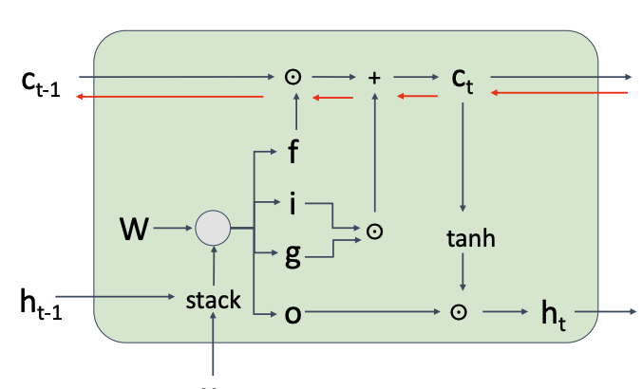
LSTM
At each time step: we introduce 4 gates and a new state -> cell state
cell state
gates
hidden state
Slide Credit: Justin Johnson

Slide 11
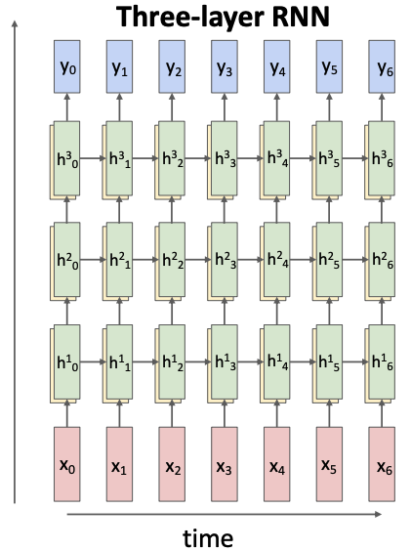
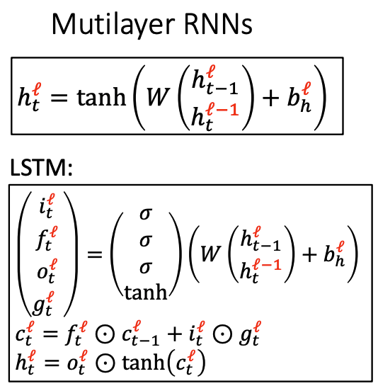
Stacking RNN and LSTM
Slide Credit: Justin Johnson

Slide 12
Key Concepts
RNN
Can model the sequential data
Backward flow of gradients in RNN can explode or vanish
Exploding is controlled with gradient clipping
Vanishing is controlled with additive interaction (gates cells)
LSTM
Maintain a cell state
Use gates to control the flow of information
Input gate stores relevant info
Forget gate gets ride of irrelevant info
Selectively update cell state
Output fate returns a filtered version of the cell state

Slide 13
1. LSTM 2. Attention and Transformers

Slide 14
Attention Is All You Need
ChatGPT
BERT
Transformer
Notes:
Attention is all you Need

Slide 15
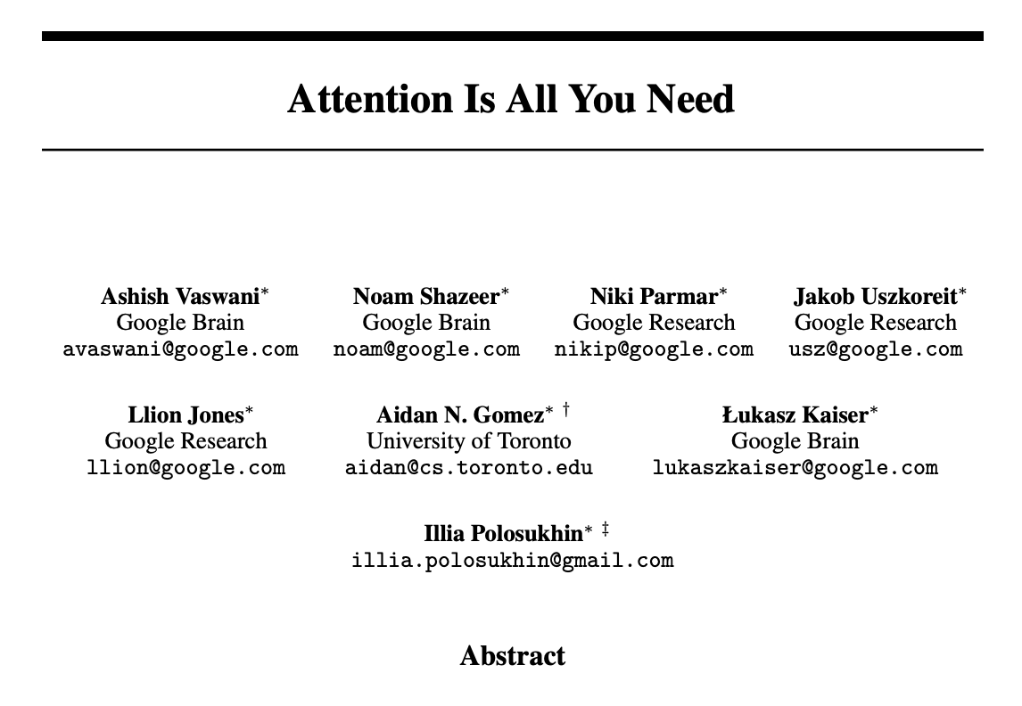
Core idea:
Attending to the most important parts of an input
Extract the features with high attention (learned by the network)
Notes:
The core diea is that we do not need to keep tracker of the key state, like we do in LSTM and RNN,
For each step, we should just look over the entire sequence and then kind of get context from there
Now we are seeing that transforemer is spidering out all kinds of applications.

Slide 16
A very approximate timeline
1986 RNN
1997 LSTM
1990 Static Word Embeddings
2003 Neural Language Model
2008 Multi-Task Learning
2015 Attention
2017 Transformer
2018 Contextual Word Embeddings and Pretraining
2019 Prompting

Slide 17
Attention as a mechanism
A mechanism for helping compute the embedding for a token by selectively attending to and integrating information from surrounding tokens (at the previous layer).
More formally: a method for doing a weighted sum of vectors.
Input: Given a sequence of token embeddings:
x₁ x₂ x₃ x₄ x₅ x₆ x₇
Output: a_{i} = a weighted sum of x₁ through x₇
Weighted by their similarity to x_{i}

Slide 18
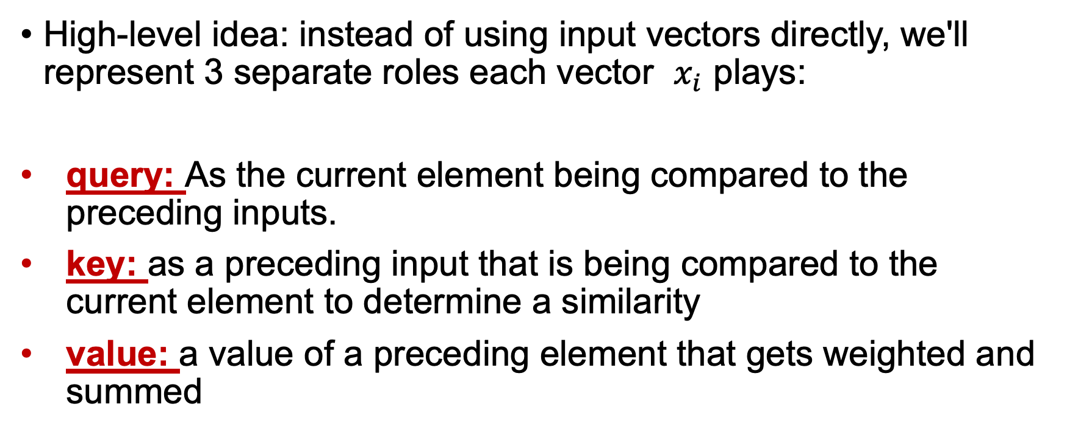
Attention introduces 3 separate rols
High-level idea: instead of using input vectors directly, we'll represent 3 separate roles each vector $x_{i}$ plays:
query: As the current element being compared to the preceding inputs.
key: as a preceding input that is being compared to the current element to determine a similarity
value: a value of a preceding element that gets weighted and summed
Notes:
The word head is used in transformers to refer to specific structured layers

Slide 19
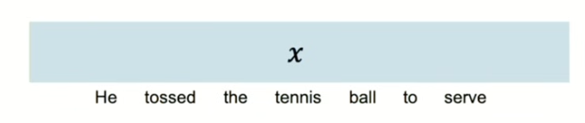

Attention for sequence modeling
Goal: identify and attend to most important features in input
x_{i}
Data is fed in all at once, not going to handle this timestep by timestep.
What information is lost?

Slide 20
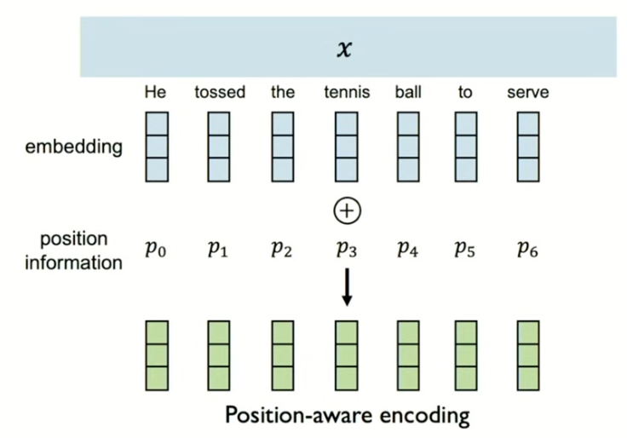
Positional embedding
Data is fed in all at once, we need to encode position information

Slide 21
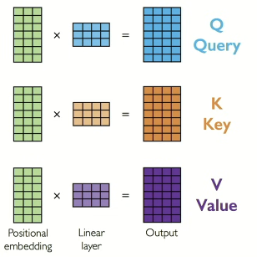

Extract query, key, value
Extract the three introduced components Q, K, V

Slide 22
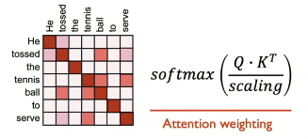
Compute attention weights
Extract the three introduced components Q, K, V

Slide 23
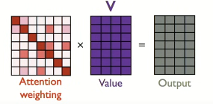
Extract features using self attention
Input: Given a sequence of token embeddings:
x₁ x₂ x₃ x₄ x₅ x₆ x₇
Output: a_{i} = a weighted sum of x₁ through x₇
Weighted by their similarity to x_{i}

Slide 24
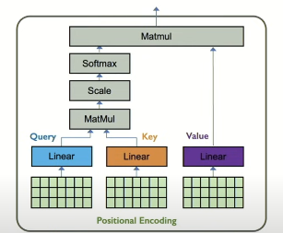
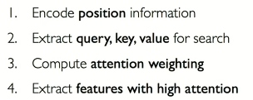

Learning attention with neural networks

Slide 25
in-class practice
Attention from scratch

Slide 26
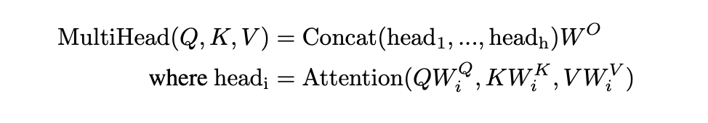
Actual Attention: multi-head
Instead of one attention head, we'll have lots of them!
Intuition: each head might be attending to the context for different purposes
Different linguistic relationships or patterns in the context
Notes:
Up to 128 in Lllama3 405B

Slide 27
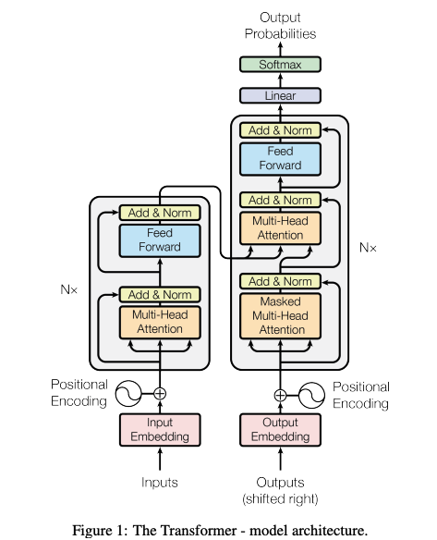
From attention to transformer model

Slide 28
Summary
RNN are well suited for sequence modeling tasks.
Model sequence via a recurrence relation
LSTM can resolve the gradient vanishing issue
Attention mechanism can model sequences without recurrence
Attention is the basis for transformer and many large language models

Slide 29
FAQ about final project
About dataset size
About model complexity
About the performance of the model

Slide 30
Other things
HW8 out.
Final project out (start early)
Coming next:
CNN

