Slide 1
STATS 507 Data Analysis in Python
Week14-1: CNN in PyTorch
Dr. Xian Zhang

Slide 2
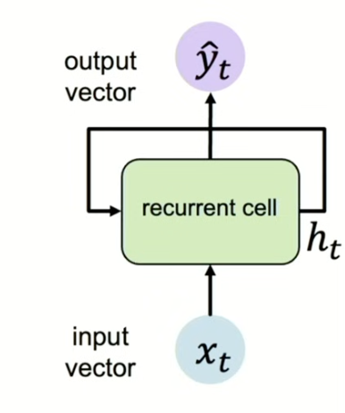
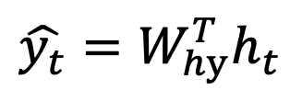
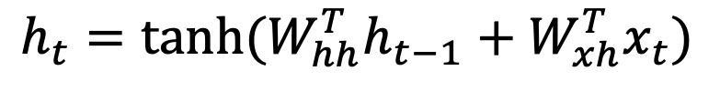
Recap: Sequential Modeling with RNN
Update hidden state (cell state)
past memory
$$h_{t}=tanh(W_{hh}^{T}h_{t−1}+W_{xh}^{T}x_{t})$$
Hidden State
Activation
function
Previous
hidden state
Input vector
$$\hat{y_{t}}=W_{hy}^{T}h_{t}$$
Note: in RNN, we use the SAME function and set of parameters at every time step.
Slide Credit: Ava Amini

Slide 3
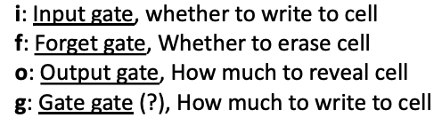
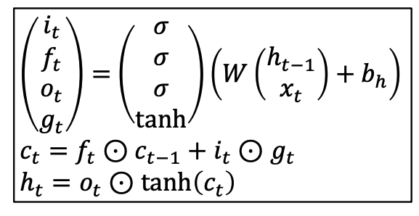




Recap: LSTM
At each time step: we introduce 4 gates and a new state -> cell state
LSTM
$$i_{t}=σ\left(x_{t}W_{xi} +h_{t−1}W_{hi}\right)+ b_{i}$$
$$f_{t}=σ\left(x_{t}W_{xf} +h_{t−1}W_{hf}\right)+ b_{f}$$
[0,1]
$$o_{t}=σ\left(x_{t}W_{xo} +h_{t−1}W_{ho}\right)+ b_{o}$$
$$g_{t}=tanh\left(x_{t}W_{xg} +h_{t−1}W_{hg}\right)+ b_{g}$$
[-1,1]
Learned weights!
Slide Credit: Justin Johnson

Slide 4
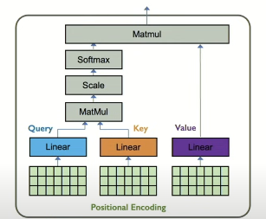
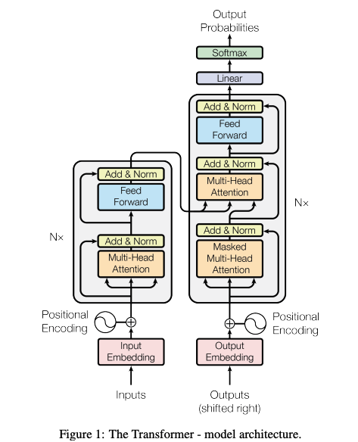
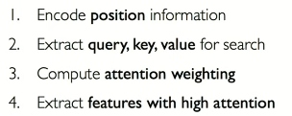
Recap: Attention and transformer

Slide 5
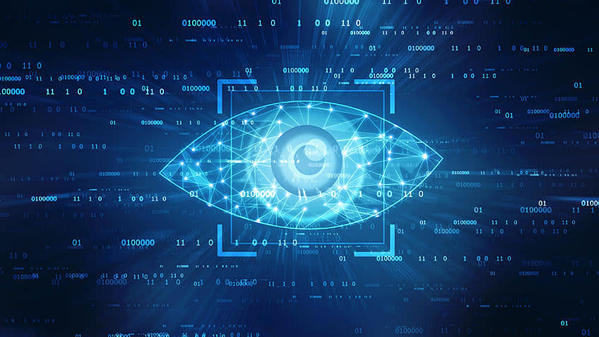
Today: teach machine to see with CNN
Vision: to see what is where.

Slide 6
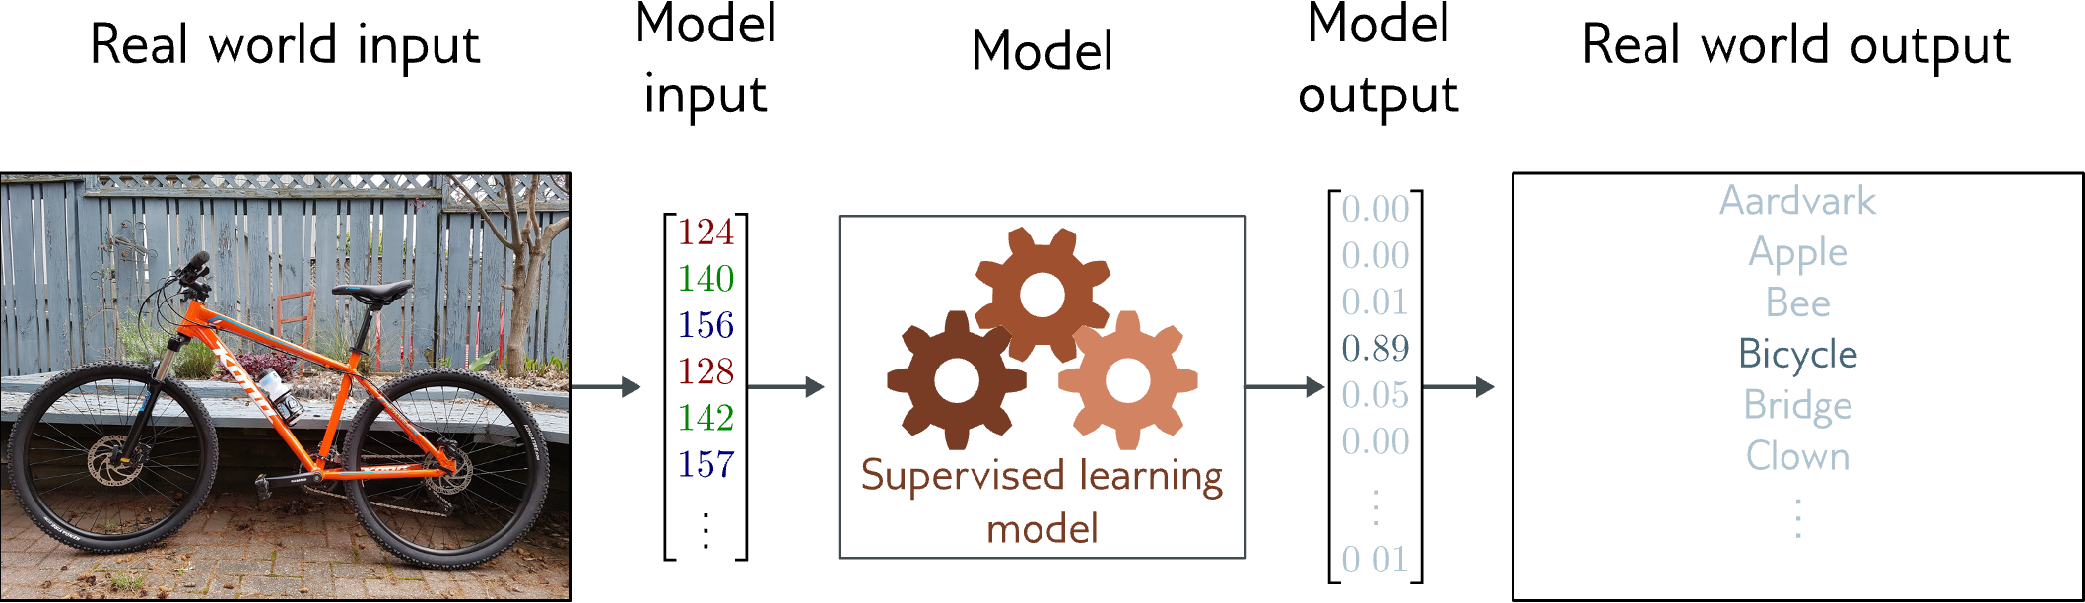
Image classification
Multiclass classification problem (discrete classes, >2 possible classes)
Convolutional network
Slide Credit: Simon Prince

Slide 7
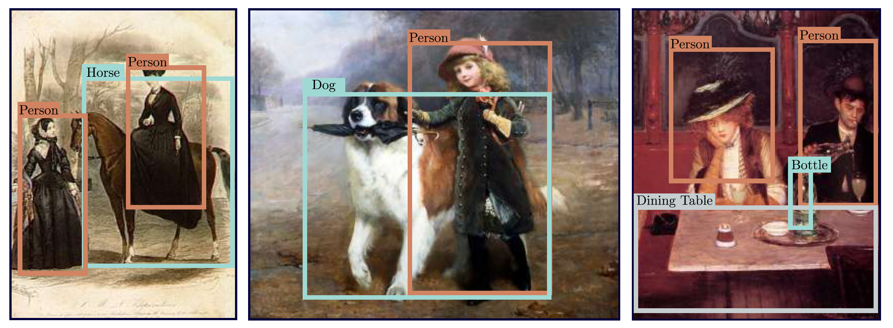
Object detection
Slide Credit: Simon Prince

Slide 8
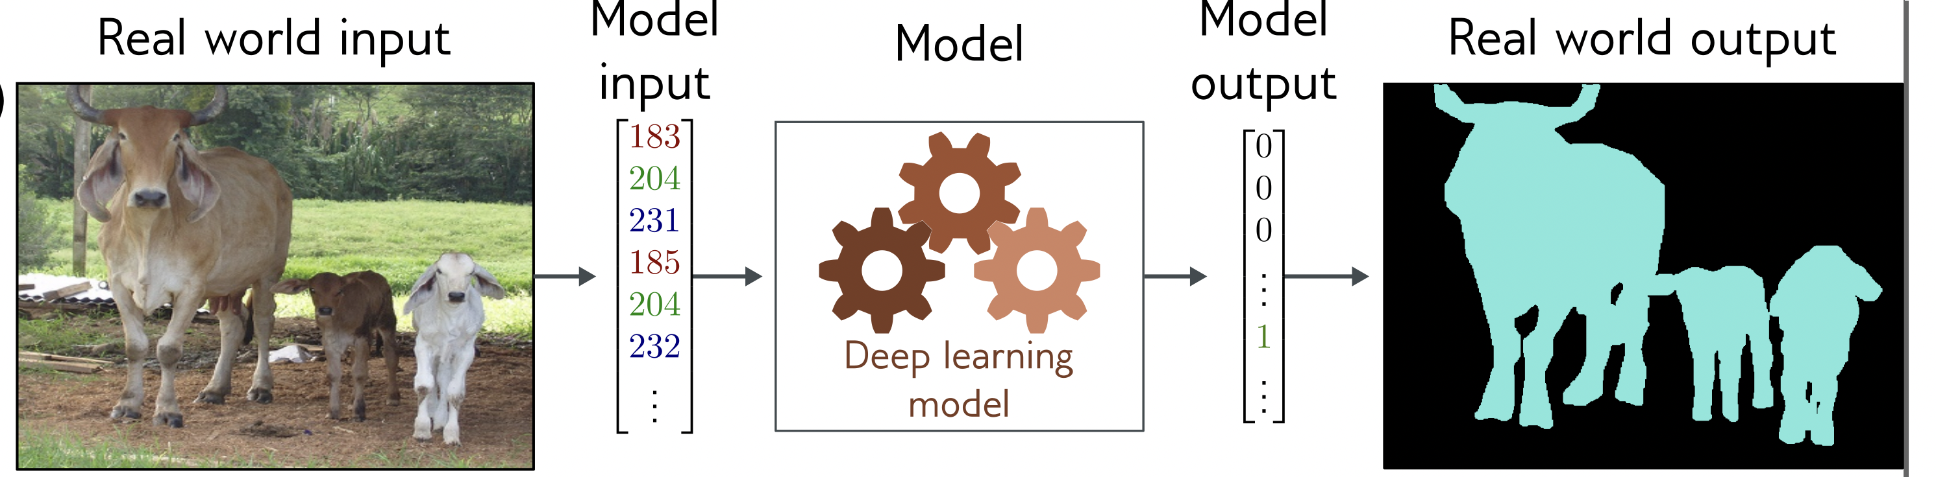
Image segmentation
Multivariate binary classification problem (many outputs, two discrete classes)
Convolutional encoder-decoder network
Slide Credit: Simon Prince

Slide 9
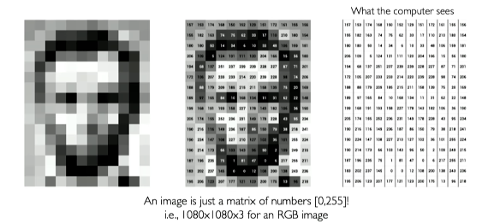
How can we teach a machine to see?
Manual Feature Extraction
Through Learning
Slide Credit: Alexander Amini

Slide 10



Manual Feature Extraction
How can we do better?
Problem?
Human face feature: eyes, noses, mouths…
Detect small features first and then do the classify task
Types of features are very difficult to define
Slide Credit: Alexander Amini

Slide 11
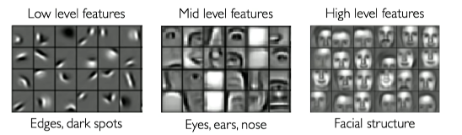
Learning with Neural Network
What we want: detect the features in image automatically
Ideally can learn a hierarchy of features.
Slide Credit: Alexander Amini

Slide 12
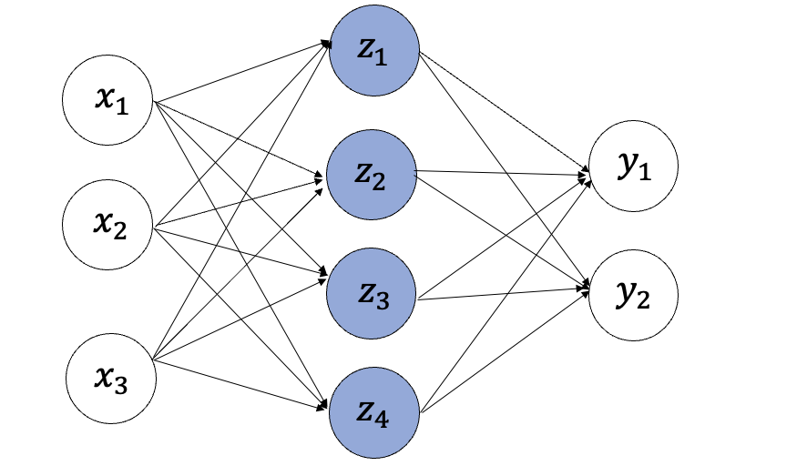
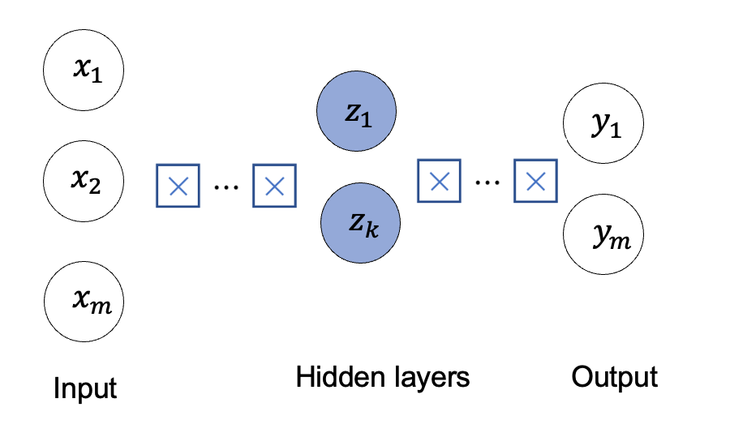
Learning with MLP
Input
Fully Connected Neural Network
Problem?
No Spatial information preserved
2D image
Vector of pixel values (flattened…)
Many many parameters…
How can we use the spatial structure in the input?

Slide 13
1. CNN basics 2. torchvision: vision in PyTorch

Slide 14
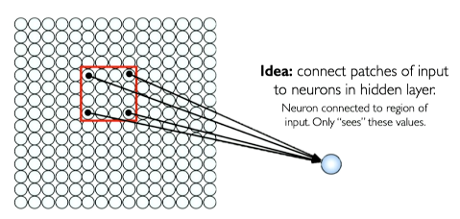
Learning with spatial structure: patching
Input
How does the perceptron act on the input?
Each neuron only connects (“see”) a patch of the input
2D image
Array of pixel values
No flattening…
Slide Credit: Alexander Amini

Slide 15
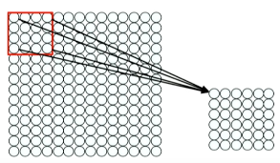
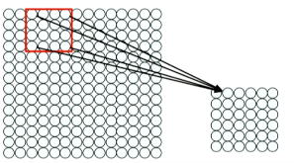
Sliding to see different patches
Connect patches in input layer to a single neuron in subsequent layer, using a sliding window to define connections.
Feature map
Same filter (weights) for different local regions across the image.
Slide Credit: Alexander Amini

Slide 16
Extract features with convolution
This allows us to extract local features with spatial info
Apply a set of weights – a filter – to extract local features
Use multiple filters to extract different local features
Spatially share parameters of each filter
Filter of 4*4: 16 weights
Apply the same filter to 4*4 patches in input
Shift by 2 pixels for next patch
Slide Credit: Alexander Amini

Slide 17
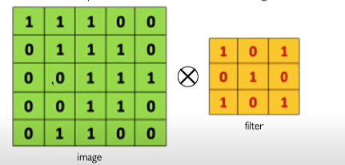
The Convolution Operation
Suppose we want to compute the convolution of a 5 * 5 image and a 3*3 filter..
We slide the same 3*3 filter over the input image, element-wise multiply, and add the outputs to represent the ”local” feature…
Slide Credit: Alexander Amini

Slide 18
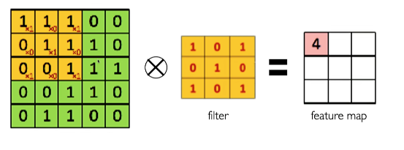
The Convolution Operation
We slide the same 3*3 filter over the input image, element-wise multiply, and add the outputs to represent the ”local” feature…
Slide Credit: Alexander Amini

Slide 19
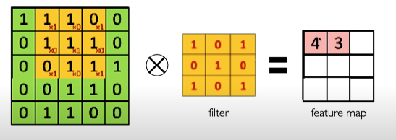
The Convolution Operation
We slide the same 3*3 filter over the input image, element-wise multiply, and add the outputs to represent the ”local” feature…
Slide Credit: Alexander Amini

Slide 20
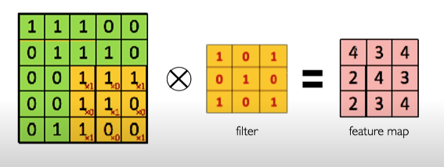
The Convolution Operation
We slide the same 3*3 filter over the input image, element-wise multiply, and add the outputs to represent the ”local” feature…
Slide Credit: Alexander Amini

Slide 21
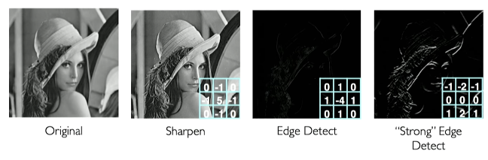
Feature maps with different filters
We can extract different local features with different filters.
One filter -> One feature maps…
Slide Credit: Alexander Amini

Slide 22
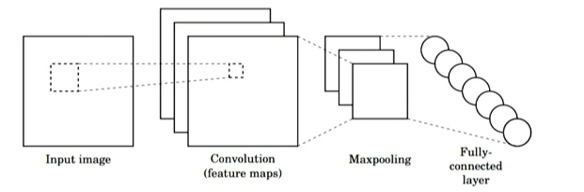
From Convolution to CNN
Three main operations:
Use convolution and filters to extract different feature maps
Nonlinearity: Often Relu
Pooling: downsample operation on each feature map.
Slide Credit: Alexander Amini

Slide 23
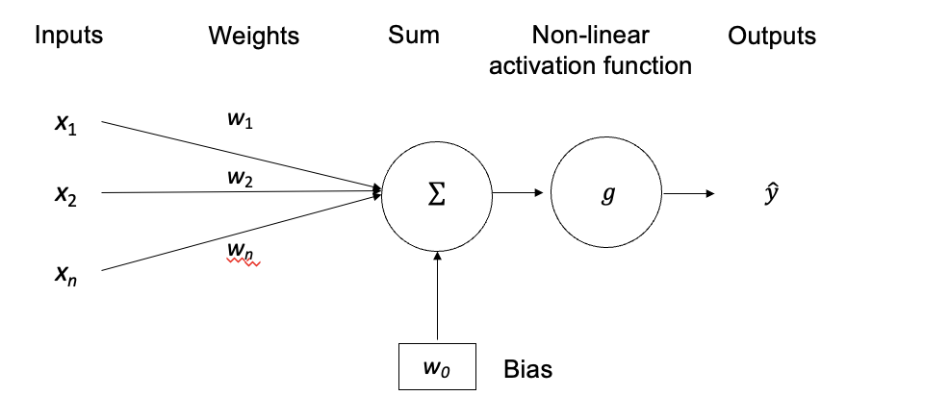
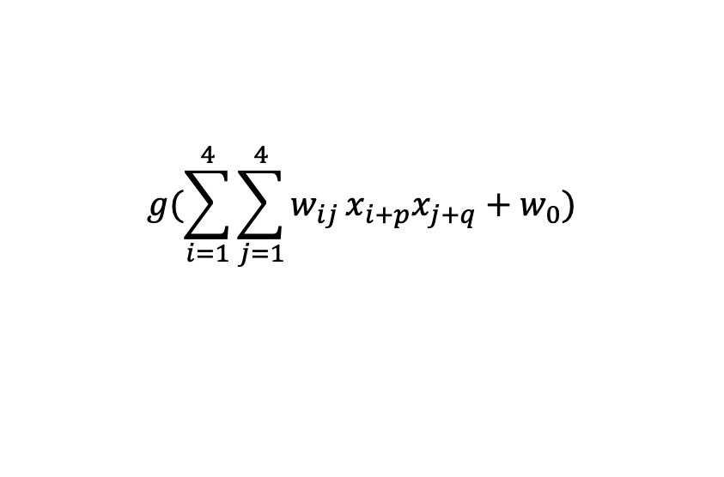
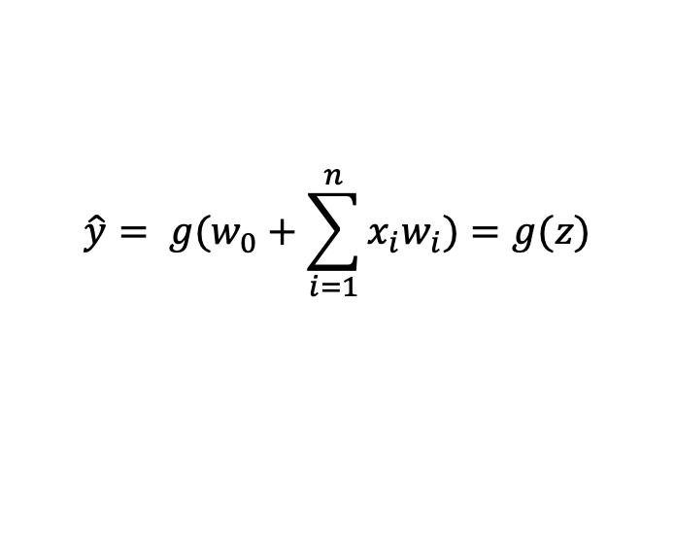
Convolutional layers: to extract local features
For a neuron on a CNN layer:
Takes 2d Input from a patch
Compute weighted sum
Add bias
For a 4*4 filter
For neuron (p,q)
$$\hat{y}= {g(w}_{0}+\sum_{i=1}^{n}{x_{i}w_{i})=g(z)}$$
$$g(\sum_{i=1}^{4}{\sum_{j=1}^{4}{w_{ij}}x_{i+p}x_{j+q}+w_{0}})$$
Slide Credit: Alexander Amini

Slide 24
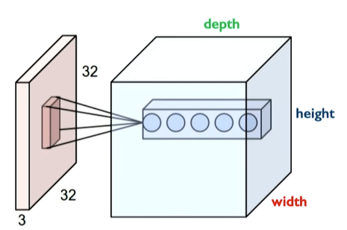
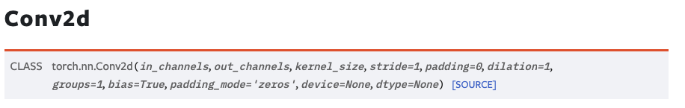
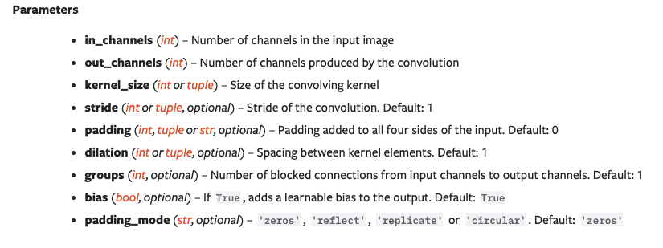
Convolutional layers in Pytorch
Depth: number of filters/feature maps
https://pytorch.org/docs/stable/generated/torch.nn.Conv2d.html

Slide 25
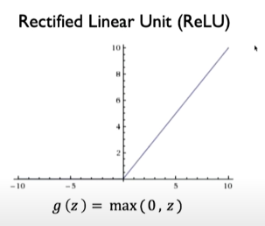
Introducing non-linearity
Apply after every convolutional operation (after convolutional layers)
Slide Credit: Alexander Amini

Slide 26
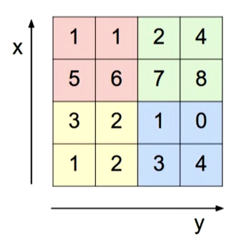
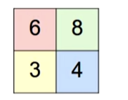
Pooling
Downsample and still preserve spatial structure?
Max pool with 2*2 filters with stride 2
https://pytorch.org/docs/stable/generated/torch.nn.Conv2d.html
Slide Credit: Alexander Amini

Slide 27
Put it all together: in-class practice
Define a CNN for CIFAR-10 images classification using PyTorch
https://www.cs.toronto.edu/~kriz/cifar.html

Slide 28
1. CNN basics 2. torchvision: Vision in PyTorch

Slide 29
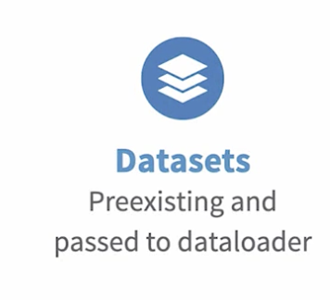

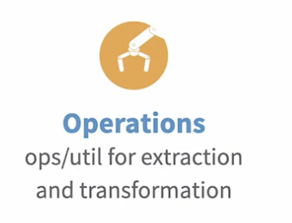
Torchvision overview
Torchvision is a library within PyTorch for image and video processing
https://pytorch.org/vision/stable/index.html

Slide 30
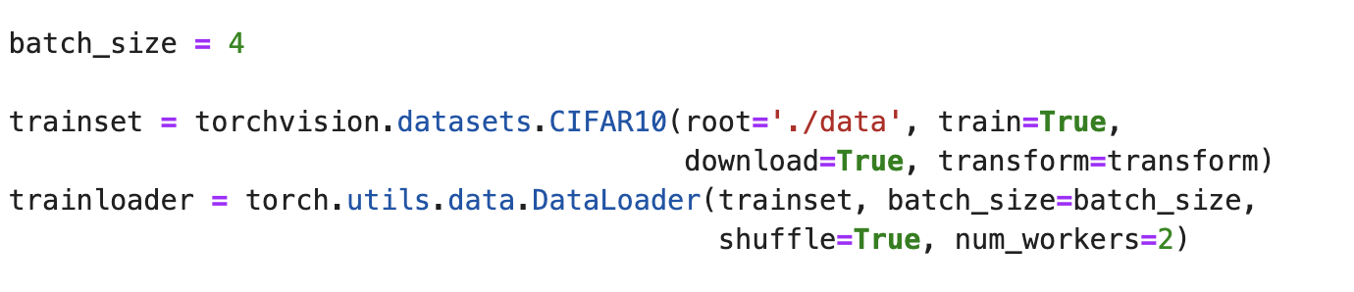
Dataset and Dataloader
Torchvision provides many built-in datasets in the torchvision.datasets module, as well as utility classes for building your own datasets.
Step 1: Load the datasets using torchvision.datasets
Step 2: Pass the dataset to a torch.utils.data.DataLoader which can load (and batch) multiple samples in parallel
https://pytorch.org/vision/stable/datasets.html

Slide 31
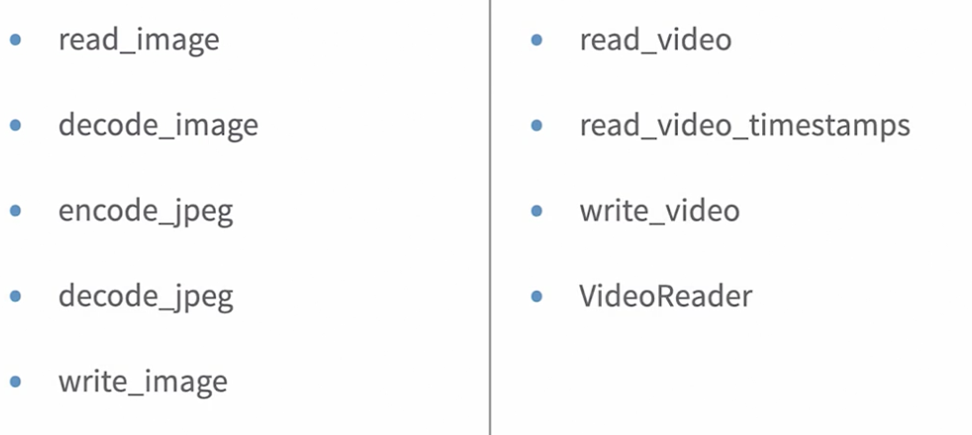
Torchvision io: read/write image/video
The torchvision.io module provides utilities for decoding and encoding images and videos.
Image
Video
Read a JPEG or a PNG image into a 3d RGB tensor.
It will decode images straight into (uint8 [0, 255]) image tensors
https://pytorch.org/vision/stable/io.html
Optionally convert the image to the desired format…

Slide 32
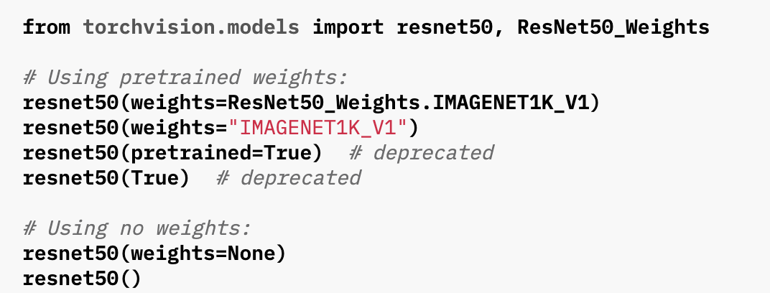
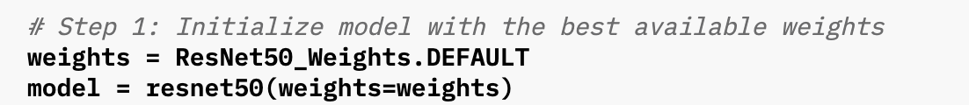
Torchvision models/pretrained weights
The torchvision.models subpackage contains definitions of models for addressing different tasks, including:
image classification
pixelwise semantic segmentation
object detection
instance segmentation
person keypoint detection
video classification
…
Use pre-defined model
Use pretrained weights to initialize a model
https://pytorch.org/vision/stable/models.html

Slide 33
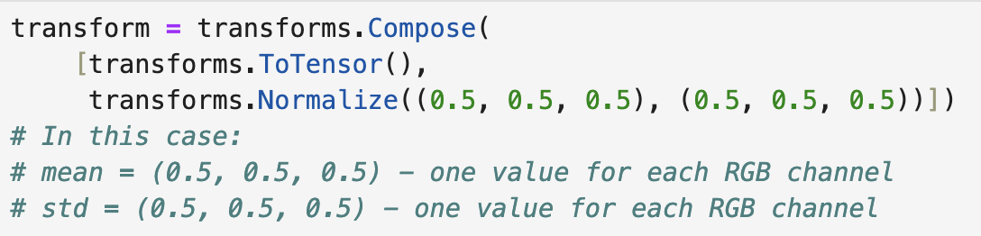
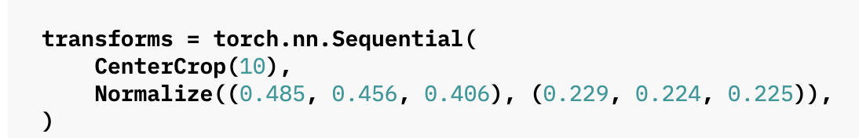
Torchvision transform
Transforms can be used to transform or augment data for training or inference of different tasks.
Rotate
Crop
Convert RGB to grayscale
…
Can use nn.sequential to compose operations
https://pytorch.org/vision/stable/transforms.html

Slide 34
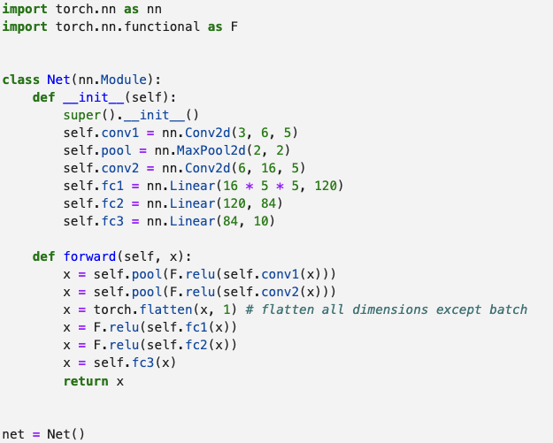
In class practice solution

Slide 35
Other things
Final project due on 04/22/2025 (No late days)!
Coming next:
A review on learning approaches for self-driving.
Come to class if you need my help for final project.

