Slide 1
STATS 507 Data Analysis in Python
Week14-1: Deep Generative Modeling and VAE
Dr. Xian Zhang
Adapted from slides by Ava Amini
MIT Introduction to Deep Learning

Slide 2
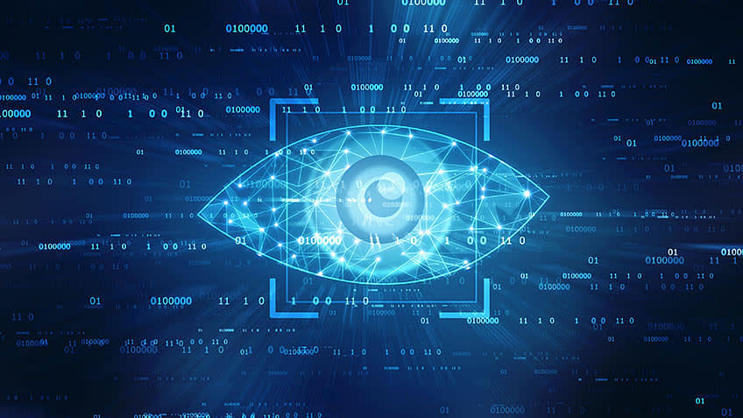
Recap: teach machine to see with CNN
Vision: to see what is where.

Slide 3
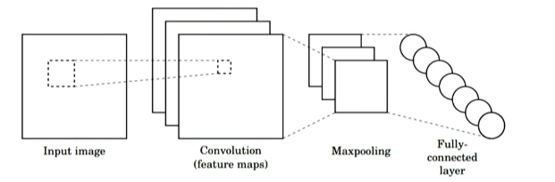
Recap: From Convolution to CNN
Three main operations:
Use convolution and filters to extract different feature maps
Nonlinearity: Often Relu
Pooling: downsample operation on each feature map.
Slide Credit: Alexander Amini

Slide 4
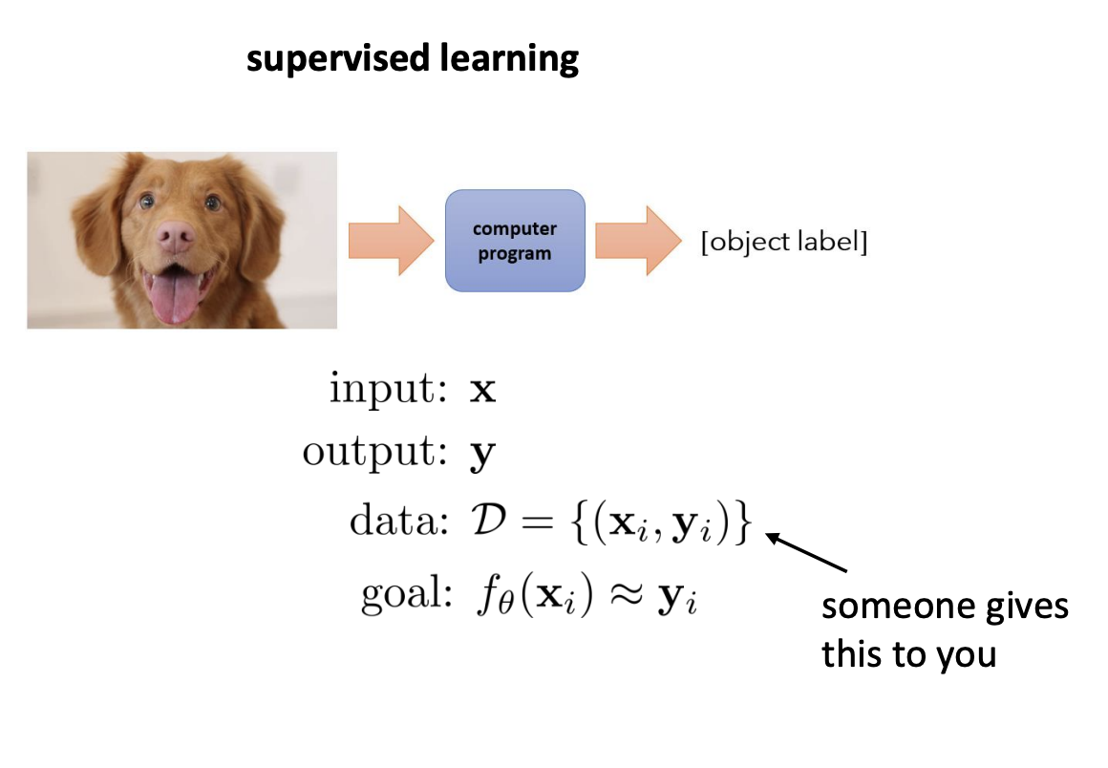
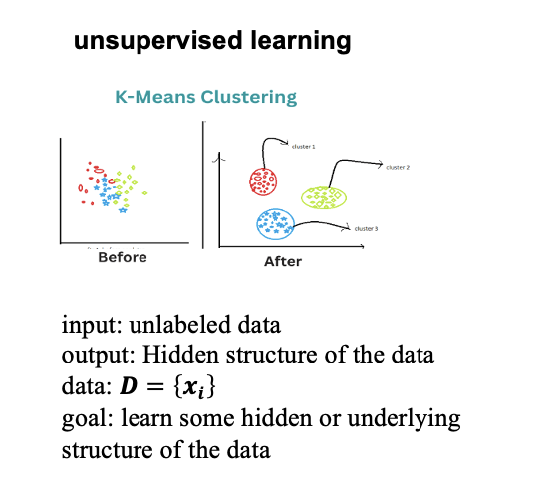
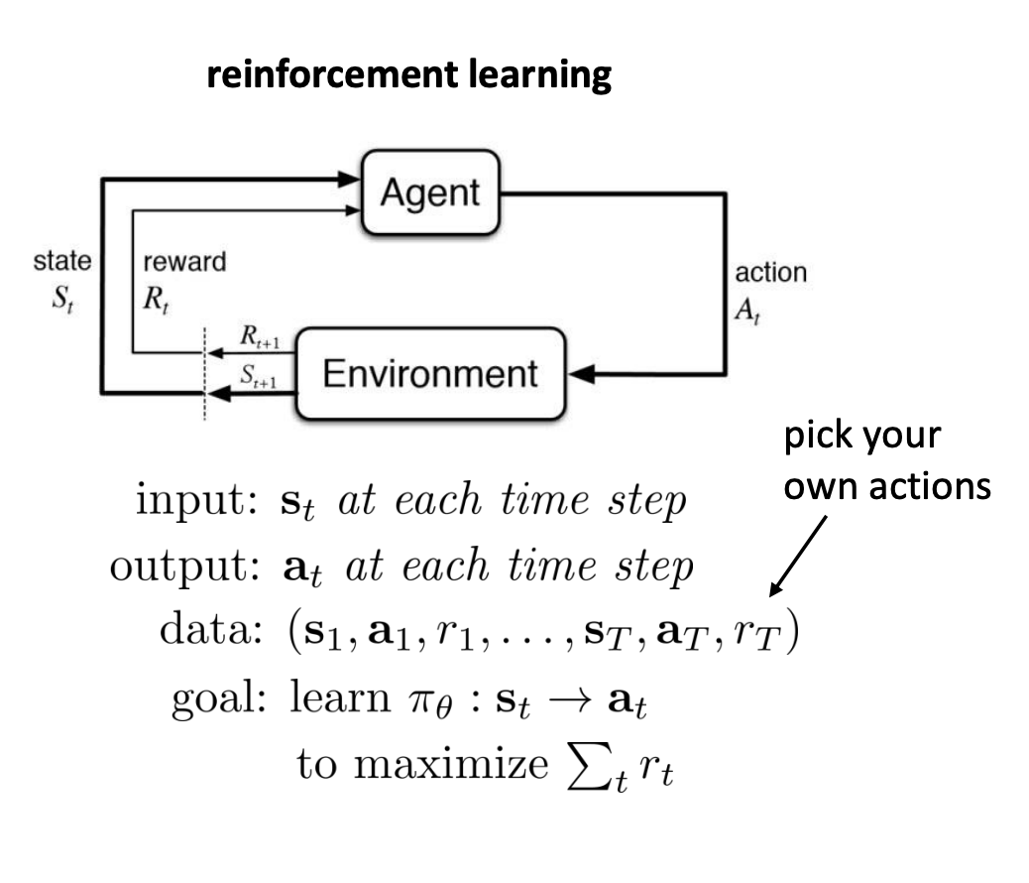
Recap: learning problems so far…
Ref: https://rail.eecs.berkeley.edu/deeprlcourse/

Slide 5
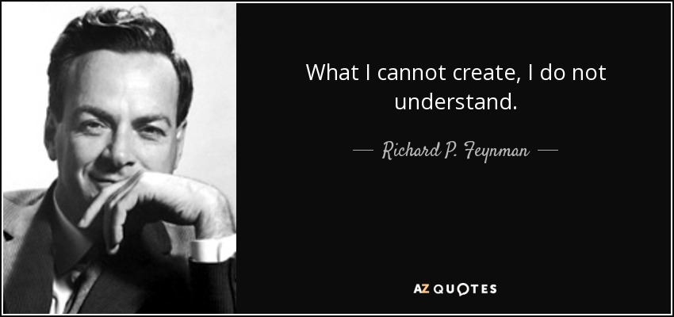
Today: generative modeling

Slide 6
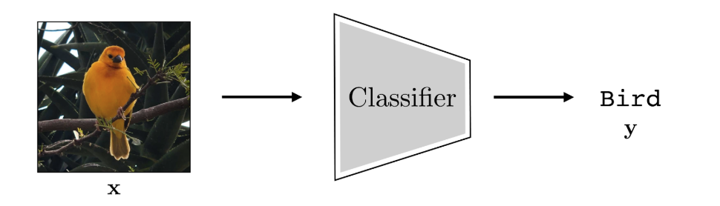
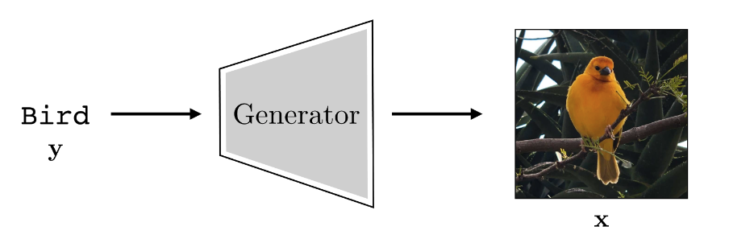
What is generative modeling
Recall with an image classifier:
Many to one
A generative model does the opposite:
One to many
How?
Ref: https://visionbook.mit.edu/generative_models.html

Slide 7
1. Autoencoders 2. Variational Autoencoders (VAEs)

Slide 8
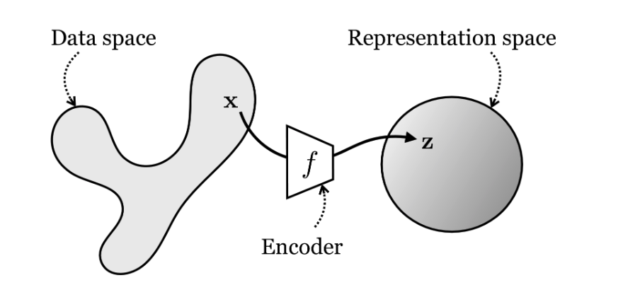
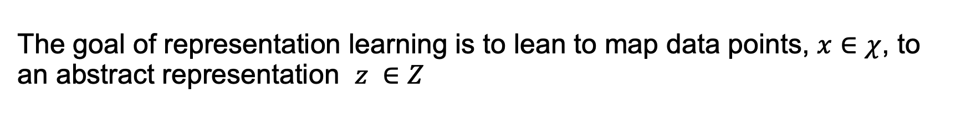
Representation Learning/ Latent variables
The goal of representation learning is to lean to map data points, $x∈χ$, to an abstract representation $z ∈Ζ$
Data point space
Representation space
vector embedding
Simpler
More abstracted
Also called latent variable
Ref: https://visionbook.mit.edu/representation_learning.html
Notes:
We also saw that deep neural networks can be thought of as transforming the data, layer by layer, from one representation into another and another.

Slide 9
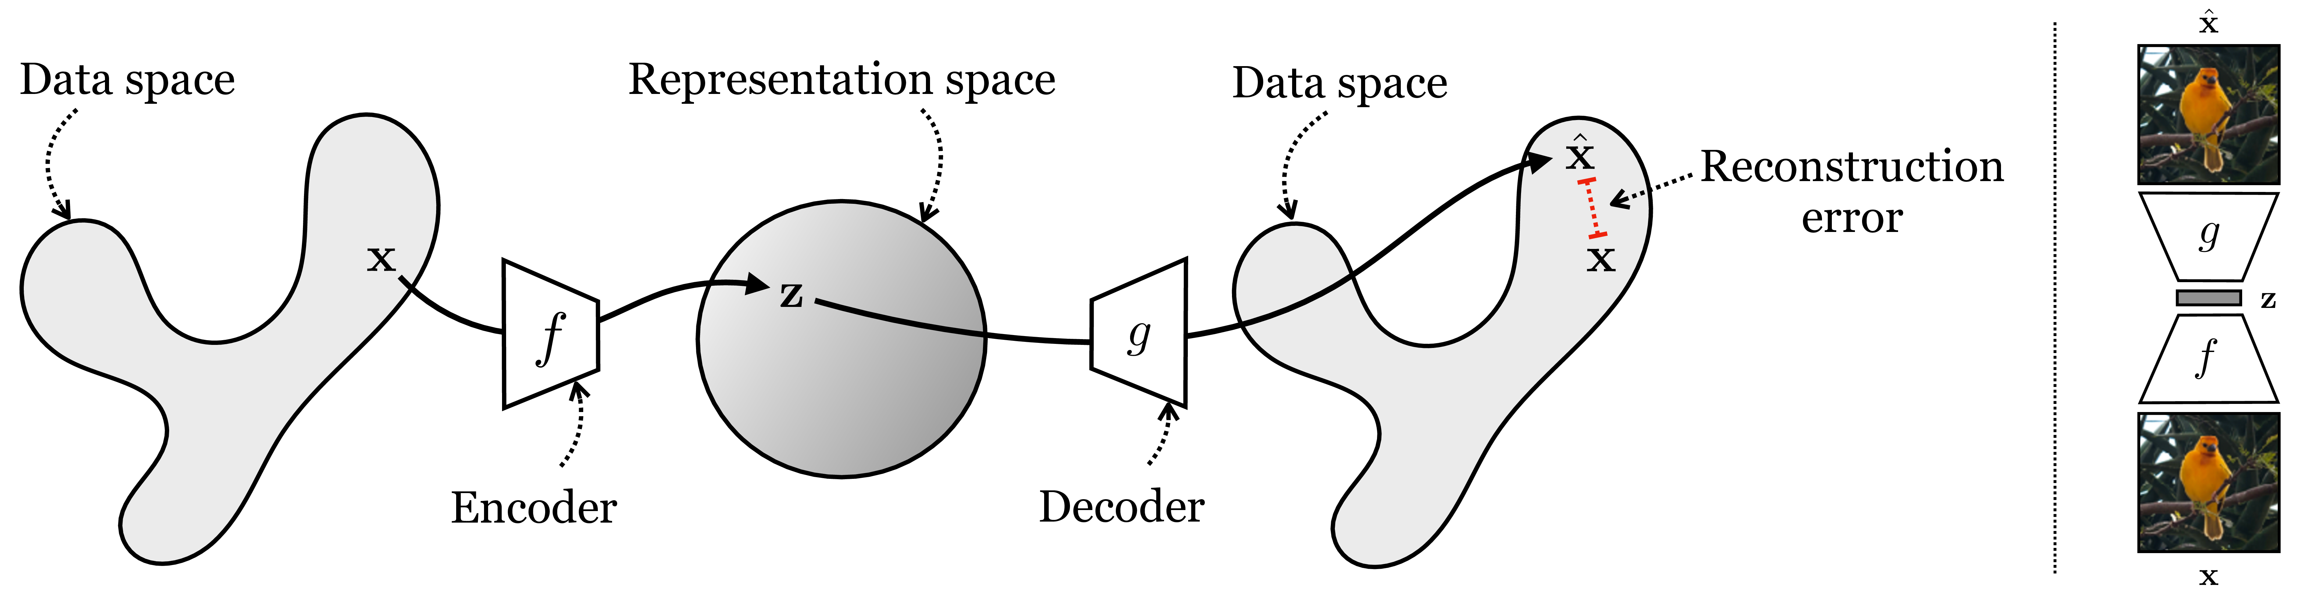
Autoencoders
Autoencoders are one of the oldest and most common kinds of representation learners. An autoencoder is a function that maps data back to itself (hence the “auto”), but via a low-dimensional representational bottleneck.
latent variable
Ref: https://visionbook.mit.edu/representation_learning.html
Notes:
We also saw that deep neural networks can be thought of as transforming the data, layer by layer, from one representation into another and another.

Slide 10

Autoencoders
The goal: learn a lower-dimensional feature representation from unlabeled training data.
$$z ∈Ζ$$
Latent variable
Compressed data
$$x∈χ$$
Slide Credit: Ava Amini

Slide 11




How can we learn this latent space?
Problem setup: train the model to reconstruct the original data.
$$x$$
$$\hat{x}$$
$$x$$
$$z$$
Encoder
Decoder
Unsupervised. No label needed.
With reconstruction loss: $ℒ\left(x, \hat{x}\right)={\left\|x −\hat{x}\right\|}^{2}$
Ref: https://introtodeeplearning.com/
Slide Credit: Ava Amini

Slide 12
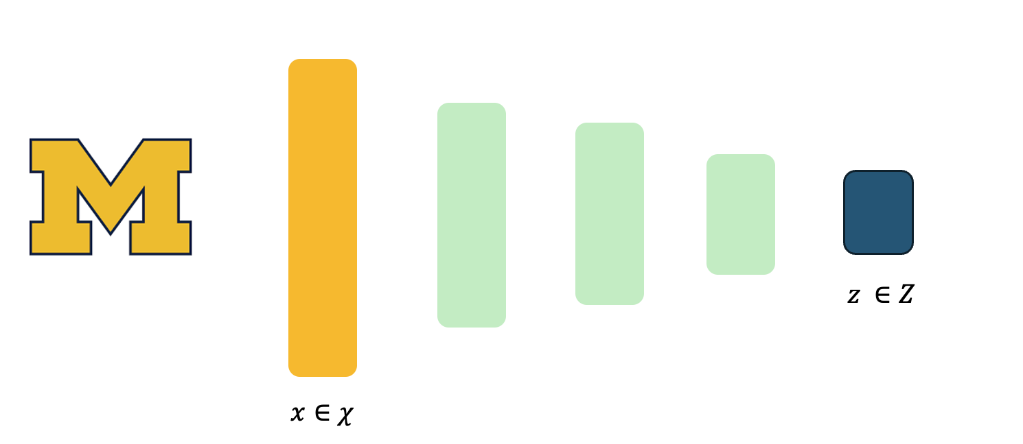
Autoencoding is a form of compression
Learn a lower-dimensional feature representation.
Compressed representation:
Capture the essential characteristics of the data.
Require less memory to store
A way to achieve invariance to nuisance factors (camera noises, lighting conditions, view angles…)
Slide Credit: Ava Amini

Slide 13
In summary
Autoencoding = Automatically encoding data
No label needed
Reconstruction loss forces the latent variable to capture as much “information” about the original data as possible.
Ref: https://introtodeeplearning.com/
Slide Credit: Ava Amini

Slide 14
1. Autoencoders 2. Variational Autoencoders (VAEs)

Slide 15
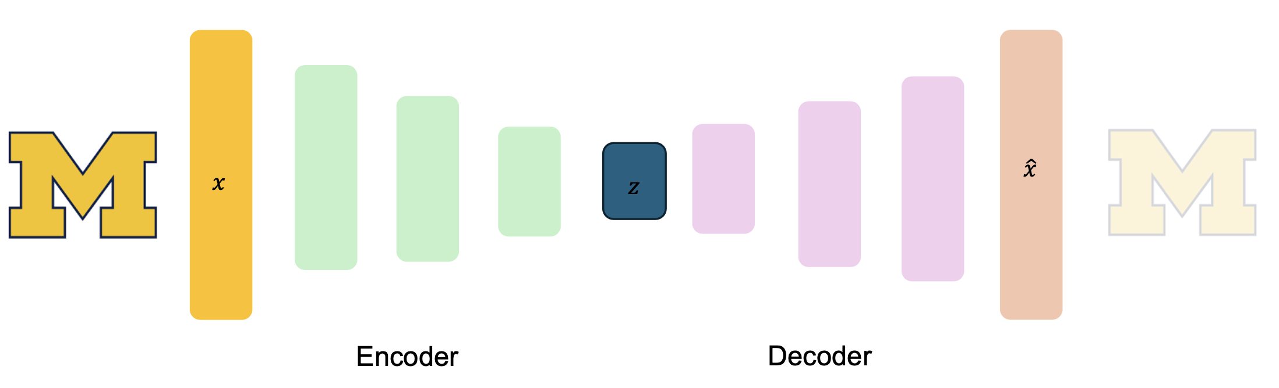
Traditional autoencoder is deterministic
Reconstruction loss: $ℒ\left(x, \hat{x}\right)={\left\|x −\hat{x}\right\|}^{2}$
Adopted from slide of Ava Amini

Slide 16
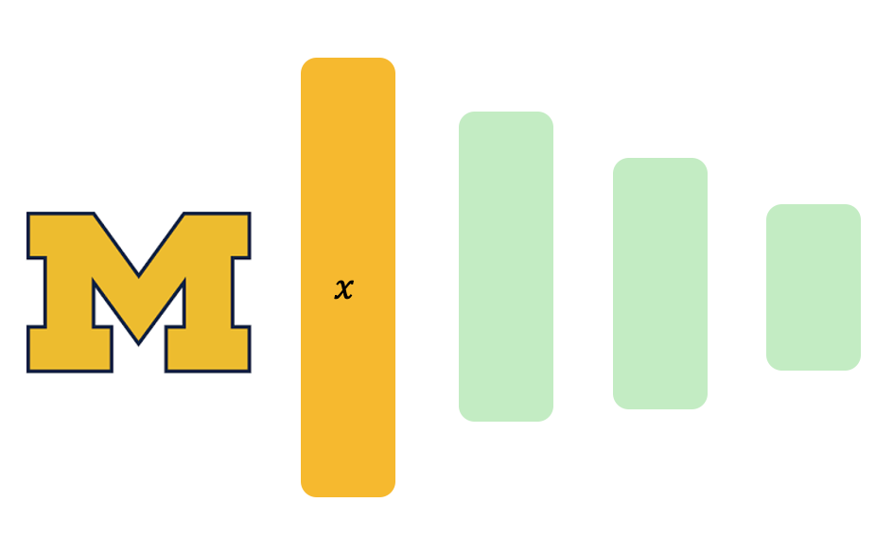
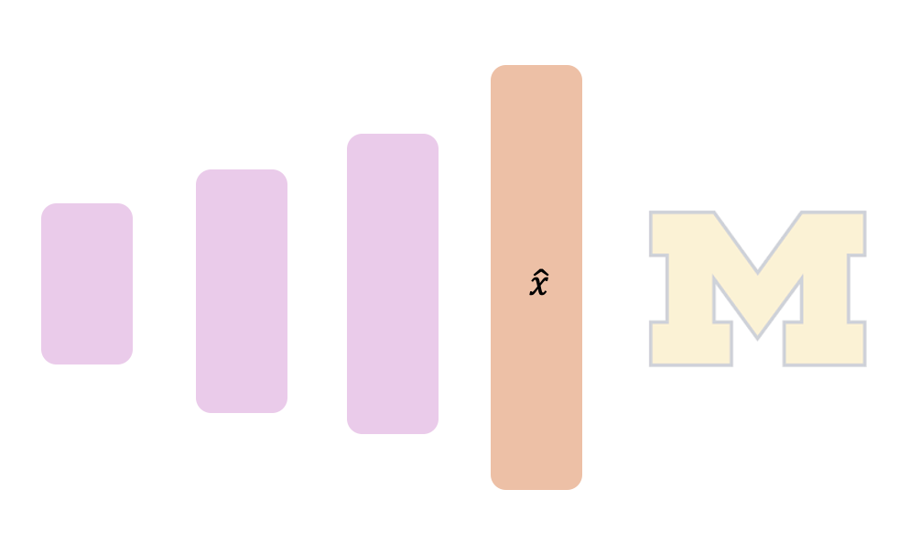



Adding stochastics …
Introduce notion of randomness to latent variable and learn the distribution of the latent variable.
$$μ$$
$$z$$
$$σ$$
Sample from the mean and standard deviation to generate new data instances
Adopted from slide of Ava Amini

Slide 17




VAE formulation
$$μ$$
$$z$$
$$σ$$
Probabilistic distributions
$$\text{Encoder} \text{maps}\text{:} q_{φ}(z|x)$$
$$\text{Decoder} \text{maps}\text{:} p_{θ}(z|x)$$
Adopted from slide of Ava Amini

Slide 18





Defining loss
$$μ$$
$$z$$
$$σ$$
$$\text{Encoder} \text{maps}\text{:} q_{φ}(z|x)$$
$$\text{Decoder} \text{maps}\text{:} p_{θ}(z|x)$$
Reconstruction loss: $ℒ\left(x, \hat{x}\right)={\left\|x −\hat{x}\right\|}^{2}$
Regularization term
The error between the input and the reconstructed output
Assuming a prior distribution
Adopted from slide of Ava Amini

Slide 19






Defining Loss: the regularization term
Inferred latent distribution:
$$q_{φ}(z|x)$$
$$μ$$
$$z$$
$$σ$$
Some fixed prior distribution (initial guess) on latent variable:
$$p(z)$$
One common example
$$p\left(z\right)= 𝒩(μ=0, σ^{2}=1)$$
A distance metric:
$${D(q}_{φ}\left(z | x\right)|| p(z)$$
KL-divergence
between the two distributions.
Adopted from slide of Ava Amini

Slide 20
Train a VAE
Potential problem during training?
We can not backpropagating gradients through stochastic layers…
Introducing reparametrizing the sampling layers

Slide 21




Reparametrizing Trick
$$μ$$
$$z$$
$$σ$$
Inferred latent distribution:
$$z \sim 𝒩(μ, σ^{2})$$
Reparametrizing the latent variable as:
A fixed $μ$
A fixed $σ$, scaled by a random constants $ε$generated from$ε\sim 𝒩(μ, σ^{2}$
Slide Credit: Ava Amini

Slide 22
In-class practice
Put it all together in PyTorch.
Train a VAE using the MNIST dataset.
Sample from latent space and decode to generate new samples

