Slide 1
Imatron Installation GUIDE

Slide 2
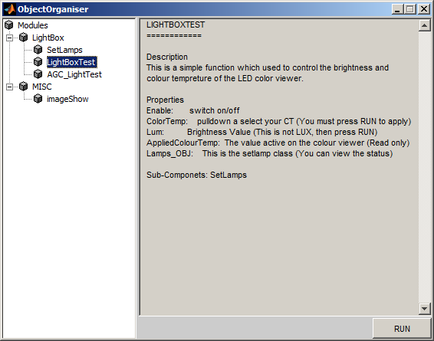
OVERVIEW
Imatron is a tool to organise matlab scripts in a convenient environment. This allow engineers that are not familiar with matlab to run a wide range of scripts used for IQ tuning. This is for internal use only and should not be shared with any customers.
Any script written in this environment should be in a convenient format to connect to the CTT.

Slide 3
Installing Imatron
Mapping the code Base
The code can be found on vc4-dev, please sync before using the tool as much as possible
//software/projects/isp_tools/cambs_matlab/
Include all the paths in matlab
Load matlab
File >> Set Path >> Add Folder with SubFolders
Select the root folder you mapped vc4 (//software/projects/isp_tools/cambs_matlab)
Run the tool
Run the following from the command prompt
Close all
Clear classes
ObjectOrganiser
Create a Shortcut (Optional but recommended)
Load matlab
File >> Set Path >> Add Folder with SubFolders
Select the root folder you mapped vc4 (//software/projects/isp_tools/cambs_matlab)

Slide 4
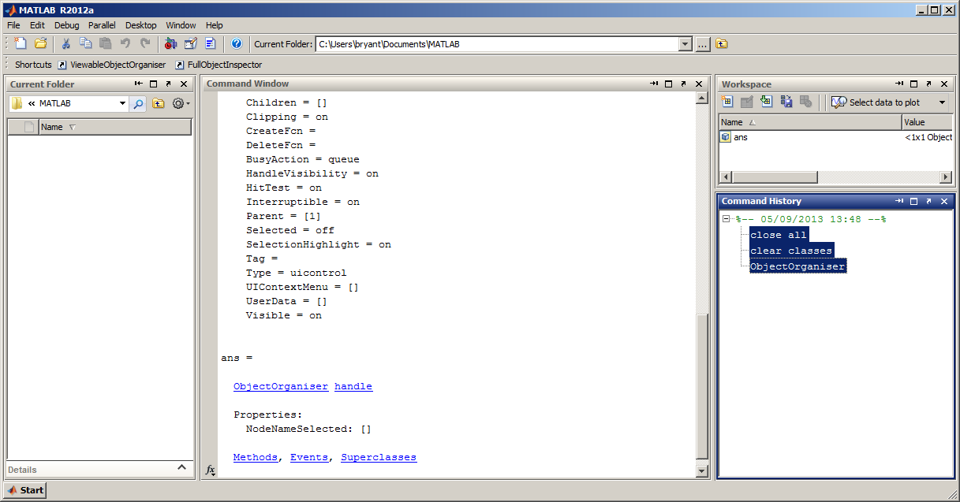
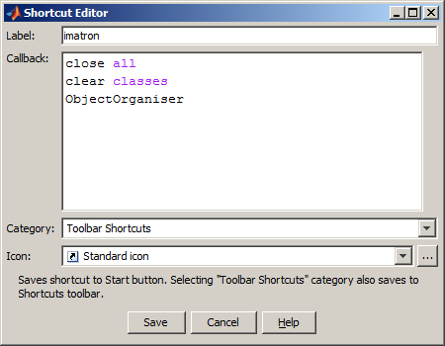
Create a short-cut
Create a Shortcut (Optional but recommended)
I find it easier to add a shortcut.
Drag and drop the command from the Command History on to the shortcuts menu bar at the top
2. Drag and drop them onto the Shortcuts menu bar
1. Select commands from the Command History
3. Type the Label “imatron”, and then click the Save button

