Slide 1
Color vibrancy
(Half or full)
Nicolas Roux Imaging Division
Processor Architecture Group
Version 1.00

Slide 2
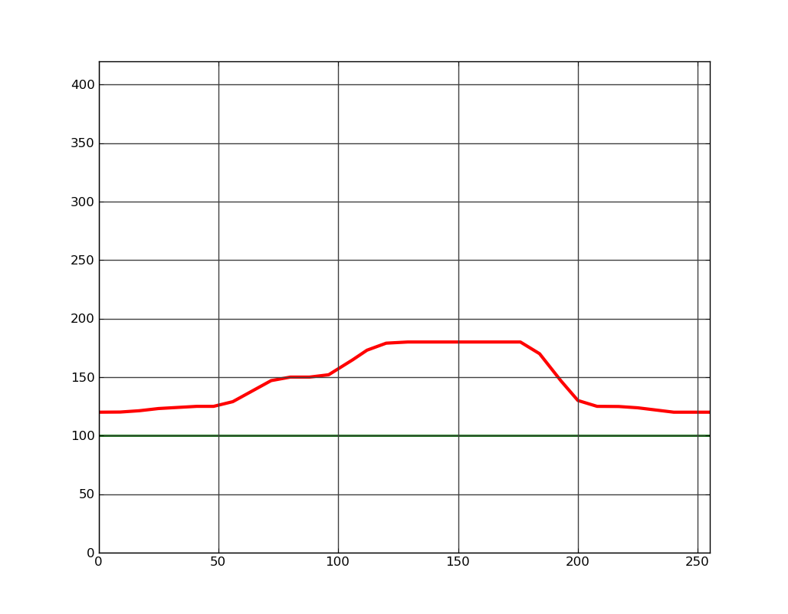
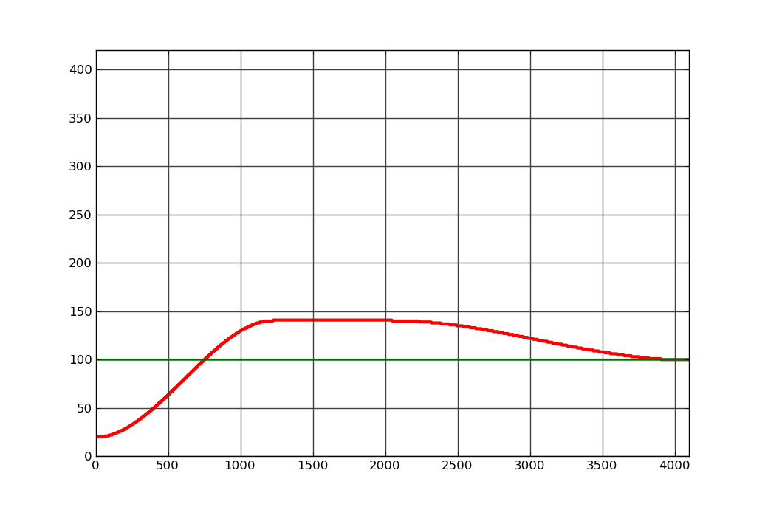
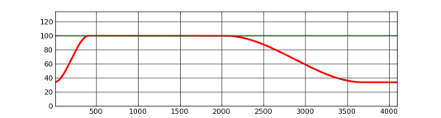
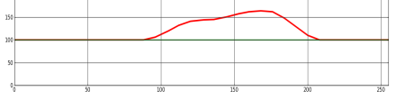
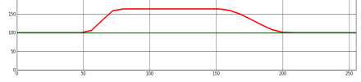
Micro-architecture: half
RGB to HSV
S_{Max}
*Clip of saturation factor is done at LUT generation.
Hue_{HSV}
YRGB to Sat_{YUV}
Sat
*
Min
Saturation_{YUV}
S_{Max}
Gain of Colour Saturation_{YUV}
RGB to Y
Luminance_{YUV}
RGB Color matrix of Saturation
HSV Saturation in RGB
RGB
RGB
RGB to HSV
S_{Max}
Hue_{HSV}
Gain of Colour Saturation_{HSV}
Min
Sat
*
Saturation_{HSV}

Slide 3
Micro-architecture: full
RGB to HSV
S_{Max}
*Clip of saturation factor is done at LUT generation.
Hue_{HSV}
YRGB to Sat_{YUV}
Sat
*
Min
Saturation_{YUV}
S_{Max}
Gain of Colour Saturation_{YUV}
RGB to Y
Luminance_{YUV}
RGB Color matrix of Saturation
HSV Saturation in RGB
RGB
RGB
RGB to HSV
S_{Max}
Hue_{HSV}
Gain of Colour Saturation_{HSV}
Min
Sat
*
Saturation_{HSV}

