Slide 1
DLS

Slide 2
PREPARING THE FILES
TERMINOLOGY
DLS: Dynamic Lens Shading
FSD: Full Scale Deflection

Slide 3
LENS SHADING
Introduction
The purpose of the lens shading stage is to remove spatial variance in pixel values across the field, caused by optical effects.
Luminance shading, or vignetting, is caused by intensity of the light incident on the photopixels. There are several apertures in the optical path, including iris, lens, lens aperture, micro lens aperture, micro-lenses and the deep-well photopixel structure. For each of these, the light intensity will vary, typically decreasing from the centre outwards.
Far-field apertures produce a relatively gentle roll-off. Rays normally incident on the deep-well photopixel will cuase the strongest reponse, which occurs in the denter of the lens, The angle of incidence descrease towards the edges of the lens, leading to weaker response, maybe about 40% of the centre. This can be modelled by a 4th order radial polynomial fit.
Near-field aperture effects are dominated by obscuring part of the light field near the edges. These cause mush sharper, and harder to model luminance functions.
The effects may have different optical centers, including the sensor centre and where readout occurs. All these effect combine produce the observed luminance shading.
Chrominance shading is caused by mainly IR cutoff filter, which has a band pass filter designed to remove the IR to which the photopixels are also sensitive. The exact passband of this filter changes with the angle of incidence, which again causes the colour of the incident light to be shifted towards the edges of the lens.

Slide 4
BLOCK DIAGRAM (VC4)
Black Level
Compensation
Lens
Shading
Compensation
IM <2448x3264>
Statistical Data
IM <2448x3264>
Frame (n-1)
Statistics.hi: FSD-20
Sat Pixel Clipper
Frame (n)
This grid is defined by the CTT tool- I can see two version on dos (win32) and a matlab script.
Pedastel: 16
Statistics.low: 30
GRID <28x22>
Does it reverse only the DLS result or DLS + old lens shading? I think it should only reverse only DLS which means this diagram is wrong? (The old lens shading algorithm does have chroma correction).
IM <2448x3264>
Averages
DLS
GRID <32x24>
(MEMORY)
LENS SHADING
TABLES
Frame (n-1)
Reverse LS
GRID <28x22>
Frame (n)
GREEN TABLE COR
Low CT Grid
High CT
Grid
GRID <28x22>
GRID <32x24>
DLS calc
GRID <32x24>
IM <16x12>
White
Balance
Frame (n)
Down
scale
Frame (n)
CT estimation

Slide 5
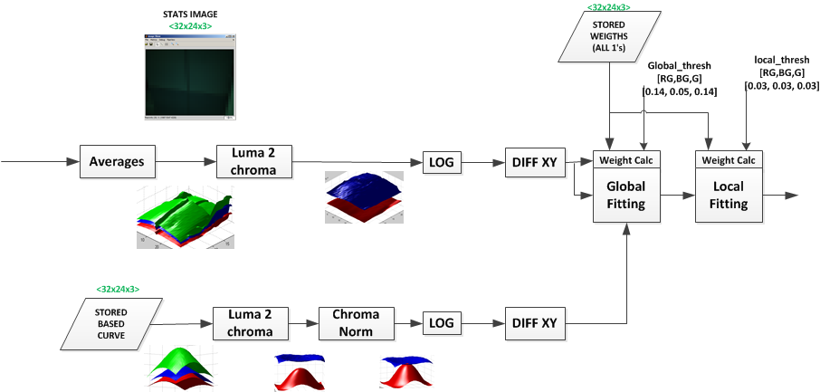
VISIO DLS CALC DIAGRAM (VC4)

Slide 6
CHANGES IN M CODE
Centre Value move to non-log world (Option)

Slide 7
FUTURE WORK
What is the name of the old lens shading algorithm?
The DXO algorithm is call ACLS? What does that stand for?
The center val calculation may suffer is the group 0 grid size is not even.
The red and blue are ignore from the calibration. This means losing the calibration data from red and blue. The NVM or old lens shading calibration is very good at removing non-radial elements of lens shading.
e.g tilt , lens centering etc. So I expected us to use this data.
It might help to denoise the derivatives

Slide 8
FUTURE WORK
V5 integration

