Slide 1
953 WB part to part
Report on White balance variation for 953.
8th September 2010
Applications team

Slide 2
Matlab Procedure Notes
20 parts were used in the simulation
Non-Biased (This represent a WB system which has no part to part compensation
Biased (This represents a WB system which uses the sensitivity compensation factors)
Noise bubble are reduce.
D65 shows no variation since this is a calibrate condition.
This simulation assumes all test stations have the same colour temperature.

Slide 3
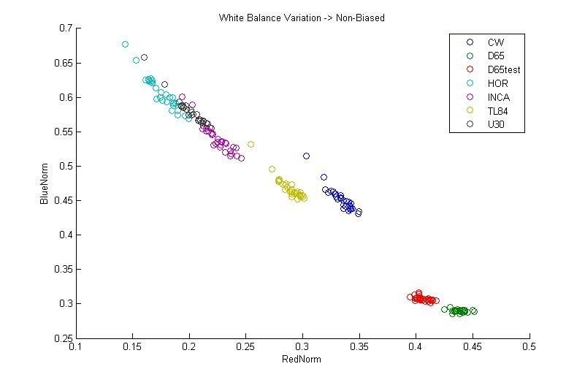
Non - Biased

Slide 4
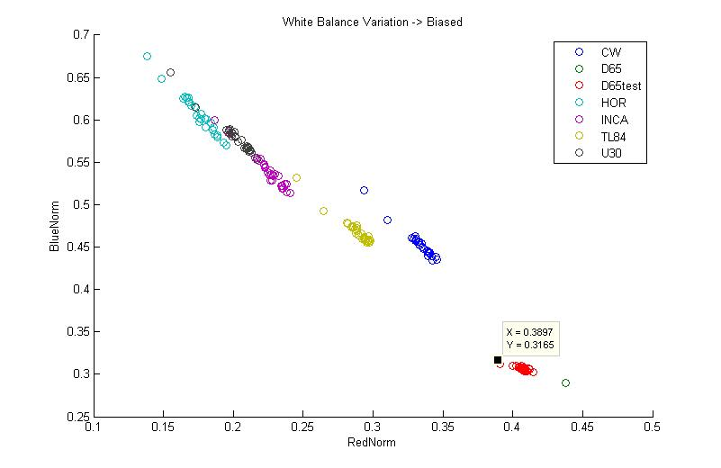
Biased
Two rogue parts in all illuminates. What are these?
On previous device I’ve test these distributions tend to be more oval in shape. The distribution observed have a large error in one dimension
BLUE
GREEN
RED
Normally distributions point towards this point. In this case the true distribution may point towards this point. However there is another more dominating error point towards the red area.
D65 has no variation since this is the calibrated condition or “anchor point”

