Slide 1
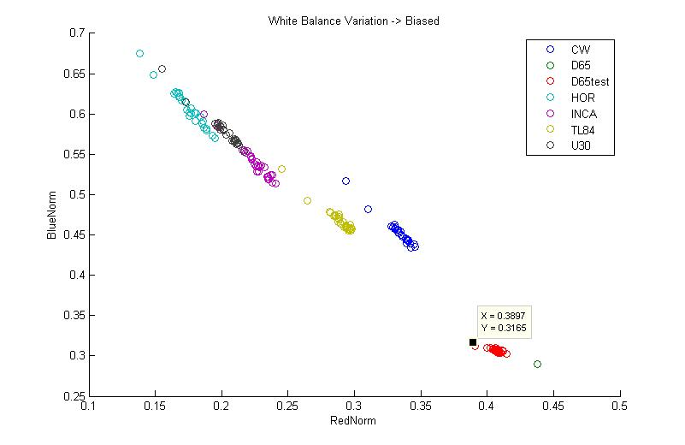
CT Estimation
CT Estimation

