Slide 1
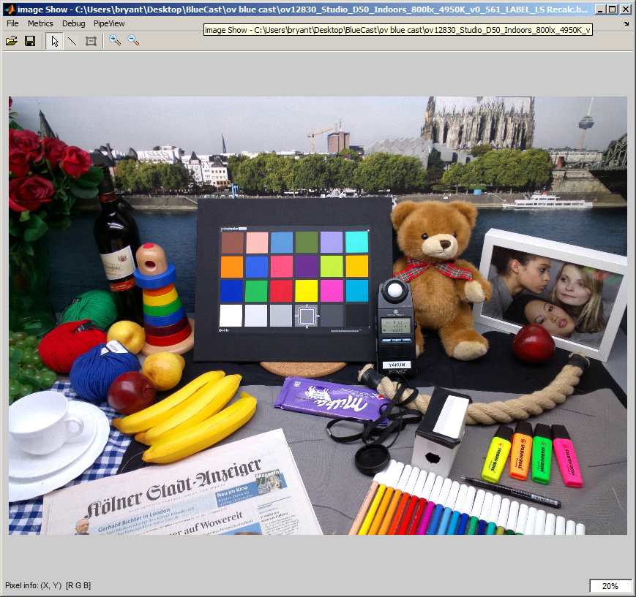
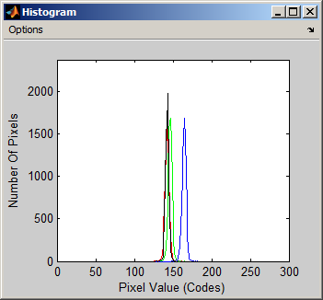
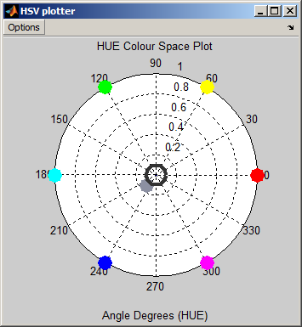
OV Blue Cast Image (From JIRA)

Slide 2
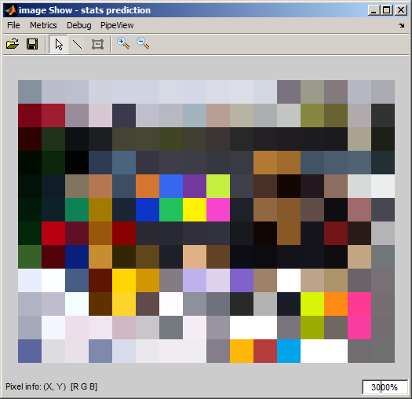
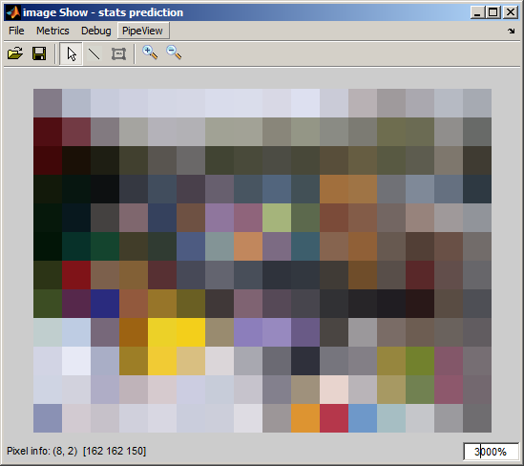
Colour Mixing Effect Of Resize (By Averaging)
METHOD: Nearest
METHOD: Bi-linear
Note:- This is not the “real” stats. I used the still image and downscaled. This should be very near the real values but may differ. This was a much quicker method to investigate the problem.

Slide 3
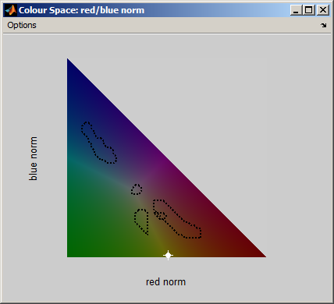

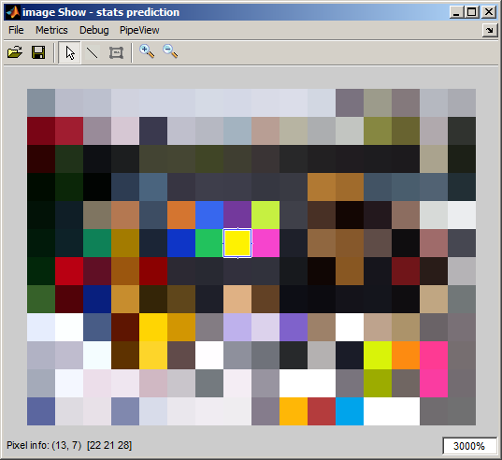
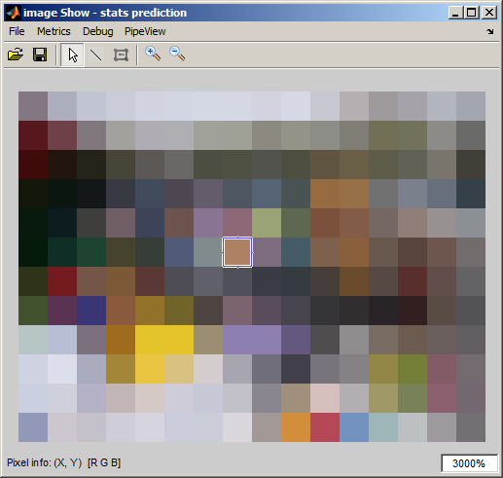
Example of colour mixing effect
Macbeth patches yellow and red are mixed to give a colour which is possibly on the black body curve.
Lots more examples like this in the stats image.
Please Note: only grey pdf is used.

Slide 4
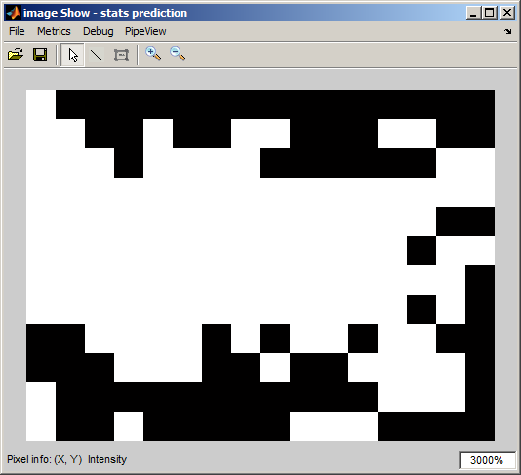
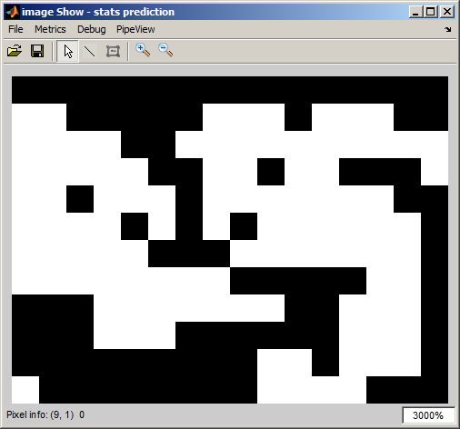
Detection Map
Each pixel has been reference to the netural pdf to see if the result has a non-zero weight. If pixel has a weight (i.e inside the neutral pdf) the image will be black. If the value has no weight then it’s outside the pdf and is displayed as white. The detection map on the nearest neighbour map show and improved detection. The averaging ethods have wrongly detected Greys across the macbeth chart.
METHOD: Nearest
METHOD: Bi-linear

Slide 5
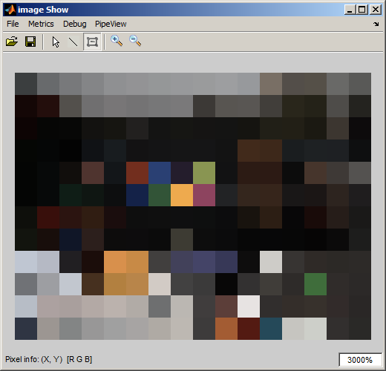
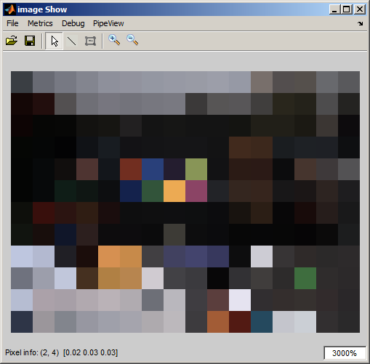
Matlab vs Simulator
METHOD: Matlab
METHOD: Reijo Simulation RGB gains
The matlab assumptions are not the same as the simulator. By working through these differences I should be able to tell what causes the blue case. The matlab simulation has a much better white balance. Next stage is to add more logging into the c simulator to check all the assumptions.

Slide 6
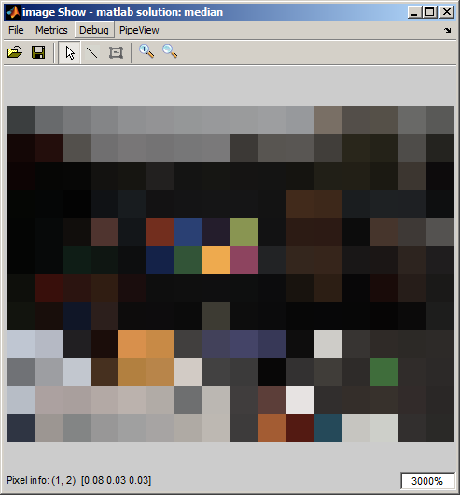
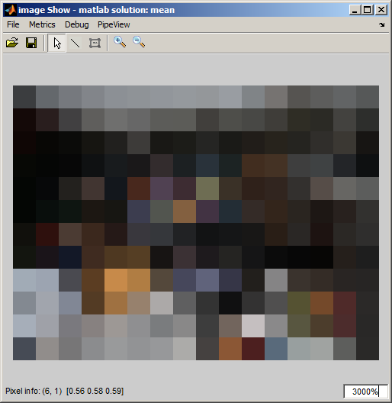
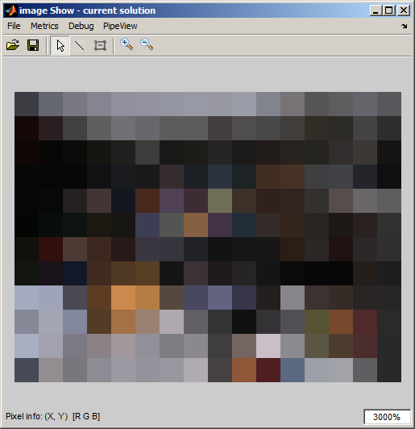
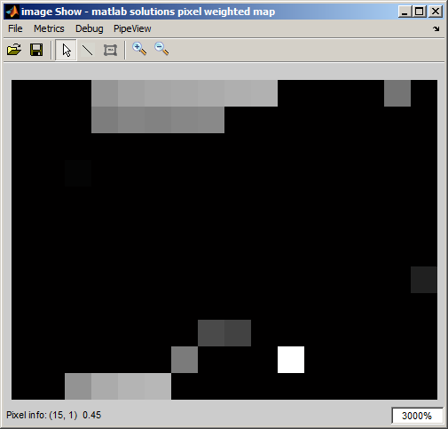
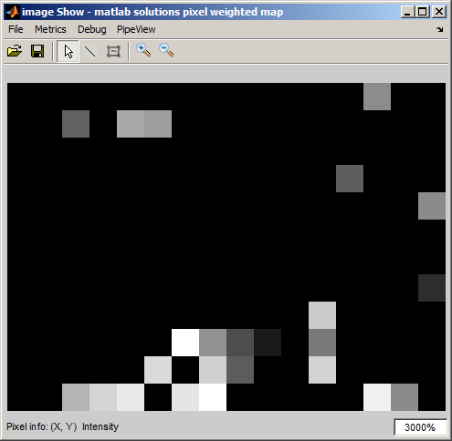
Matlab vs Simulator
Blue error reduce by 3 in sim.
median
mean
Median filtering has reduce blue error but isn’t the main issue. However I think the colour mixing may be interacting with the centre of gravity calculation.

Slide 7
Notes
This presentation is NOT the real hardware. I merely doing some quick simulations to get a feel for the problem. If we think it worth continuing then things will be added to the simulator to properly test the theory.

Slide 8
Possible Conclusions
The pdf detection map appears to improved when in nearest neighbour mode due to avoid colour mixing.
Sub-Sample or Median filter could be used to help this issue.
This may be the reason why the netural pdf is fat. (In theory only cope with rounding from the step size but it appears bigger than this)
Why Blue – Because the world is really brown.
Although I believe the average method can be replace by sub-sampling or median filter to improve the white balance performace I can’t say today this is the same problem reijo is seeing. But it feels like it’s probable.

Slide 9
Possible Future Work
Use the real wb stats, apply wb and CCMs within matlab.
Try median, sub sample, average to get wb stats.
Add test code to the simulator.

