Slide 1
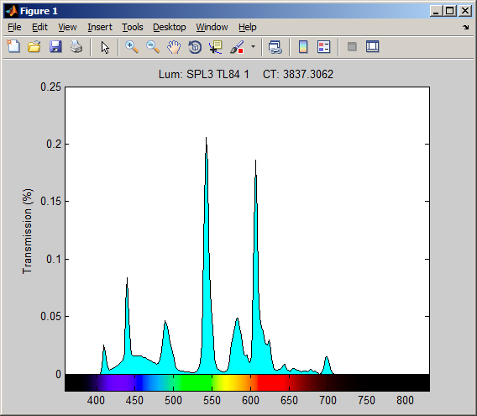
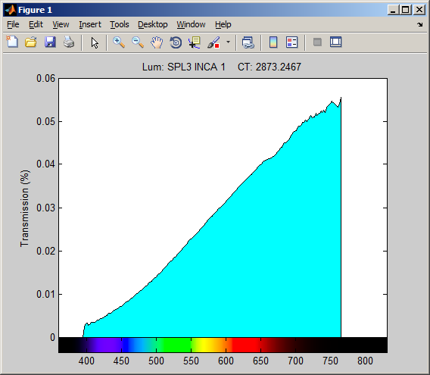
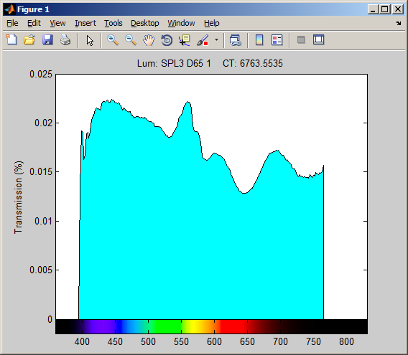
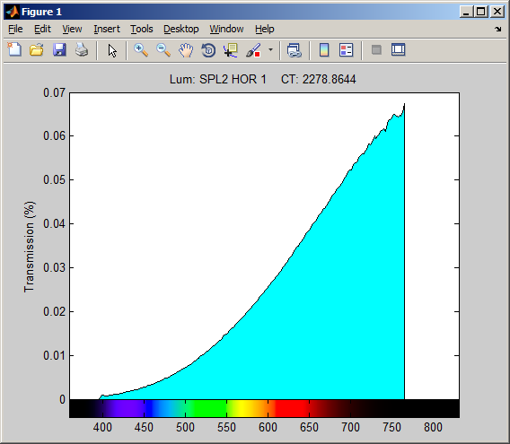

Slide 2
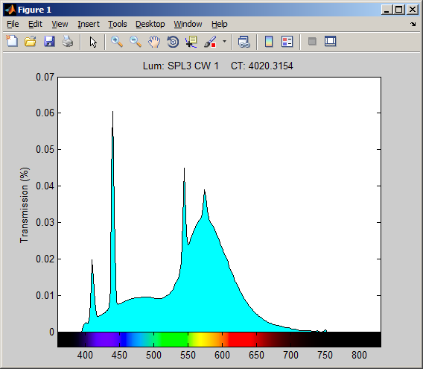

Slide 3
CT Table
Name | CT (K)
TL84 | 3837
INCA | 2873
D65 | 6764
HOR | 2279
CW | 4020
DPN 5100K | 5100

Slide 4
Probable relationship
Potentially problematic
lights under test
TL84
D65
DPN 5100K
CWF
Red
Bowl
INCA
HOR
2000K
4500K
7000K

Slide 5
Current Calibration
Potentially problematic
lights under test
TL84
D65
DPN 5100K
CWF
Red
Bowl
INCA
HOR
2000K
4500K
7000K

