Slide 1
DLS VS WB relationship

Slide 2

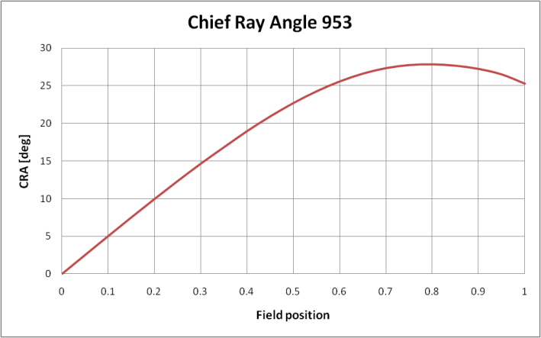
OFF Axis - Adaptive AV effect - Root cause
IR cut-off wavelength of the IR filter depends of the angle of incidence of light on the filter (as given on the top-right diagram)
In that region of the spectrum (~650nm), red pixel QE is a lot higher than green or blue pixel QEs. So if the cut-off wavelength decreases, Red pixel light level decreases more than Green and Blue pixel light levels.
The Chief Ray Angle increases with field position, and so if the difference between Red and Green RI
724 has showed less effect because CRA was less than 953 CRA (while the IR filter had the same wavelength shift).

Slide 3
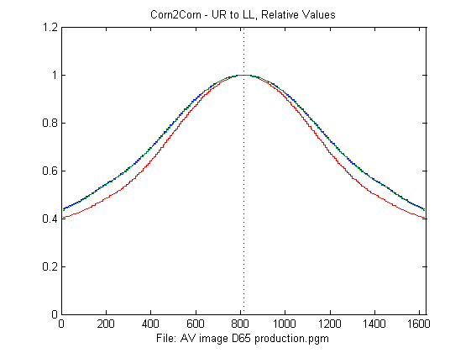
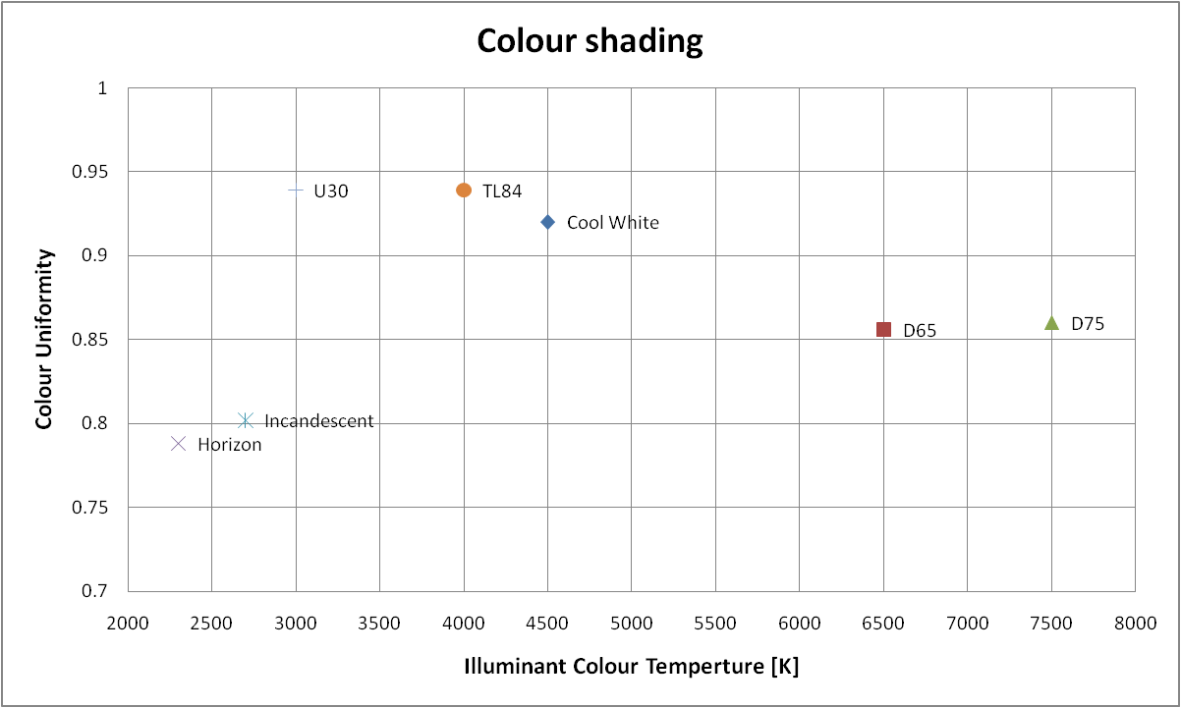
OFF Axis - Adaptive AV effect - Explained
Colour uniformity Metric (RI Ratio)
Minimum of Red RI divided by Green RI over field
=1 means that Red and Green RI overlay
<1 means that Red RI drops faster than Green higher
IR CUT-OFF RANGE
The range of values would correlate well with the “adaptive AV effect”. Minimising this range would help AV lens correction.
Fluorescents have very low energy in red near the IR cut-off frequency. This results in distinctively different AV profiles.

