Slide 1
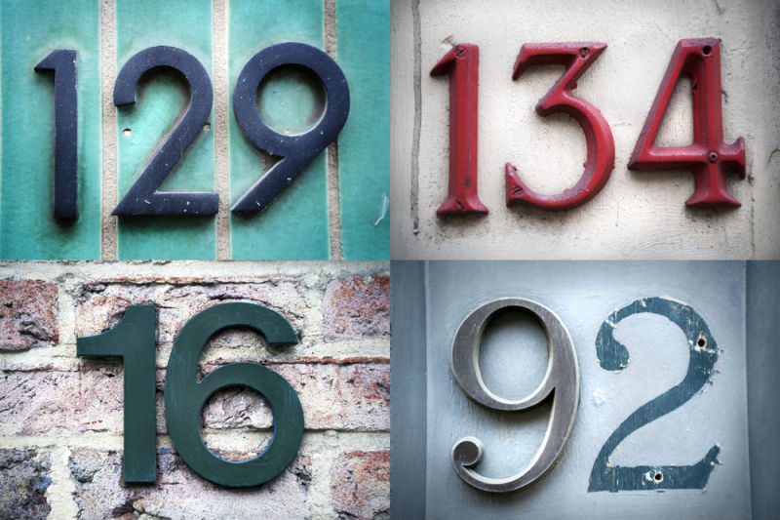
Google street view house number classification
Bryant Biggs
5th August 2016

Slide 2
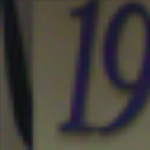


Dataset
32 x 32 Cropped Digits
 | Available | Used
Test | 73,257 | 7,326
Train | 26,032 | 2,603
Extra | 531,131 | 0
Original Full Images
10 Classes: 0-9
Source: http://ufldl.stanford.edu/housenumbers/

Slide 3
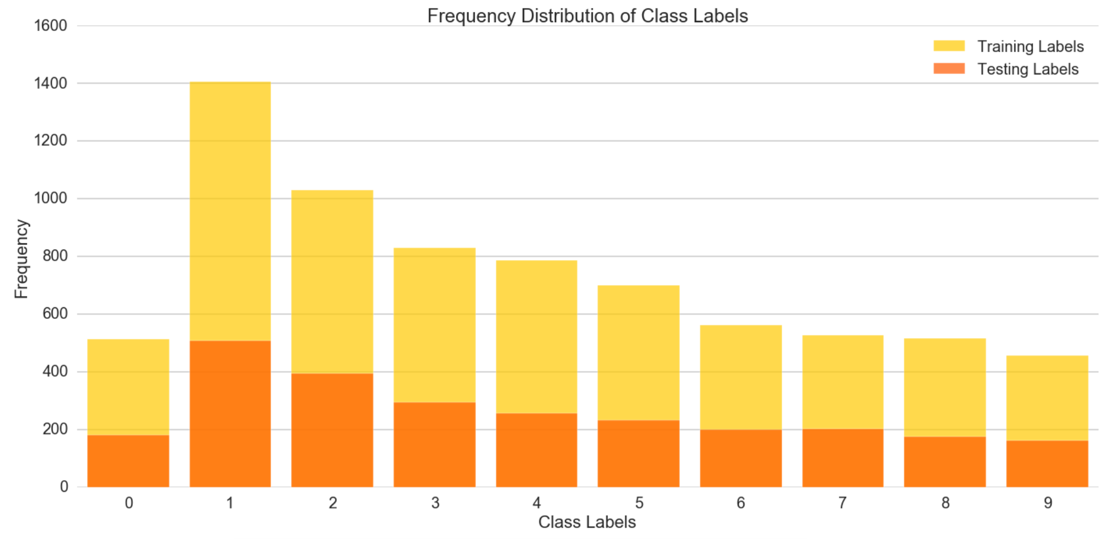
dataset

Slide 4

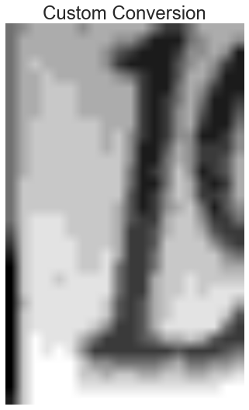




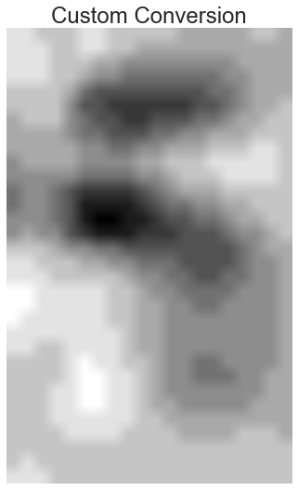



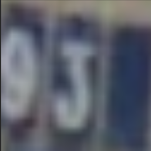

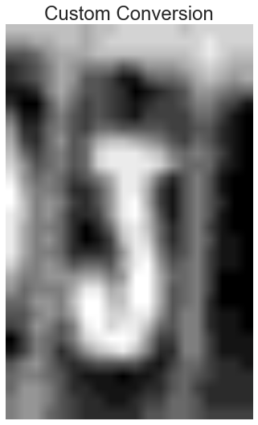



preprocess
Original
PCA
Custom
Otsu’s
AMT
AGT

Slide 5
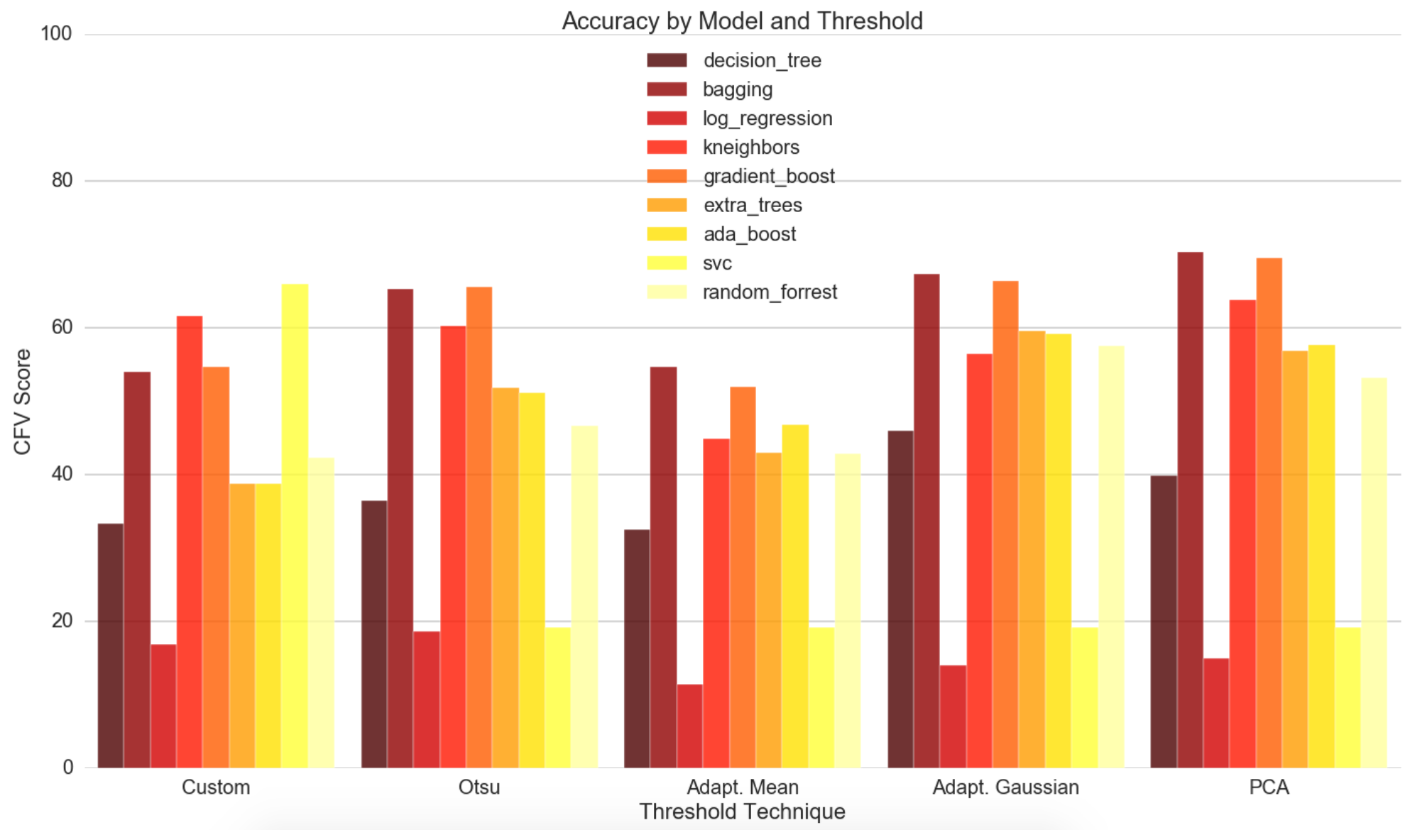
Baseline models

Slide 6
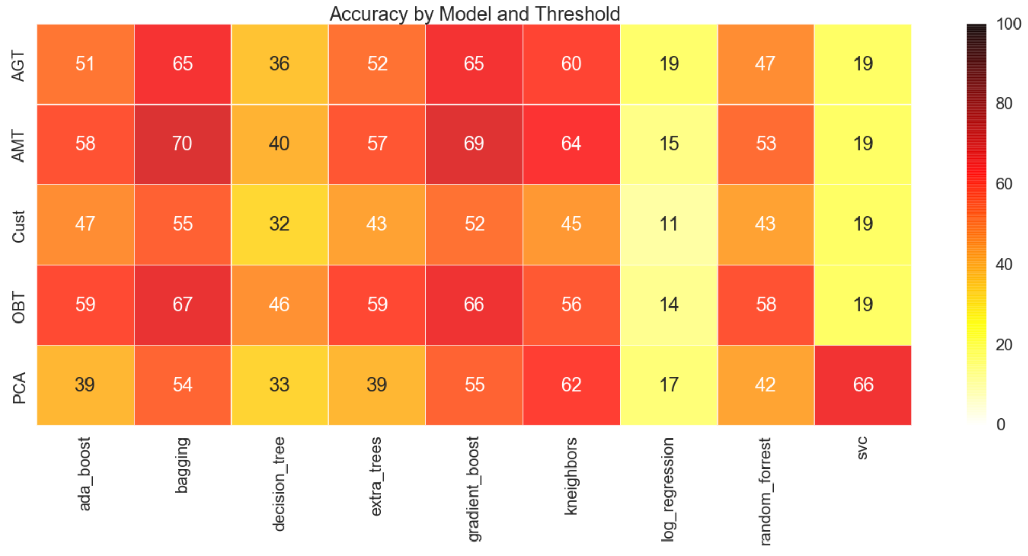
Baseline models

Slide 7
Baseline models

Slide 8
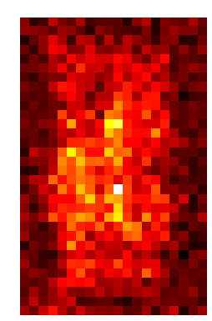
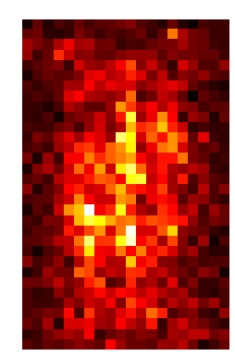
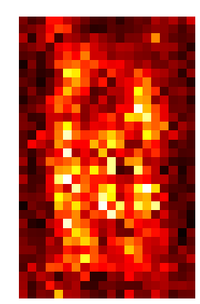
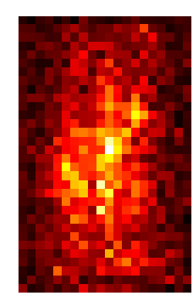
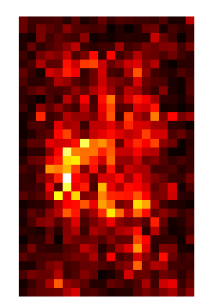
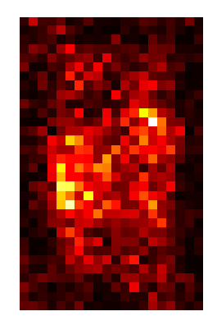
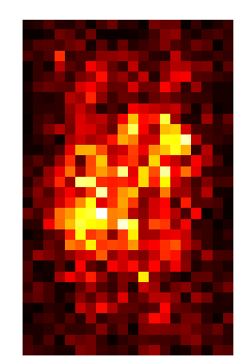
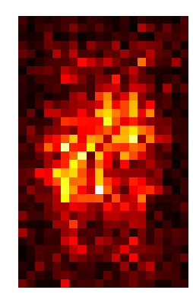
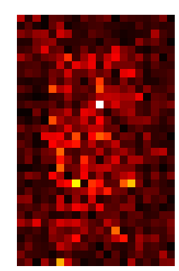
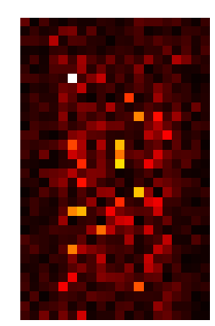
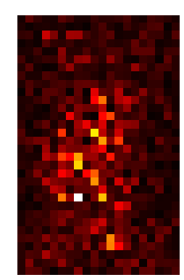
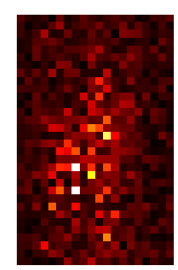
Relevant features
Relevant
Custom
Otsu’s
AMT
AGT
Extra Trees
Gradient Boost
Decision Tree
Not Relevant

Slide 9
results
GRADIENT BOOSTING CLASSIFER
USING ADAPTIVE MEANS THRESHOLDING
Labels | Precision | Recall | f1-score
0 | 0.75 | 0.66 | 0.70
1 | 0.78 | 0.87 | 0.82
2 | 0.72 | 0.85 | 0.78
3 | 0.61 | 0.63 | 0.62
4 | 0.73 | 0.72 | 0.73
5 | 0.67 | 0.72 | 0.69
6 | 0.63 | 0.59 | 0.61
7 | 0.79 | 0.68 | 0.73
8 | 0.77 | 0.51 | 0.61
9 | 0.73 | 0.58 | 0.65
Avg. | 0.72 | 0.72 | 0.72

Slide 10
Thank you

Slide 11
Top ten
 | Model | Accuracy
1 | gradient_boost_AMT | 0.719939
2 | extra_trees_AMT | 0.711103
3 | bagging_AMT | 0.699193
4 | gradient_boost_AGT | 0.689589
5 | random_forrest_AMT | 0.683826
6 | extra_trees_AGT | 0.678448
7 | ada_boost_AMT | 0.667307
8 | bagging_AGT | 0.657703
9 | ada_boost_OBT | 0.656166
10 | gradient_boost_OBT | 0.651556

