Slide 1
Balancing Act:
Sensitive Data and Accuracy in University Dropout Prediction
Bryan Chi Fai Pang
Student ID: 50120081
CIND820 Project Presentation
Supervisor: Dr Ceni BABAOGLU

Slide 2
University Student Dropout
Global dropout rate ranging from 30% OECD countries to 50.9% in Costa Rica
North American Context:
Canada: Up to 20% of students quit, 20%-50% of students change initial program.
Canadian workers in their 40s with degrees earn 53% (Cdn $13) per hour more
In US, eight year difference in term of life expectancy between degree holder and non degree holders

Slide 3
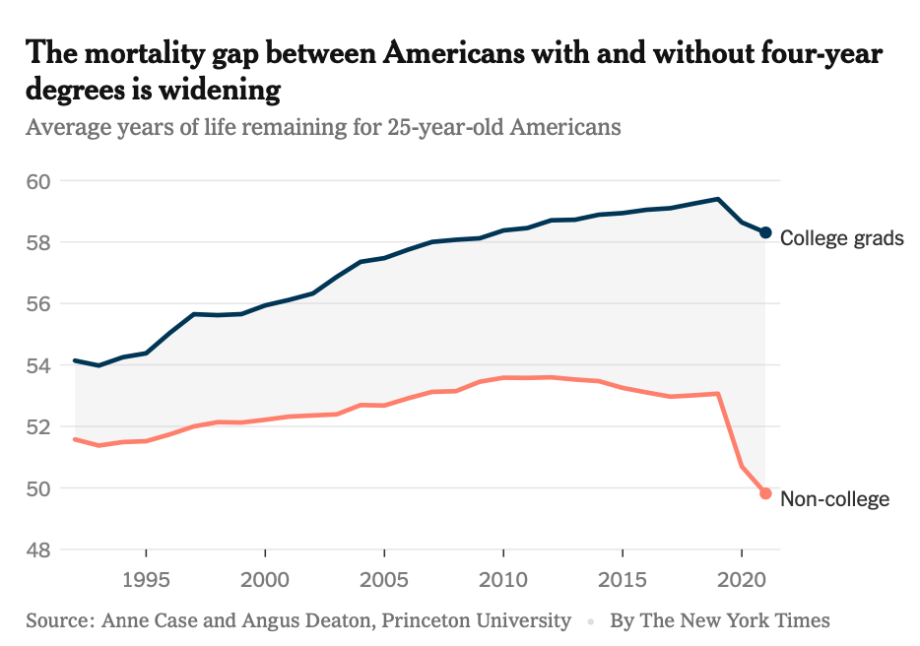

Slide 4
States and shortcomings of University Student Dropout Prediction in Machine Learning
While all the studies confirm the effectiveness of data mining and ML approach in predicting dropout…
YET:
They focus on algorithms and not on feature space…
CONCERNS:
Use of sensitive features: Is it necessary ?

Slide 5

Two studies focused on Algorithm Fairness and Model Performance
Deho, O. et al. (2023). Should Learning Analytics Models Include Sensitive Attributes? Explaining the Why.
Yu, Renzhe, et al. (2021). Should College Dropout Prediction Models Include Protected Attributes?
Protected attribute Binary = Male, Female, High Income / Low Income, etc
Privileged Class Male vs Female
Favorite Outcome Likely to Dropout / Graduate
Comparison Based on Blind and Aware Dateses
Features are considered as isolation instance, rather than part of a cluster.
Up to 4 features are excluded in these two studies and both study show no significant difference in model performance.

Slide 6
Research Question:
Attribute Types and Prediction Performance in University Dropout
How do different types of attributes impact the performance of student dropout prediction models?
What are the consequences of including or excluding specific classes of features on the accuracy of student dropout predictions?
Features are considered a clustered set, grouped by their nature.
Models are trained by different subsets and their performance compared.

Slide 7
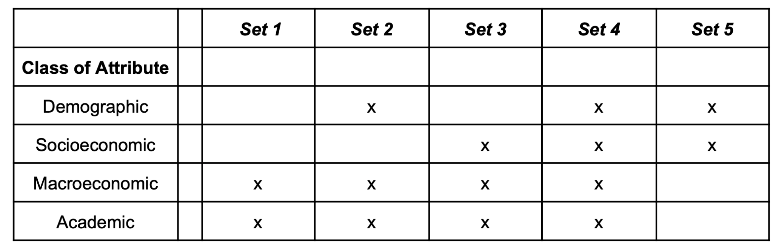

Slide 8
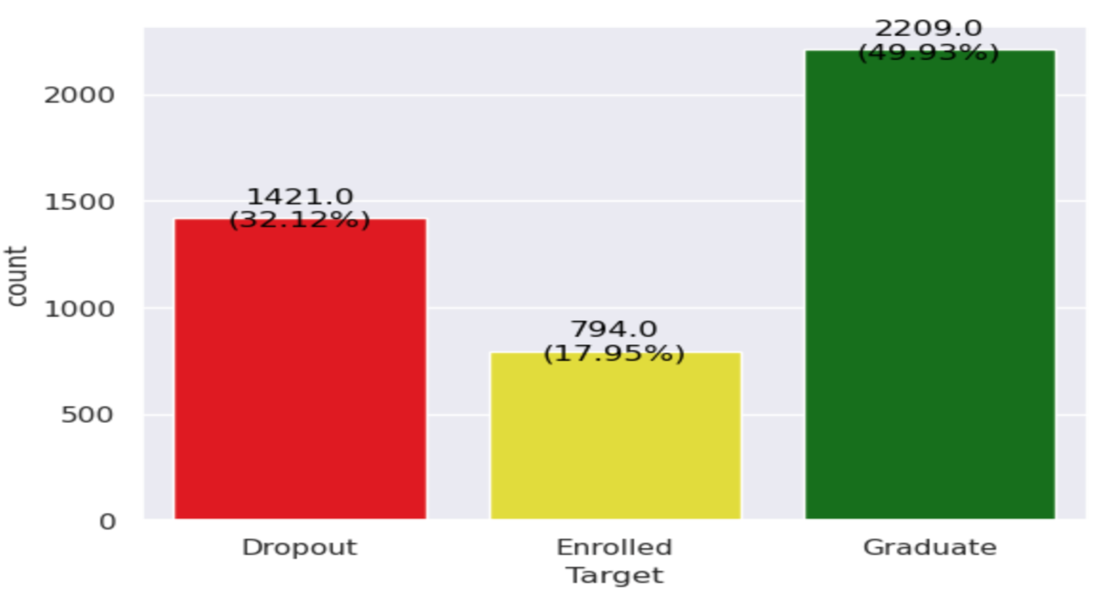
Valentim Realinho’s dataset: 4424 students and 35 attributes, presented as a paper and available in UC Irvine Machine Learning Repository
Rich in features
Demographic (6 features)
Socioeconomic (8 features)
Macroeconomic (3 features)
Academic (17 features)
Target is three classes (Dropout, Enrolled, Graduate)

Slide 9
Methodology
Dataset is split into Train/validation set (TV set) (80%) and Test Set (20%)
Algorithms Selection: Cross validation with TV set (Random Forest n=10, RF n=100, Support Vector Machine, SVC kernel linear, Gradient Boosting, XGB Booster)
Best three are used, based on Average F1 and Average Accuracy

Slide 10
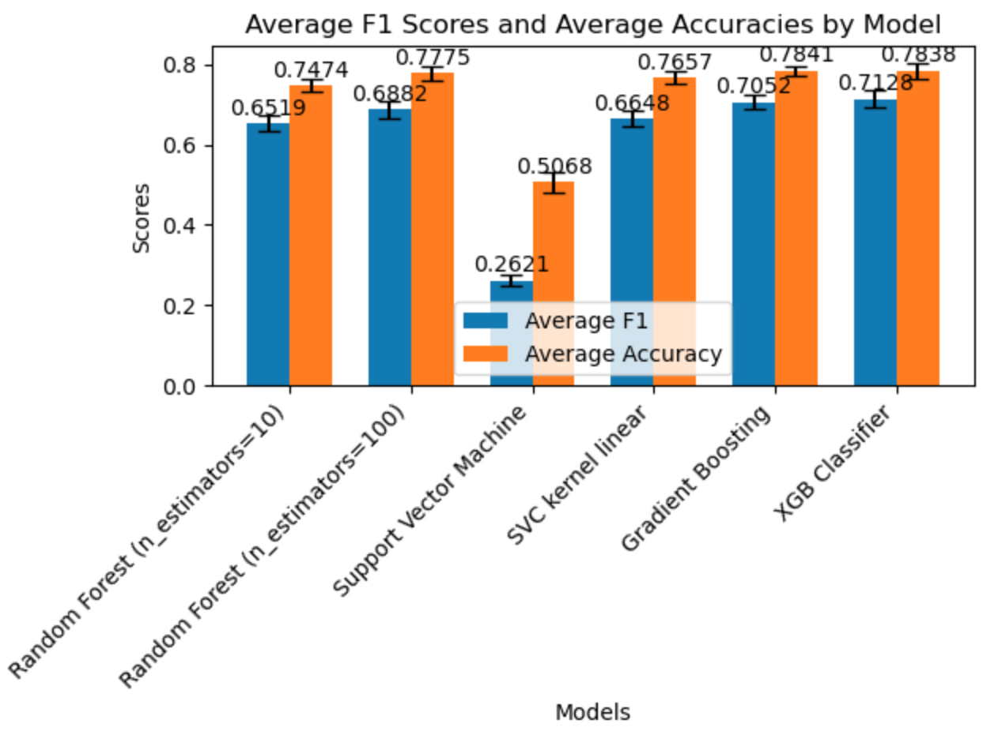

Slide 11
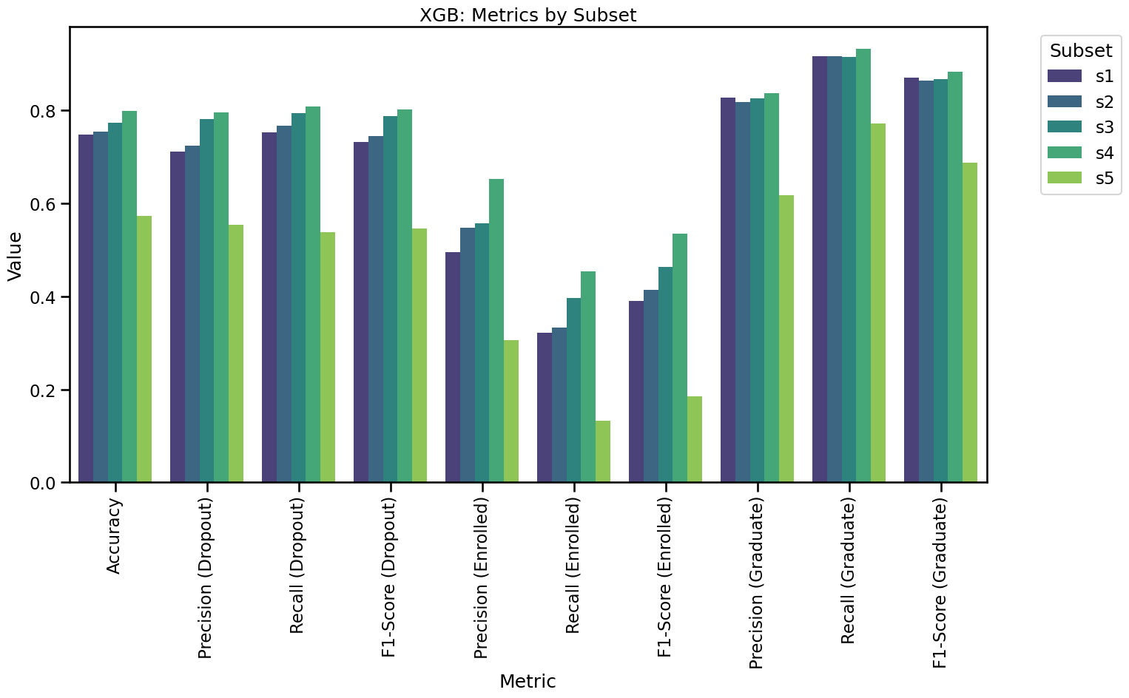

Slide 12
Results:
Model trained using Academic and Macroeconomic data (s1) performs well at 74.71 % accuracy.
Model with additional Demographic data (s2) shows slight improvement at 75.40% accuracy (0.69 % )
Model with baseline and additional socioeconomic data (s3) shows (2.65% increase) at 77.36% accuracy.
Model with all the data (s4) performs best, with 79.89% accuracy (5.1% increase)
Model with just demographic and socioeconomic data shows worst performance 57.24% accuracy ( decrease in 17.47%)

Slide 13
Precision and Recall and Classes
Graduate: 80% Precision and 90% in Recall throughout s1-s4
Dropout: 70-80% both Precision and Recall s1-s4
Enrolled: 50-65 % Precision, 32-45% in Recall s1-s4

Slide 14
Discussions
Use of demographic and socioeconomic data increases model accuracy by 5% in XGBoost Model, comparing to using to using only academic and macroeconomic data alone.
However, the increase of performance is achieved through addition of 14 features, many of them can be considered sensitive and unrelated to academic performance.

Slide 15
Achievement of the study
Refocus on the feature space and features rather than algorithms used.
Demonstrate that reasonable good model can be developed with academic data alone.
Contribute to study of use of AI Fairness and ML-based decision making in Dropout Prediction and informed decision in the use of sensitive features in dropout prediction.

Slide 16
Limitations of study and scope for further research
The target of the dataset is three classe, whereas all of the studies reviewed are binary classification.
Complexity of the methodology: three models, 5 subsets and three classes. A simpler approach (two subset and 2 class models) would be easier to understand and execute.

