Slide 1
Balancing Act:
Sensitive Data and Accuracy in University Dropout Prediction
Bryan Chi Fai Pang
Student ID: 50120081
CIND820 Project Presentation
Supervisor: Dr Ceni BABAOGLU
Notes:
Good Afternoon, my name is Bryan Pang and the title of my project is Balancing Act: Sensitive Data and Accuracy in University Dropout Prediction.
WHY STUDY STUDENT DROPOUT

Slide 2
University Student Dropout
Global dropout rate ranging from 30% OECD countries to 50.9% in Costa Rica
North American Context:
Canada: Up to 20% of students quit, 20%-50% of students change initial program.
Canadian workers in their 40s with degree earn 53% (Cdn $13) per hour more
In US, eight year difference in term of life expectancy between degree holders and non degree holders
Notes:
Here are some reasons:
First of all, It is a global phenomenon - ranging from 30% student dropout in OECD to 50.9 % in Costa Rica.
#It affect university administration in terms of resource planification. On the student side,
In a North American context, 20% Canadian students started,univerisy but do not finish, and without a degree, they, on average, earn 53% less than someone with a degree.
.

Slide 3
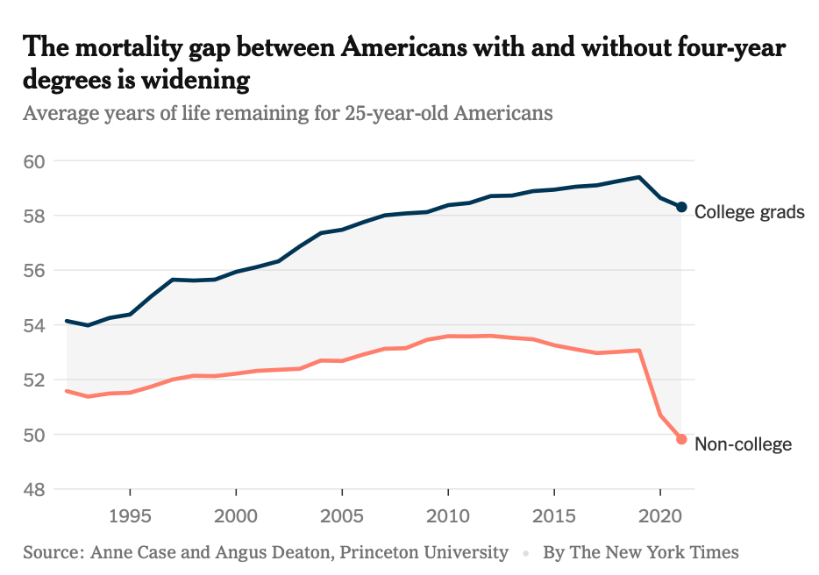
Notes:
In America, on average, someone with a degree lives 8 years longer than someone without a degree (83 vs 75) and this mortality gap is actually widening.

Slide 4
States and shortcomings of University Student Dropout Prediction in Machine Learning
While all the studies confirm the effectiveness of data mining and ML approach in predicting dropout…
YET:
They focus on algorithms and not on feature space…
CONCERNS:
Use of sensitive features: Is it necessary ?
Notes:
Given the importance of having degree and the fact that university routinely collect student’s data, it is not surprising that there are many studies on using machine learning to predict student dropout.
Here are some observation of these studies.
There is a consensus that Machine Learning is effective in predicting student dropout.
However, a majority of these studies focus on the algorithms used, features, themselves,on the other hand, are often taken a backseat
When the features are mentioned
It is in the context of AI fairness, the possibility of discrimination and the question : is the use of protected feature necessary ?

Slide 5

Two studies focused on Algorithm Fairness and Model Performance
Deho, O. et al. (2023). Should Learning Analytics Models Include Sensitive Attributes? Explaining the Why.
Yu, Renzhe, et al. (2021). Should College Dropout Prediction Models Include Protected Attributes?
Features are considered as isolation instances, rather than part of a cluster.
Up to 4 features are excluded in these two studies and both show no significant difference in model performance.
Aware Model | Blind Model
All the features | Excluding gender, age, disability, home language
Notes:
We have come across two studies that focus sensitive features and model performance.
In both studies, comparison between two models: one trained with all the features, the aware model, and blind model, in which 4 protected features such as aged, disability removed
In both studies, the findings are that there are no difference in performance between aware and blind model.
Suggesting personal information may not be necessary

Slide 6
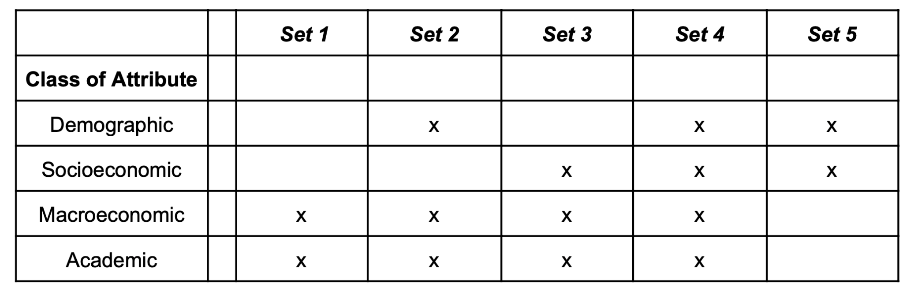
Notes:
We ask yourself, can we follow this line of inquiry and expand them: and instead of just excluding 4 features only can we exclude all the demographic and socioeconomic data and still have models that are effective.
In order to do that, we classify feature into 4 categories. Demographic soceniom, macrocenomi and academic
We constructed 5 subset of data, varying the class of feature they contain.
Baseline, S1, contain macroeconomic and academy data.
Set 2, demographic data is added to the baseline,
Set3, socioeconomic data add to the baseline,
S4, with all the feature.
S5, with only demographic and socioeconomic data.

Slide 7
Research Question:
Attribute Types and Prediction Performance in University Dropout
What are the consequences of including or excluding specific classes of features on the accuracy of student dropout predictions?
Models are trained by different subsets and their performance compared.
Notes:
How do different types of attributes impact the performance of student dropout prediction models?
What are the consequences of including or excluding specific classes of features on the accuracy of student dropout predictions?

Slide 8
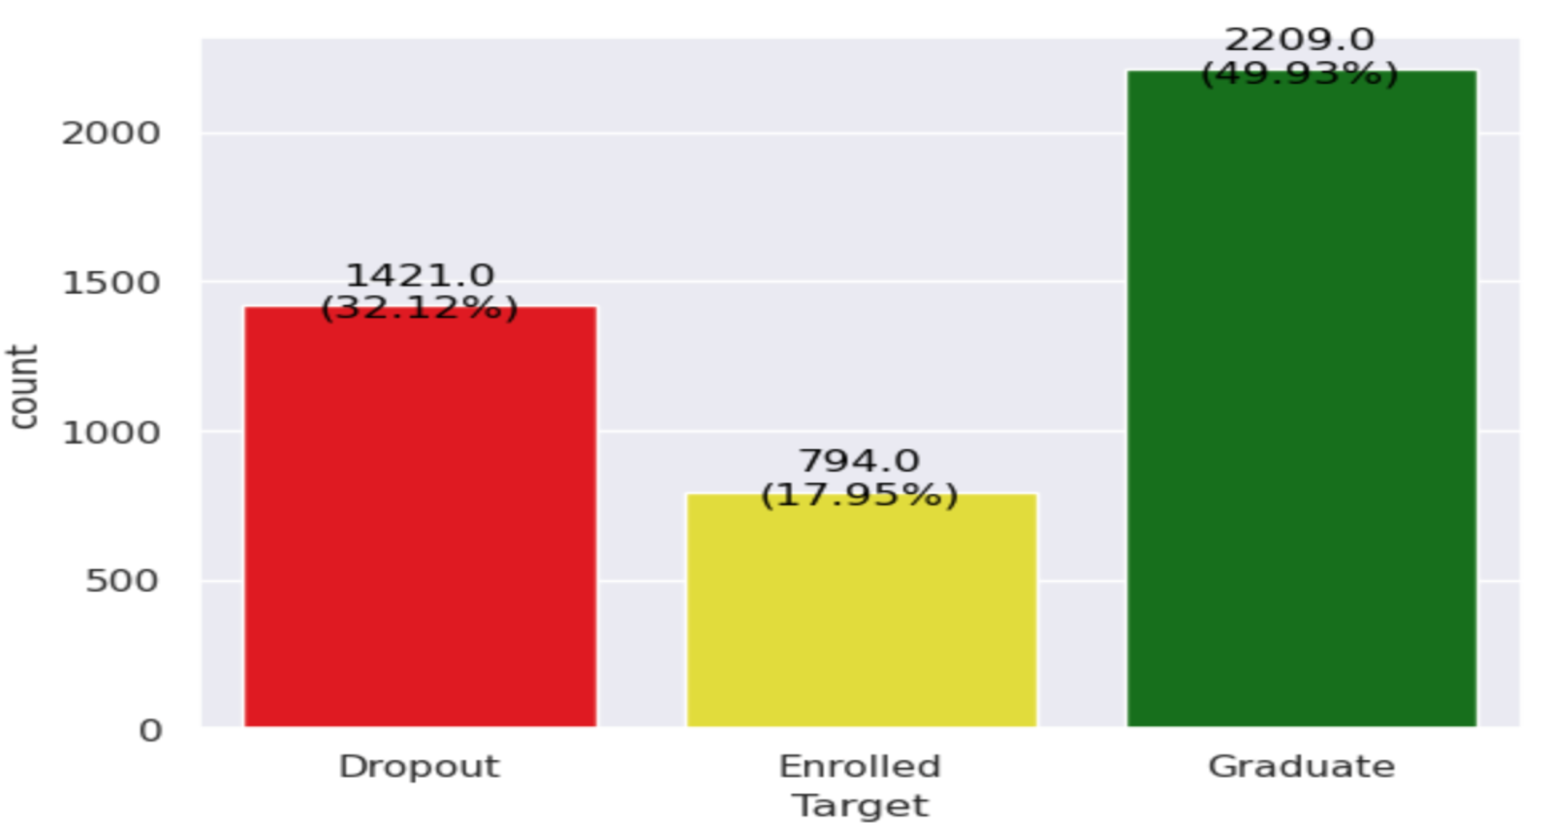
Valentim Realinho’s dataset: 4424 students and 35 attributes, presented as a paper and available in UC Irvine Machine Learning Repository
Rich in features
Demographic (6 features)
Socioeconomic (8 features)
Macroeconomic (3 features)
Academic (17 features)
Target is three classes (Dropout, Enrolled, Graduate)
Notes:
We have used Realinho’s dataset which 4424 students and 35 features. Which is available in UC Irving Machine Learnig Reposinbery
We have selected because it is rich in the 4 classes of feature.
And Target is defined at the end of year three, do the student dropout, enrolled and graduate.
There is also a target in imbalance, 32% 18% and 50%

Slide 9
Methodology
Dataset is split into Train/validation set (TV set) (80%) and Test Set (20%)
Algorithm Selection: Cross validation with TV set (Random Forest n=10, RF n=100, Support Vector Machine, SVC kernel linear, Gradient Boosting, XGB Boost)
Best three are used, based on Average F1 and Average Accuracy
Notes:
Dataset is split into train validation set and test set (80% and 20%)
6 potential model are considered using 10-fold cross validation
2 random forest, Support Vector Machine, SVC Kernel, Gradien Boosting and XGBooster.
The 3 model with the highest F1 and accuracy are selected.

Slide 10
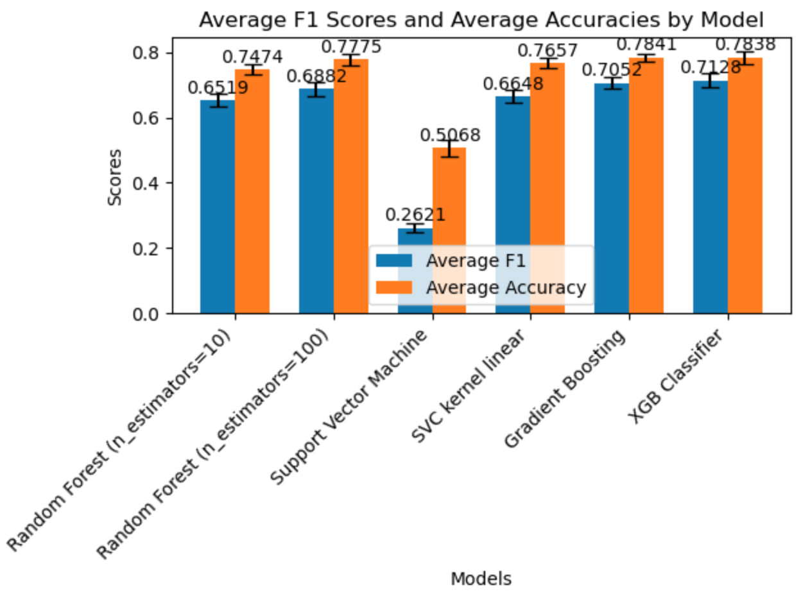
Notes:
(2 Random Forest, Support Vector Machine, SVC Kernel, Gradien bososting and XGBoost)
Dataset is split into train validation set and test set (80% and 20%)
6 potential model are consider uisg CV with the trainist set.
2 random forest, Support Vector Machine, SVC Kernel, Gradien Boosting and XGBoost.
The 3 model with the highest F1 and accuracy are selected.
And they are Random Forest, Gradient Boosting and XGBoost Classier.

Slide 11
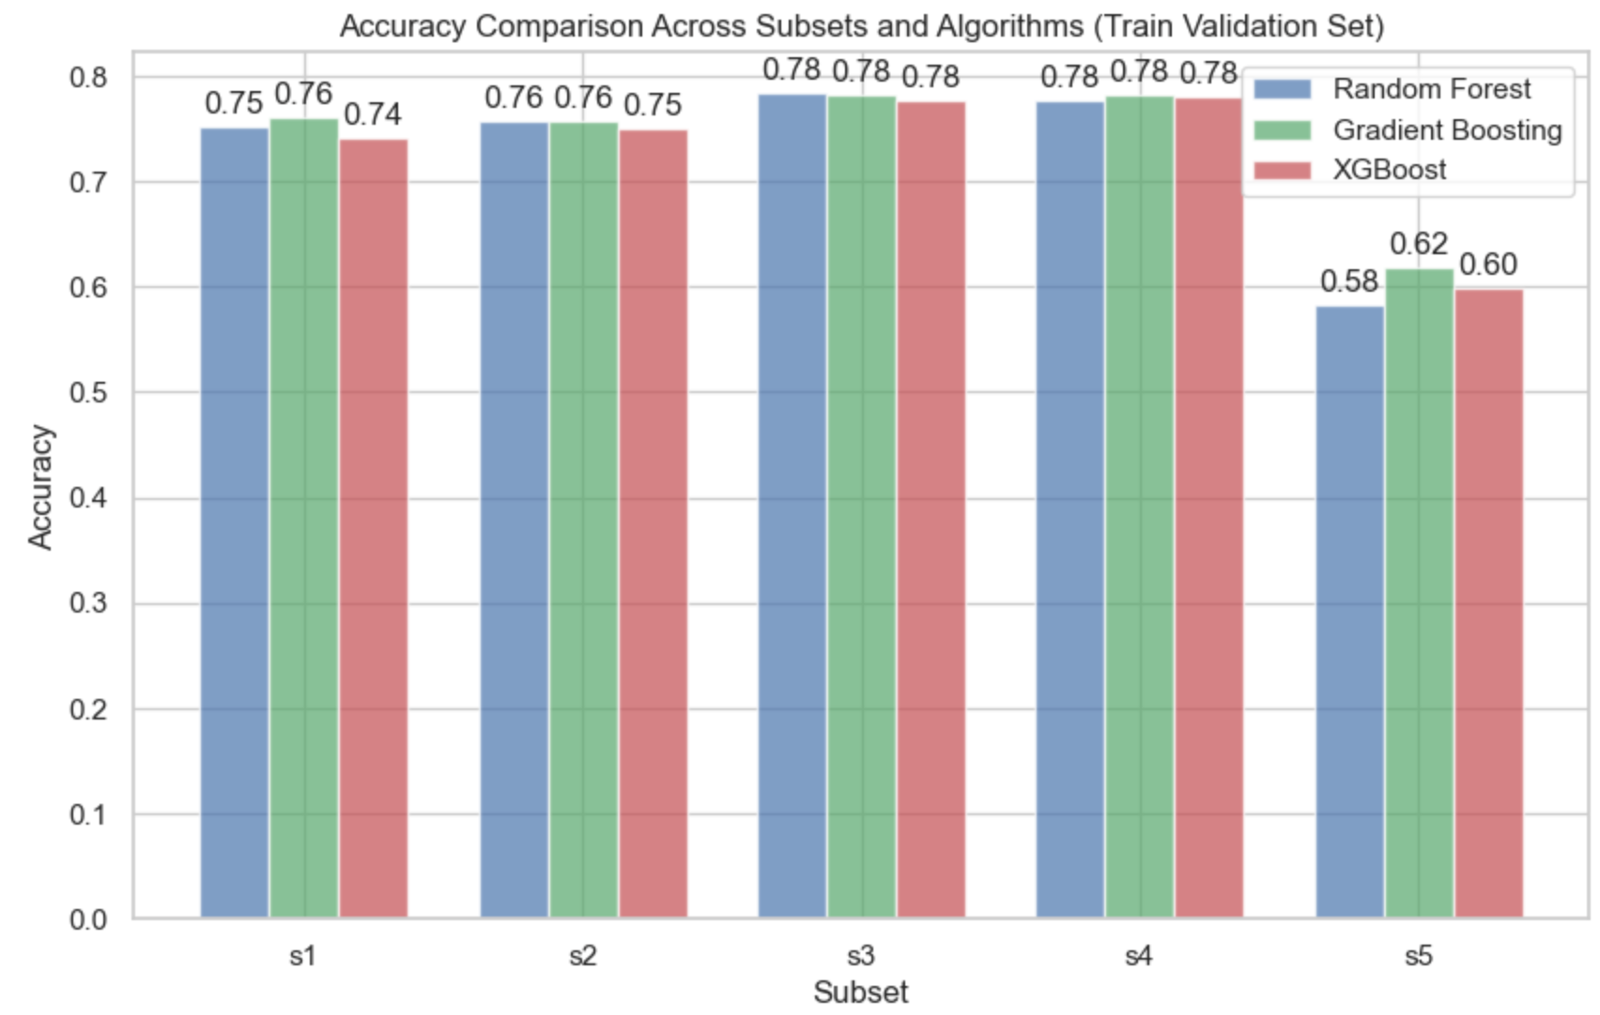
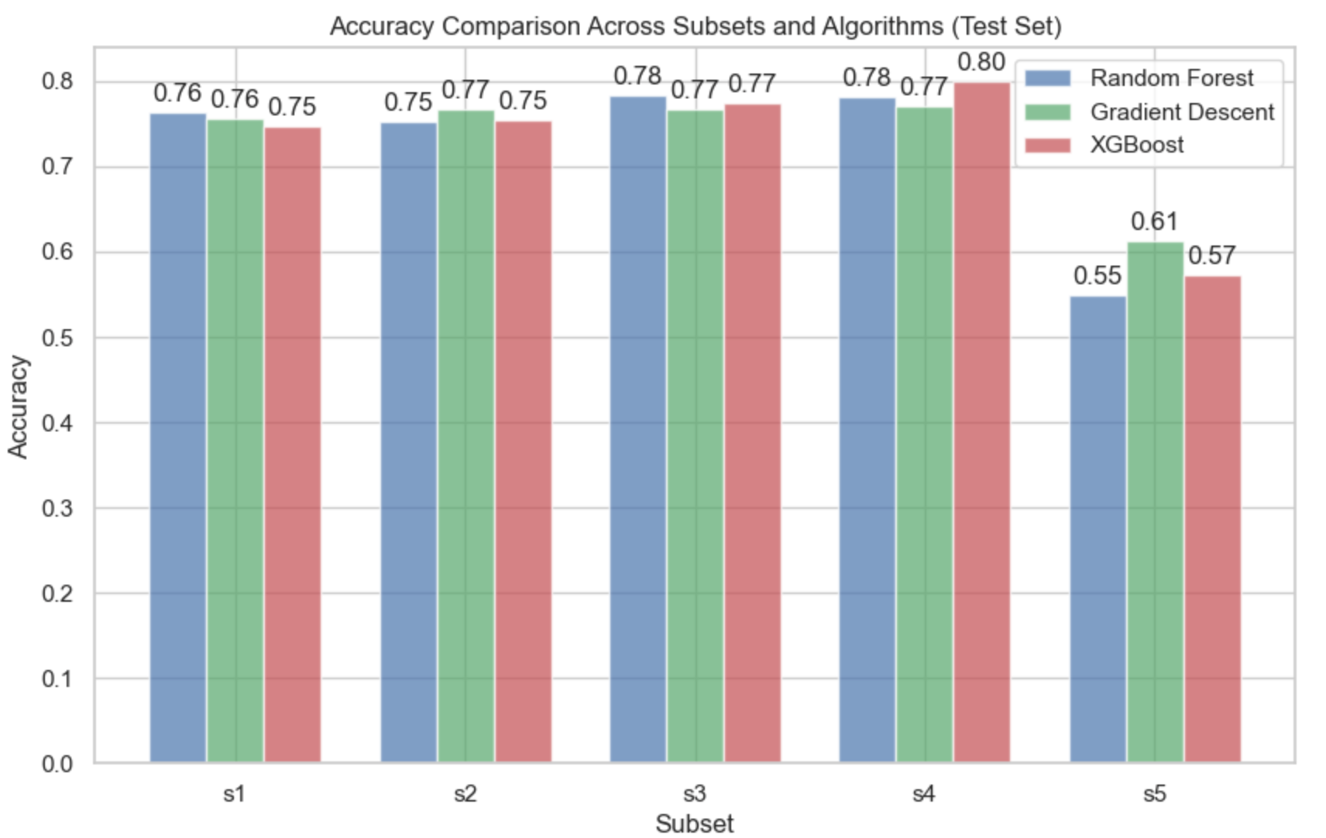
Notes:
Here are the accuray of of training set and test set with these three model.
As you can see, they are very similar so I will use the test set data to explain our finding.
Which is on righ hand side and I will ues the XGBoost model.
Our baseline with academic and macroeconmi data, perform really well with 75 accuracy. (s1)
Adding demographic data on the baseline, (s2) dosn’t change the accuracy.
S3, base

Slide 12
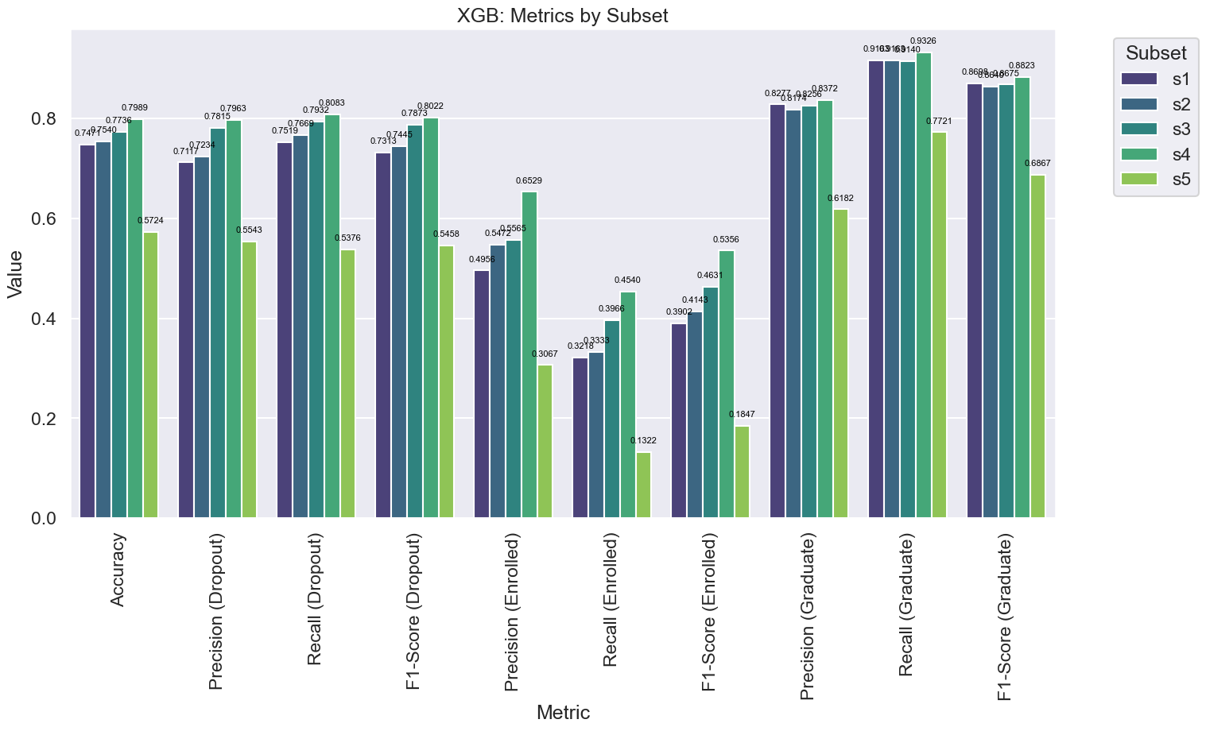
Notes:
Results:
Model trained using Academic and Macroeconomic data (s1) performs well at 74.71 % accuracy.
Model with additional Demographic data (s2) shows slight improvement at 75.40% accuracy (0.69 % )
Model with baseline and additional socioeconomic data (s3) shows (2.65% increase) at 77.36% accuracy.
Model with all the data (s4) performs the best, with 79.89% accuracy (5.1% increase)
Model with just demographic and socioeconomic data shows the worst performance 57.24% accuracy ( decrease in 17.47%)
Precision and Recall and Classes
Graduate: 80% Precision and 90% in Recall throughout s1-s4
Dropout: 70-80% both Precision and Recall s1-s4
Enrolled: 50-65 % Precision, 32-45% in Recall s1-s4

Slide 13
Results:
Model trained using Academic and Macroeconomic data (s1) performs well at 74.71 % accuracy.
Model with additional Demographic data (s2) shows slight improvement at 75.40% accuracy (0.69 % )
Model with baseline and additional socioeconomic data (s3) shows (2.65% increase) at 77.36% accuracy.
Model with all the data (s4) performs the best, with 79.89% accuracy (5.1% increase)
Model with just demographic and socioeconomic data shows the worst performance 57.24% accuracy ( decrease in 17.47%)
Notes:
Results:
Model trained using Academic and Macroeconomic data (s1) performs well at 74.71 % accuracy.
Model with additional Demographic data (s2) shows slight improvement at 75.40% accuracy (0.69 % )
Model with baseline and additional socioeconomic data (s3) shows (2.65% increase) at 77.36% accuracy.
Model with all the data (s4) performs the best, with 79.89% accuracy (5.1% increase)
Model with just demographic and socioeconomic data shows the worst performance 57.24% accuracy ( decrease in 17.47%)

Slide 14
Precision and Recall and Classes
Graduate: 80% Precision and 90% in Recall throughout s1-s4
Dropout: 70-80% both Precision and Recall s1-s4
Enrolled: 50-65 % Precision, 32-45% in Recall s1-s4

Slide 15
Discussions
Use of demographic and socioeconomic data increases model accuracy by 5% in XGBoost Model, comparing to using only academic and macroeconomic data alone.
However, the increase of performance is achieved through addition of 14 features, many of them can be considered sensitive and unrelated to academic performance.

Slide 16
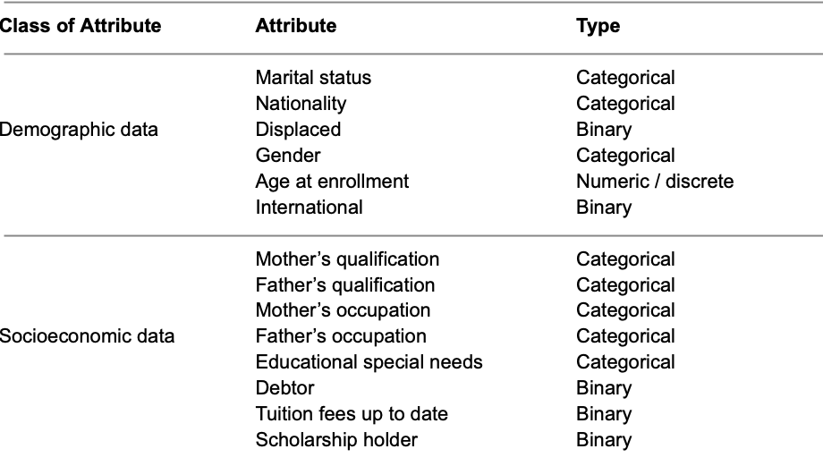

Slide 17
Achievement of the study
Refocuses on the feature space and features rather than algorithms used.
Demonstrates that reasonable good model can be developed with academic data alone.
Contributes to study of AI Fairness and ML-based decision making.

Slide 18
Limitations of study and scope for further research
The target of the dataset is three-class, whereas all of the studies reviewed are binary classification.
Complexity of the methodology: three models, 5 subsets and three classes. A simpler approach (two subset and a binary (graduate, non-graduate models) would be easier to understand and execute.

Slide 19
Thank you.

