Slide 1
Templates in C++

Slide 2
Generic Programming
Programming/developing algorithms with the abstraction of types
The uses of the abstract type define the necessary operations needed when instantiation of the algorithm/data occurs

Slide 3
C++ Templates
Templates are not types, but rather they are a placeholder for a type
At compile time, the compiler makes a copy of the templated code and automatically “replaces” the placeholders with the concrete type
C++ templates come in two flavors:
Functions templates
Class templates
Notes:
A good explanation The idea is to ”pass in” the data type so we can avoid repeating code.
Examples:
For functions : sort(), max(), min()
If you want to find the max/min or sort an array of int,char,double,float, the code is pretty much exactly the same except for the type. Templates help us to not repeat this code for each type.
For classes : vectors
Instead of creating a vector class for every type, we can use templates.

Slide 4
Function Templates
Used to define generic algorithms
While useful, the function only works for integers.
A better solution is to define a function template
int Max(int x, int y)
{
if ( x < y ) return y;
return x;
}
template <class T>
T Max(T x, T y)
{
if ( x < y ) return y;
return x;
}
Notes:
Template functions have the following form:
template < template-argument-list >
function-definition
The template-argument-list is one or more type-names within the scope of the template definition.
In template functions the first argument is always a type.

Slide 5
Function Templates
Nothing special has to be done to use a function template
Note: all that is required of the type passed to Max is the comparison operator, operator<.
int main(int argc, char* argv[]) {
int a = 3, b = 7;
double x = 3.14, y = 2.71;
cout << Max(a, b) << endl; // Instantiated with type int
cout << Max(x, y) << endl; // Instantiated with type double
cout << Max(a, x) << endl; // ERROR: types do not match
}
Notes:
Nothing special has to be done to use a function template
No special libraries or header files required.
The compiler examines the types of the arguments and instantiates the appropriate function for you.
For this example, we are only using the built-in types (e.g. int and double), so the C++ language defines the ‘less-than’ operator.

Slide 6
Class Templates
template <class T>
class myarray {
private:
T* v;
int sz;
public:
myarray(int s) { v = new T [sz = s]; } // Constructor
~myarray() { delete[] v; } // Destructor
T& operator[] (int i) { return v[i]; }
int size() { return sz; }
};
You can instantiate the same container with different types
myarray<int> intArray(10);
myarray<Shape> shapeArray(10);
Notes:
Class Templates
Just as a function template is able to take argument of any type, a class template may contain (as its data members) objects of any type.
class myarray
You can instantiate different myarrays which store objects of different types:
myarray<int> iwidget(10);
myarray<char> cwidget(10);
myarray<shape> swidget(10);
Take a look at the notation, the type-name is myarray<specific_type>.

Slide 7
Typedef
“alias” of types into a short hand
Very common when using templates as syntax can be verbose
Ex:
typedef vector<int> VecInt;
typedef map<string, tuple<double, int, float, MyClass> > MyTuple;
Notes:
You can think of it like a “variable” for a type.
(Working example in the solution for Lab3)

Slide 8
The skies are the limit!
Can have templated classes and functions with many template parameters
Specialized templates for specific types
Specialized functions for potential optimization
template<class t1, class t2>
void myFunc(T1& t1, T2& t2);
template<class T>
void myFunc(T& t);
template<>
void myFunc<string>(string& t); //specialization for strings
template<int n>
float dotProduct(float *v1, float *v2) {
float rval = 0;
for ( int i = 0; i < n; i++ ) {
rval += v1 [ i ] * v2 [ i ];
}
return rval;
} // must call with template argument... dotProduct<3> ( v1, v2 );

Slide 9
Summary
Generic programming allows for the abstraction of types
C++ templates are an instantiation of generic programming
C++ has function templates and class templates
Templates have many uses and allow for very interesting code design

Slide 10
Exercise
Create a class Point which has a template parameter of the type of internal data, T, and a template parameter for the dimension of the Point(2D, 3D etc.). Store a statically allocated, internal array of type T with dimension n. Ensure to include any constructer(s),destructors, getters or setters you might need. (10 points)
Create a template function which computes the Euclidean distance between 2 points. (6 points)
Instantiate two Point<double, 3> and compute their distance. Instantiate two Point<int, 2> and compute their distance.(4 points)

Slide 11
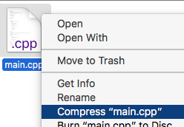
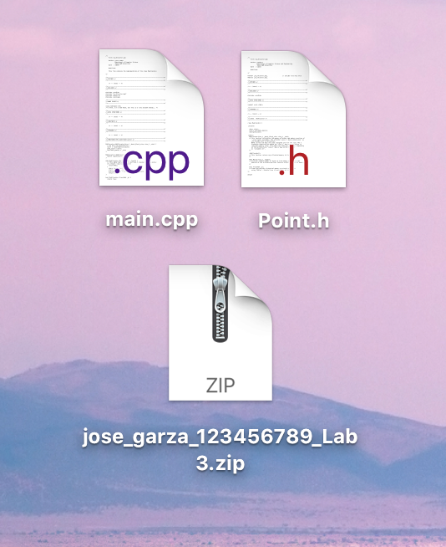
Assignment Details
For this assignment, turn in a .h and a .cpp file. This includes the main(), structs, and any classes.
Deadline: Monday 16 September 11:59pm
Rubrics = 20 points total (10+6+4)
Submission: Please turn in a zip folder all of your files
Name Convention: Lastname_FirstName_UIN_Lab3.zip

