Slide 1

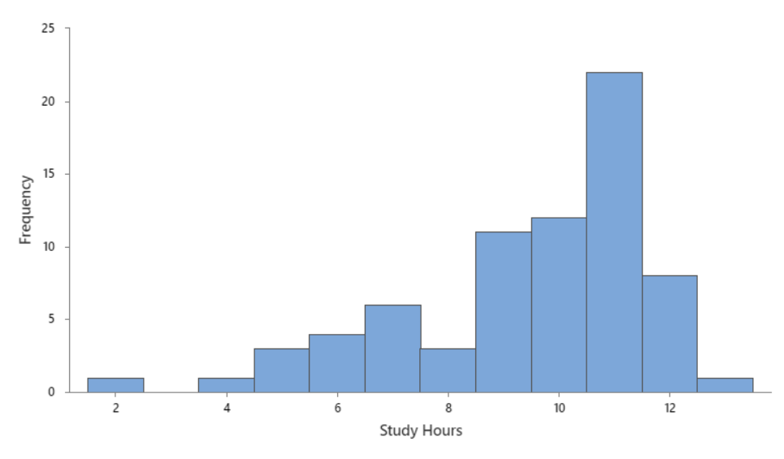
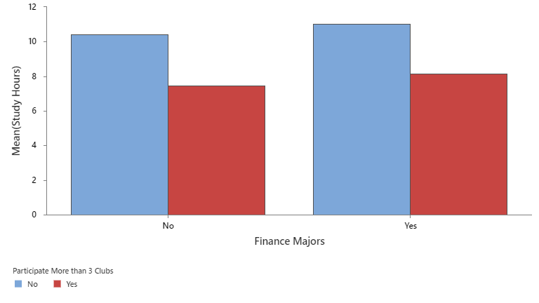
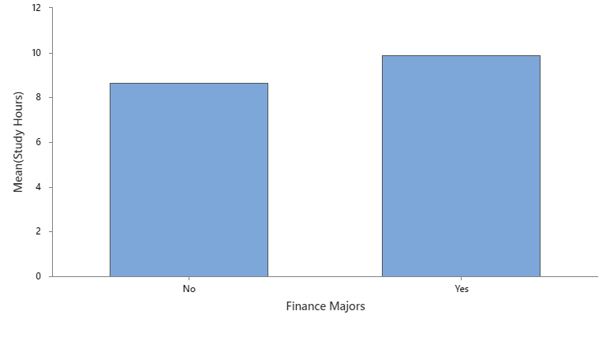
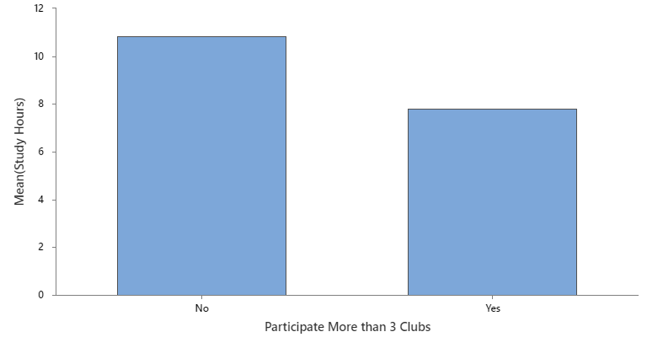
Freshman’s Study Hours at Bryant University
Your name | Teacher’s name | School
Introduction
Data Visualization 1
Data Visualization 4
We study the weekly study hours of a Bryant freshman and if club activities affect the study hours. We also investigate if finance majors study longer than non-finance majors.
Hypothesis
Hypothesis 1: Bryant Freshman study more than 10 hours a week.
Hypothesis 2: Bryant Freshman who involved in more than three clubs study less than those who involved in less than or equal to three class.
Hypothesis 3: Finance major freshman study one more hour per week than non-finance majors do.
Data Visualization 2
Test Results
Hypothesis | P-value
1 | 0.99
2 | 0.00
3 | 0.667
Data Collection/Survey
Conclusion
Our survey to Bryant freshman consists of three questions
Q1: How many hours do you study a week?
Q2: Are you participating in more than three clubs? (Yes/No)
Q3: Are you a finance major? (Yes/No)
We received 75 responses, in which 3 responses have missing values.
We use Minitab to for our calculations and visualization. We use one-sample t-test for hypothesis 1 and two-sample t-test for hypotheses 2 and 3.
Using the 5% confidence level, we conclude there is insufficient evidence to conclude that Bryant Freshman study more than 10 hours (p-value = 0.99) and that finance majors study one hours more than non-finance majors (p-values = 0.667).
We do find sufficient evidence from the data (p-value = 0.00) to support that those who involved in more than three clubs study more hours than those participating in less than or three clubs.
This result may be useful for the freshman who seek balance between study time and club activities.
Data Visualization 3
Notes:
To change this poster, replace our sample content with your own. Or, if you'd rather start from a clean slate, press the New Slide button on the Home tab to insert a new page. Now enter your text and pictures in the empty placeholders. If you need more placeholders for titles, subtitles or body text, copy any of the existing placeholders, then drag the new one into place.

