Slide 1
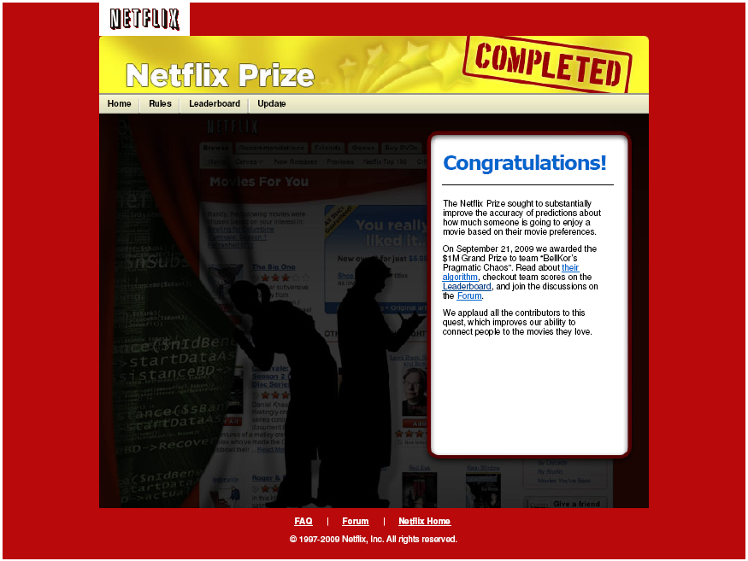

Slide 2
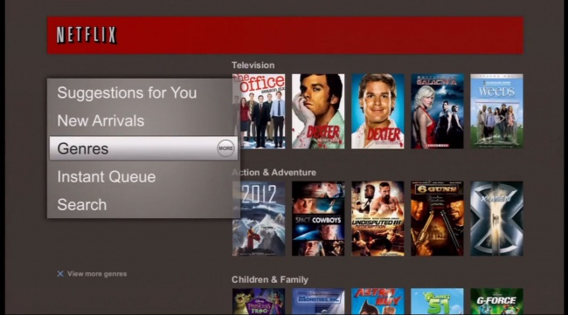
Netflix Viewing Recommendations

Slide 3
The Netflix Prize Contest
GOAL: use training data to build a recommender system, which, when applied to qualifying data, improves error rate by 10% relative to Netflix’s existing system
PRIZE: first team to 10% wins $1,000,000
Annual Progress Prizes of $50,000 also possible

Slide 4
The Netflix Prize Contest
PARTICIPATION:
51051 contestants on 41305 teams from 186 different countries
44014 valid submissions from 5169 different teams

Slide 5
Model Building and Submission Process
training set
probe set
ratings
known
99,072,112
1,408,395
tuning
MODEL
validate
make predictions
RMSE on
public
leaderboard
RMSE kept
secret for
final scoring
1,408,342
1,408,789
quiz set
test set
qualifying set
(ratings unknown)

Slide 6
Why the Netflix Prize Was Hard
Massive dataset
Very sparse – matrix only 1.2% occupied
Extreme variation in number of ratings per user
Statistical properties of qualifying and probe sets different from training set

Slide 7
Dealing with Size of the Data
MEMORY:
2 GB bare minimum for common algorithms
4+ GB required for some algorithms
need 64-bit machine with 4+ GB RAM if serious
SPEED:
Program in languages that compile to fast machine code
64-bit processor
Exploit low-level parallelism in code (SIMD on Intel x86/x64)

Slide 8
Common Types of Algorithms
Global effects
Nearest neighbors
Matrix factorization
Restricted Boltzmann machine
Clustering
Etc.

Slide 9
Nearest Neighbors in Action
Identical preferences –
strong weight
Similar preferences –
moderate weight

Slide 10
Matrix Factorization in Action
< a bunch of numbers >
+
reduced-rank
singular
value
decomposition
(sort of)
< a bunch of
numbers >

Slide 11
Matrix Factorization in Action
+
multiply and add
features
(dot product)
for desired
< user, movie >
prediction

Slide 12
Netflix Prize Progress: Major Milestones
DATE: | Oct. 2007 | Oct. 2008 | July 2009
WINNER: | BellKor | BellKor in BigChaos | ???

Slide 13
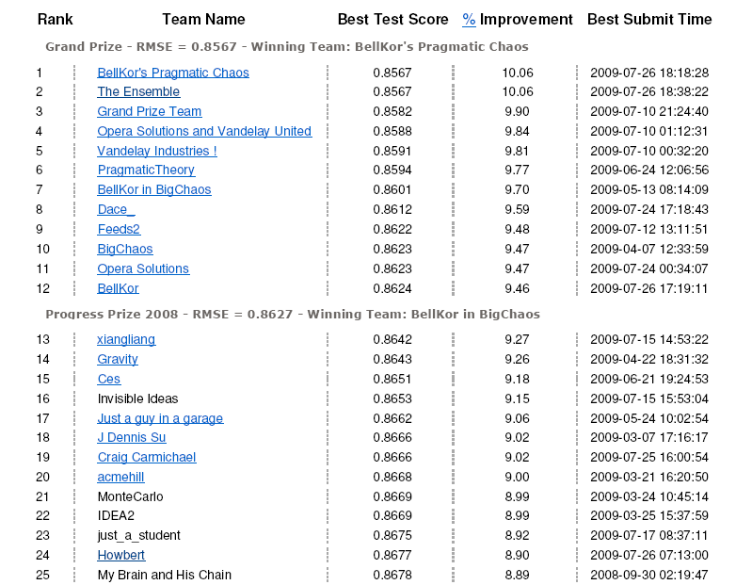
Final Test Scores

Slide 14
"That 20 minutes was worth a million dollars."

Slide 15
Models
Netflix uses "straightforward statistical linear models” with a lot of data conditioning
The most accurate algorithm in 2007 used an ensemble method of 107 different algorithmic approaches.
“Our experience is that most efforts should be concentrated in deriving substantially different approaches, rather than refining a single technique. Consequently, our solution is an ensemble of many methods.”
Netflix Never Used its $1m Algorithm!

