Slide 1
Untitled

Slide 2
Overfitting and Model Tuning
author: Son Nguyen font-family: Garamond

Slide 3
Reading Materials
Max Kuhn. Chapter 4.

Slide 4
Prediction Problem
Given data of $X=[X_{1},X_{2},...,X_{d}]$ and $Y$. Find the relation between $X$ and $Y$.

Slide 5
Prediction Problem - Examples
One Input Variable $X$

Slide 6
X | Y
13 | 4.0
6 | 3.5
14 | 3
10 | 3.9
7 | 2.7
12 | 3.8
1 | 1.5

Slide 7
How are $X$ and $Y$ related?

Slide 8
Prediction Problem - Examples
Multiple Input Variables

Slide 9
$X_{1}$ | $X_{2}$ | … | $X_{35}$ | $Y$
1 | -1 | … | 2 | Tree
2.1 | 0 | … | 6 | Not a Tree
3 | 0 | … | 8 | Tree

Slide 10
How are $X$ and $Y$ related?

Slide 11
Prediction Problem
If $Y$ is continous, we have a regression problem.
If $Y$ is categorical, we have a classification problem.
If $Y$ is binary, we have a binary classification problem.

Slide 12
Prediction Problem - Examples
This is a regression problem since $Y$ is continuous.

Slide 13
X | Y
13 | 4.0
6 | 3.5
14 | 3
10 | 3.9
7 | 2.7
12 | 3.8
1 | 1.5

Slide 14
Prediction Problem - Examples
This is a binary classification Problem since $Y$ is binary.

Slide 15
$X_{1}$ | $X_{2}$ | … | $X_{35}$ | $Y$
1 | -1 | … | 2 | Tree
2.1 | 0 | … | 6 | Not a Tree
3 | 0 | … | 8 | Tree

Slide 16
Overfitting
Consider the data:

Slide 17
X | Y
13 | 4.0
6 | 3.5
14 | 3
10 | 3.9
7 | 2.7
12 | 3.8
1 | 1.5

Slide 18
We will fit these data by polynomial model.
In polynomial model, $Y$ is a polynomial function of $X$.

Slide 19
Overfitting
## -- Attaching packages -------------------------------------------------------------------------------- tidyverse 1.3.0 --
## v ggplot2 3.3.2 v purrr 0.3.4 ## v tibble 3.0.2 v dplyr 1.0.0 ## v tidyr 1.1.0 v stringr 1.4.0 ## v readr 1.3.1 v forcats 0.5.0
## -- Conflicts ----------------------------------------------------------------------------------- tidyverse_conflicts() -- ## x dplyr::filter() masks stats::filter() ## x dplyr::lag() masks stats::lag()

Slide 20
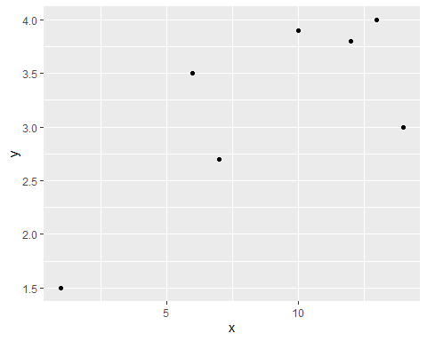

Slide 21
We will fit these data by polynomial model.
In polynomial model, $Y$ is a polynomial function of $X$.

Slide 22
Overfitting - Polynomial Model
In polynomial model, we need to specify the degree of the polynomial, $n$. Let try a few.
If $n=1$, we have a familiar linear model.
Question: Does increasing $n$ resuls in a better model?

Slide 23
Overfitting - Polynomial Model
$n=1$.

Slide 24
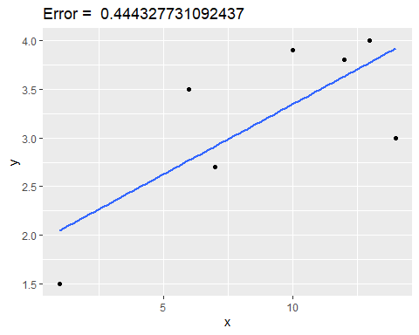

Slide 25
Overfitting - Polynomial Model
$n=2$.

Slide 26
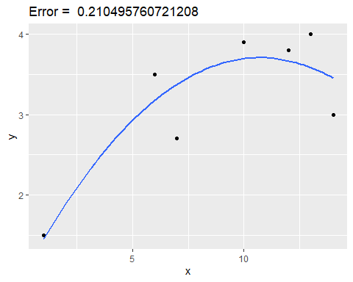

Slide 27
Overfitting - Polynomial Model
$n=3$.

Slide 28
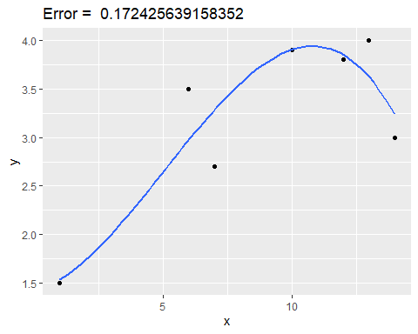

Slide 29
Overfitting - Polynomial Model
$n=4$.

Slide 30
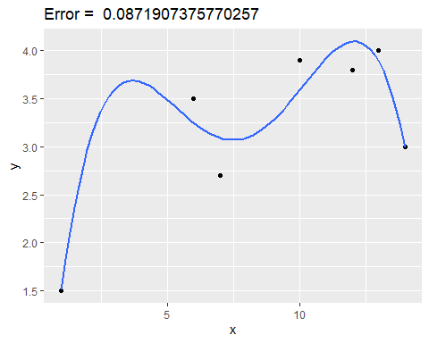

Slide 31
Overfitting - Polynomial Model
$n=5$.

Slide 32
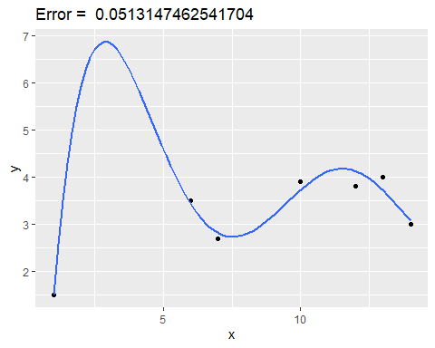

Slide 33
Overfitting - Polynomial Model
$n=6$.

Slide 34
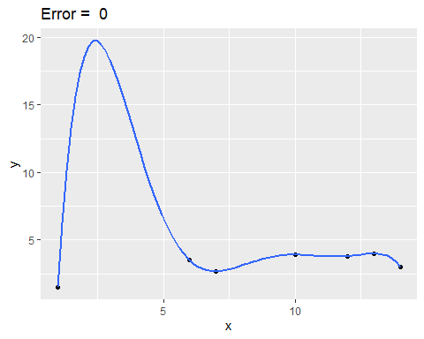

Slide 35
Overfitting - Polynomial Model
Question: What are the errors when $n>6$?

Slide 36
Overfitting - Polynomial Model
Question: What are the errors when $n>6$?
Answer: The errors are all zeros. (There are actually many solutions for each degree greater than 6.)

Slide 37
Overfitting - Polynomial Model
Question: What is the best model?

Slide 38
Overfitting - Polynomial Model
Question: What is the best model?
Answer: We do not know. We need a validation dataset to validate the models.

Slide 39
Overfitting - Polynomial Model
The errors we have seen are called training errors

Slide 40
Overfitting - Polynomial Model
Let’s validate these models with a validation dataset
Validation Data

Slide 41
X | Y
5 | 2.6
7 | 3.5
9 | 4.0
6 | 3.7
12 | 5.0

Slide 42
Overfitting - Polynomial Model
$n=1$.

Slide 43
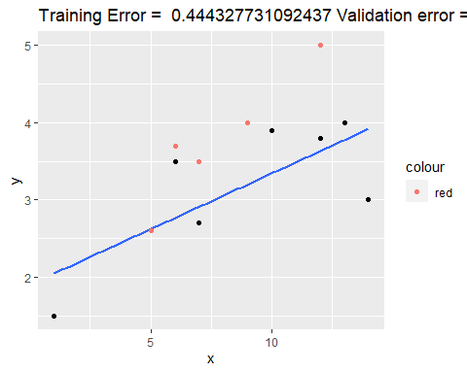

Slide 44
Overfitting - Polynomial Model
$n=2$.

Slide 45
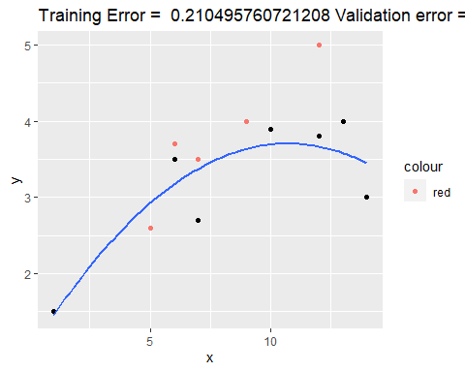

Slide 46
Overfitting - Polynomial Model
$n=3$.

Slide 47
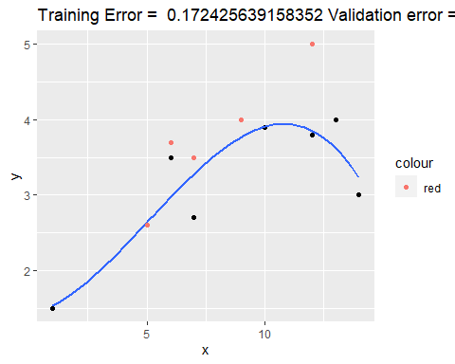

Slide 48
Overfitting - Polynomial Model
$n=4$.

Slide 49
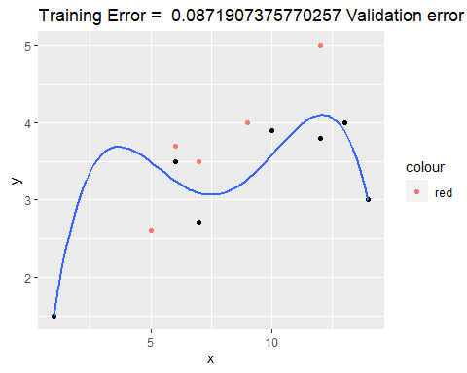

Slide 50
Overfitting - Polynomial Model
$n=5$.

Slide 51
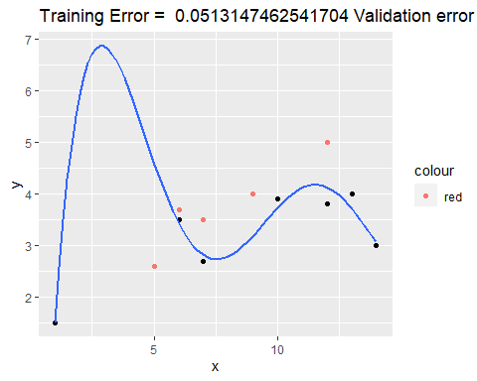

Slide 52
Overfitting - Polynomial Model
$n=6$.

Slide 53
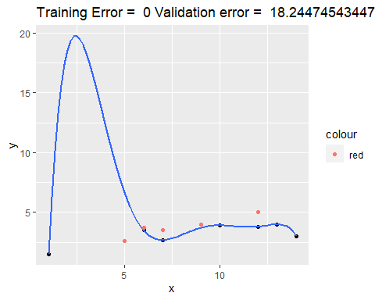

Slide 54
Overfitting - Polynomial Model
Training Error vs. Validation Error

Slide 55
 | Training Error | Validation Error
$n=1$ | 0.4443277 | 3.726484
$n=2$ | 0.2104958 | 2.304728
$n=3$ | 0.1724256 | 1.955191 (Best!)
$n=4$ | 0.08719074 | 2.515661
$n=5$ | 0.05131475 | 5.987636
$n=6$ | 0 | 18.24475

Slide 56
Overfitting - Polynomial Model
Training Error vs. Validation Error
## ## Attaching package: 'reshape2'
## The following object is masked from 'package:tidyr': ## ## smiths

Slide 57
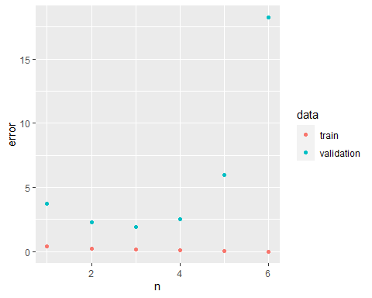

Slide 58
Overfitting - Polynomial Model
As the degree $n$ increases, the training errors decrease
Model 6 ($n=6$) is the best (perfect) in training but the worst in validation.
The best model is the model with the best (lowest) error in validation data.
Overfitting - Polynomial Model ## - Model 4, 5 and 6 are overfitted - Model 1 and 2 are underfitted - Model 3 is the best model.

Slide 59
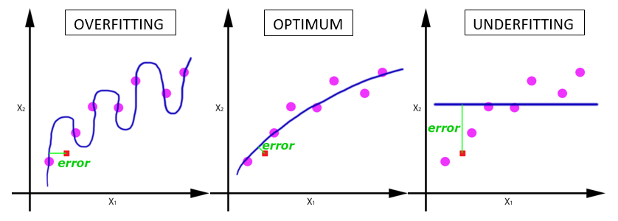
Overfitting in Regression

Slide 60
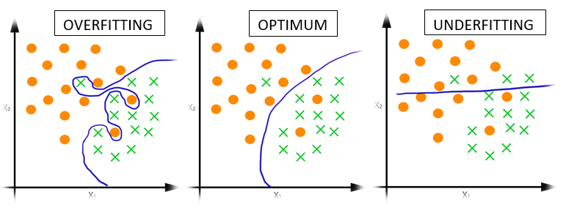
Overfitting in Classification

Slide 61
Model Complexity/Capacity
In polynomial models, the larger $n$, the more complex/capable the model.
Model complexity can be measured by the number of parameters/unknown of the model.

Slide 62
Model Complexity/Capacity
Linear model:
$$y=ax+b$$
Question: How many unknowns/parameters in linear model?

Slide 63
Model Complexity/Capacity
Linear model $(n=1)$:
$$y=ax+b$$
Question: How many unknowns/parameters in linear model?
Answer: Two unknowns/paramters: $a$ and $b$

Slide 64
Model Complexity/Capacity
Quadratic model $(n=2)$:
$$y=ax^{2}+bx+c$$
Three unknowns: $a$, $b$, and $c$.
Quadratic model has more unknowns/parameters then linear model. Thus, quadratic model is more complex than linear model

Slide 65
Model Complexity/Capacity
The mode complex the model, the easier it becomes overfitted!

Slide 66
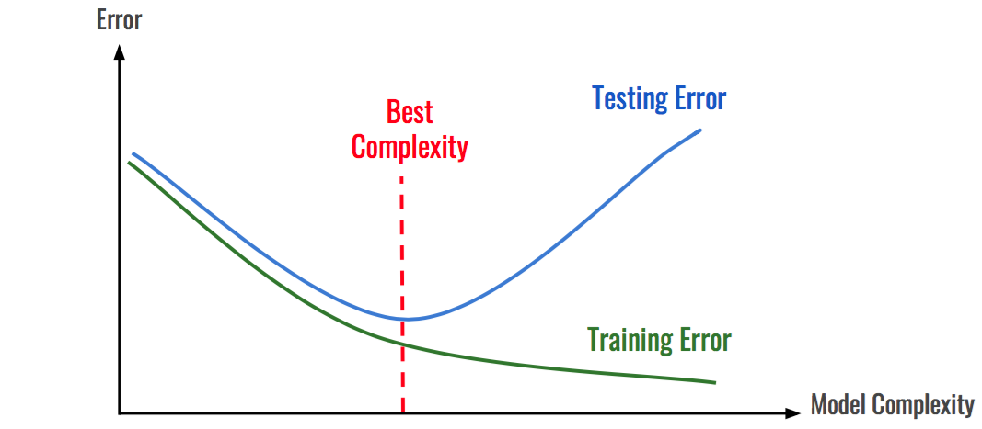
Model Complexity/Capacity

Slide 67
Model Tuning
We just “tuned” the the parameter $n$.
The parameter $n$ is called tuning parameter, or hyperparameter

Slide 68
Model Tuning
Model tuning is the process of finding the best values for the tuning parameters of the model
This is done through trying out many values for the tuning parameters then select the best values.

Slide 69
Model Training
Model training is the process of finding the unknown/parameters of the model
Example: Training linear model $y=ax+b$ is to find $a$ and $b$ that best fit the data

Slide 70
Model Training vs. Model Tuning
Model training finds the parameters
Model tuning finds hyperparameters

Slide 71
Model vs. Family of Models
The polynomial model is a family of models.
Linear model is just one model
A family of models has “tuning parameters”.
A single model, say, linear model, does not have tuning parameter
Some model has multiple tuning parameters.

Slide 72
Data Splitting
We need validation data for model tuning.
Question: How can one of obtain validation data?

Slide 73
Data Splitting
We need validation data for model tuning.
Question: How can one of obtain validation data?
Answer: We do not use the entire data to train models. We use a portion of it for training and save data for validation and testing.

Slide 74
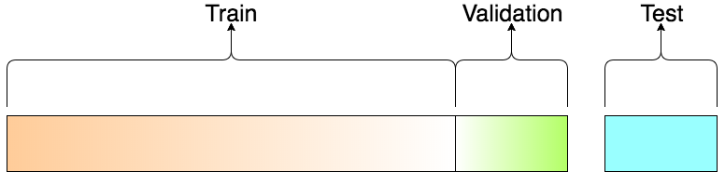
Data Splitting: Train-Validation-Test

Slide 75
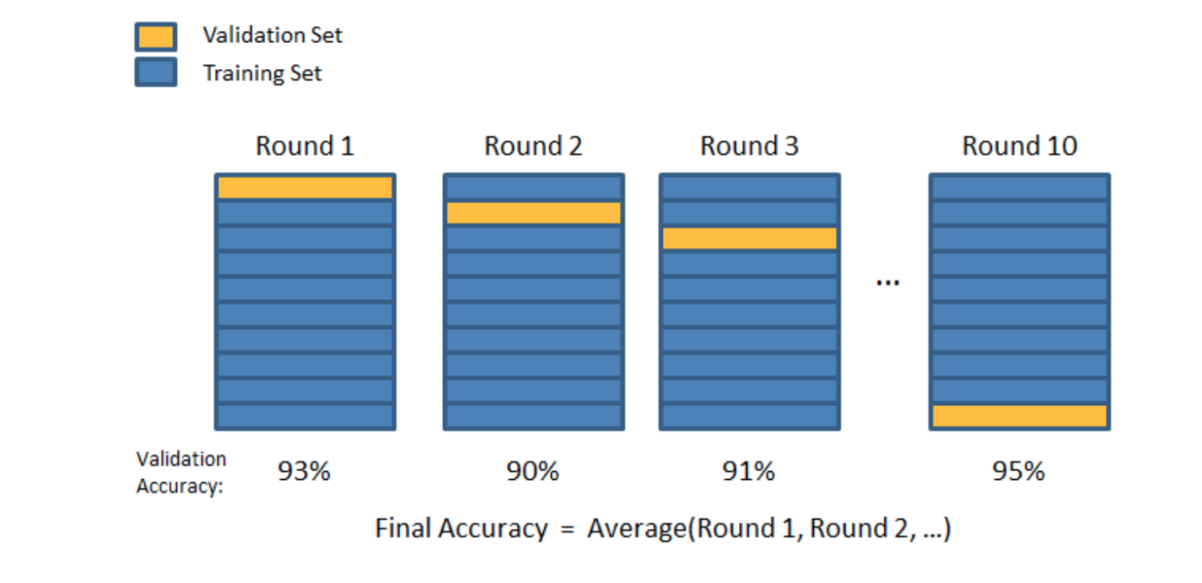
k-folds Cross Validation

Slide 76
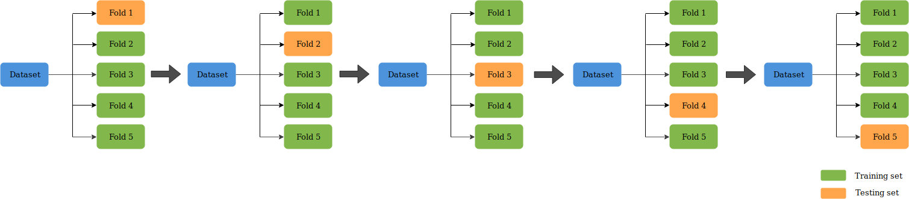
k-folds Cross Validation

Slide 77
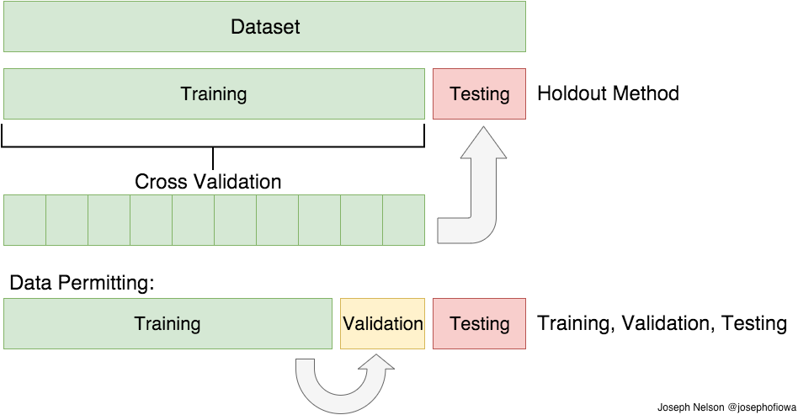
k-folds Cross Validation and test

