Slide 1
图 1
11 cases (279,576 variants)
keywords: e.g. HAPE, AMS
sources: Pubmed, Malacards
Step1: gene panel filtration
(HAPE-462)
HAPE-337 (5,931 variants)
MAF < 0.05
sequencing depth ≥ 40
retaining of exon and splicing
deletion synonymous
variants prediction
Step2: common screening
HAPE-34 (49 variants)
Step3: Sanger sequencing
HAPE-26 (36 variants)
P < 0.0001
Step4: pathway analysis
HAPE-18 (20 variants)
homologous sequencs alignment
function domain analysis
gene expression analysis
protein structrue modeling
Step5: silico analysis
HAPE-2 (2 variants)

Slide 2
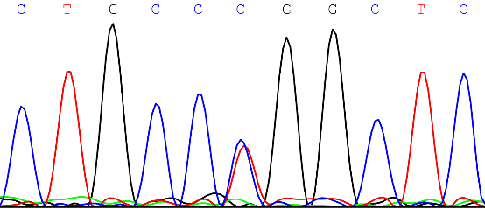
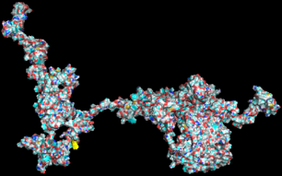
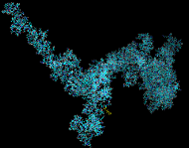
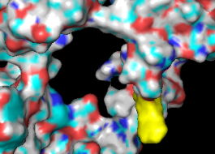
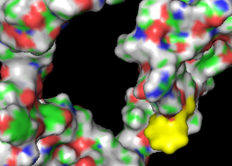
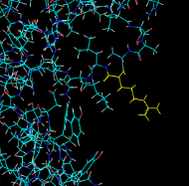
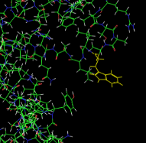
图 2
A
c.3103C>T (p.Arg1035Trp)
T
GF-18
B
300
600
p.Arg1035Trp
1200
1434 aa
900
NO_synthase
FAD_binding
NAD_binding
C
D
Human
Mouse
Rat
Dog
Rabbit
Sheep
Chimpanzee
Bovin
Horse
Rhesus macaque
Chicken
Pig
KKRVSAARLLSRQNL
KKRVSAARLLSRQNL
KKRVSAARLLSRQNL
KKRVSAARLLSRQNL
KKRVSAARLLSRQNL
KKRVSAARLLSRQNL
KKRVSAARLLSRQNL
KKRVSAARLLSRQNL
KKRVSAARLLSRQNL
KKRVSAARLLSRQNL
KKRVYAARLITRQNL
KKRVSAARLLSRQNL
9.5
P = 0.03*
9.0
8.5
NOS1
mRNA expression
8.0
7.5
7.0
6.5
Control
HAPE
E
F
Arg 1035
Trp 1035
Arg 1035
Trp 1035

Slide 3
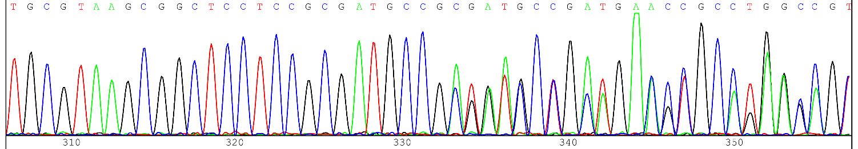
图 3
A
c.578_579insCCGCGATG
(p.Lys193Lysfs*85)
GF-22
B
1
112
299
343
aa
Apolipoprotein
WT
aa
Partial
p.Lys193Lysfs*85
1
112
193
278
C
11.0
P = 0.04*
10.0
9.0
APOE
mRNA expression
8.0
7.0
6.0
Control HAPE

