Slide 1

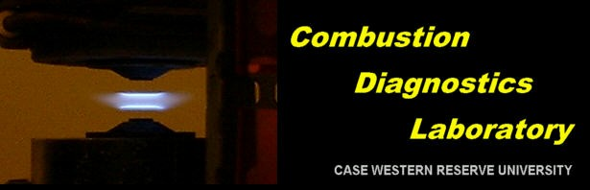
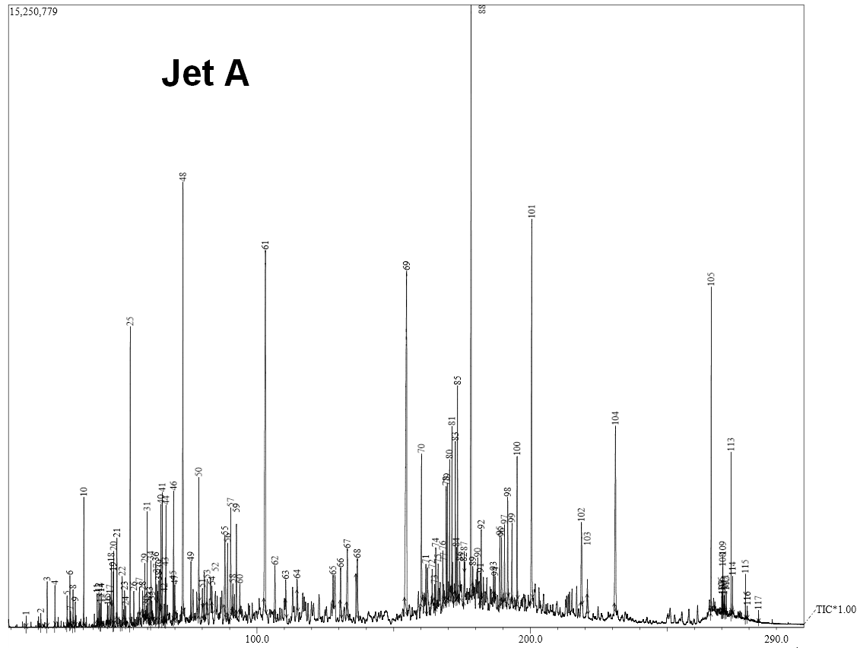
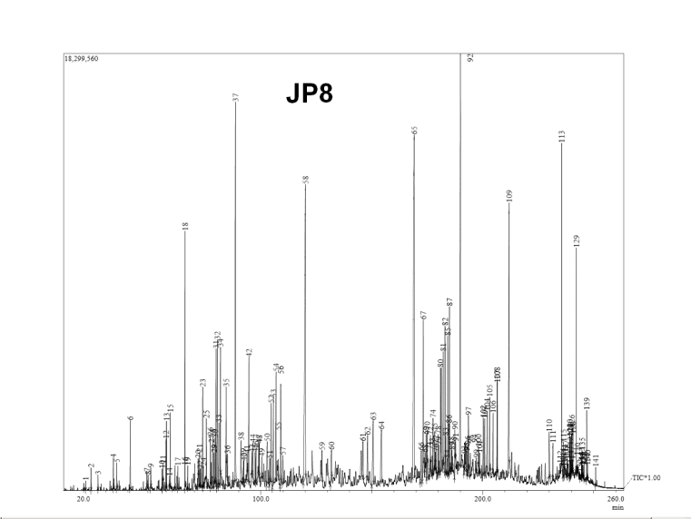
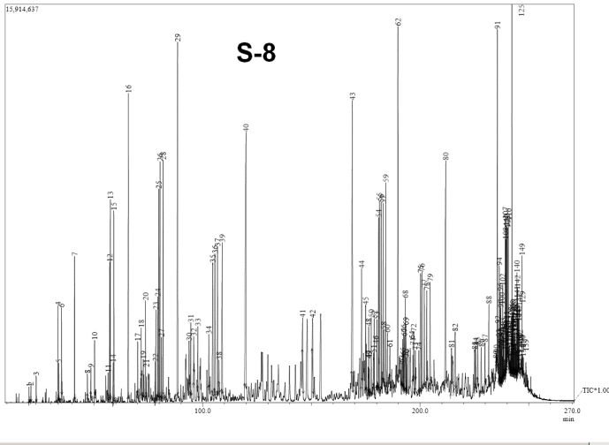
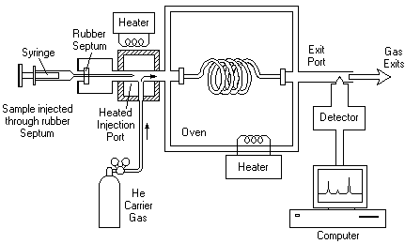
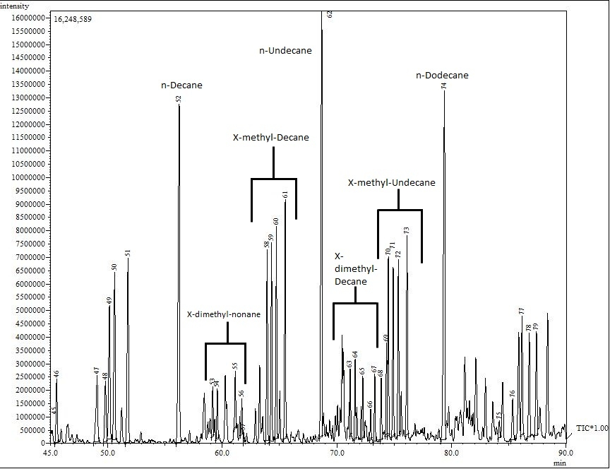
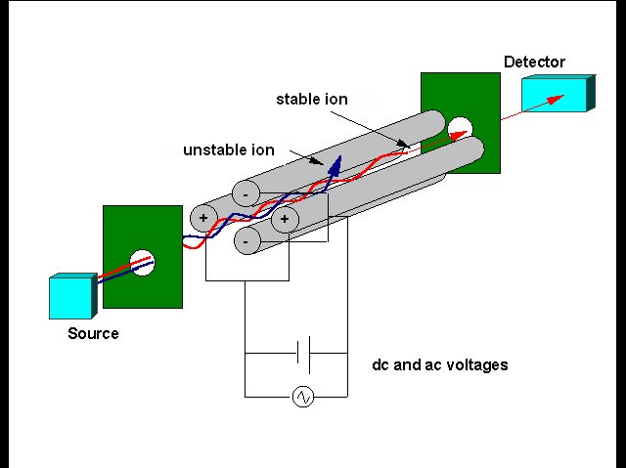
An Investigation of Hydrocarbon Flames using Probe Sampling and GC/MS
Bryan Weber, bww3@case.edu
Department of Mechanical and Aerospace Engineering
Case Western Reserve University
Cleveland, OH 44106, USA
ABSTRACT
Fundamental operation of the Gas Chromatographer/Mass Spectrometer (GC/MS) is discussed. Differences between detection methods are discussed and specific analysis issues are considered. Experimental results by analyzing two conventional jet fuels (Jet-A and JP-8) and a synthetic jet fuel (S-8) are presented and compared. Gas Chromatography/Mass Spectrometry is used to qualify the components of each fuel. Several batches of S-8 from two sources, NASA and AFRL, are analyzed and compared. Strong similarities between the batches are observed, although key differences indicate they are not from the same batch. Results of S-8 fuel analysis are further compared to those obtained by NIST. While good agreement is seen, variations in injection and Gas Chromatography programs are noted to yield discrepancies. Results common to all fuel types show interesting patterns in the peak distribution. Components are eluted in order of increasing molecular weight and isomers of components of the same molecular weight are eluted together. Normal alkanes are the last of each molecular weight group to be eluted. Finally, aromatics follow a similar trend as alkanes, but do not match the molecular weight of the alkane group with which they elute.
RESULTS OF MS ANALYSIS OF JET FUELS:
SAMPLE CHROMATOGRAMS OF JET FUELS:
Name | Jet A | JP8 | S-8
# of Peaks Identified | 117 | 141 | 149
Primary Species: | Dodecane | Decane | Octane
 | Hexadecane | Dodecane | Nonane (5)
 | Decane | Tridecane | Decane (3)
 | Octane | Cyclohexane | Undecane (2)
 | Cyclohexane | Benzene | Dodecane (1)
 | Benzene | Benzene Isomers | Tridecane (4)
 | Benzene Isomers | Non-Hydrocarbon Additives | Tetradecane (6)
Table 1 - Components identified in Jet Fuels. Numbers in parenthesis indicate ranking in area percent of that compound’s peak. Note the absence aromatic molecules from the synthetic fuel, S-8
Trends in the Chromatograms of Jet Fuels:
Compounds elute in order of increasing molecular weight
Compounds with the same molecular weight elute in the following order:
Multi-methyl isomers
Mono-methyl isomers
n-alkanes
The n-alkane of each weight is the last of that weight to elute. Thus, peaks can be grouped by molecular weight, with the weight of each group increasing by 14
Cyclic and aromatic molecules follow a similar trend, but do not match the molecular weight of the alkane group with which they elute
Only saturated aliphatic and aromatic hydrocarbons were positively identified
FUNDAMENTALOPERATION OF GC/MS:
Gas Chromatography (GC):
Sample is injected into column
Column separates sample mixtures by slowing the flow of mixture components at different rates
As components elute from the column, they are sent through a detector
Figures 3,4,5 – Mass Spectrographs for Jet A, JP-8 and S-8 Jet fuels. Note the large number of peaks for all three cases
Separation Method Details:
Column:
5 meter tuning column (5% diphenyl / 95% dimethyl polysiloxane, 1.0 μm film thickness)
100 meter column (100% dimethyl polysiloxane, 0.5 μm film thickness)
Optimized for hydrocarbon seperation
Temperature is controlled by the GC. A specific program is chosen, ramping the temperature from 60°C to 250°C over the course of approximately 3 hours.
Holds are placed at temperatures in the middle of the program to optimize separation of intermediate compounds
Large number of components and heavy components necessitate long programs with high temperatures for this length column
Temperature programs are largely empirically chosen
Data Analysis Method:
Computer data system collects output mass spectra from the MS
Peaks are integrated by program “GCMSSolutions”
Compounds are identified by their mass spectra by looking up the spectra in an NIST database
Figure 1 – Fundamental parts of a Gas Chromatograph
Image Courtesy: Department of Chemistry, McMaster University, Ontario, Canada¹
Mass Spectrometry (MS):
“Source” ionizes components eluted from the column
Ions are directed into an electrical field created by voltages applied to conductive rods
Ions of particular mass to charge ratio have stable paths through the rods and reach the detector
Varying the electrical field allows particular ions through
Figure 6– Portion of S-8 chromatogram, showing features described, such as grouping of isomers and major alkane peaks
Figure 2 – Fundamental parts of a Quadrupole Mass Spectrometer, the kind used on this project.
Image Courtesy: Department of Chemistry, University of Adelaide, Australia²
Comparison of NASA and Air Force Research Laboratory (AFRL) S-8 Batches:
Strong similarities exist between the batches
Many matches for retention time and compound between NASA and AFRL
More than 2/3 of total identified compounds match (~70 matches/90 identified compounds)
More stringent peak selection criteria reduce total number of compounds from above (149 peaks to 90 peaks)
Matches for major compounds are expected because these are the same base fuel
Small differences indicate that these are different batches of S-8 fuel
NASA batch is missing lighter components present in AFRL batch
NASA batch is possibly weighted toward heavier compounds
Injection method errors may cause bias from one sample run to the next
Other Common Detection Methods:
Flame Ionization Detector
Specializes in quantifying organic hydrocarbons
Thermal Conductivity Detector
Specializes in detecting non-hydrocarbons
Advantages of GC/MS:
GC specializes in separating mixtures into components
MS specializes in identifying individual compounds
The combination provides a “best of both worlds” approach.
ACKNOWLEDGEMENTS:
The author would like to thank several people, without whom this project would not have been possible. First, my advisor, Dr. Jackie Sung in the Mechanical and Aerospace Department. Next, my advisor for this project, Dr. Gaurav Mittal. I would like to thank Sheila Pedigo and Bethany Pope at the SOURCE Office for their support. The Office of the Provost at CWRU, Dominion Energy and the Case Alumni Association provided financial support to make the SURES program possible. Finally, thank you to my colleagues at the Combustion Diagnostics Lab for their personal and technical support in completing this project.
References:
1: http://www.chemistry.mcmaster.ca/~chem2oa3/labmanual_2002-03/2oa3_exp2.html
2:http://www.chemistry.adelaide.edu.au/external/soc-rel/content/quadrupo.htm

