Slide 1
Autoignition of Butanol Isomers at Elevated Pressure and Low to Intermediate Temperature Using a Rapid Compression Machine
Bryan Weber, Kamal Kumar, Chih-Jen Sung
Prepared for
2011 AIAA Aerospace Sciences Meeting
Jan. 5, 2011
Presenting: Bryan Weber

Slide 2
Introduction
Butanols – 4 Isomers
Motivation – Why Butanol?
n-Butanol is a second generation biofuel with the potential to replace ethanol and gasoline
The isomers of butanol have potential as high-octane gasoline additives
The butanol system is the smallest alcohol system with primary, secondary and tertiary alcohol groups

Slide 3
Previous Work
Black et al.¹ have measured ignition delays of n-butanol in a shock tube at low pressure and high temperature
Moss et al.² have measured ignition delays of all four isomers of butanol in a shock tube at low pressure and high temperature
Grana et al.³ have measured flame speeds of the isomers of butanol
Van Geem et al.⁴ have performed pyrolysis experiments of the four isomers of butanol
Heufer et al.⁵ have investigated high pressure and intermediate to high temperature ignition delays of n-butanol in a shock tube
1. Black, G., Curran, H., Pichon, S., Simmie, J. M., and Zhukov, V., Combustion and Flame, Vol. 157, No. 2, 2010, pp. 363-373.
2. Moss, J. T., Berkowitz, A. M., Oehlschlaeger, M. A., Biet, J., Warth, V., Glaude, P., and Battin-Leclerc, F., The Journal of Physical Chemistry. A, Vol. 112, No. 43, 2008, pp. 10843-10855.
3. Grana, R., Frassoldati, A., Faravelli, T., Niemann, U., Ranzi, E., Seiser, R., Cattolica, R., and Seshadri, K., Combustion and Flame, Vol. 157, 2010, pp. 2137-2154.
4. Van Geem, K. M., Pyl, S., Marin, G., Harper, M., and Green, W., Industrial & Engineering Chemistry Research, Vol. 49, No. 21, 2010, pp. 10399-10420.
5. Heufer, K.A., Fernandes, R. X., Olivier, H., Beeckmann, J., and Peters, N., Proceedings of the Combustion Institute, Vol. 33, 2011, pp.359-366.

Slide 4
Objectives
Provide complementary data to the previous studies using a Rapid Compression Machine
Focus on high pressure and low to intermediate temperature conditions
Provide validation studies for the existing reaction mechanisms
Cover many pressure ranges, equivalence ratios, and fuel loading conditions
Experimental Conditions:
P_{C}=15, 30 bar, T_{C}=680-925 K, ϕ=0.5, 1.0, 2.0
O₂/N₂ ratio varied to independently find the effects of initial fuel and oxygen mole fractions

Slide 5
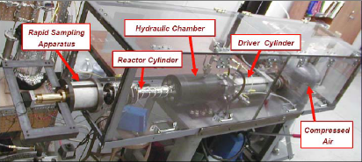
Rapid Compression Machine (1)
Obtain experimental data for autoignition delays at elevated pressures and low-to-intermediate temperatures, using a heated rapid compression machine

Slide 6
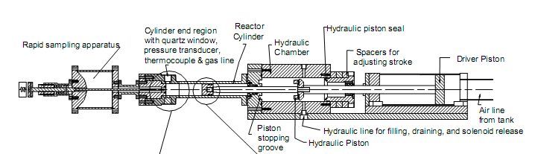
Rapid Compression Machine (2)
Single, retractable piston
Piston is pneumatically driven and hydraulically stopped, with compression time around 30 ms
Piston is machined with crevices to contain roll-up vortex created by piston motion

Slide 7
Rapid Compression Machine (3)
Pressure and Temperature from Top Dead Center (TDC) are reported as “compressed conditions”, P_{C} and T_{C}
Ability to vary P_{C} and T_{C} independently
P_{C} up to 45 bar
T_{C} between 660-1100 K
Fuel and oxidizer are preheated and mixed in a 15 L mixing tank to ensure homogeneity

Slide 8
Check Mixture Composition (1)
2 goals:
Ensure fuel does not decompose while being held in the mixing tank
Ensure the expected composition is being created in the mixing tank
Use GCMS to identify any decomposition products and quantify the concentration of n-butanol in the mixing tank
iso-Octane is used as an internal standard for quantitative check of the concentration of n-butanol

Slide 9
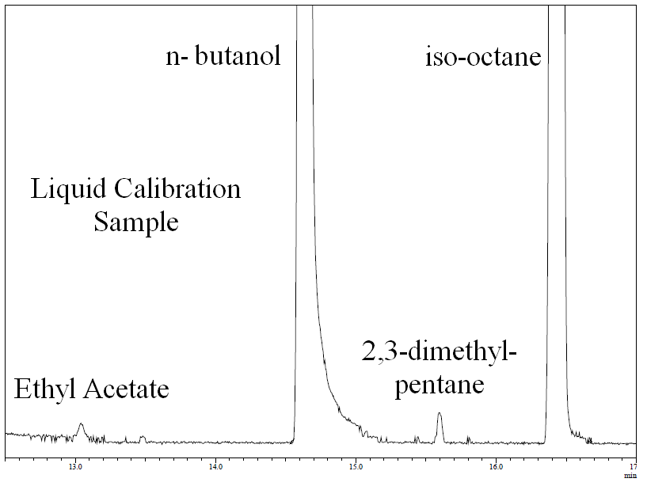
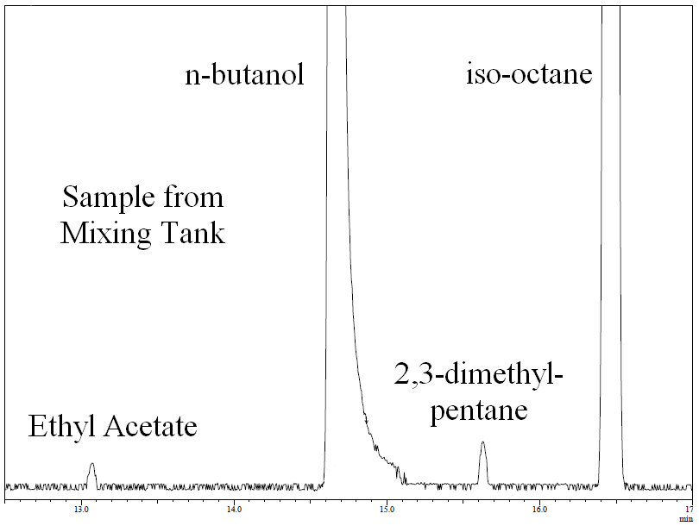
Mixture Composition Check (2)
Liquid standard is created with known concentrations of n-butanol and iso-octane
Small peaks are impurities from n-butanol and iso-octane
There are no extra peaks in the chromatogram of the sample withdrawn from the mixing tank
No decomposition!
Concentration of n-butanol within 4% of expected value

Slide 10
Definition of Ignition Delay
Ignition criteria is the maximum rate of pressure rise
Ignition delay is the time difference from the end of compression to ignition point
Each condition is repeated at least 6 times to ensure repeatability

Slide 11
Experimental Results (1)
Non-reactive case replaces oxygen with nitrogen to eliminate oxidation reactions but maintain the specific heat ratio
Pressure traces for n-butanol deviate from non-reactive case
Indicates minor pre-ignition heat release

Slide 12
Experimental Results (2)
Two apparent crossover points of the ignition delay for n-butanol
ϕ=0.5 mixture becomes more reactive than the ϕ=1.0 mixture at about 870 K
ϕ=0.5 mixture becomes more reactive than the ϕ=2.0 mixture at about 925 K
This trend agrees with the work by Black et al.¹ and Moss et al.², who found that the lower equivalence ratios were more reactive in their high temperature shock tube studies

Slide 13
Experimental Comparisons
Comparison of the data for n-butanol from this work and the work by Heufer et al.⁵ shows good agreement
A correlation to the data from the current study produces a good regression for all the various fuel loading and pressure conditions considered
This correlation does not include data from other studies

Slide 14
Experimental Results of Isomers (1)
No two-stage ignition or NTC region for any of the fuels under these conditions
tert- and iso-butanol do not deviate significantly from the non-reactive pressure trace

Slide 15
Experimental Results of Isomers (2)
n-Butanol is more reactive than iso-butanol, which is more reactive than tert-butanol
As the temperature goes down, tert-butanol appears to become more reactive than iso-butanol

Slide 16
Types of Simulations
Simulations of ignition delay are performed in CHEMKIN-PRO⁶ using four mechanisms available in the literature
Constant Volume, Adiabatic simulations have initial conditions set to the pressure and temperature conditions at TDC, and neglect heat loss to the reactor walls
Variable Volume simulations have the reactor volume as a controlled function of time
Used to compute T_{C} by matching the experimental pressure trace during compression
Include effects of heat loss after compression by including parameters deduced from non-reactive experimental cases
6. CHEMKIN-PRO, Software Package, Ver. 15092, Reaction Design, San Diego, CA, 2008.

Slide 17
Variable Volume Simulations
For n-butanol, most of the reaction mechanisms do not have ignition near the experimental value despite matching the compression stroke quite well
This is due to the fact that these do not include low temperature chemistry of n-butanol, which causes over-prediction of the ignition delay in this temperature range

Slide 18
Simulations of Isomer Autoignition
Most mechanisms over predict the ignition delay of all the isomers, but the mechanisms by Moss et al.² and Grana et al.³ do not include low temperature chemistry
The mechanism by Van Geem et al.⁴ performs the best
Variable Volume simulations improve results for tert- and iso-butanol

Slide 19
Summary
New autoigniton delay data has been collected for three isomers (n-, tert-, and iso-) of butanol at elevated pressure and low to intermediate temperature conditions
These are, to the author’s knowledge, the first data reported at these conditions for n-, tert-, and iso-butanol
One reaction mechanism available in the literature predicts the ignition delay reasonably well for n-, tert- and iso-butanol

Slide 20
Acknowledgements
This work was supported as part of the Combustion Energy Frontier Research Center and Energy Frontier Research Center funded by the U.S. Department of Energy, Office of Science, Office of Basic Energy Sciences, under Award Number DE-SC0001198.
We thank Dr. Y. Zhang at the University of Connecticut for his help operating the GCMS.

