Slide 1
Introduction to ATAC-seq
BMS bioinformatics bootcamp 2018
Josh Chiou

Slide 2
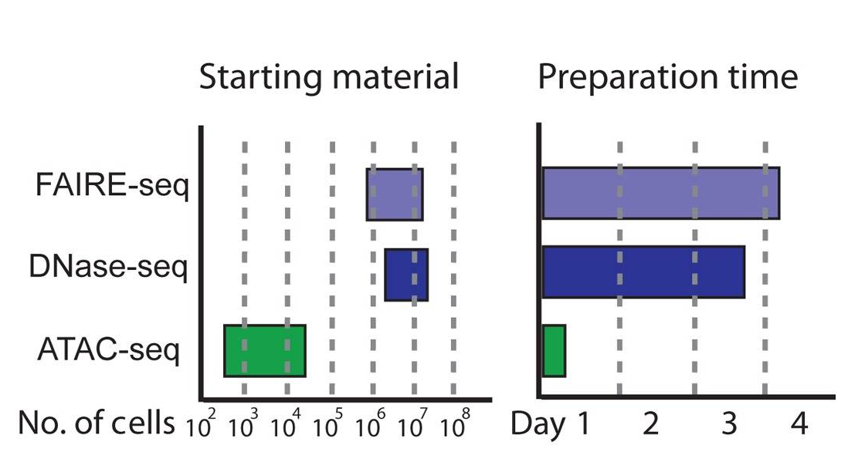
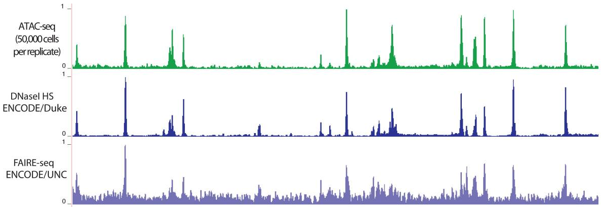
What is ATAC-seq?
Assay for Transposase Accessible Chromatin with sequencing
Requires much less starting material (~50k cells) and processing time (hours) than previous assays
Highly concordant with previous assays (DNAseI, FAIRE-seq) which were hard to perform
Buenrostro et al., 2013

Slide 3
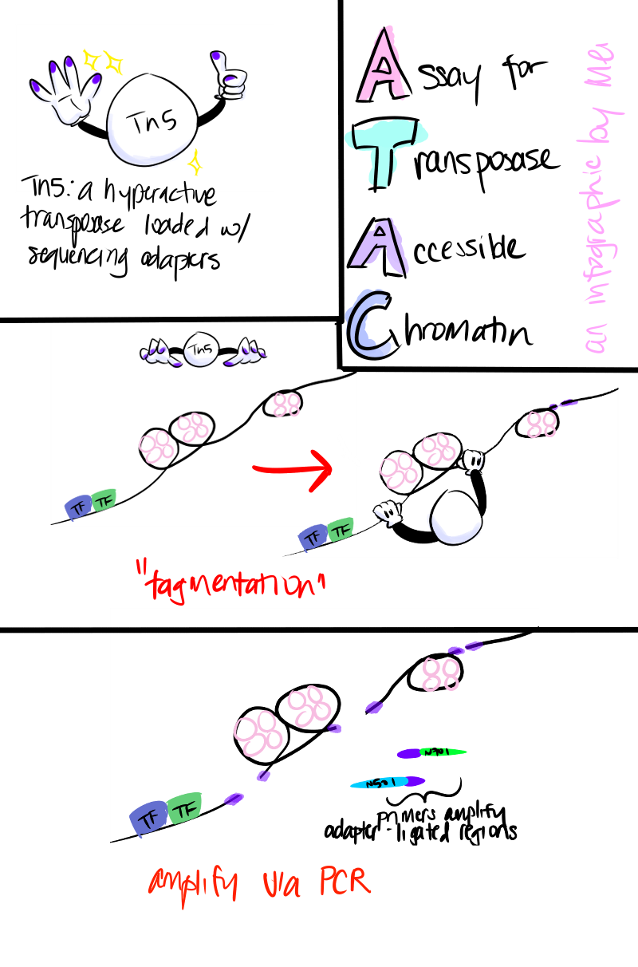
How does ATAC-seq work?
Tagmentation = DNA fragmentation and sequencing adapter tagging in the same step with a hyperactive transposase (Tn5)
Sequence the fragments with paired-end sequencing (spans both ends of the fragment)
Courtesy of Mei – a technician in the Gaulton lab with too much time on her hands

Slide 4
How do you process ATAC-seq data?
Trim sequencing adapters from fastq file
Map paired-end reads to the reference genome
Remove duplicate reads
Call ATAC-seq peaks (extend reads to 200 bp)
Good ATAC-seq peak (read pileup)
Bad ATAC-seq peak (duplicate reads)

Slide 5
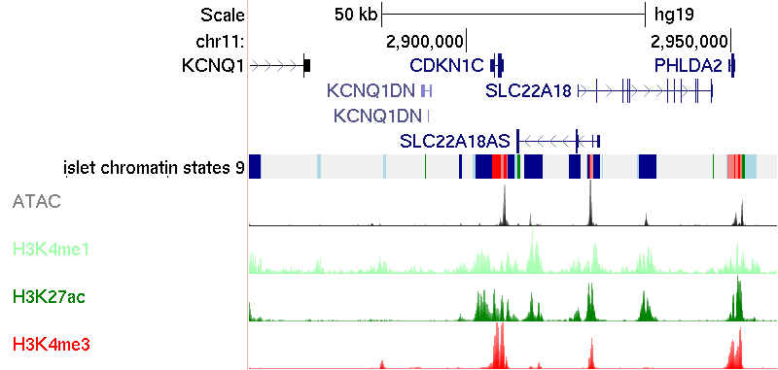
What can ATAC-seq find?
Promoter
Enhancer

Slide 6
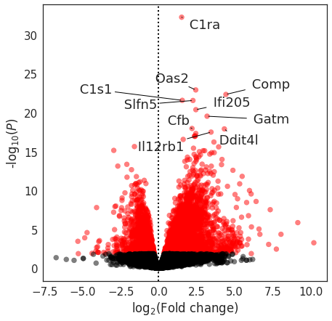
Examples of ATAC-seq uses
Like RNA-seq…
Unlike RNA-seq…
Differential accessible chromatin activity across treatments or conditions (like differential expression)
Map networks of co-accessible regulatory peak (like finding networks of co-expressed genes)
Discover enriched transcription factor motifs that may be driving regulatory activity
Map non-coding disease risk to specific tissues (variation from genetic association studies)

Slide 7
Chromatin changes in immune cells in response to PMA-I stimulation
Genome browser shots around cell-specific genes at the basal (non-stimulated) state for different immune cell types
Calderon et al., 2018; biorxiv

Slide 8
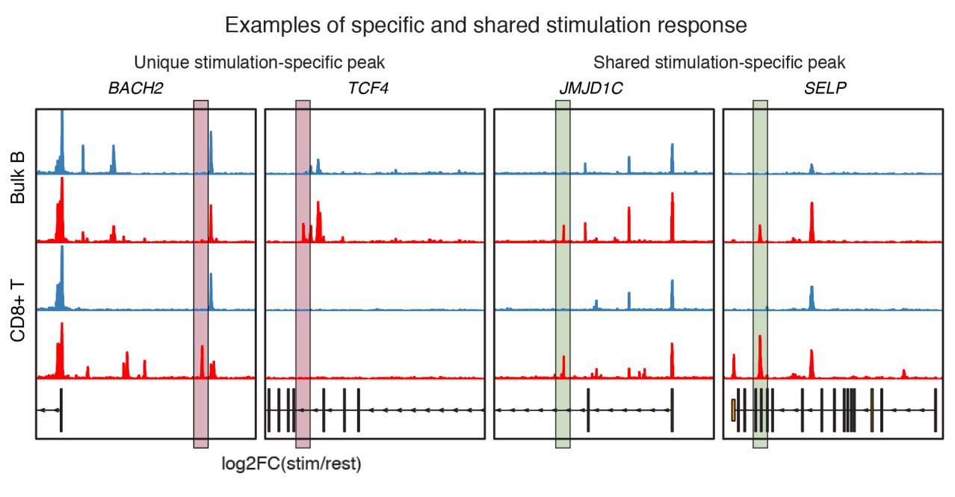
Chromatin changes in immune cells in response to PMA-I stimulation
Differential accessible chromatin analysis identifies both shared and cell type specific chromatin changes after PMA stimulation
Calderon et al., 2018; biorxiv

Slide 9
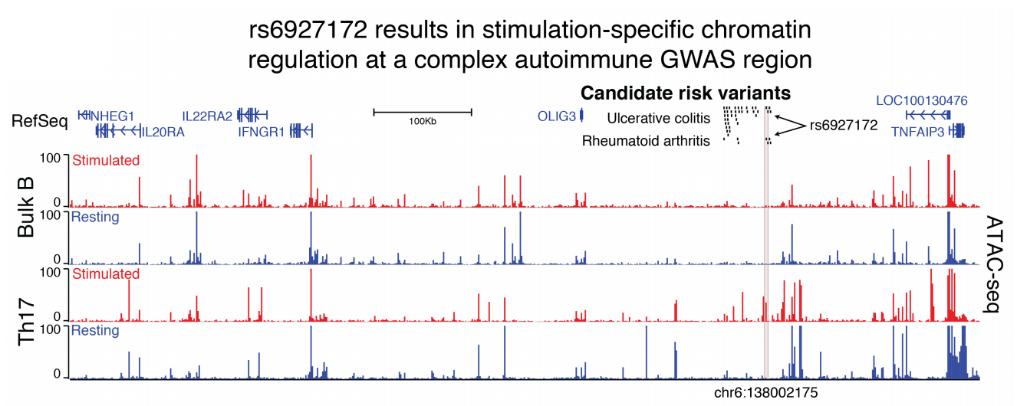
Integration of stimulated ATAC-seq data with disease risk
Calderon et al., 2018; biorxiv

Slide 10
What will we be learning to do with ATAC-seq?
Run through an ATAC-seq processing pipeline
Trim adapters from reads
Align paired-end reads and remove duplicate reads
Call ATAC-seq peaks
Find peaks that are specific to the LPS treatment dataset
Use gene ontology (for non-coding regions) to summarize broad changes after LPS treatment
Find motifs that are enriched after LPS treatment
Visualize ATAC-seq tracks on the genome browser

Slide 11
Single cell ATAC-seq
Relatively new (2015) technology that allows profiling accessible chromatin at single cell resolution
Handful of published papers from 3 labs so far
Challenging to perform and analyze due to the binary readout (might be easier once 10X releases their kit)
Buenrostro et al., 2018

Slide 12
UCSD faculty that use ATAC-seq (among other tools) in their research
BMS Faculty*
Non-BMS Faculty
Bing Ren
Kyle Gaulton
Maike Sander
Kelly Frazer
Neil Chi
Frank Furnari
Paul Mischel
Joe Gleeson
Alon Goren
Olivier Harismendy
Paula Desplatz
Nick Webster
*And many more…

