Slide 1
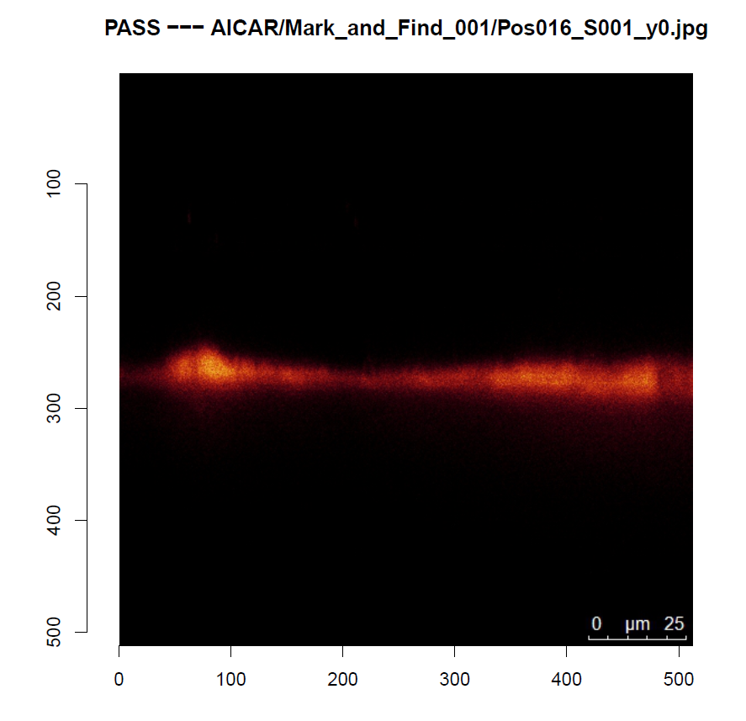
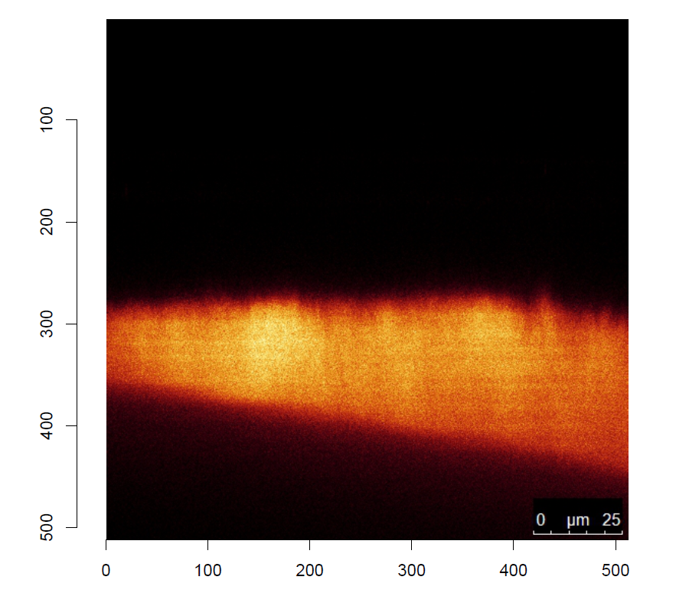
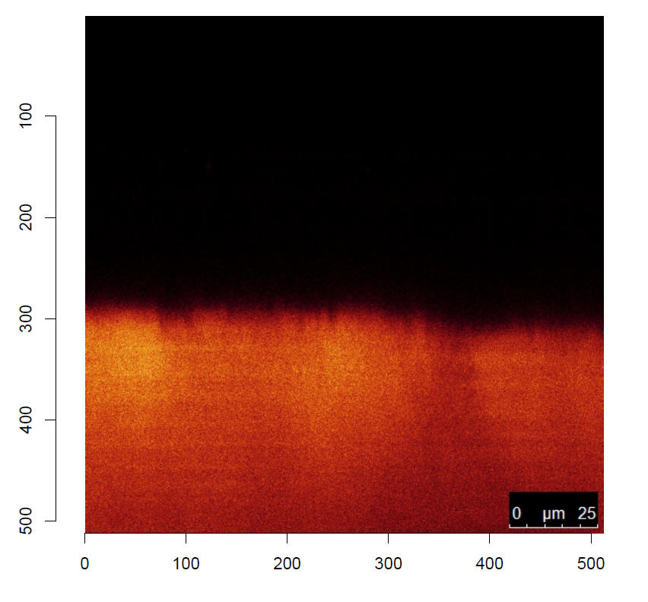
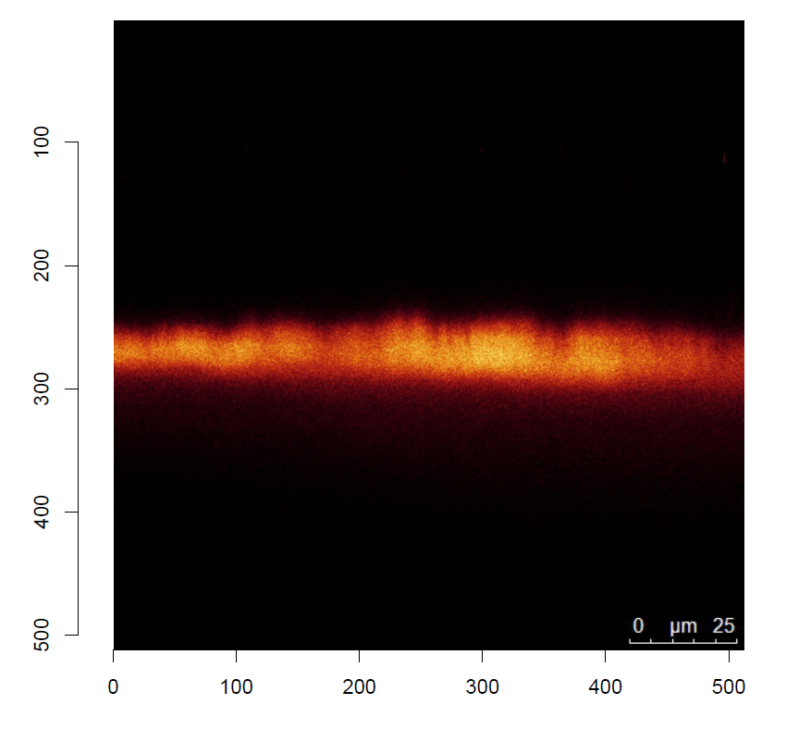
Airway Surface Liquid (ASL) heights
Area between mucus and epithelial cells
One of the many approaches in measuring the effects of peptides
A single experiment can yield thousands of images
Can be very subjective

Slide 3
Considerations
Processing images in their entirety is computationally expensive
This needs to be ran by a researcher that does not access an HPC cluster, cloud, etc
Can be complicated, so should try to employ machine learning
But as above, must be lightweight
Needs to be comparable to historical data
Benchmark the software against old data

Slide 4
Make some categories
Have researchers rate images on a spectrum
Allows for a form of leniency to make a pass/fail call
1
3
2
5

Slide 5
Find the data
What features do great/good images have over bad/unusable images?
All lies in the distribution of signal
Isolate red channel, sum intensities
Serves as a more lightweight alternative to and entire image
Use these distributions to train a random forest
file group distribution
✔ IMG01 1 0000000000011115559999555111100000000000
❌ IMG02 5 9999999999988887777666222110000000000000
✔ IMG03 1 0000000000000000000000000002234889876510
✔ IMG04 1 0000112255889996521000000000000000000000
✔ IMG05 2 0000000000000000033888844221100000000000

Slide 6
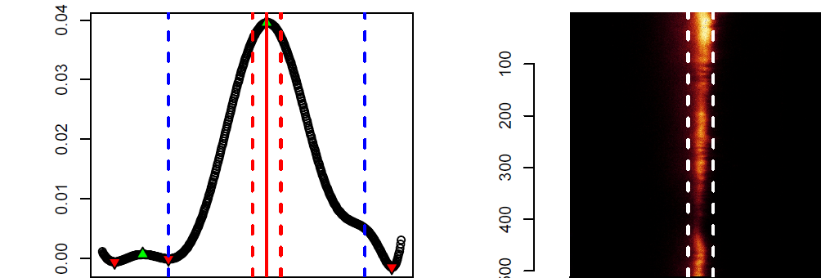
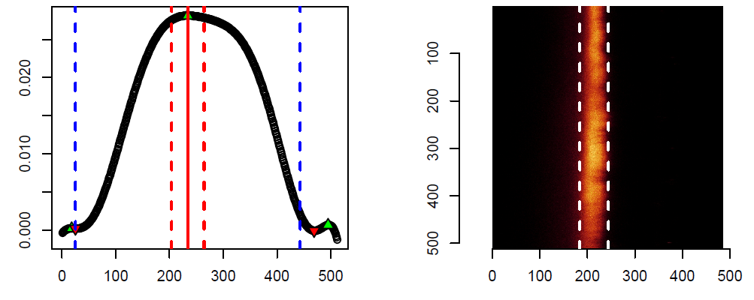
Measuring ASLs of passing images
If an image passes, the distribution is fit to a high order polynomial
Allows for ‘flexing’ across the data to find a ‘peak’
Highest peak with the neighboring valleys allow to pinpoint the band
Capturing the band width itself is relatively easy

Slide 7
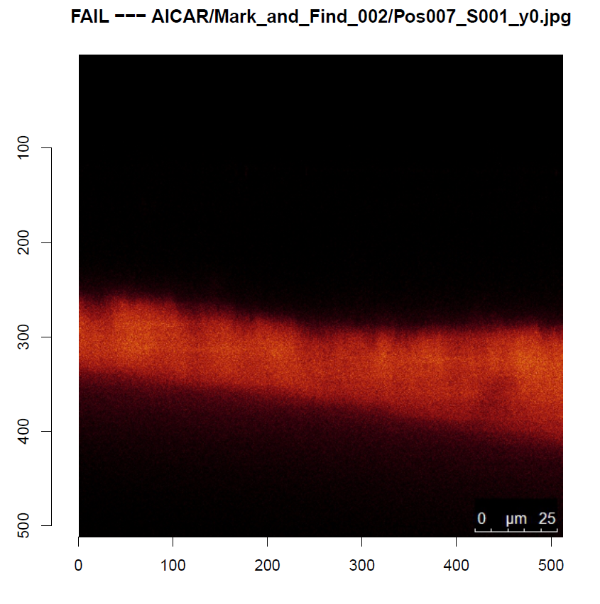
Results
Training model allows for 96% accuracy in classifying images as pass or fail
Losing a good image isn’t the end of the world
Keeping a bad image is, so reporting IQR of data protects the confidence of results
High speed
~300/min on cheap computer
Automated output
ggplots, Excel compatible tables
Groupwise comparisons
Pass/fail PDF and log for review

