Slide 1
Dogecoin sentiment analysis using Amazon Comprehend and python nltk
Presented by: Bryan Kenneth Barrion

Slide 2
Agenda
Setup
Dashboards
All tweets
Positive
Negative
Data Architecture

Slide 3
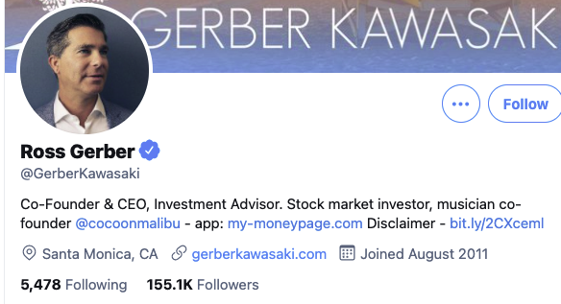
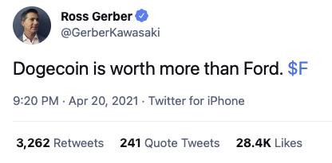
Setup
Date tested : April 10, 2021 to May 10, 2021
Significant movement of Dogecoin
Prices went up, sideways and down
Verified tweeters were only tested
Users or Companies that are famous and is verified by Twitter
Significant number of likes/retweets per tweet
Maximum of 1000 tweets per day were tested
A Total of 11894 tweets were collected

Slide 4
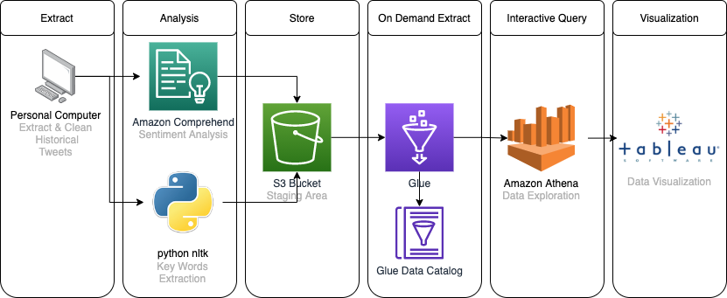
Data Architecture

Slide 5
Sentiment are High, Price increases
Sentiment are Low, Price decreases
Sentiments are neutral, Price went sideways
Sentiments are High, Price increases
Sentiments are Low, Price decreases
1
4
3
2
5

Slide 7
Positive Sentiment Dashboard

Slide 8
Negative Sentiment Dashboard

