Slide 1
R Forecast
Alexis Richards, Bryce Bowles, Brenna Mayer, Chris Pirrello, Grace Zhang

Slide 2
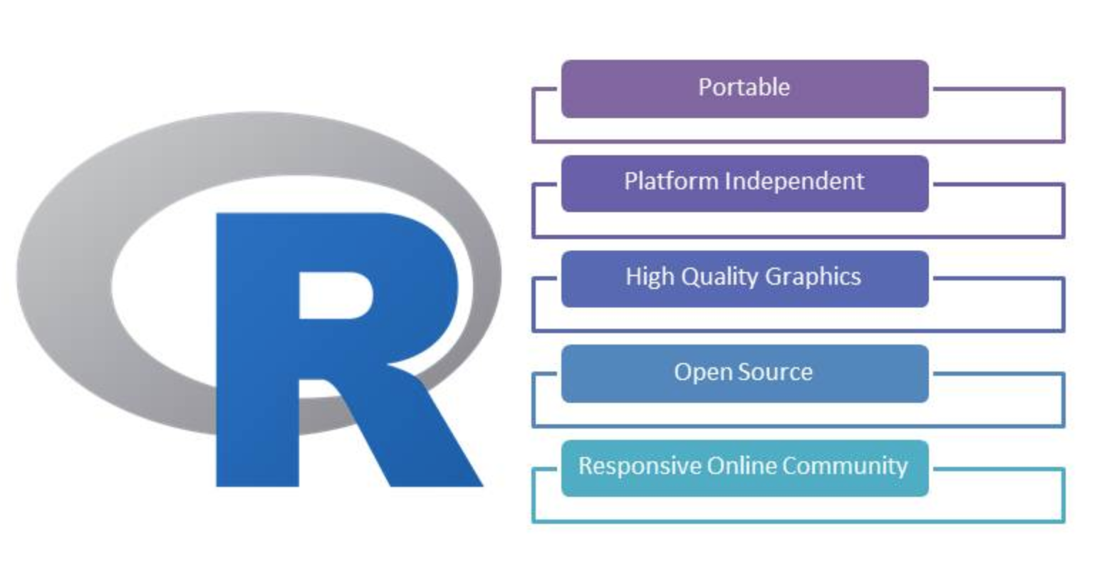
Introduction to R
What is it?
Programming language
Widely available
Free software
What is it used for?
Statistics
Data analysis
Machine learning algorithm
Who uses it?
Academics
Companies in many industries (Uber and Google for example)

Slide 3
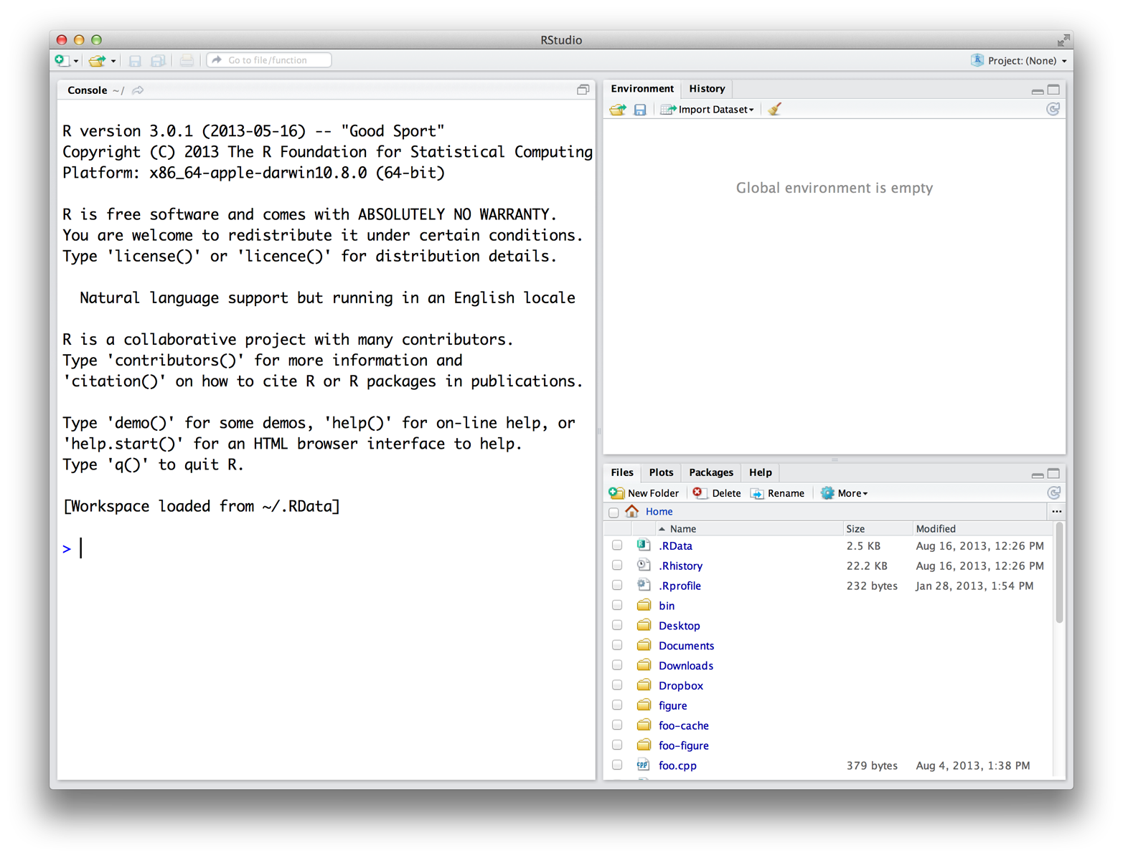
Introduction to R
Using R:
R Studio Application free to download
Can be used on Mac and Windows
R Studio is used to help write R code

Slide 4
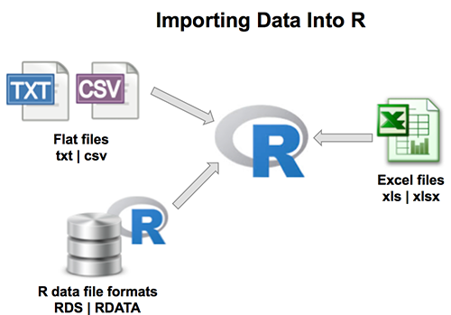
Ease or difficulty getting data into software?
Check your data
1st row headers
Missing values are “NA”
Avoid using special characters such as ?, $,%, ^, &, *, (, ),-,#, ?,,,<,>, /, |, \, [ ,] ,{, and };
Importing Data Files
Most file types/sources including other statistical software
Format Columns for Data types
R must have the data labeled as correct format
Vectors (numerical, date, character, logical,)
Matrices (2-dimensional Vectors)
Data frames (column and row labels)
Time series are often ordered in data frames.
Lists
Etc.
Notes:
Overall, it can be known as difficult to import the data. Here are a few steps you’ll need to take to import the data.

Slide 5
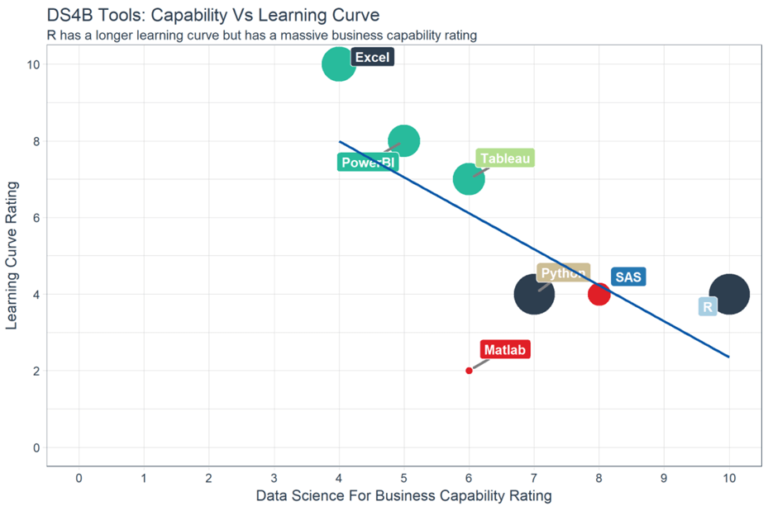
Ease of use?
Reputation: Hard to learn
Easing the difficulty
R packages - prevent having to reinvent the wheel
*Documentation and training
Easier to master more complicated models than in other software
Open source Software
Users can modify and share because it’s design is publicly accessible
Less secure
Notes:
https://www.guru99.com/r-programming-introduction-basics.html

Slide 6
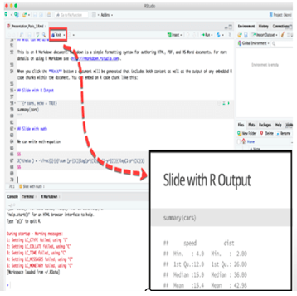
Transparency
Is R Transparent?
If you understand the code, yes.
Markdown is required to display results in a way that a lay person can understand
Notes:
Brenna

Slide 7

Flexibility
Good data required
Automatic Forecast models are available
Fluent users can customize their forecasting models.
Notes:
Brenna

Slide 8
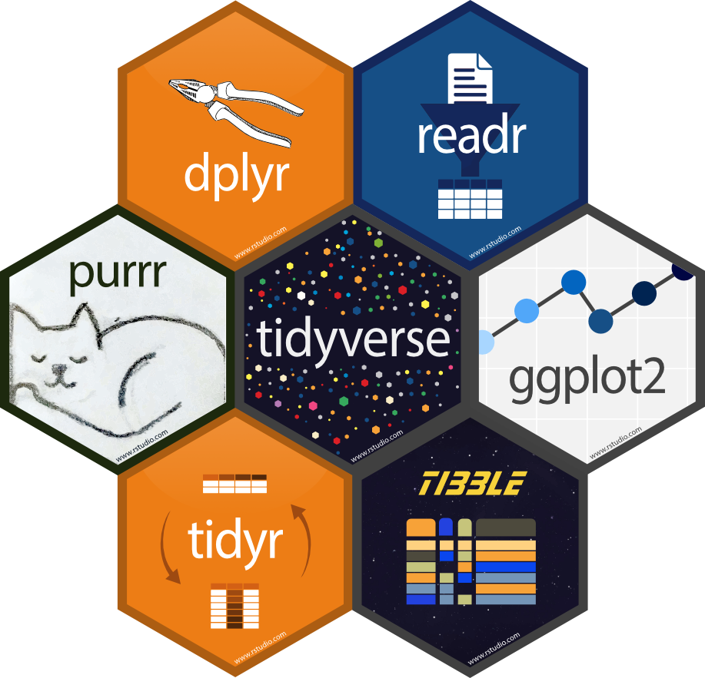
Data Cleansing - Tidyverse
Read Data
Import
Data Manipulation
Transform
Programing
Visualise
Create
Graphics
Advanced Toolkit
Reimagin data.frame
Tidy Data
Tidy
Notes:
https://www.tidyverse.org/packages/

Slide 9
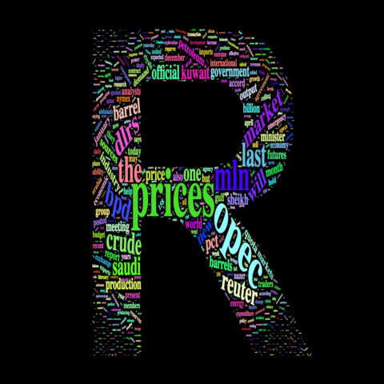
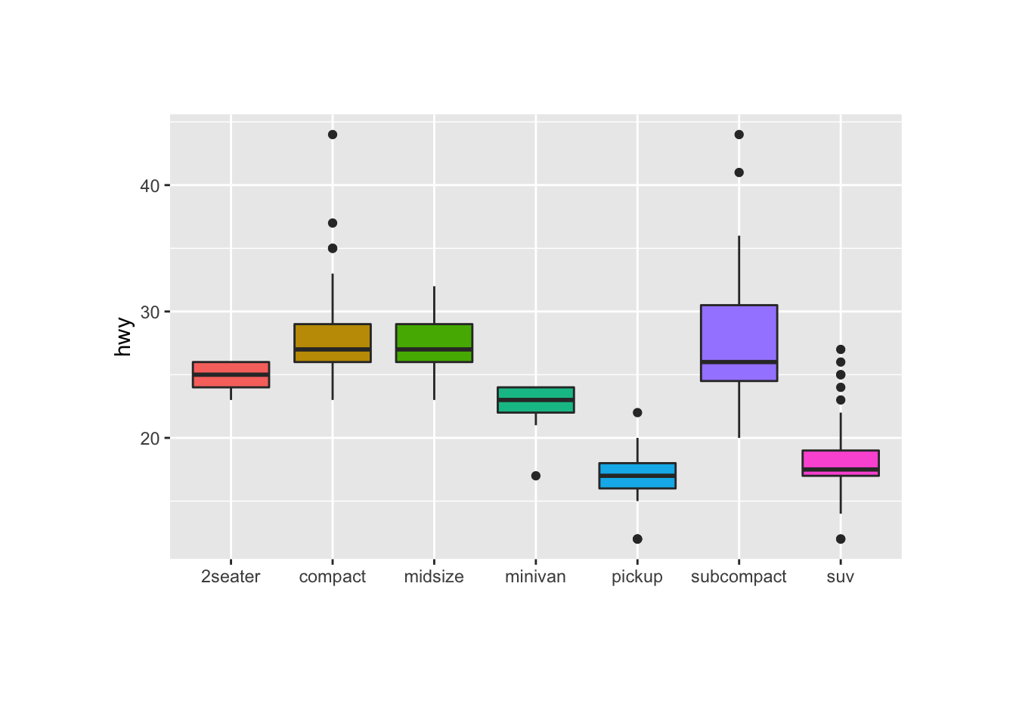
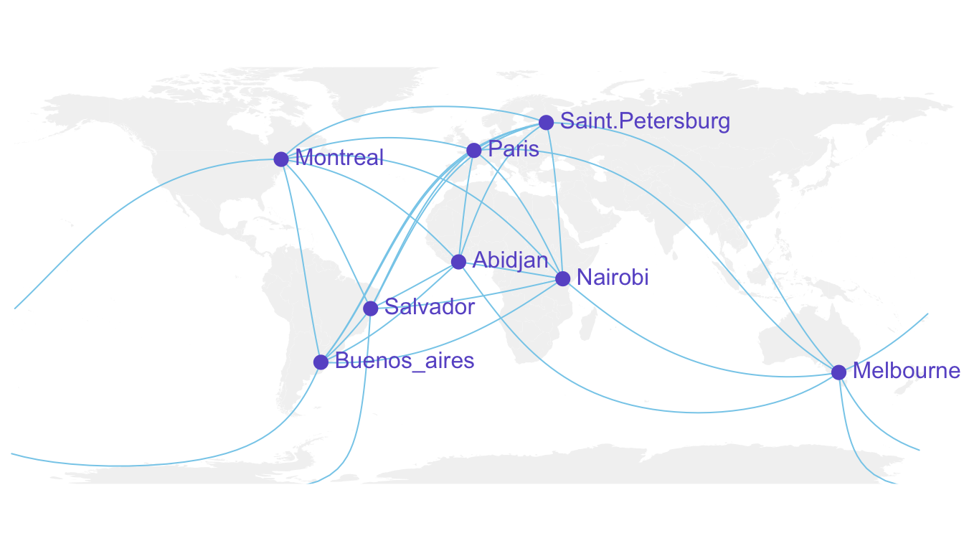
Output - Visualize
Notes:
https://www.r-graph-gallery.com/271-ggplot2-animated-gif-chart-with-gganimate.html

Slide 10
Live Demo!

Slide 11
Questions?

