Slide 1
KNIME Flower Species Cluster Analysis
Bryce Bowles
04/06/2020

Slide 2
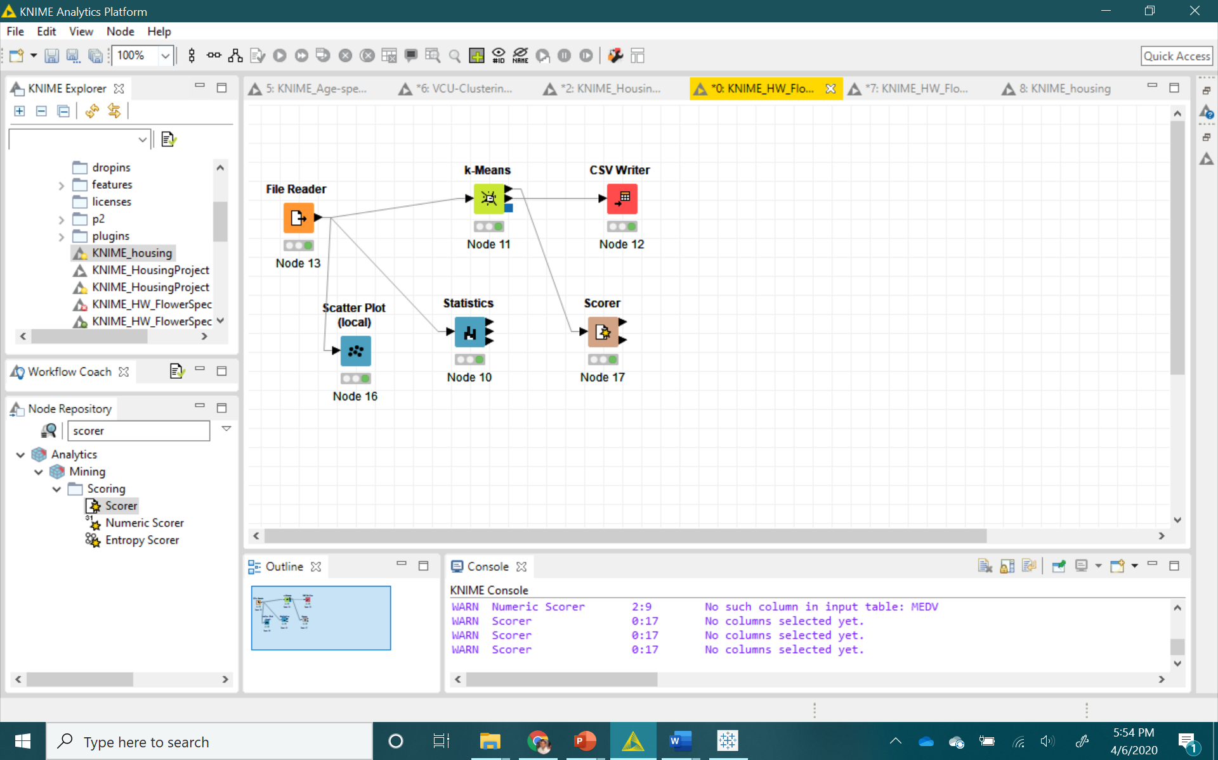
*Clustering model in KNIME: explaining the flow of the process

Slide 3
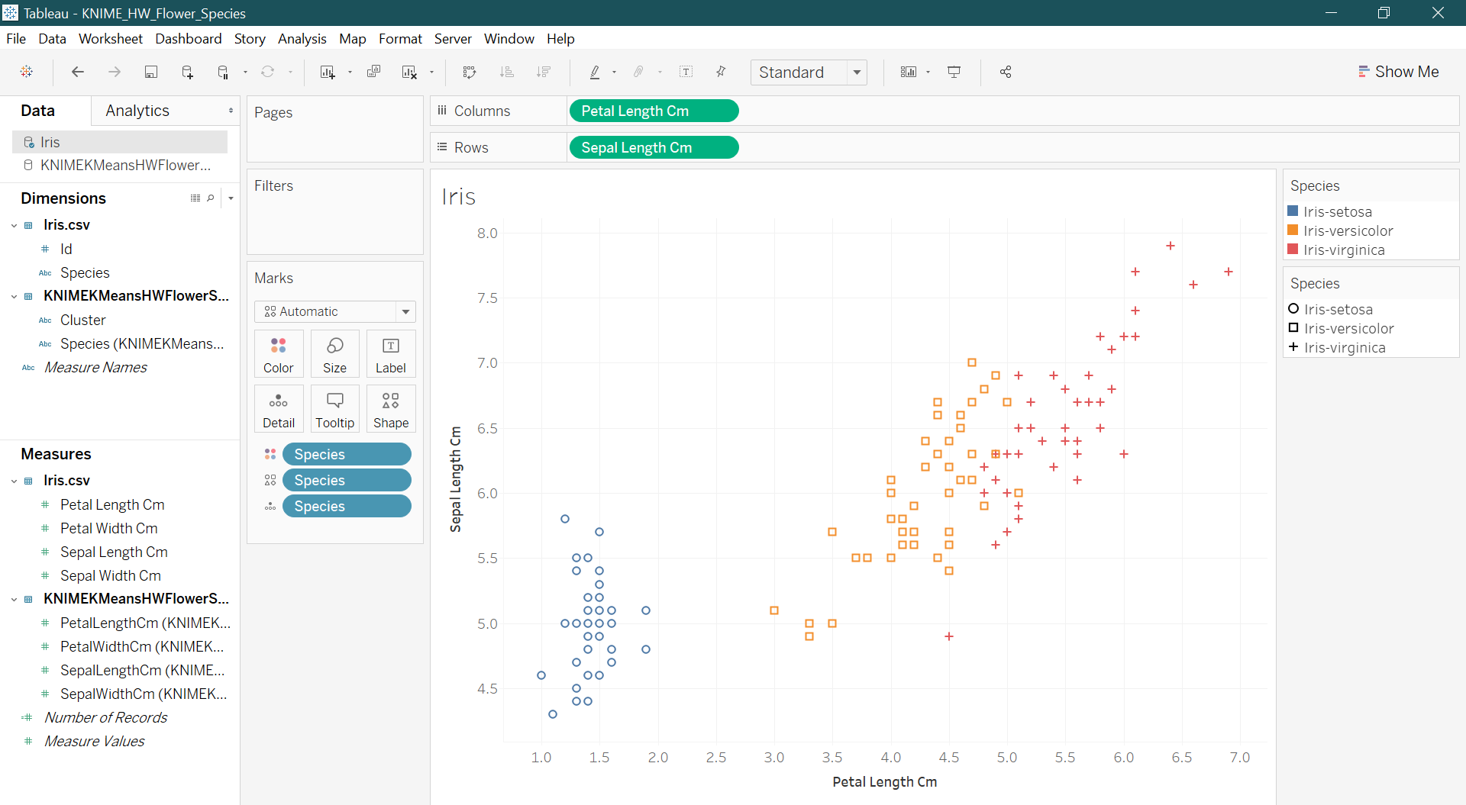
*Clustering model in Tableau: existing flower species or actual clusters

Slide 4
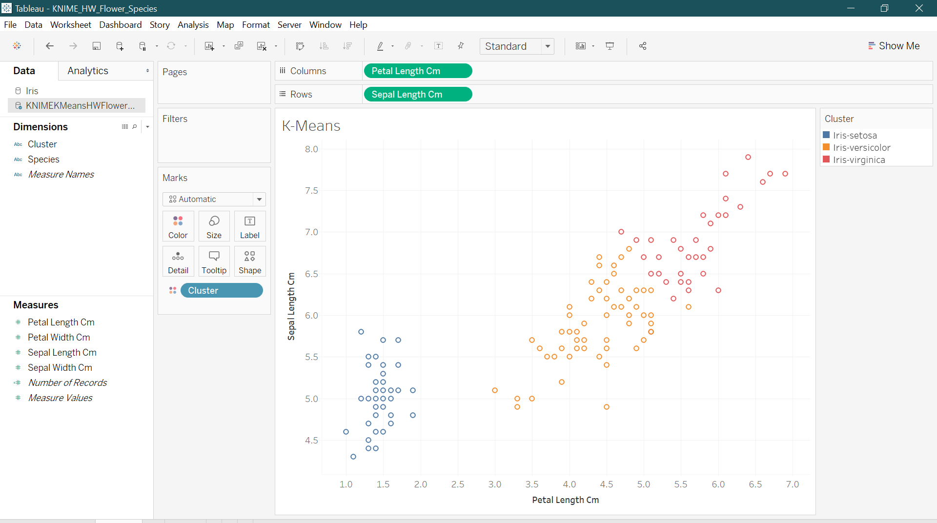
*Clustering model in Tableau: predicted clusters of flower species

Slide 5
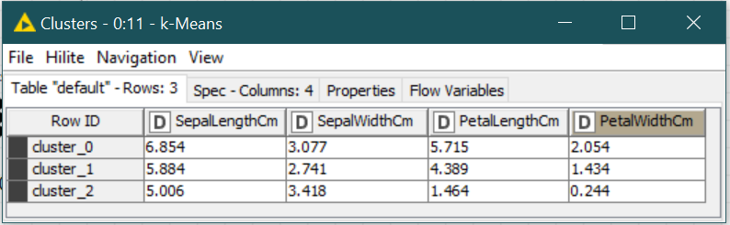
Analysis
Accuracy of predicted vs actual clusters:
What is the overall accuracy of the clustering model in this case?

