Slide 1
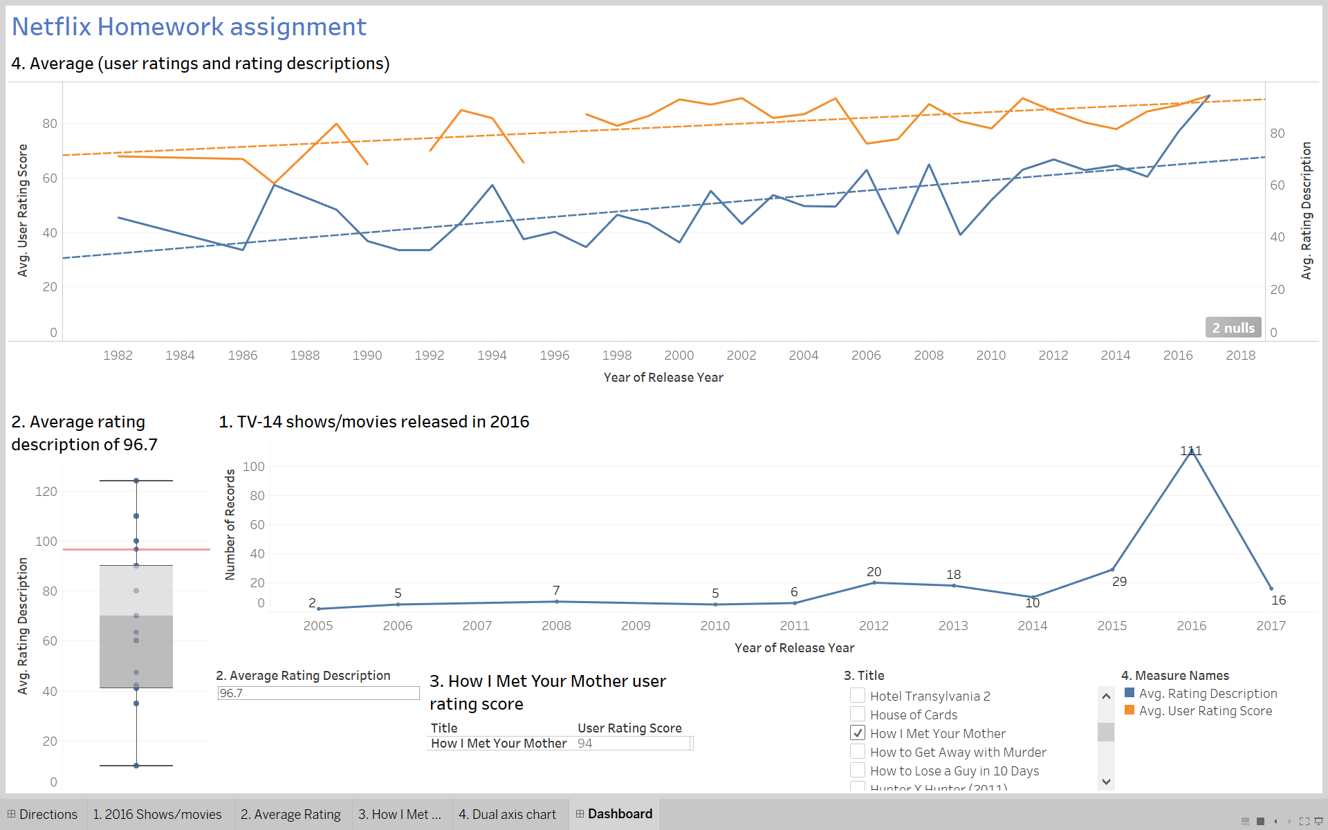
Netflix Student Competition
Line Graph displays the spike in number of shows/movies released in 2016 (111)
Box and Whisker chart shows average rating description in perspective of the other shows/movies. Red reference line indicates “Boardertown” has an average rating description of 96.7.
User rating score has the option to filter based on title (94)
Trend line added to show slope of average past 1980. Average user rating score tends to be higher than average rating description.

