Slide 1
New Product Forecast
Smart Sticky Note Printer
Bryce Bowles
Brenna Mayer
Christopher Pirrello
Alexis Richards
Grace Zhang

Slide 2
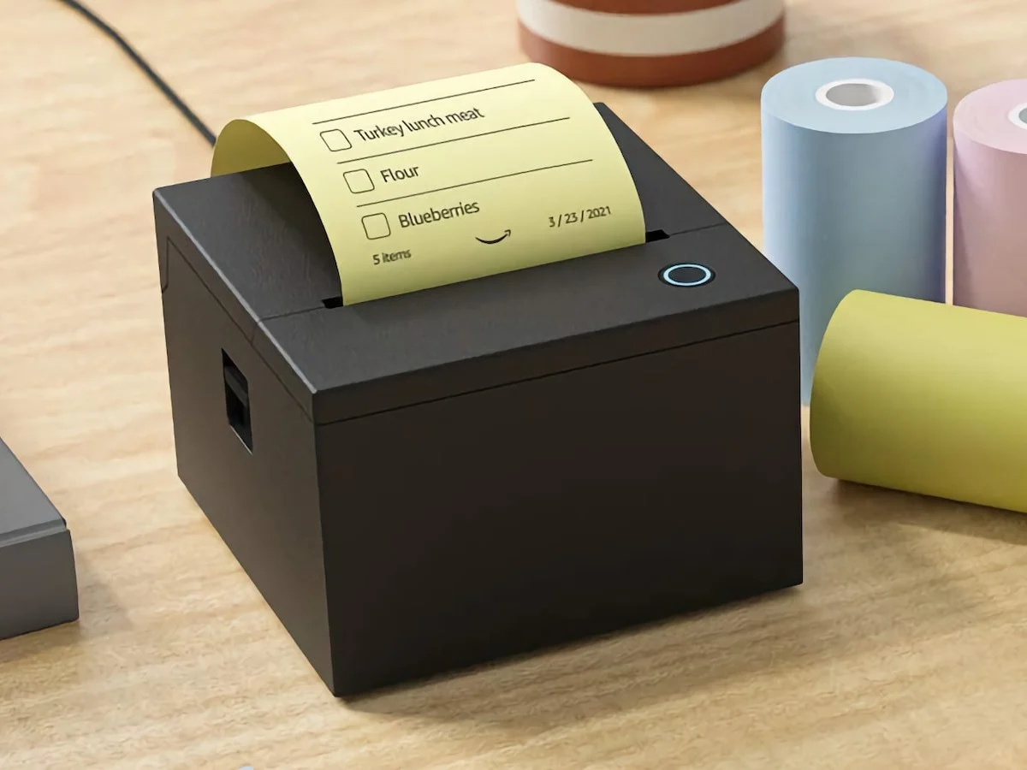
Background - Product
Smart Sticky Note Printer
Day 1 Edition concept
Compatible with Amazon Alexa
Use voice to take notes/make lists
No ink needed
Printer paper refills are sold separately
$90 for the printer and first roll of paper

Slide 3
Background - Industry
Smart Speakers
83.1M Smart Speaker Users
68.2% Amazon
Valued at $11.9B
Speaker starting price $24.99
Once a customer buys their first device, it is very unlikely that they will switch to a competitor
Printers
Approximately 70% of the U.S. workforce is working from home
Companies changed focus from commercial to personal printers
The future of the workforce is an important variable

Slide 4
Delphi Method - Round 1
Expert 2
Year 1 - $450,000
Year 2 - $720,000
Year 3 - $675,000
Expert 1
Year 1 - $270,000
Year 2 - $450,000
Year 3 - $540,000
Forecast Coordinator
Expert 5
Year 1 - $1,053,000
Year 2 - $1,350,000
Year 3 - $1,575,000
Expert 4
Year 1 - $121,500
Year 2 - $938,250
Year 3 - $2,061,630
Expert 3
Year 1 - $255,060
Year 2 - $280,530
Year 3 - $336,600

Slide 5
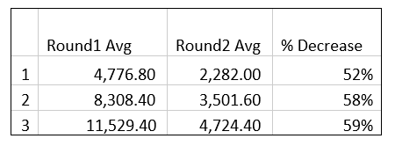
Delphi Method - Round 2
Expert 2
Year 1 - $134,190
Year 2 - $147,600
Year 3 - $162,360
Expert 1
Year 1 - $180,000
Year 2 - $360,000
Year 3 - $450,000
Forecast Coordinator
Expert 5
Year 1 - $208,620
Year 2 - $271,260
Year 3 - $298,350
Expert 4
Year 1 - $121,460
Year 2 - $337,795
Year 3 - $618,511
Expert 3
Year 1 - $382,590
Year 2 - $459,090
Year 3 - $596,790

Slide 6
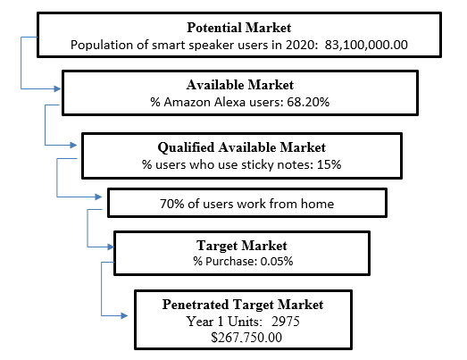
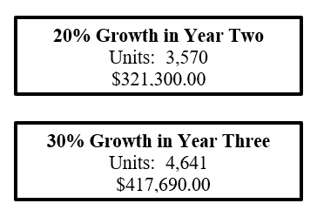
New Product Forecasting - Assumptions Based

Slide 7
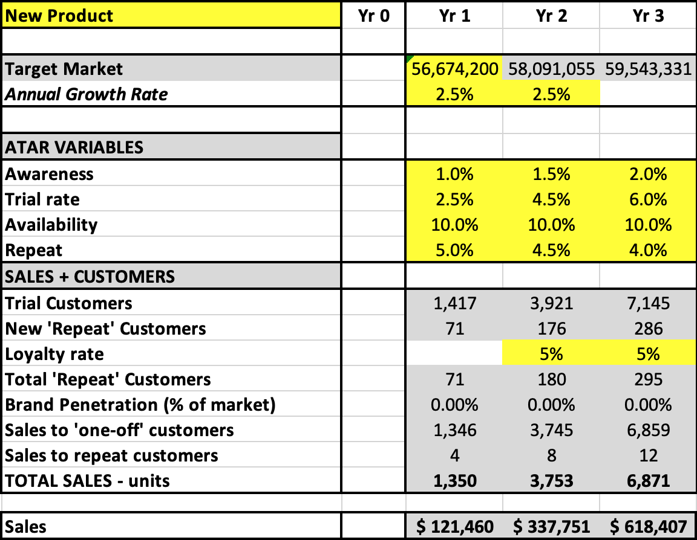
Assumptions Based - ATAR model
Target Market - 68.2% of Smart Speak User Population.
Low Awareness due to “Amazon Day 1: Editions”. Minimal marketing of product.
Trail Rate Year 1 driven by Diffusion of Innovation - Innovators (2.5%)
Low Availability - Sold only on Amazon
Low Repeat Customers - Customers will only re-buy this item if its for friends or family.
Low Loyalty Rate - Driven by uniqueness of product and market competition.

Slide 8
ATAR Model - Sensitivity Analysis
 | Market Size | Awareness | Trial | Availability | 1st Year Penetration | Potential | Revenue (Price = $90 each)
Best Case | 56,674,200 | 3.00% | 3.50% | 25% | 25% | 3719 | $334,731.99
Likely Case | 56,674,200 | 1% | 2.50% | 10% | 15% | 213 | $19,127.54
Worst Case | 56,674,200 | 0.50% | 1% | 5% | 10% | 14 | $1,275.17
 | Worst | Likely | Best | Range | $ Below | $ Above
Awareness | $ 9,563.77 | $19,127.54 | $ 57,382.63 | $ 47,818.86 | $9,563.77 | $ 38,255.09
Trial | $ 7,651.02 | $19,127.54 | $ 26,778.56 | $ 19,127.54 | $11,476.53 | $ 7,651.02
Availability | $ 9,563.77 | $19,127.54 | $ 47,818.86 | $ 38,255.09 | $9,563.77 | $ 28,691.31
1st Year Penetration | $ 12,751.70 | $19,127.54 | $ 31,879.24 | $ 19,127.54 | $6,375.85 | $ 12,751.70

Slide 9
Recommendation - Final Projection
Final Projection - ATAR Model
Delphi Method resulted in high range of forecast
Assumptions Based Model is based on market research assumptions
ATAR Model is based on the same assumptions considering trial rate, repeat purchases, and customer loyalty

Slide 10
Questions?

