Slide 1
Opioid Prescribing Data
INFO 609 Data Centric Reengineering
12/13/2021
Bryce Bowles
Bhumika Modi
Allen Philips Agnelo

Slide 2
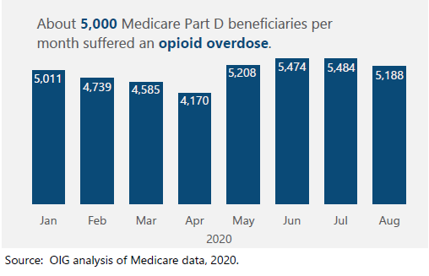
Why
Key to addressing the Opioid Crisis:
Identifying individuals and geographic areas who are at risk of overdose or abuse
Concerns related to accessing treatment.
“At least 5,000 Part D beneficiaries per month suffered an opioid overdose during the first 8 months of 2020.”
Families and Children are affected by loved ones lost

Slide 3
Data Background
Data is from Centers for Medicare & Medicaid Services (Data.CMS.gov)
In 2019, Medicare Part D spending was $183 billion; U.S. retail prescription drug spending was about $370 billion.
“Nearly a million (930,433) people are covered by Medicare Part D in Virginia in 2018.”
“74% of Medicare beneficiaries have Medicare prescription drug coverage”
Virginia Sample size is roughly, almost 700,000
Year State County Locality_Level Region Tot_Prscrbrs Tot_Opioid_Prscrbrs Tot_Opioid_Clms | Tot_Clms Opioid_Prscrbng_Rate Opioid_Prscrbng_Rate_5Y_Chg Opioid_Prscrbng_Rate_1Y_Chg LA_Tot_Opioid_Clms LA_Opioid_Prscrbng_Rate LA_Opioid_Prscrbng_Rate_5Y_Chg LA_Opioid_Prscrbng_Rate_1Y_Chg
Notes:
https://data.cms.gov/summary-statistics-on-use-and-payments/medicare-medicaid-opioid-prescribing-rates/medicare-part-d-opioid-prescribing-rates-by-geography

Slide 4

Data Definitions
Medicare:
Federal (Government-run) health insurance program that provides health coverage if you are 65+ or under 65 and have a disability, no matter your income.
Opioid Prescribing Rate
= Total Opioid Prescribers / Total Prescribers
Derived using data from Medicare Part D claims prescribed by health care providers.
Long-Acting Opioid:
Opioid medicines used to relieve moderate to severe long-term pain (extended-release opioids)
Claim:
A claim asks Medicare or your insurer to pay for your medical care. Claims are submitted to Medicare after you see a doctor or are treated in a hospital or in this case, filling a prescription
Notes:
https://www.cms.gov/
http://www.nacns.org/wp-content/uploads/2016/11/CMS_ReimbursementClaim.pdf
https://www.medicareresources.org/faqs/how-do-i-file-a-medicare-claim/#:~:text=What%20is%20a%20Medicare%20claim,process%20claims%20on%20Medicare%27s%20behalf.
1Y and 5Y Change: Opioid prescribing rates are derived using data from Medicare Part D claims prescribed by health care providers. The mapping tool presents data for 2019, changes in rates from 2018 to 2019, and changes in rates from 2014 to 2019.
If you have a Medicare Advantage or Part D plan, your insurer will process claims on Medicare's behalf.

Slide 5

Tableau Demo
Notes:
1. Neighboring States (Allen and Bhumika)
2. VA (Bryce)

Slide 6
Conclusions
From 2016 to 2019, Medicare Prescribing rates saw a steady decline in opioid use, along with an increased use of drugs for treatment of opioid use disorder.
Highest and lowest county with opioid prescribing rate change in 5 years is Harnett and Shelby in the state of North Carolina and Tennessee respectively.
Highest and lowest county with opioid prescribing rate change in 1 year is Botetourt and Washington in the state of Virginia and Maryland respectively.
The highest and lowest long-acting opioid 5-year change would be the county of Warren and Prince George's in the states of North Carolina and Maryland respectively.
The highest and lowest long-acting opioid 1-year change would be the county of Rockingham and Baltimore in the states of Virginia and Maryland respectively.
Locality levels: Level 3 is Greatest, then Level 2 and Level one
High Total Opioid Claims and Prescribers
Fairfax (Geo cd 51059), Richmond City (Geo cd 51706), Norfolk City (51710) etc.

Slide 7
Continued Research Throughout Covid-19
The U.S. Department of Health and Human Services has continued to monitor opioid use in Part D during the onset of COVID-19
They have found:
About 5,000 Medicare beneficiaries per month suffered an opioid overdose during the first 8 months of 2020.
# receiving short-term opioid prescriptions dipped, with a particularly sharp decline in April.
About 220,000 beneficiaries received high amounts of opioids in the first 8 months of 2020.
At the same time, the number of beneficiaries receiving drugs for medication-assisted treatment of opioid use disorder increased slightly.
The number of beneficiaries receiving naloxone—a drug that can reverse an opioid overdose-declined through April, but increased in the following months.
https://oig.hhs.gov/oei/reports/OEI-02-20-00400.asp

Slide 8

Questions?

Slide 9
Sources
Source: https://www.cms.gov/Research-Statistics-Data-and-Systems/Statistics-Trends-and-Reports/Medicare-Provider-Charge-Data/OpioidMap and https://data.cms.gov/summary-statistics-on-use-and-payments/medicare-medicaid-opioid-prescribing-rates/medicare-part-d-opioid-prescribing-rates-by-geography
Our dataset is on Medicare Part D Opioid Prescribing Mapping Tool. (https://cms-oeda.maps.arcgis.com/apps/MapSeries/index.html?appid=5390718d875d4c049b1ac5976a9ff083). Provides data on opioid prescriptions filled.
Dataset Methodology and Data Limits: https://data.cms.gov/resources/medicare-part-d-opioid-prescribing-rates-by-geography-methodology
https://oig.hhs.gov/oei/reports/OEI-02-20-00400.asp

Slide 10
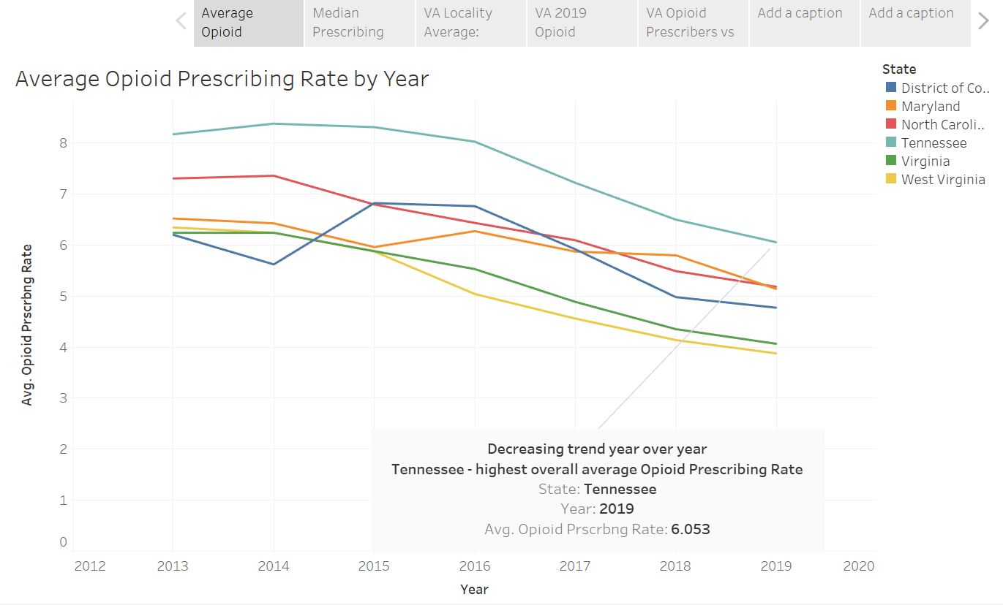

Slide 11
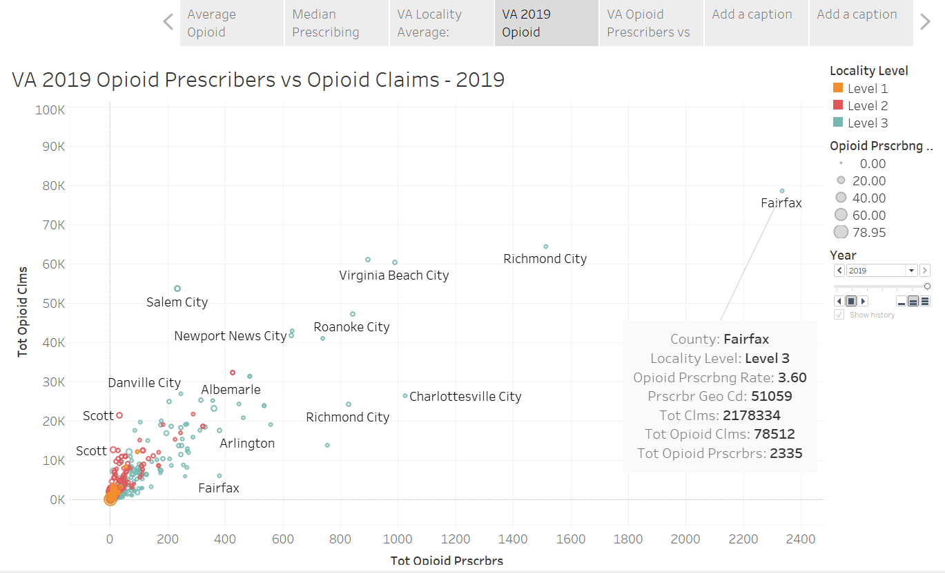

Slide 12
