Slide 1
CAPSTONE PACKAGE
PJ Channel Customer Value Analysis
Headline Channel Snapshot
Direct / Owned
139
$1,101.06
30.0% repeat
Data Technology Capstone | Public / School-Safe Version | May 2026
A privacy-safe analysis of which acquisition/source channels appear to bring higher-value Permanent Jewelry customers.
Paid Search
89
$1,455.22
42.7% repeat
Organic Search
70
9,021
19
3
$1,338.89
37.1% repeat
customer rows
eligibility rows
headline channels
Local-only; not public.
Aggregate summary rows.
Final eligible channels.
Source: aggregate capstone outputs; public/school-safe package.
01
Notes:
Open by framing the capstone as a customer value analysis, not a raw data presentation. Emphasize that this is the public/school-safe version and that only aggregate outputs are shown.

Slide 2
OBJECTIVE
The project asks which channels bring higher-value PJ customers.
Which acquisition/source channels appear to bring higher-value Permanent Jewelry customers when measured by 12-month revenue, repeat behavior, and follow-on consumables activity?
12M
Repeat
Follow-on
customer revenue
purchase behavior
consumables activity
Captures value after acquisition instead of first order only.
Shows whether customers continue buying after the first transaction.
Signals downstream product engagement after PJ purchase.
Why this matters
Acquisition volume alone can hide weak long-term customer value.
Channel recommendations need clean source eligibility rules.
Source: aggregate capstone outputs; public/school-safe package.
02
Notes:
State the research question directly. The three measures intentionally move the analysis from acquisition activity to customer value and retention behavior.

Slide 3
BUSINESS CONTEXT
Strong first-order channels do not always become strong value channels.
The capstone compares acquisition sources using a downstream customer value path.
1
First order
2
12-month value
3
Repeat behavior
4
Consumables
Initial acquisition signal from Shopify order activity.
Customer revenue accumulated inside the value window.
Whether the customer comes back after acquisition.
Follow-on behavior tied to downstream PJ needs.
Goal: compare channels using value and retention, not just sessions or first-order volume.
Source: aggregate capstone outputs; public/school-safe package.
03
Notes:
Explain that the analysis follows the customer after acquisition. The goal is to avoid over-weighting channels that generate activity but not durable customer value.

Slide 4
DATA SOURCES
Each platform had a specific role in the analysis.
Raw exports stayed private. Public outputs use aggregate summaries and methodology documentation.
Shopify
HubSpot
Salesforce
GA4
Tableau
Customers, orders, order lines, and products. Used locally to build customer value windows and product behavior measures.
Main customer-source bridge because Shopify email matching was very strong.
Supporting validation and enrichment for CRM context, Shop URL validation, and directional PJ order/revenue checks.
Marketing-platform validation only. Exports can overlap and are not treated as deduplicated totals.
Aggregate-safe visualization layer using packaged CSV exports only.
No raw customer/contact/order data is included in this public-facing package.
Source: aggregate capstone outputs; public/school-safe package.
04
Notes:
Walk through the system roles. Shopify is value behavior, HubSpot is source bridge, Salesforce validates CRM/store context, GA4 validates marketing channels in aggregate, and Tableau presents aggregate outputs.

Slide 5
PRIVACY
The final package is aggregate-only and public safe.
Included in public package
Excluded from public package
Aggregate channel KPI tables
Raw Shopify, HubSpot, Salesforce, and GA4 exports
Safe Tableau aggregate CSVs
Customer-level processed datasets
Methodology and reviewer documentation
Names, emails, phones, addresses, order IDs
Sanitized screenshots only if reviewed
Internal-only screenshots
9,021
<5
0
local customer-level rows
small-cell threshold
raw rows in deliverables
Local analysis file only.
Monthly value/rate suppression.
Aggregate outputs only.
Source: aggregate capstone outputs; public/school-safe package.
05
Notes:
This is the explicit safety slide. Point out that the customer value dataset exists locally for analysis but is not part of the public submission.

Slide 6
PREPARATION
Customer value was built through a controlled matching workflow.
The workflow joins local customer/order behavior to source context, then reports aggregate results.
1
Validate Shopify relationships
2
Normalize matching fields
3
Map source labels
Confirm customer, order, and order-line structure before value calculations.
Normalize email to match Shopify customers to HubSpot contact/source context.
Translate CRM source values into usable derived channel groups.
4
Classify products
5
Build value windows
6
Aggregate safely
Identify product behavior needed for follow-on consumables metrics.
Calculate first-order, 30/60/90-day, and 12-month customer value measures.
Export channel-level EDA and Tableau tables without customer-level rows.
Source: aggregate capstone outputs; public/school-safe package.
06
Notes:
Use this slide to show that the technical work is staged: validate the base data, match and enrich, classify products, build value windows, then aggregate.

Slide 7
VALIDATION
HubSpot carried source mapping; Salesforce and GA4 validated context.
HubSpot
Salesforce
GA4
Primary source bridge
Supporting CRM validation
Marketing validation only
High Shopify email match rate
CRM context enrichment
Aggregate channel support
Customer-source mapping
Shop URL validation
Overlap caveat documented
Derived channel labels
Directional PJ order/revenue checks
Not deduplicated customer value
Salesforce Shop URL validation identified https://sunstonepj.myshopify.com as the PJ Shopify store.
Source: aggregate capstone outputs; public/school-safe package.
07
Notes:
This slide explains the validation hierarchy. HubSpot is the bridge for customer-level source labels; Salesforce and GA4 add confidence but do not replace Shopify customer value.

Slide 8
ELIGIBILITY
Eligibility rules separated true acquisition channels from noisy source buckets.
Class
Rule
Use in Recommendation
Headline Eligible
True channel and >=50 customers
Main findings
Directional / Supporting
Small sample, imported/list, support, or context-only
Supporting context
Excluded
System, sync, technical, integration
Not used
Needs Review
Missing, unassigned, GA4-only, or unclear
Future mapping
Final headline-eligible channels
Cross-network and Organic Shopping were visible in GA4 but not cleanly mapped to customer-level channel groups.
Direct / Owned
Paid Search
Organic Search
Source: output/tables/channel_eligibility_summary.csv.
08
Notes:
Emphasize why eligibility matters: technical and imported buckets may have revenue, but they are not clean acquisition channels for headline recommendations.

Slide 9
HEADLINE KPIS
Paid Search leads revenue and repeat; Organic leads follow-on consumables.
Channel
Customers
Avg 12M Revenue
Repeat Rate
Follow-On Rate
Direct / Owned
139
$1,101.06
30%
15%
Paid Search
89
$1,455.22
42.70%
21.35%
Organic Search
70
$1,338.89
37.14%
22.86%
$1,455.22
42.70%
22.86%
Paid Search avg 12M revenue
Paid Search repeat rate
Organic follow-on rate
Highest average 12-month customer revenue.
Highest 12-month repeat purchase rate.
Highest follow-on consumables rate.
Source: tableau_exports/tableau_headline_channel_kpis.csv.
09
Notes:
This is the headline result slide. Keep the interpretation directional: Paid Search is strongest on revenue and repeat, Organic Search is strongest on follow-on consumables, and Direct / Owned has the largest sample size.

Slide 10
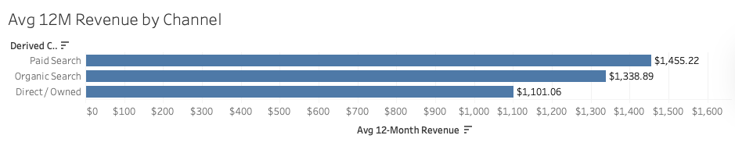
12-MONTH VALUE
Paid Search has the highest average 12-month customer revenue.
Average 12M Revenue by Channel
Direct / Owned
$1,101
Paid Search
$1,455
Organic Search
$1,339
Direct / Owned has the largest sample; Paid Search shows the strongest value signal.
Interpretation: Paid Search appears strongest on 12-month value, but CAC/profitability data is still needed before scaling recommendations.
Source: tableau_exports/tableau_headline_channel_kpis.csv.
10
Notes:
This slide uses the sanitized aggregate Tableau screenshot for average 12-month revenue by channel. Paid Search has the highest average 12-month customer revenue among headline-eligible channels; CAC/profitability data is still needed before scaling recommendations.

Slide 11
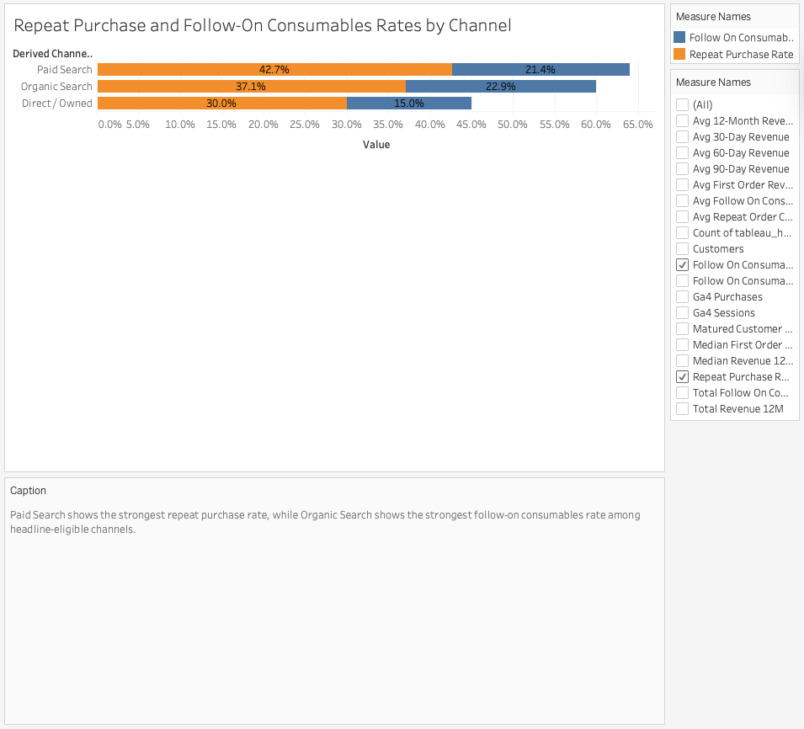
BEHAVIOR
Repeat and follow-on metrics point to different channel strengths.
Repeat Rate vs. Follow-On Consumables Rate
Follow-on rate
Direct / Owned
30.0% repeat / 15.0% follow-on
Paid Search
42.7% repeat / 21.4% follow-on
Organic Search
37.1% repeat / 22.9% follow-on
Repeat purchase rate
Paid Search: highest repeat rate. Organic Search: highest follow-on consumables rate.
Source: tableau_exports/tableau_headline_channel_kpis.csv.
11
Notes:
This slide includes a sanitized aggregate Tableau screenshot for repeat purchase and follow-on consumables behavior. Paid Search has the strongest repeat rate, while Organic Search has the strongest follow-on consumables rate.

Slide 12
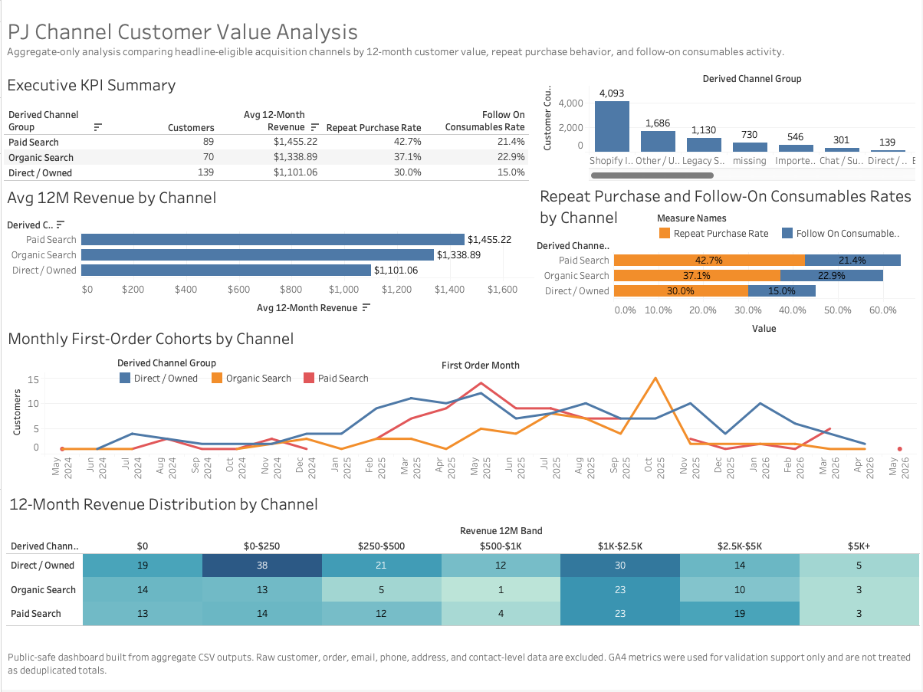
DASHBOARD SUMMARY
The Tableau package summarizes trends, distributions, and eligibility safely.
Visuals Covered
Executive KPI summary
Avg 12M revenue by channel
Repeat vs. follow-on behavior
Monthly first-order cohorts
12M revenue distribution view
Channel eligibility overview
Monthly value/rate cells under 5 customers are suppressed.
Sources: safe aggregate Tableau exports and EDA chart-planning tables.
12
Notes:
This slide includes the sanitized full Tableau dashboard screenshot. The dashboard summarizes KPI, revenue, behavior, monthly cohort, distribution, and eligibility views using aggregate-safe outputs.

Slide 13
LIMITATIONS
The findings are directional and depend on source quality.
Sample Size
Attribution
Measurement
Headline-channel samples are modest.
Missing and unclassified buckets remain.
GA4 exports overlap and are validation-only.
Some real channels fall below 50 customers.
Imported, support, and technical sources are not clean acquisition channels.
Consumables logic depends on current product classification heuristics.
Important gap: this analysis compares customer value, not profitability. CAC/ROAS inputs are future work.
Source: aggregate capstone outputs; public/school-safe package.
13
Notes:
Be candid about limitations. This is a strong aggregate value analysis, but profitability needs acquisition cost data and attribution quality can improve.

Slide 14
RECOMMENDATIONS
Next steps connect value signals to profitability and better capture.
1
Scale with guardrails
2
Strengthen Organic Search
3
Improve source capture
Continue investing in Paid Search, but monitor profitability and CAC before scaling aggressively.
Build on the strongest follow-on consumables signal with content and search improvements.
Tighten UTM discipline and CRM source mapping to reduce unclassified records.
4
Add cost exports
5
Keep outputs safe
Bring in Google Ads, Meta, and other spend data for CAC, ROAS, and contribution analysis.
Connect future Console logic to aggregate-safe customer value metrics and preserve suppression rules.
Conclusion: Paid Search is the strongest current value/repeat signal; Organic Search deserves growth attention; future work should link value to CAC.
AI disclosure: ChatGPT and Codex helped structure, script, document, and prepare sanitized materials; outputs were reviewed and raw data was kept private.
Source: aggregate capstone outputs; public/school-safe package.
14
Notes:
Close with practical recommendations and transparency. The capstone does not claim final profitability, but it gives a clear aggregate value signal and a path for future analysis.

