Slide 1


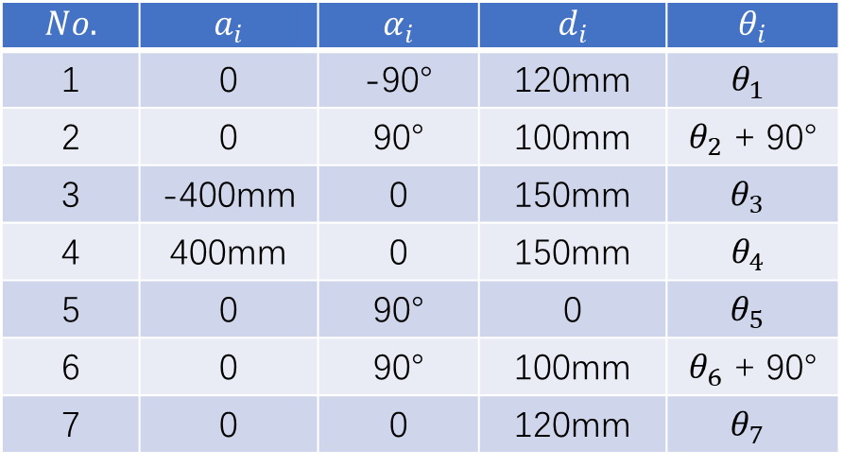














$$z_{3}$$
100
Joint 3
400
$$x_{3}$$
100
100
Joint 5
120
$$z_{2}$$
Joint 4
Joint 1
$$z_{1}$$
$$z_{5}$$
A
B
Joint 2
$$z_{4}$$
$$x_{1}$$
$$x_{2}$$
$$x_{6}$$
$$x_{4}$$
$$x_{5}$$
$$No.$$ | $$a_{i}$$ | $$α_{i}$$ | $$d_{i}$$ | $$θ_{i}$$
1 | 0 | -90° | 120mm | $$θ_{1}$$
2 | 0 | 90° | 100mm | $θ_{2}$ + 90°
3 | -400mm | 0 | 150mm | $$θ_{3}$$
4 | 400mm | 0 | 150mm | $$θ_{4}$$
5 | 0 | 90° | 0 | $$θ_{5}$$
6 | 0 | 90° | 100mm | $θ_{6}$ + 90°
7 | 0 | 0 | 120mm | $$θ_{7}$$
Joint 6
$$z_{6}$$
$$z_{0}$$
Joint 0
A
B
$$x_{0}$$
$$x_{7}$$
$$z_{7}$$

