Slide 1
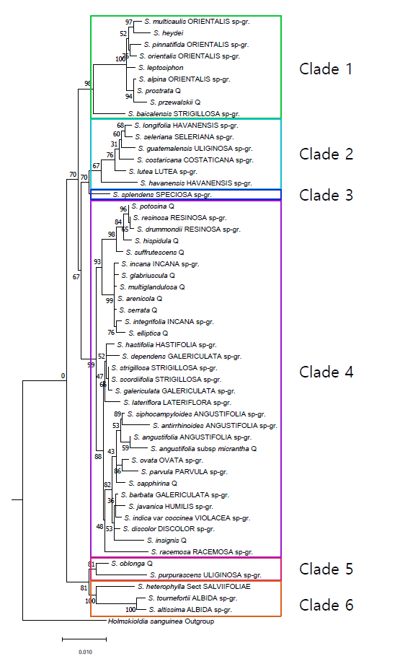
Figure 1. Phylogenetic tree of … Scutellaria species constructed from chloroplast genome, split into 6 clades. RAxML maximum likelihood algorithm used.

Slide 2
Table 1. Table describing medicinal relevance of 15 investigated flavonoids.

Slide 3
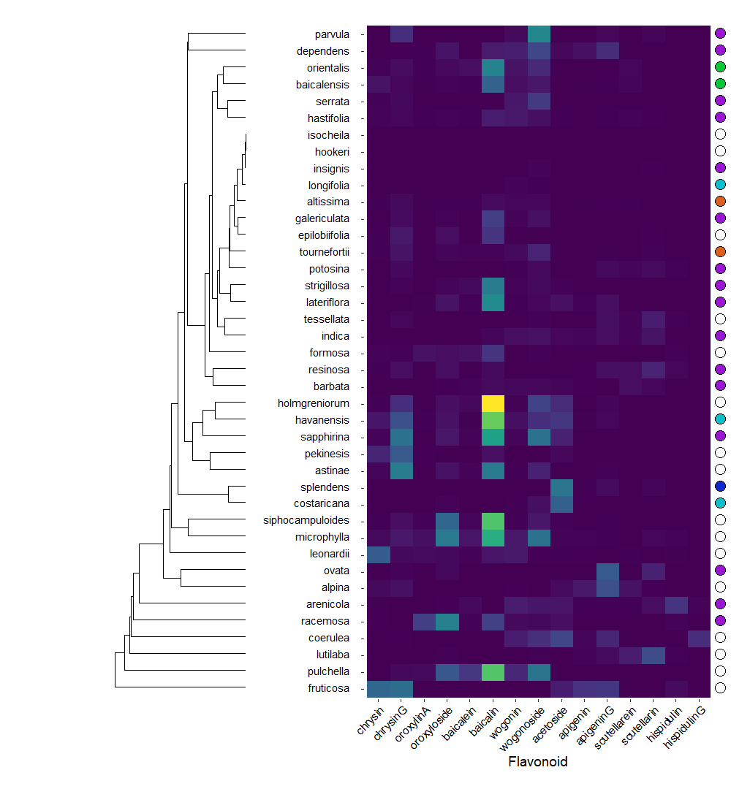
Figure 2.

Slide 4
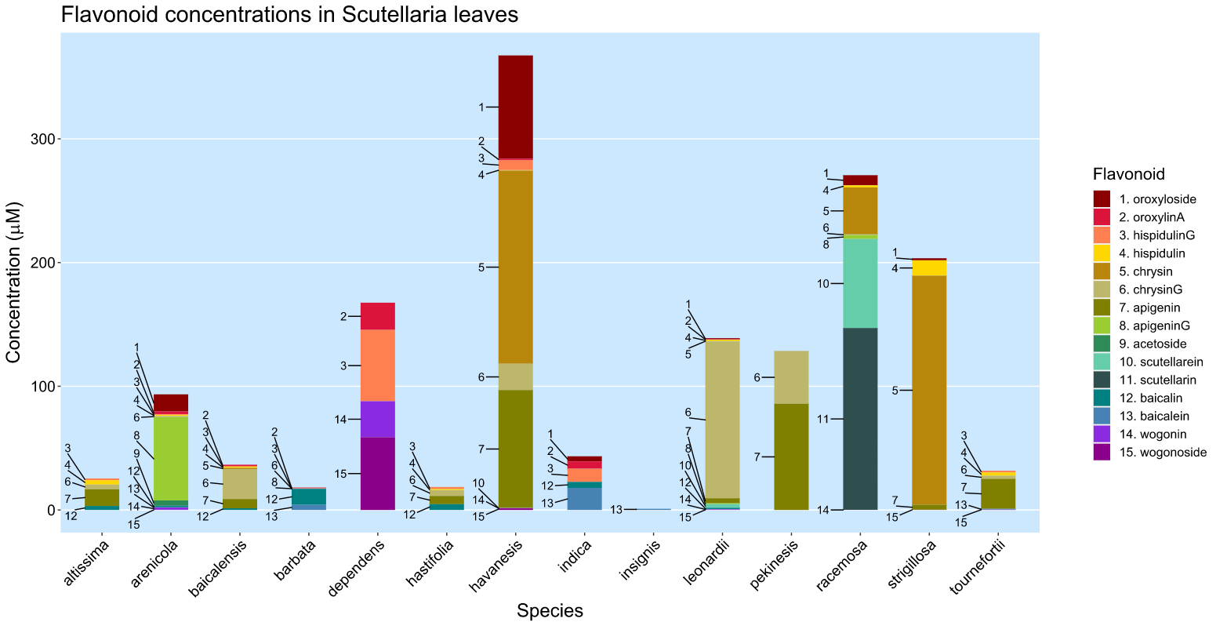
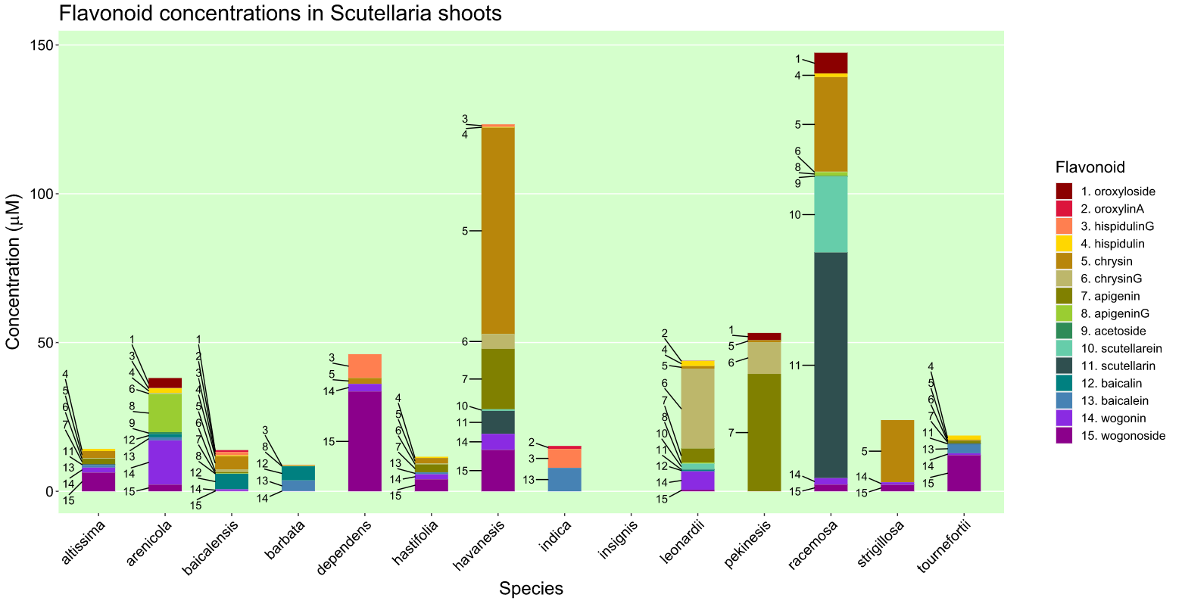
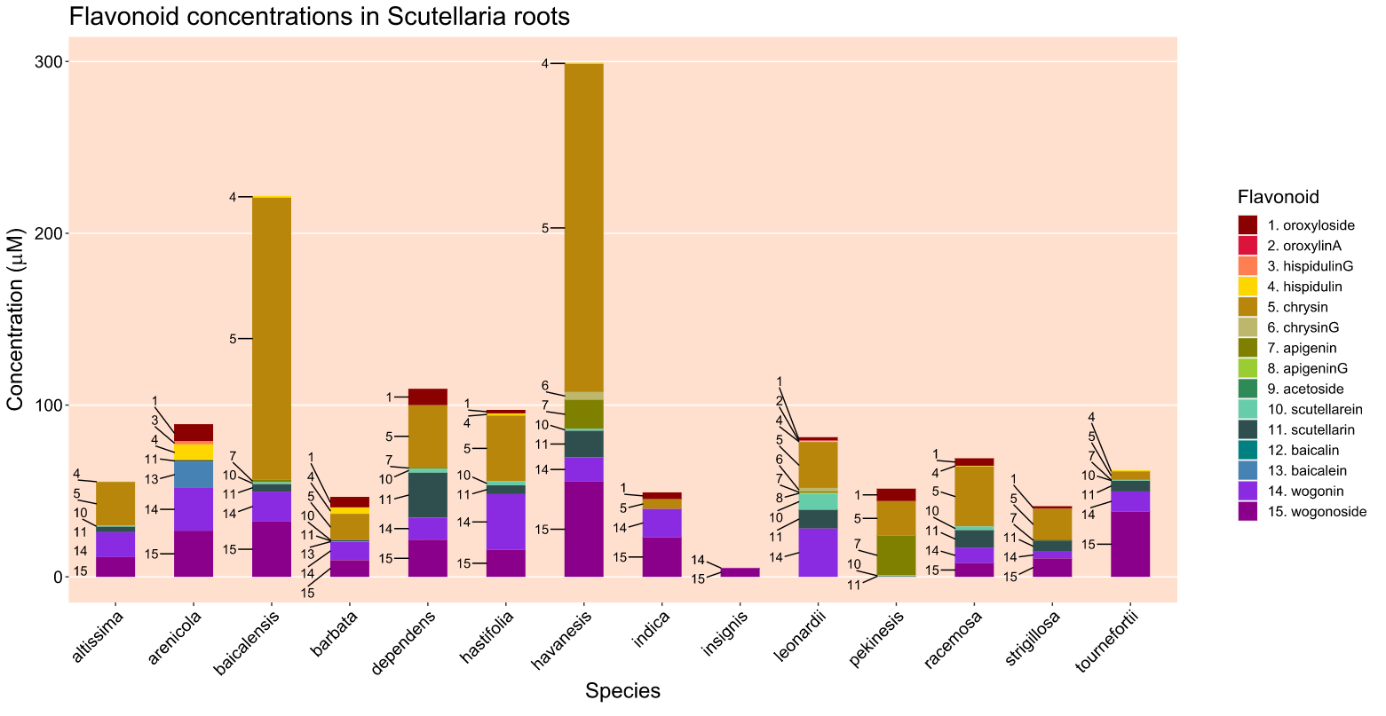
Figure 3.

Slide 5
Figure 4. Proposed modifications to S. baicalensis pathway.

Slide 6
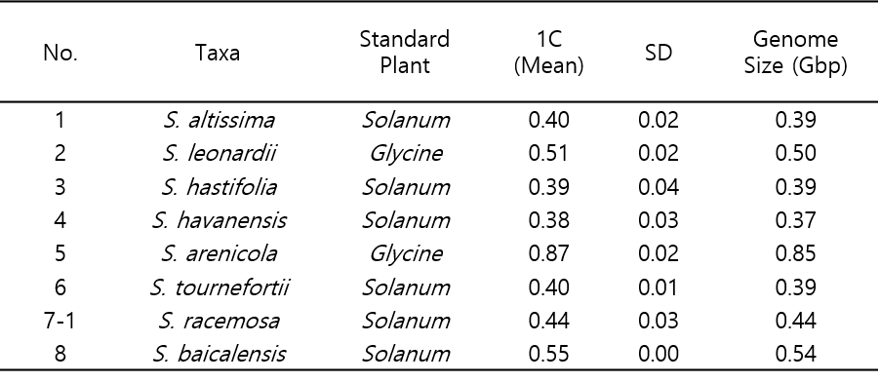
Table 2. Genome size data

