Slide 1
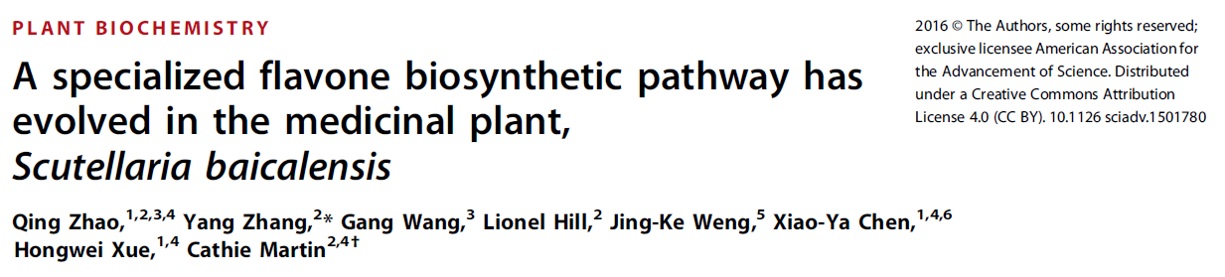
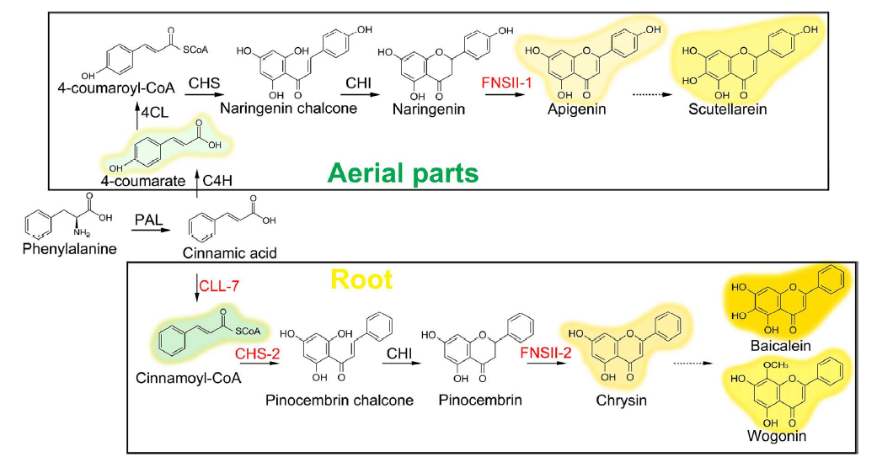

Slide 2
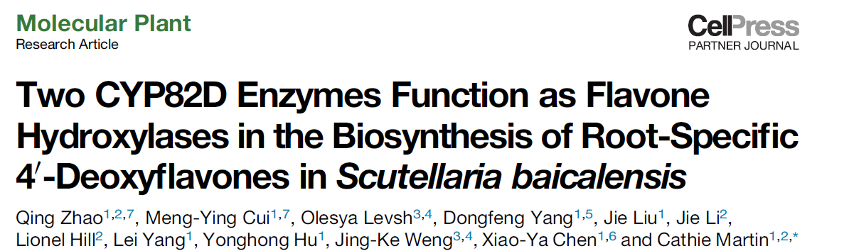
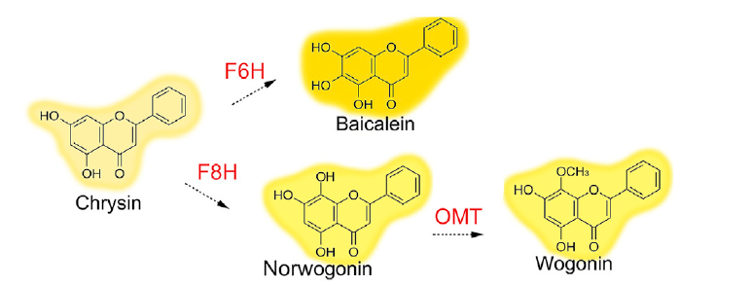
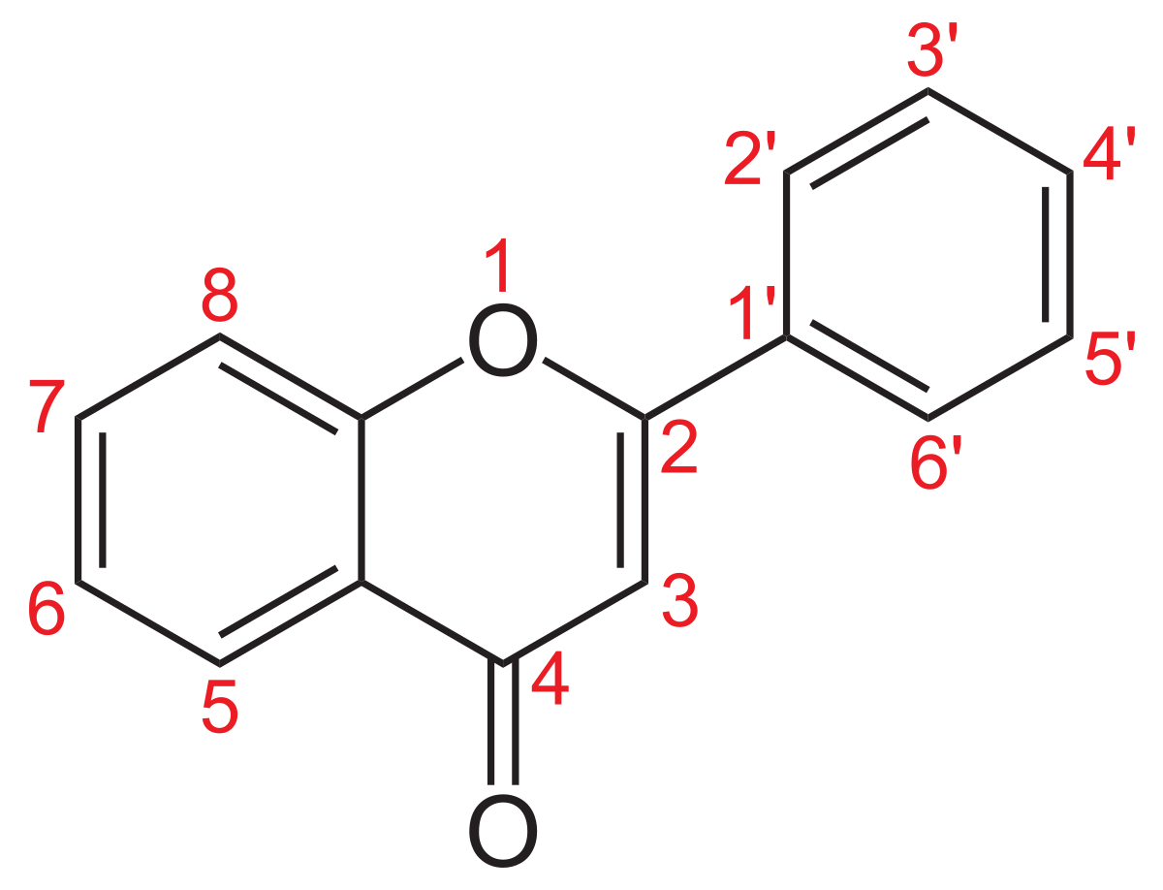

Slide 3
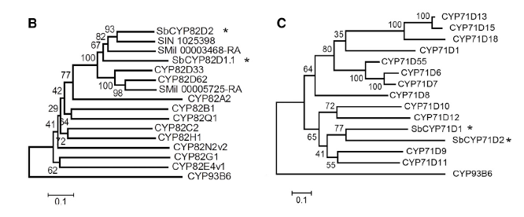
F6H in basil + mint
F6H in soybean
Four candidates:
SbCYP82D2
SbCYP82D1.1
SbCYP71D1
SbCYP71D2
Each transformed into yeast and fed with chrysin
Only yeast transformed with SbCYP82D1.1 produces baicalein

Slide 4
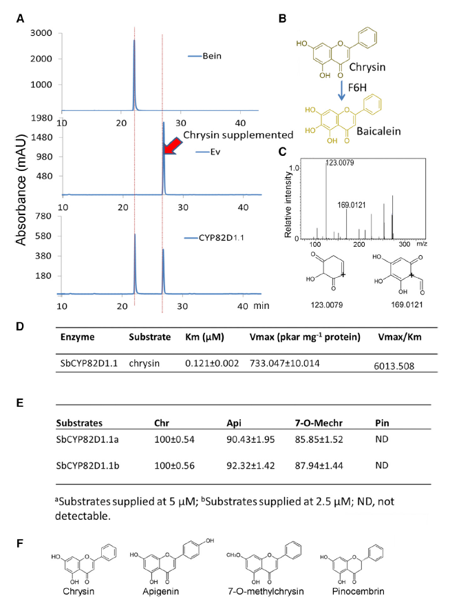

Slide 5
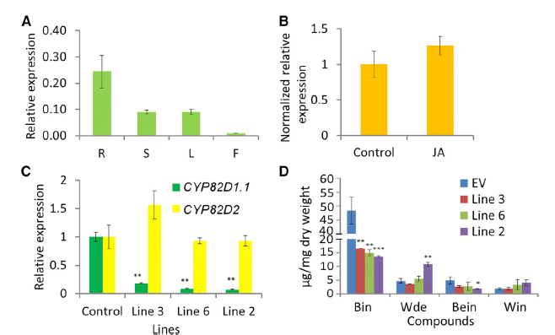
RNAi silencing
Baicalin
Baicalein
Wogonoside
Wogonin

Slide 6
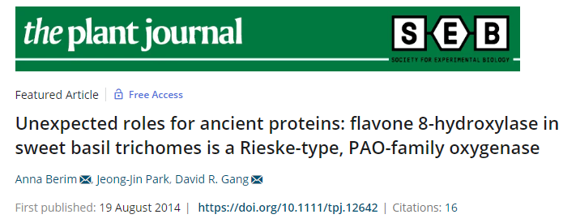
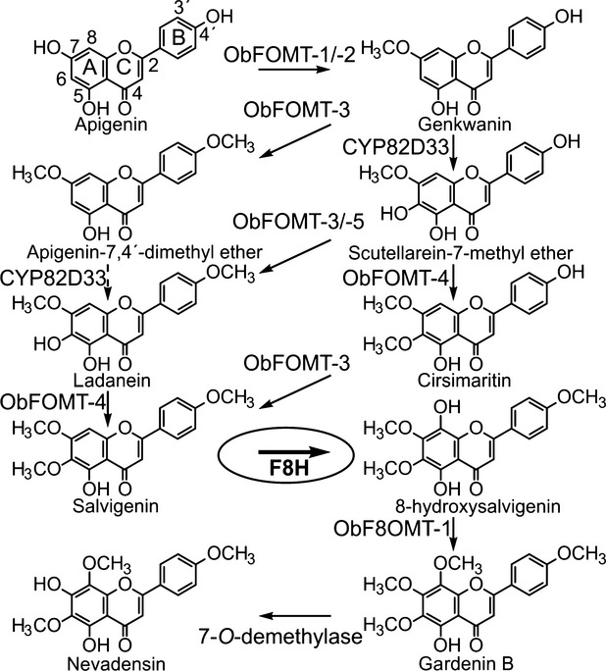

Slide 7
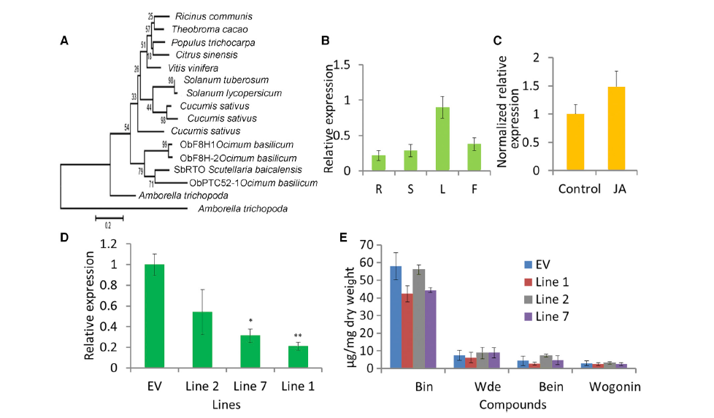
Baicalin
Baicalein
Wogonoside
Wogonin

Slide 8
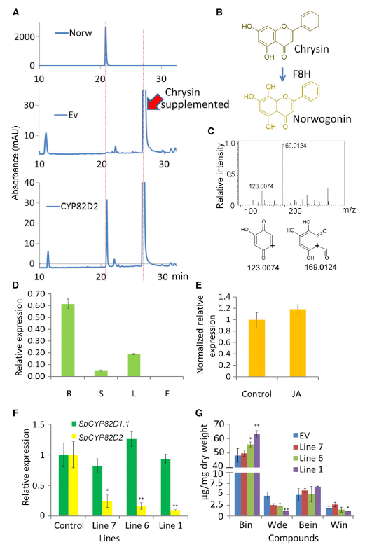
Baicalin
Baicalein
Wogonoside
Wogonin

Slide 9
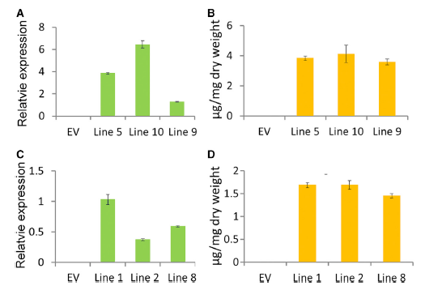
Overexpression in Arabidopsis
SbCYP82D1.1
(F6H)
Baicalein
SbCYP82D2
(F8H)
Norwogonin

Slide 10
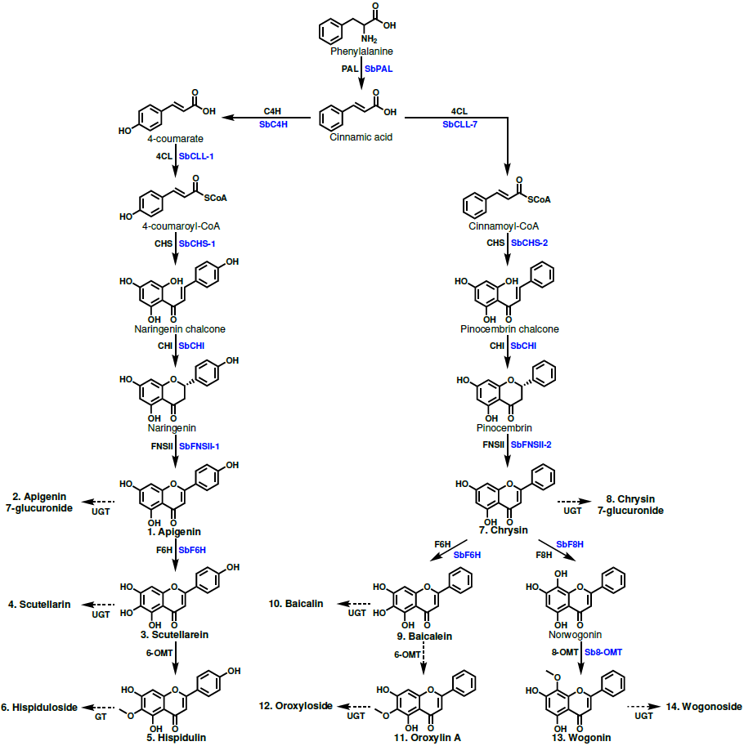
Figure 1. Proposed 4´-hydroxyflavone and 4´-deoxyflavone pathway. Structures of glycosylated metabolites are not shown to save space but are included in Appendix S1. Enzyme names in blue are specific isoforms that have been identified in S. baicalensis, and enzyme names in black are general names. Metabolites that were quantified have names in bold and are numbered to match the labeling of Figure 2.

Slide 11
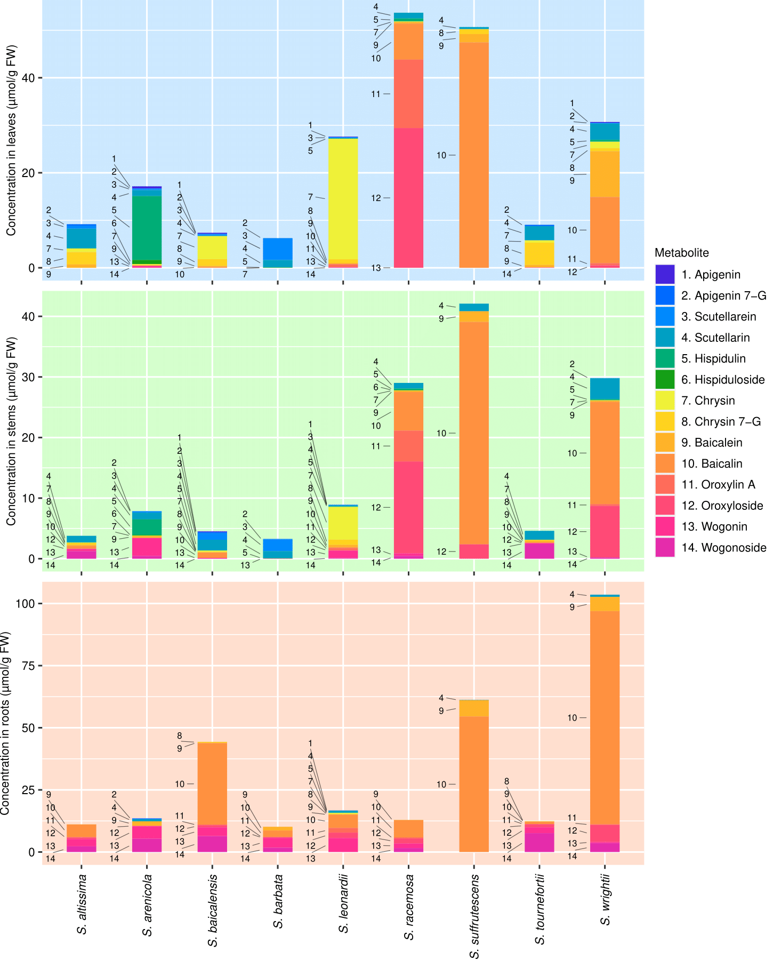
Figure 2. Organ-specific metabolite data collected from 9 Scutellaria species via High Performance Liquid Chromatography (HPLC). Samples were taken in biological triplicate, and the average concentration of each metabolite calculated. Metabolites are numbered to match their order of occurrence in the flavone pathway, shown in Figure 1.

Slide 12
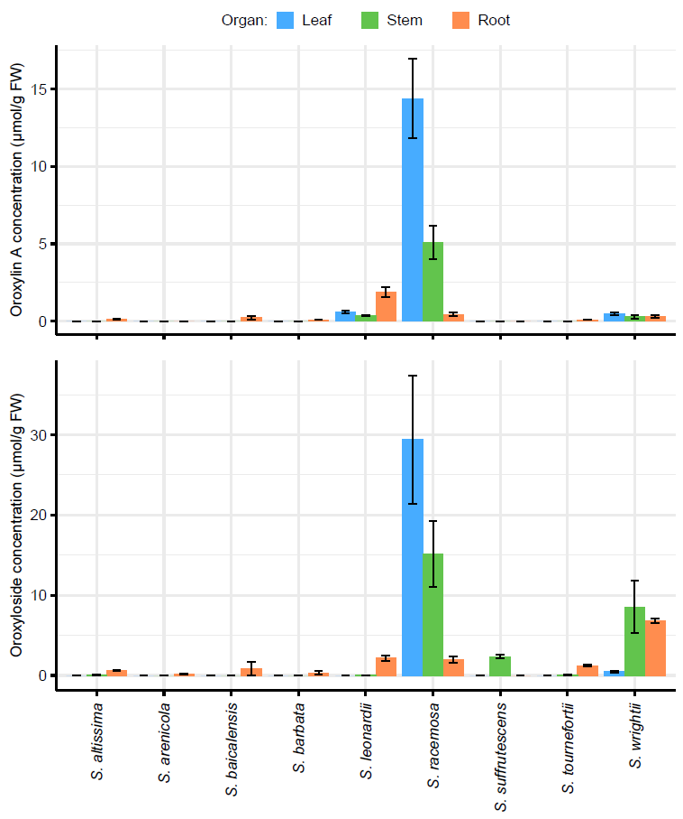
Figure 3. Organ-specific oroxylin A (top) and oroxyloside (bottom) concentrations in 9 Scutellaria species, as determined via High Performance Liquid Chromatography (HPLC). Concentrations were averaged from tissue samples taken from 3 biological replicates, and error bars represent standard error.

Slide 13
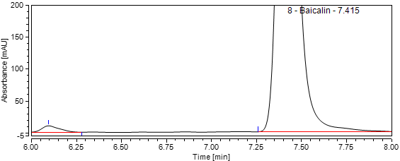
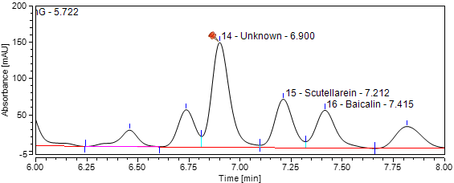
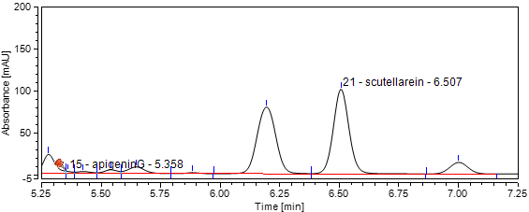
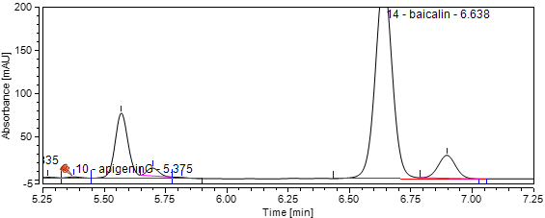
S. baicalensis roots (Costine)
S. baicalensis leaves (Costine)
S. barbata leaves
S. racemosa leaves
Figure 4. Comparison of chromatograms collected via HPLC from (A) S. baicalensis roots, (B) S. baicalensis leaves, (C) S. barbata leaves, and (D) S. racemosa leaves. Time interval displayed was selected to center the unknown peak in the chromatograms.

Slide 14
100
%
80
60
270.65
333.11
40
20
0
nm
-10
200
300
400
500

Slide 15
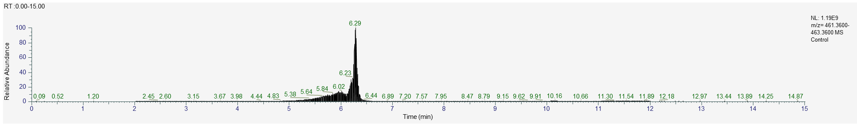
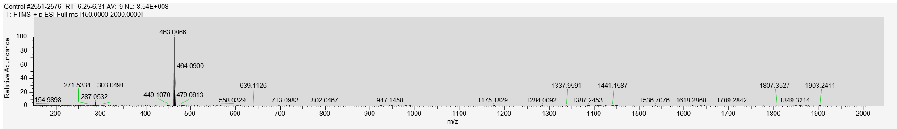
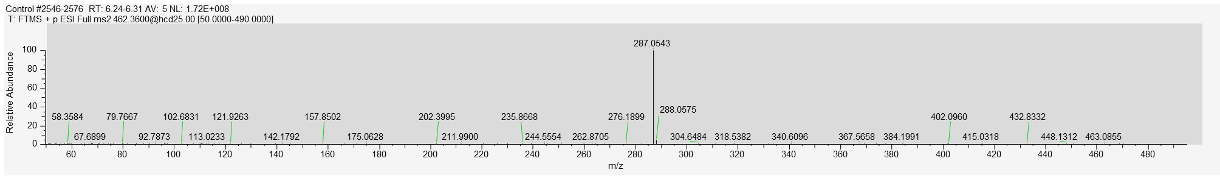
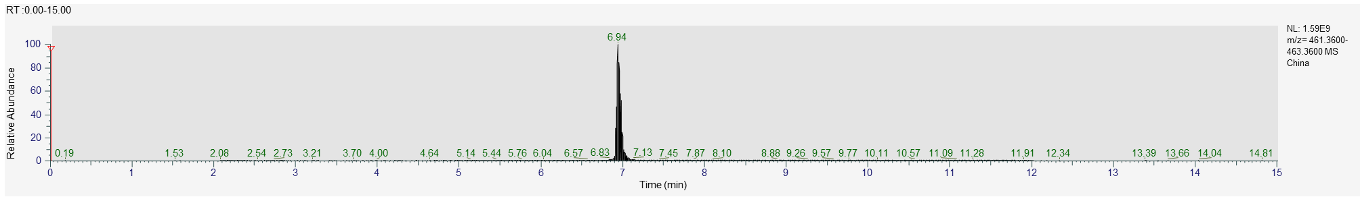
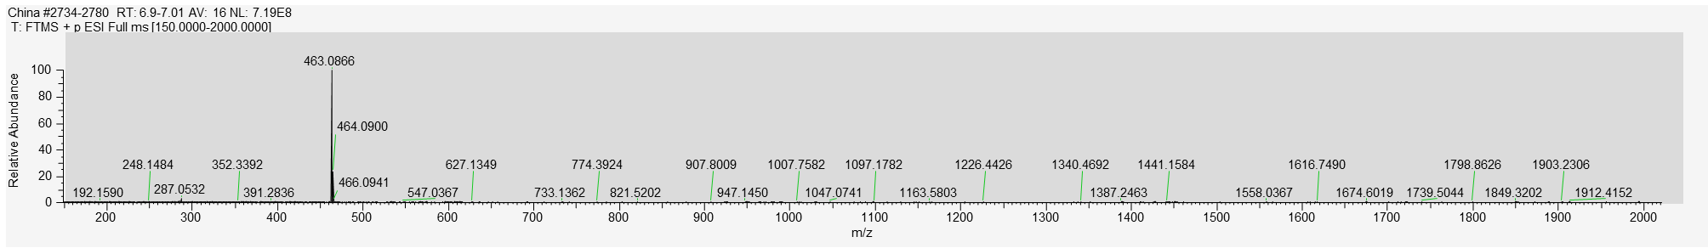
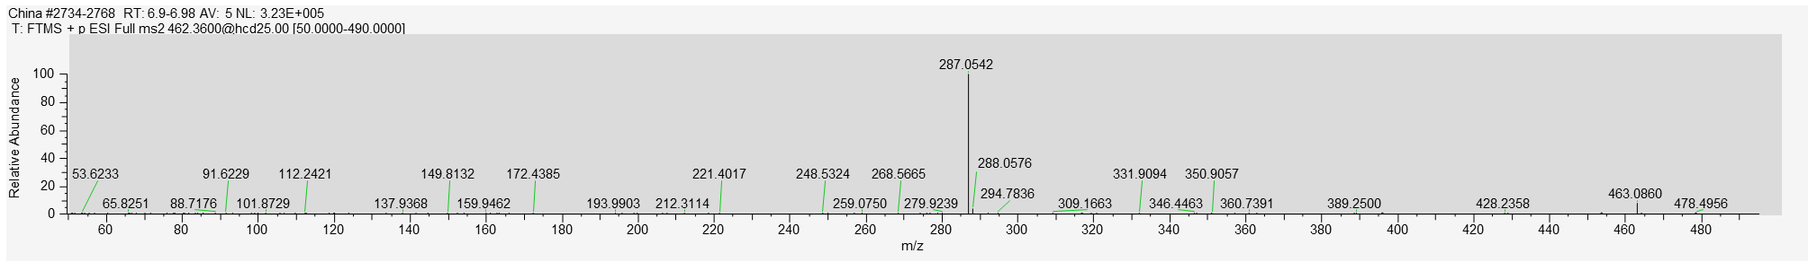
Scutellarin
EIC
M/Z
MS/MS
Unknown
EIC
M/Z
MS/MS
Figure 5. LC-MS + NMR data used to elucidate identity of unknown metabolite.

Slide 16
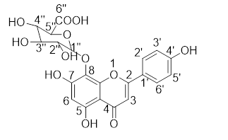
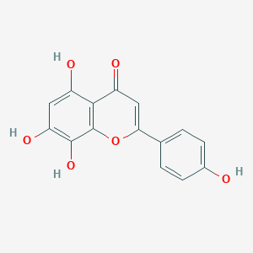
Predicted structure from NMR data:
Structure from PubChem: Isoscutellarein
Identity of unknown: Isoscutellarein 8-glucuronide
TODO:
Quantify isoscutellarein 8-glucuronide in all extractions
Apigenin feeding
Yeast activity test with Rieske-type oxygenase from S. baicalensis
Tobacco infiltration with RTO

Slide 17
Figure 6. Organ-specific isoscutellarein 8-glucuronide concentrations in 9 Scutellaria species, as determined via High Performance Liquid Chromatography (HPLC). Concentrations were averaged from tissue samples taken from 3 biological replicates, and error bars represent standard error.
Fed 100 uM apigenin, 5 days
Control
p = 0.00534
p = 0.37529
p = 0.31156
Figure 7. S. barbata apigenin feeding results / Yeast activity test / N. benthamiana infiltration

Slide 18
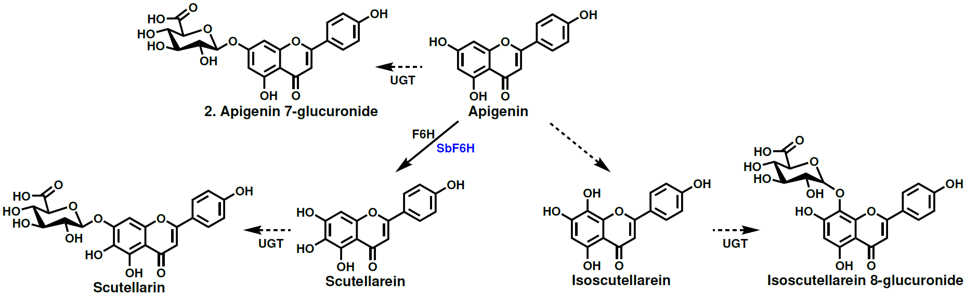
Proposed pathway:
Rieske-type oxygenase?
Figure 8. Proposed pathway for biosynthesis of isoscutellarein 8-glucuronide in Scutellaria.

