Slide 1
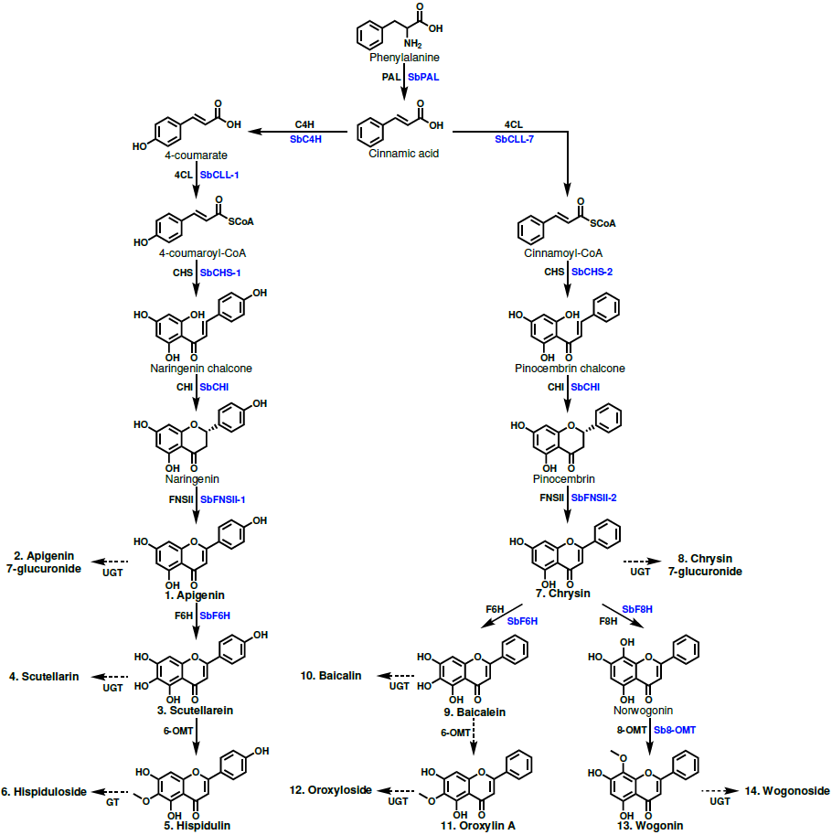
Figure 1. Proposed 4´-hydroxyflavone and 4´-deoxyflavone pathway. Structures of glycosylated metabolites are not shown to save space but are included in Appendix S1. Enzyme names in blue are specific isoforms that have been identified in S. baicalensis, and enzyme names in black are general names. Metabolites that were quantified have names in bold and are numbered to match the labeling of Figure 2.

Slide 2
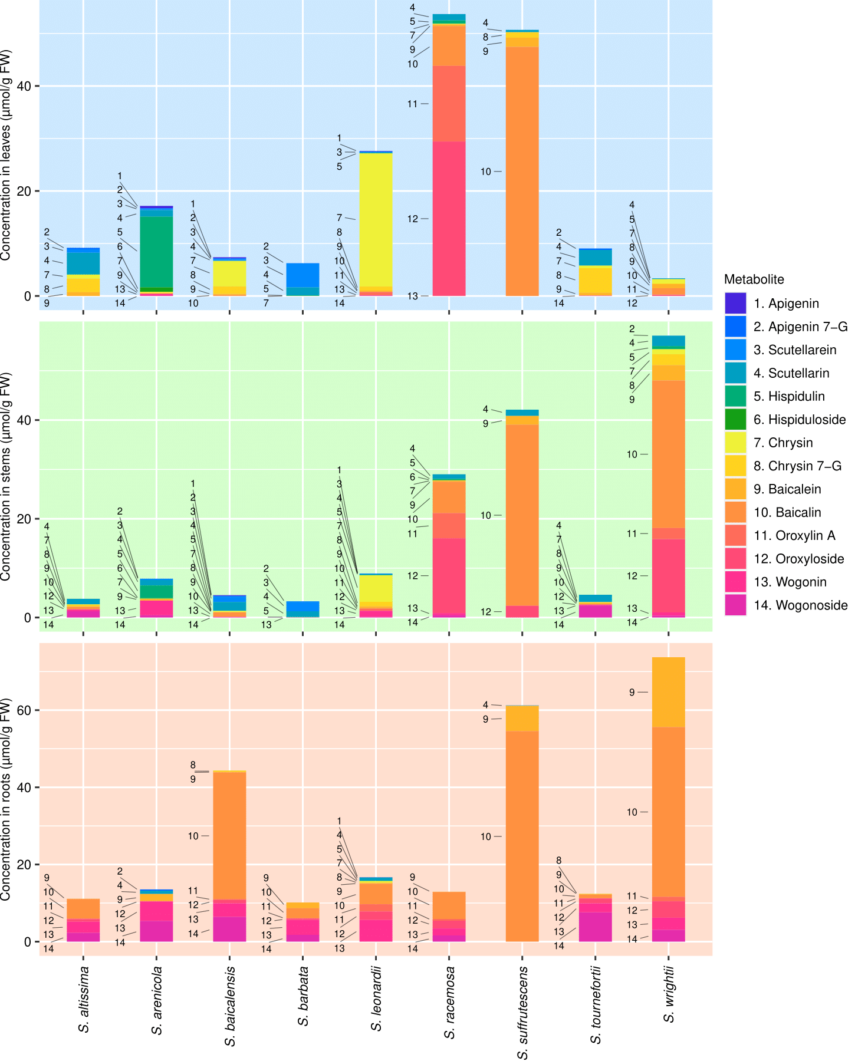
Figure 2. Organ-specific metabolite data collected from 9 Scutellaria species via High Performance Liquid Chromatography (HPLC). Samples were taken in biological triplicate, and the average concentration of each metabolite calculated. Metabolites are numbered to match their order of occurrence in the flavone pathway, shown in Figure 1.

Slide 3
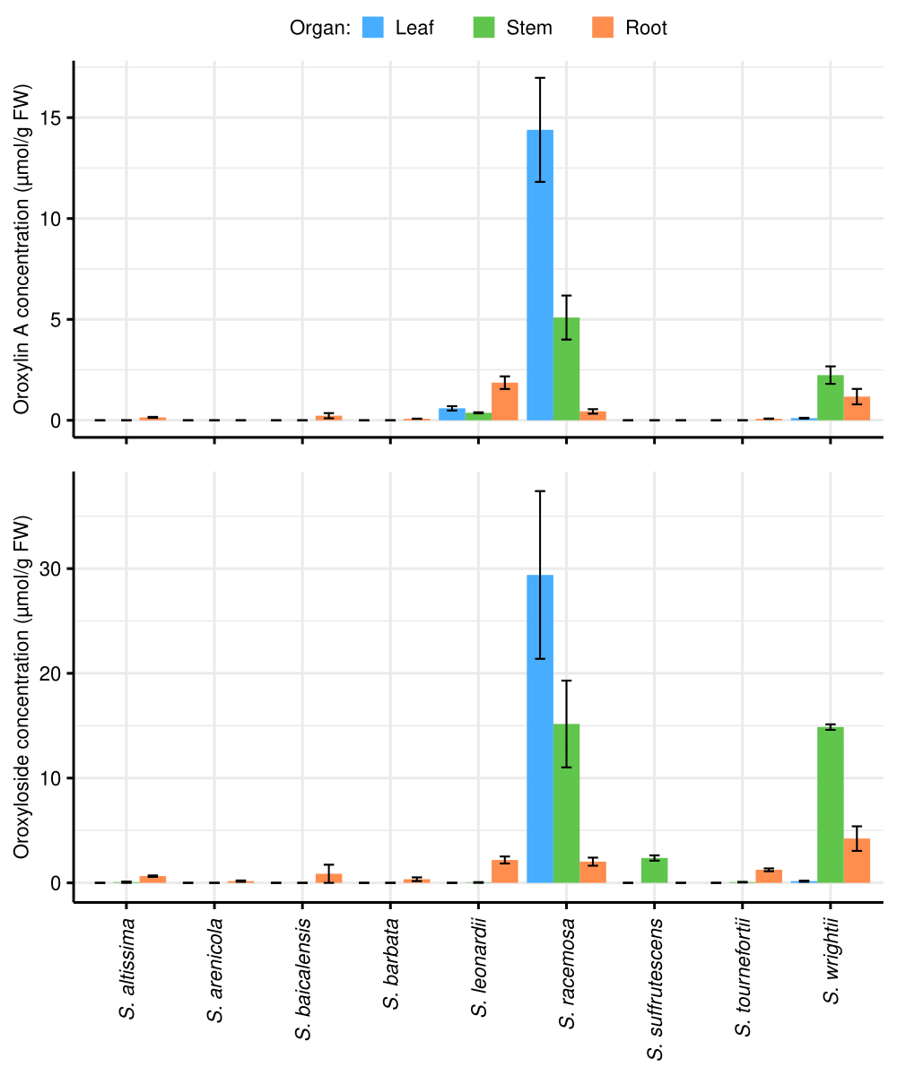
Figure 3. Organ-specific oroxylin A (top) and oroxyloside (bottom) concentrations in 9 Scutellaria species, as determined via High Performance Liquid Chromatography (HPLC). Concentrations were averaged from tissue samples taken from 3 biological replicates, and error bars represent standard error.

Slide 4
S. baicalensis roots (Costine)
S. baicalensis leaves (Costine)
S. barbata leaves
S. racemosa leaves
Figure 4. Comparison of chromatograms collected via HPLC from (A) S. baicalensis roots, (B) S. baicalensis leaves, (C) S. barbata leaves, and (D) S. racemosa leaves. Time interval displayed was selected to center the unknown peak in the chromatograms.

Slide 5
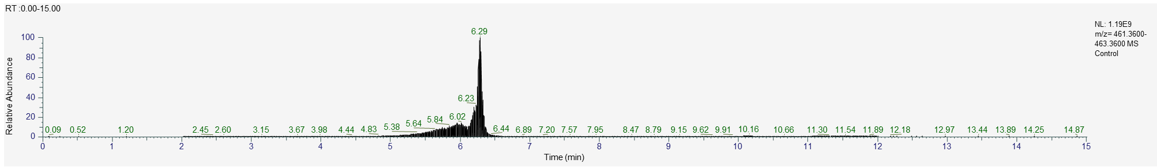
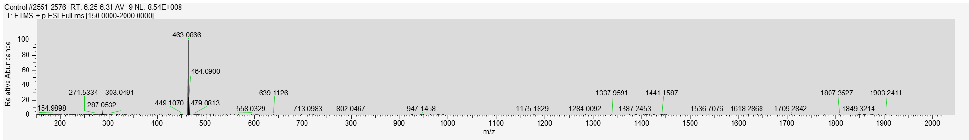
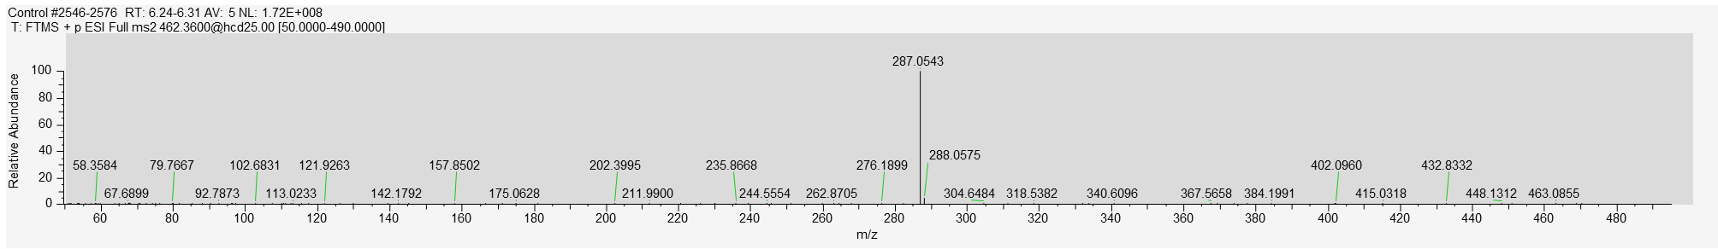
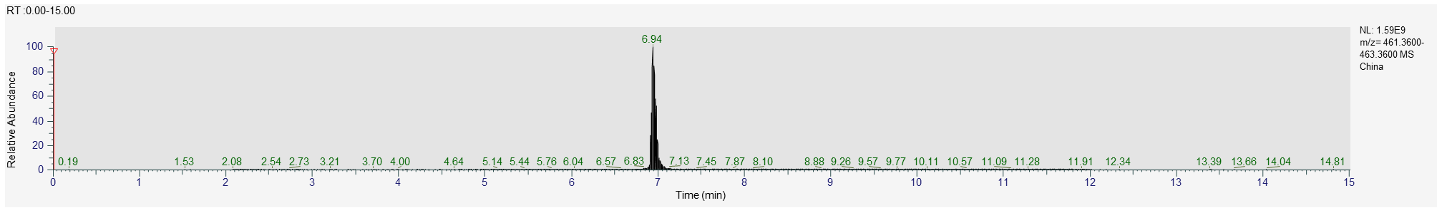
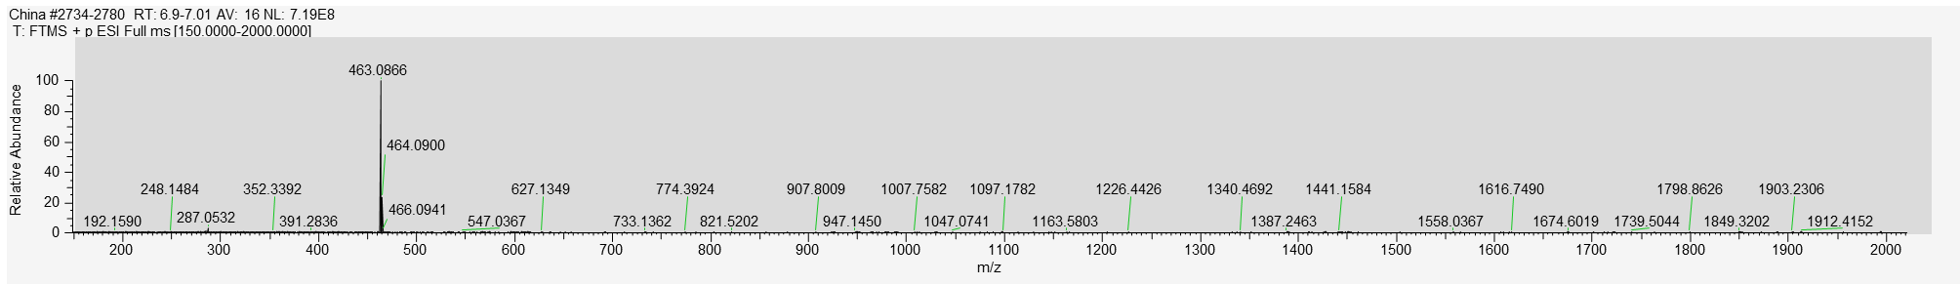
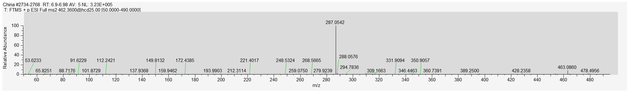
Scutellarin
EIC
M/Z
MS/MS
Unknown
EIC
M/Z
MS/MS
Figure 5. LC-MS and MS² data collected from a scutellarin standard and the unknown metabolite.

Slide 6
Figure 6. NMR data used to elucidate structure of unknown metabolite, and the structure of the unknown metabolite.

Slide 7
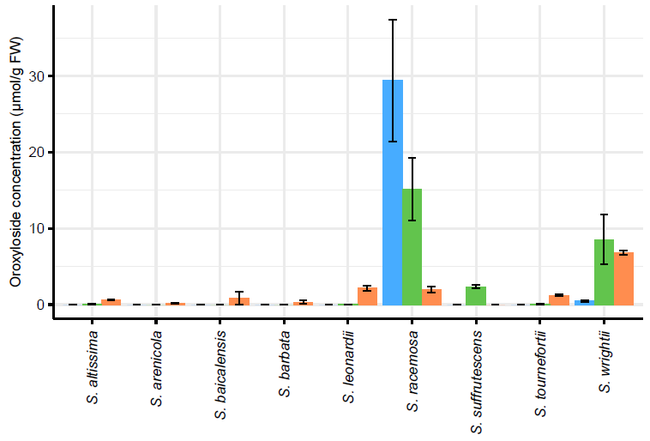
Figure 7. Organ-specific isoscutellarein 8-glucuronide concentrations in 9 Scutellaria species, as determined via High Performance Liquid Chromatography (HPLC). Concentrations were averaged from tissue samples taken from 3 biological replicates, and error bars represent standard error.

Slide 8
Fed 100 uM apigenin, 5 days
Control
p = 0.00534
p = 0.37529
p = 0.31156
Figure 8. S. barbata apigenin feeding results

Slide 9
Figure 9. Yeast activity test / N. benthamiana infiltration / A. thaliana infiltration

Slide 10
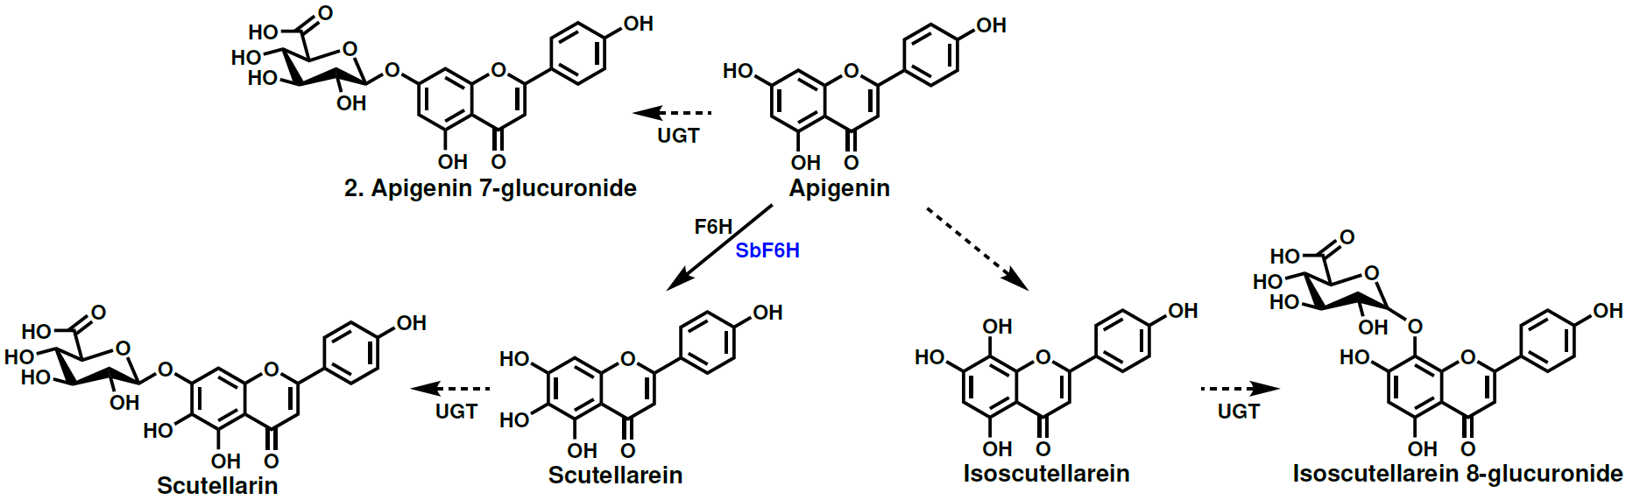
Proposed pathway:
Rieske-type oxygenase?
Figure 10. Proposed pathway for biosynthesis of isoscutellarein 8-glucuronide in Scutellaria.

