Slide 1
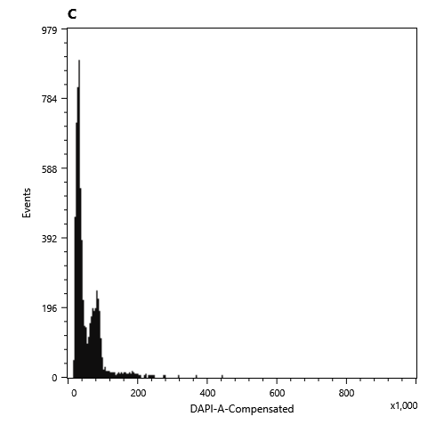
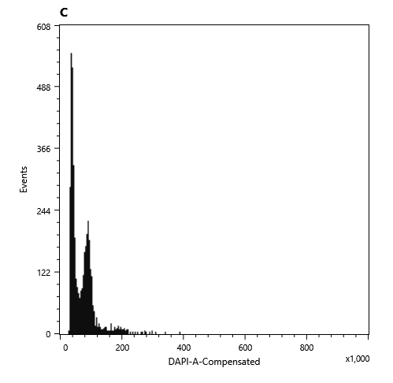
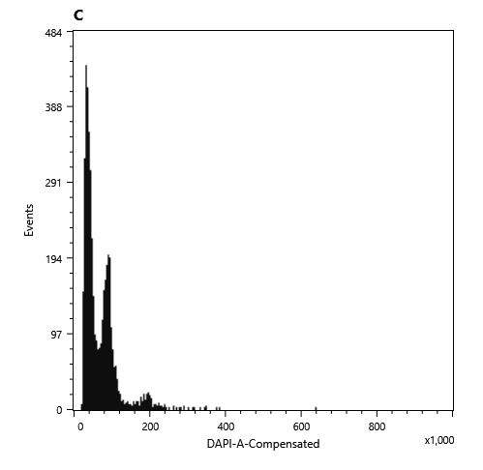

수골무꽃 Scutellaria pekinensis var. alpina
S. pekinensis
var. alpina
S. pekinensis
var. alpina
Solanum
Solanum
 | Solanum 2C | Solanum | Sample | Sample 1C
1 | 1.96 | 82500 | 32704 | 0.39
2 | 1.96 | 90076 | 36936 | 0.40
3 | 1.96 | 90229 | 33527 | 0.36
4 | 1.96 | 95940 | 37215 | 0.38
 |  |  | Mean | 0.38
 |  |  | SD | 0.02
S. pekinensis
var. alpina
S. pekinensis
var. alpina
Genome size = 0.38 Gbp
Solanum
Solanum

Slide 2

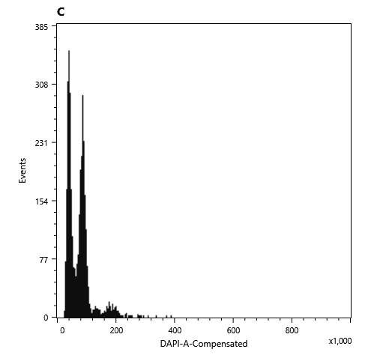

애기골무꽃 Scutellaria dependens
 | Solanum 2C | Solanum | Sample | Sample 1C
1 | 1.96 | 91996 | 41164 | 0.44
2 | 1.96 | 88121 | 40845 | 0.45
3 | 1.96 | 88253 | 41108 | 0.46
 |  |  | Mean | 0.45
 |  |  | SD | 0.01
Genome size = 0.44 Gbp
S. dependens
S. dependens
S. dependens
Solanum
Solanum
Solanum

Slide 3
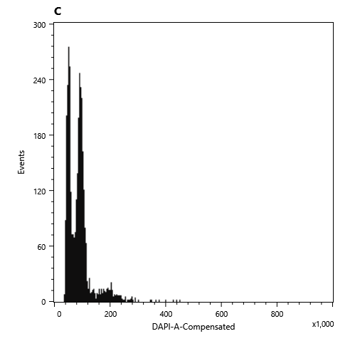
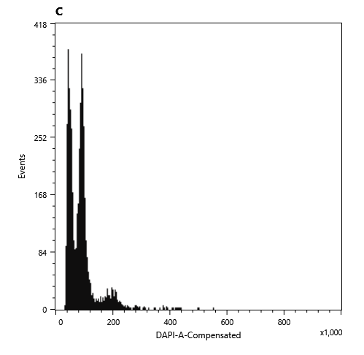
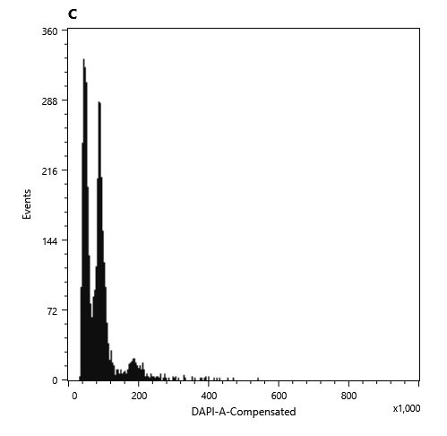

창골무꽃 Scutellaria barbata
S. barbata
S. barbata
Solanum
Solanum
 | Solanum 2C | Solanum | Sample | Sample 1C
1 | 1.96 | 92128 | 52717 | 0.56
2 | 1.96 | 89944 | 45121 | 0.49
3 | 1.96 | 96037 | 52926 | 0.54
4 | 1.96 | 87954 | 48672 | 0.54
 |  |  | Mean | 0.53
 |  |  | SD | 0.03
S. barbata
S. barbata
Genome size = 0.52 Gbp
Solanum
Solanum

