Slide 1
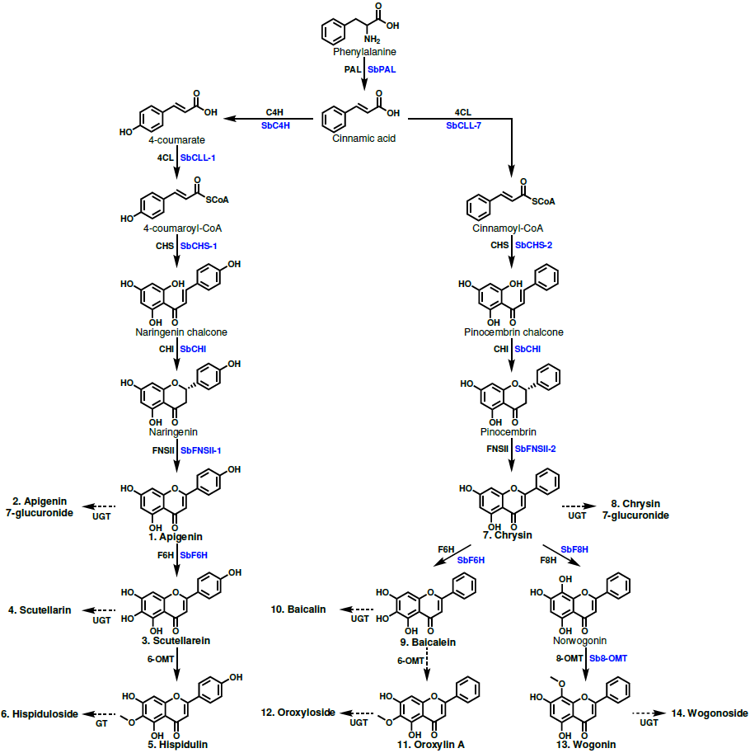
Figure 1. Proposed 4´-hydroxyflavone and 4´-deoxyflavone pathway. Structures of glycosylated metabolites are not shown to save space but are included in Appendix S1. Enzyme names in blue are specific isoforms that have been identified in S. baicalensis, and enzyme names in black are general names. Metabolites that were quantified have names in bold and are numbered to match the labeling of Figure 2.

Slide 2
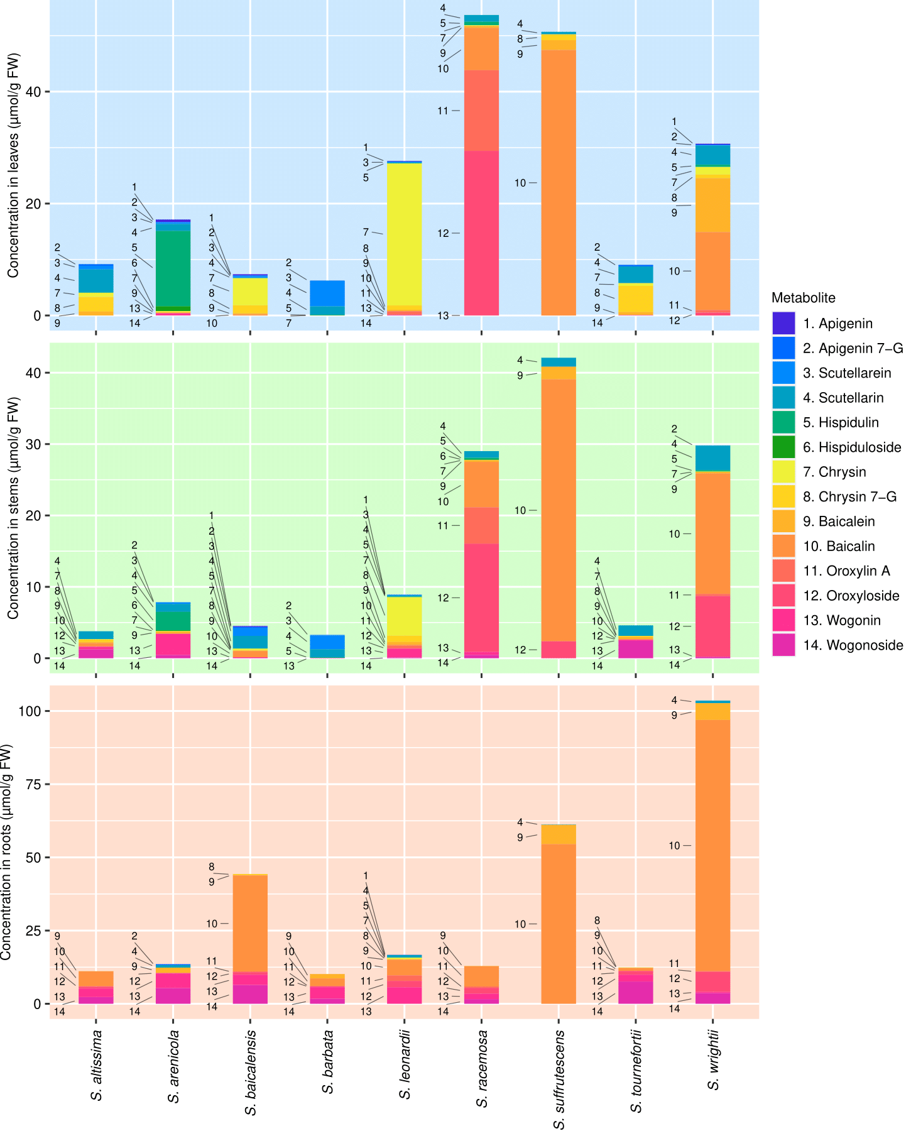

Slide 3
