Slide 1
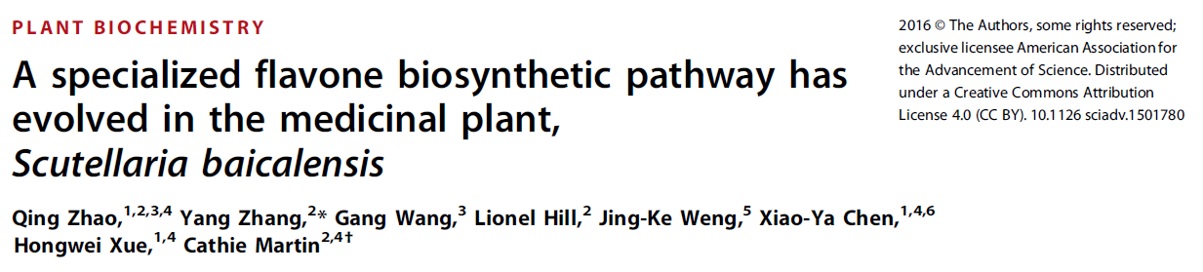
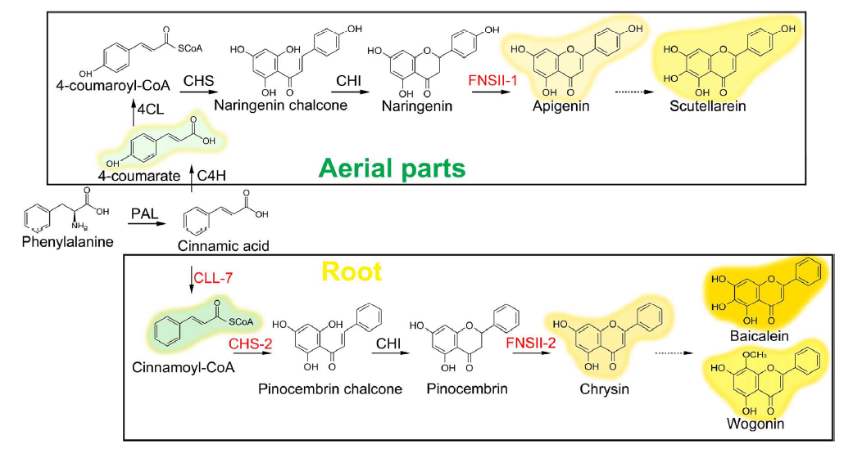

Slide 2
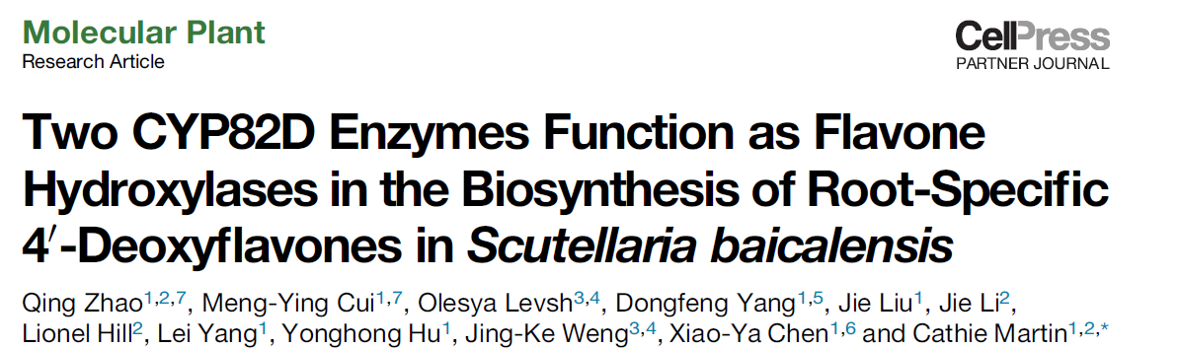
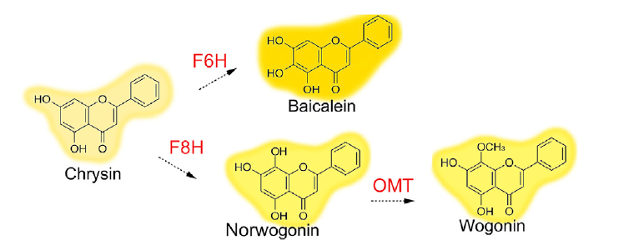
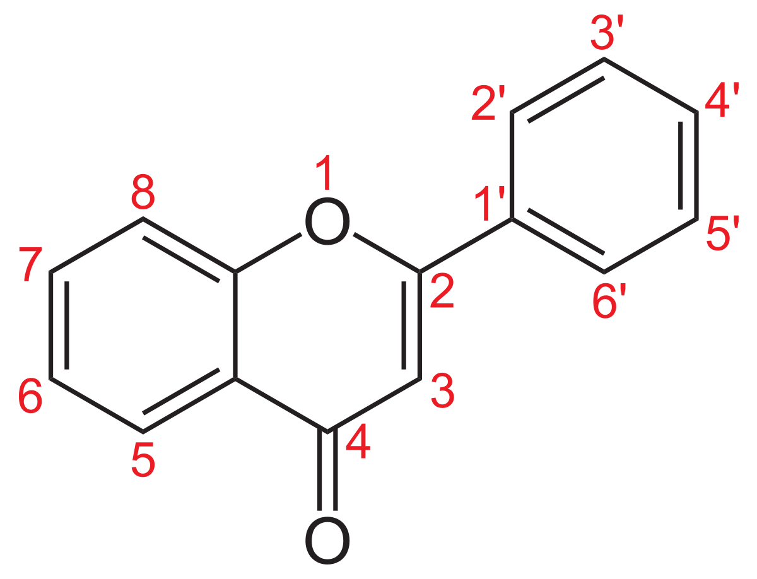

Slide 3
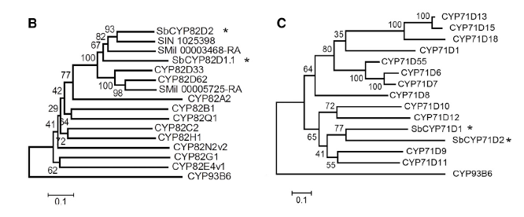
F6H in basil + mint
F6H in soybean
Four candidates:
SbCYP82D2
SbCYP82D1.1
SbCYP71D1
SbCYP71D2
Each transformed into yeast and fed with chrysin
Only yeast transformed with SbCYP82D1.1 produces baicalein

Slide 4
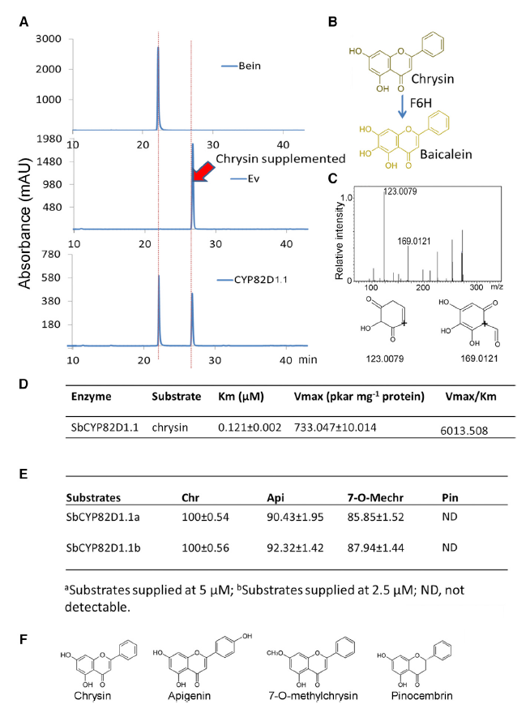

Slide 5
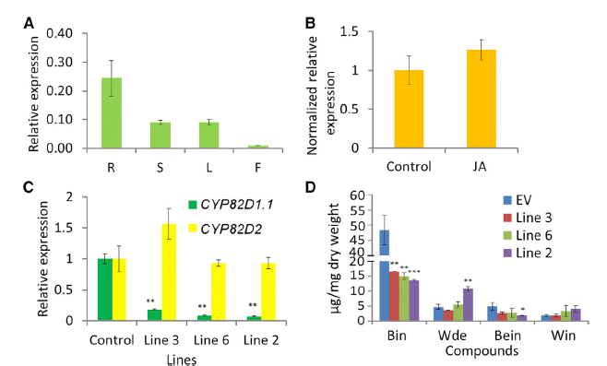
RNAi silencing
Baicalin
Baicalein
Wogonoside
Wogonin

Slide 6
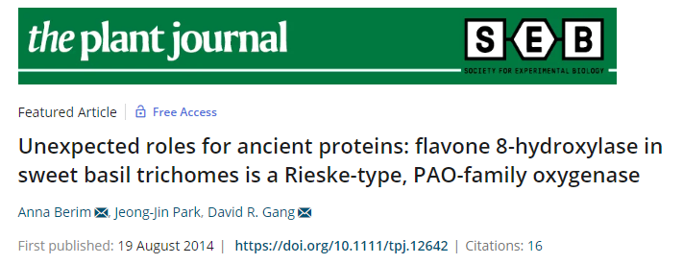
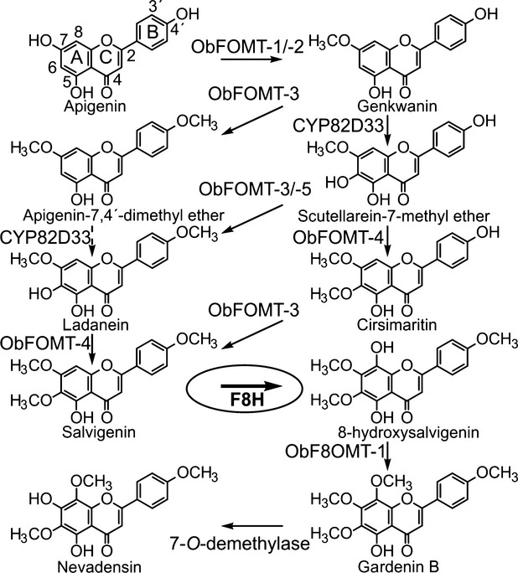

Slide 7
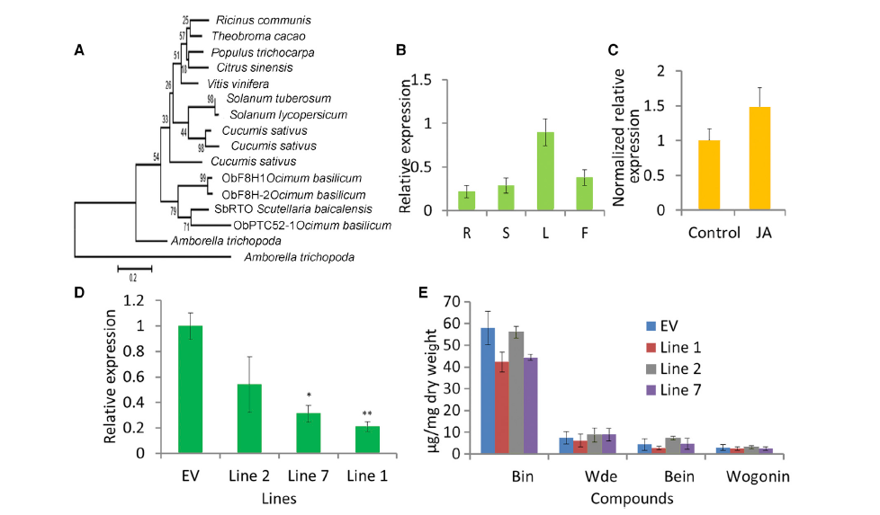
Baicalin
Baicalein
Wogonoside
Wogonin

Slide 8
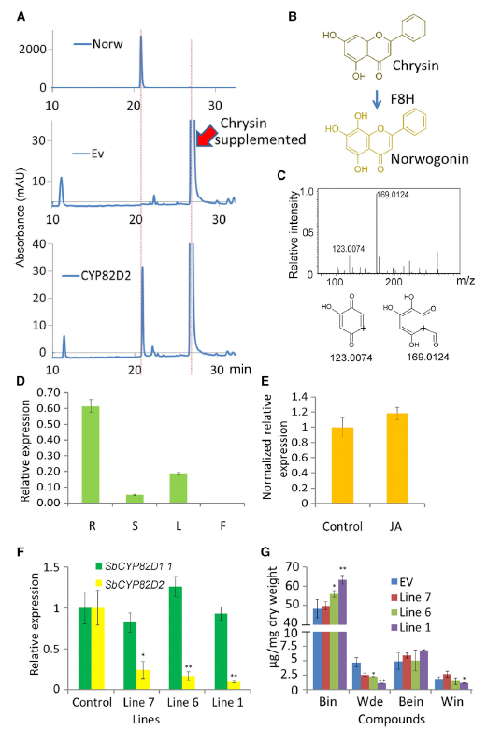
Baicalin
Baicalein
Wogonoside
Wogonin

Slide 9
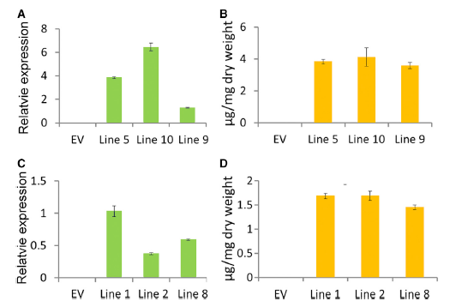
Overexpression in Arabidopsis
SbCYP82D1.1
(F6H)
Baicalein
SbCYP82D2
(F8H)
Norwogonin

Slide 10
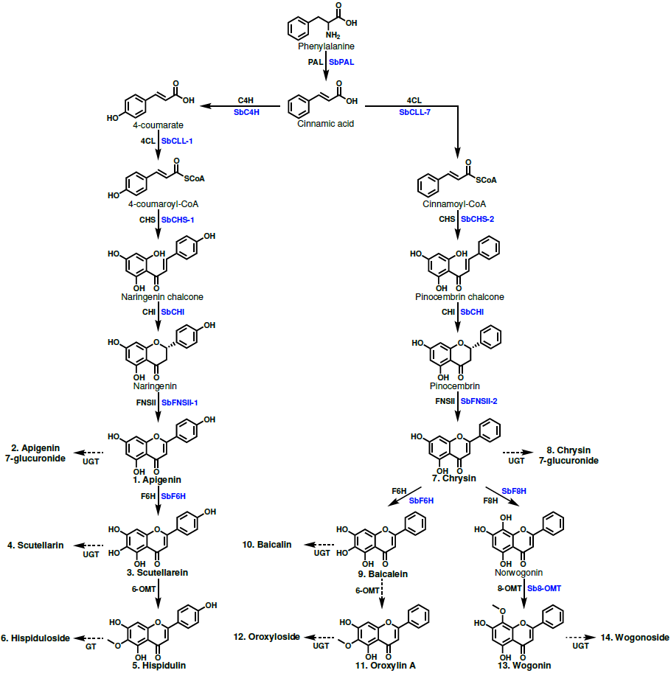
Figure 1. Proposed 4´-hydroxyflavone and 4´-deoxyflavone pathway. Structures of glycosylated metabolites are not shown to save space but are included in Appendix S1. Enzyme names in blue are specific isoforms that have been identified in S. baicalensis, and enzyme names in black are general names. Metabolites that were quantified have names in bold and are numbered to match the labeling of Figure 2.

Slide 11
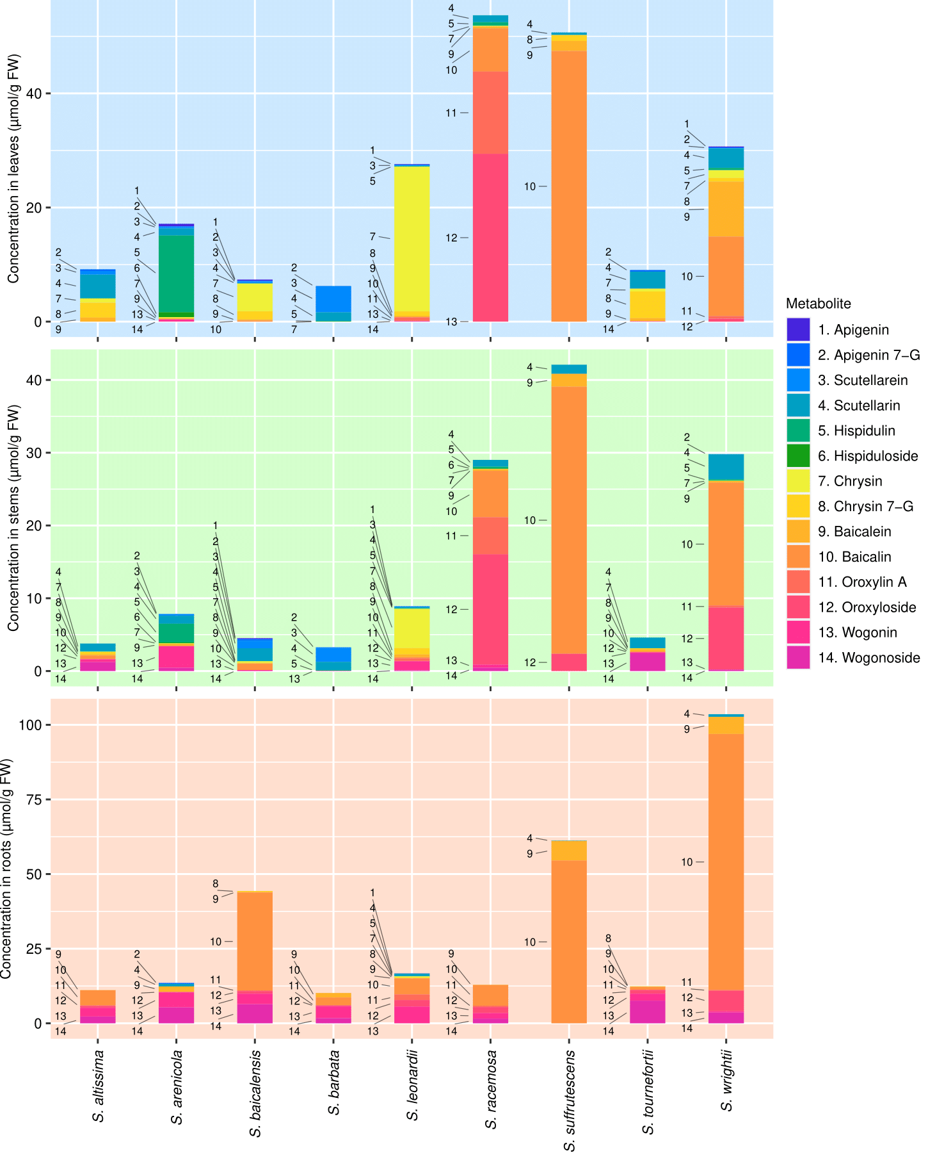
Figure 2. Organ-specific metabolite data collected from 9 Scutellaria species via High Performance Liquid Chromatography (HPLC). Samples were taken in biological triplicate, and the average concentration of each metabolite calculated. Metabolites are numbered to match their order of occurrence in the flavone pathway, shown in Figure 1.

Slide 12
S. baicalensis roots (Costine)
S. baicalensis leaves (Costine)
S. barbata leaves
S. racemosa leaves

Slide 13
100
%
80
60
270.65
333.11
40
20
0
nm
-10
200
300
400
500

Slide 14
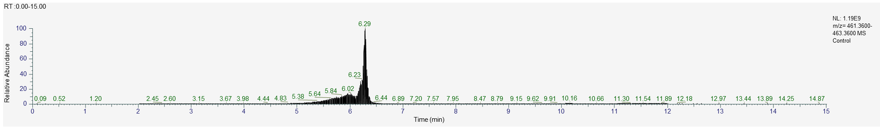
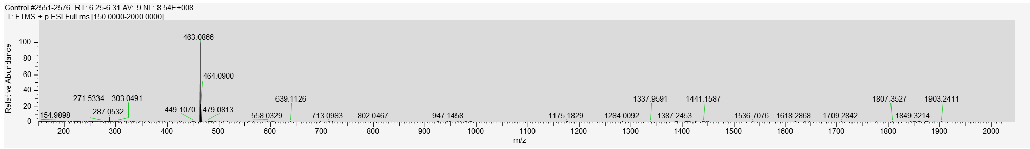
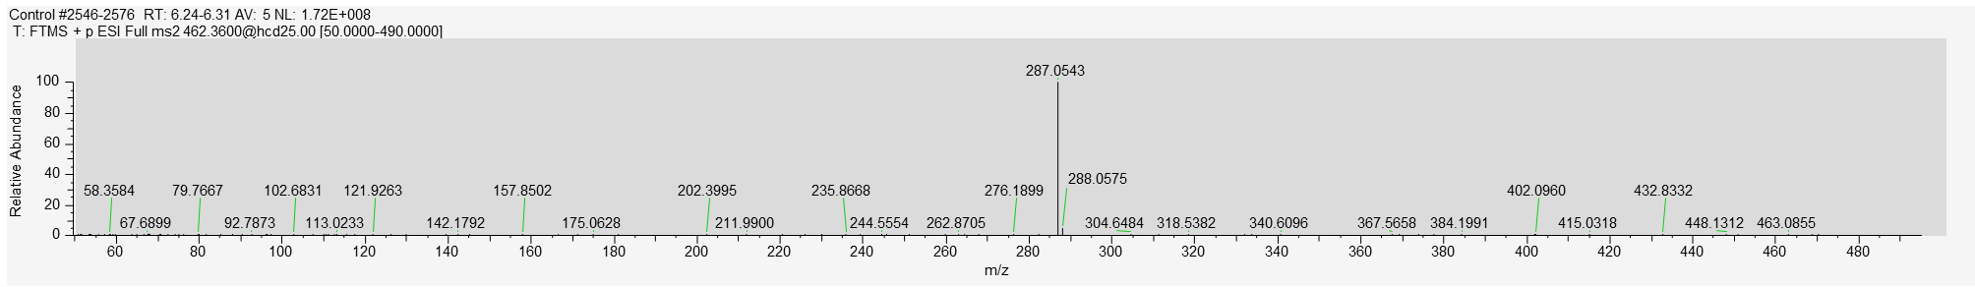
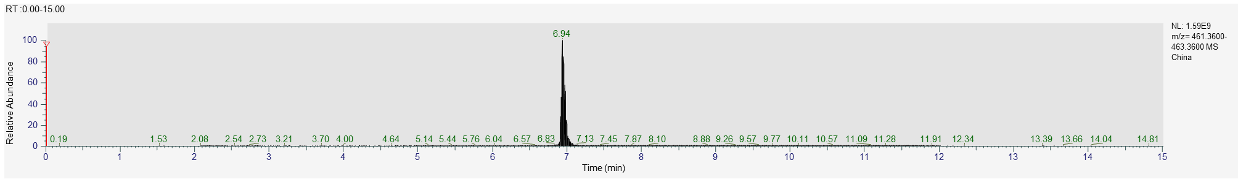
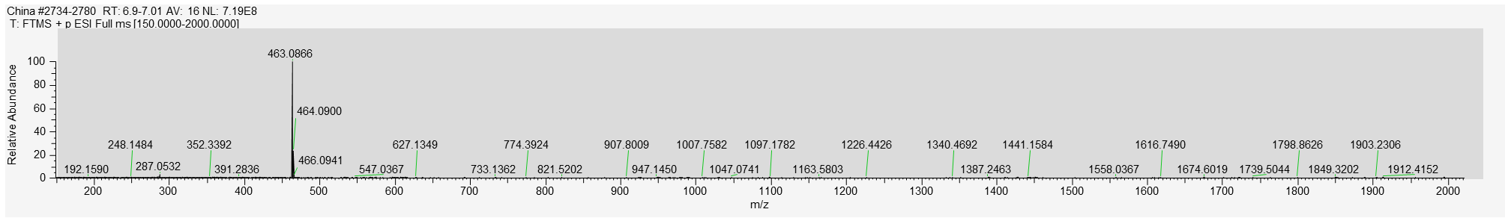
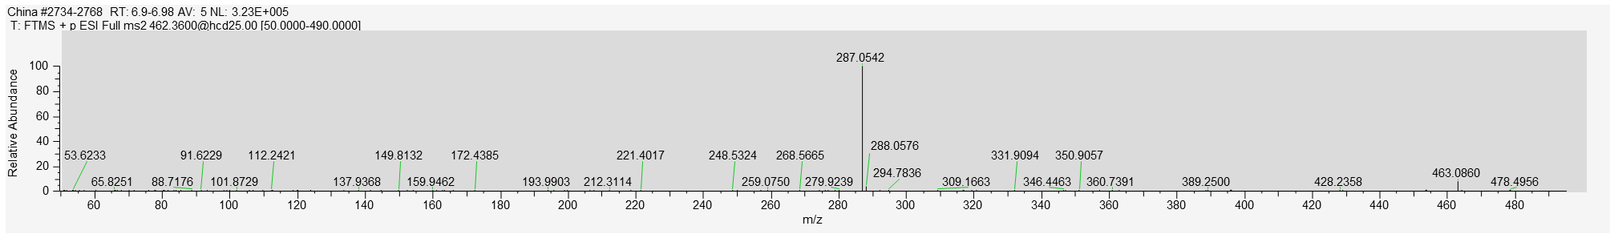
Scutellarin
EIC
M/Z
MS/MS
Unknown
EIC
M/Z
MS/MS

Slide 15
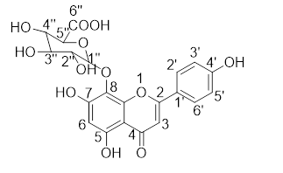
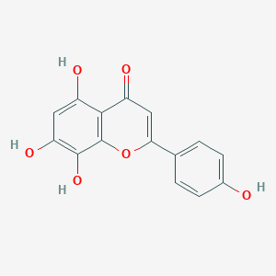
Predicted structure from NMR data:
Structure from PubChem: Isoscutellarein
Identity of unknown: Isoscutellarein 8-glucuronide
TODO:
Quantify isoscutellarein 8-glucuronide in all extractions
Apigenin feeding
Yeast activity test with Rieske-type oxygenase from S. baicalensis
Tobacco infiltration with RTO

Slide 16
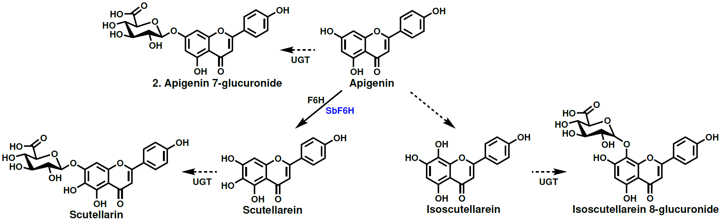
Proposed pathway:
Rieske-type oxygenase?

