Slide 1
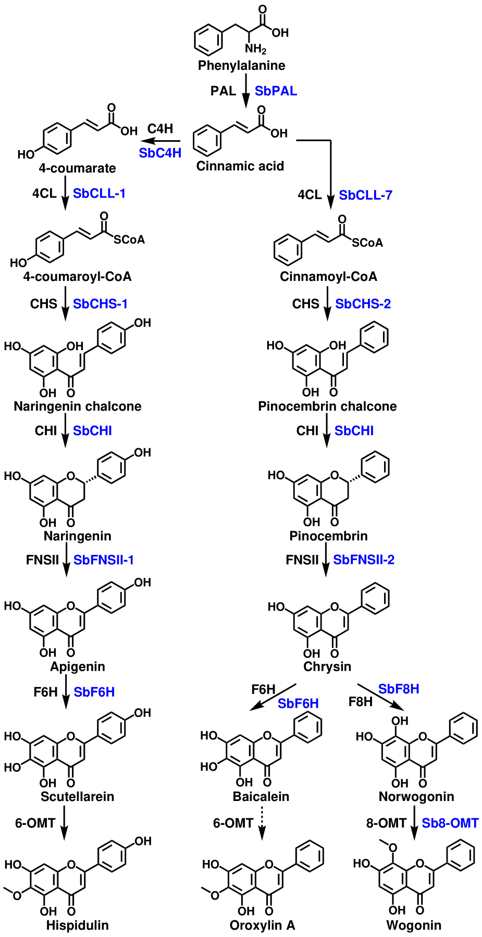
Figure 1. Proposed 4´-hydroxyflavone and 4´-deoxyflavone pathway with aglycones only. Enzyme names in blue are specific isoforms that have been identified in S. baicalensis, and enzyme names in black are general names.

