Slide 1
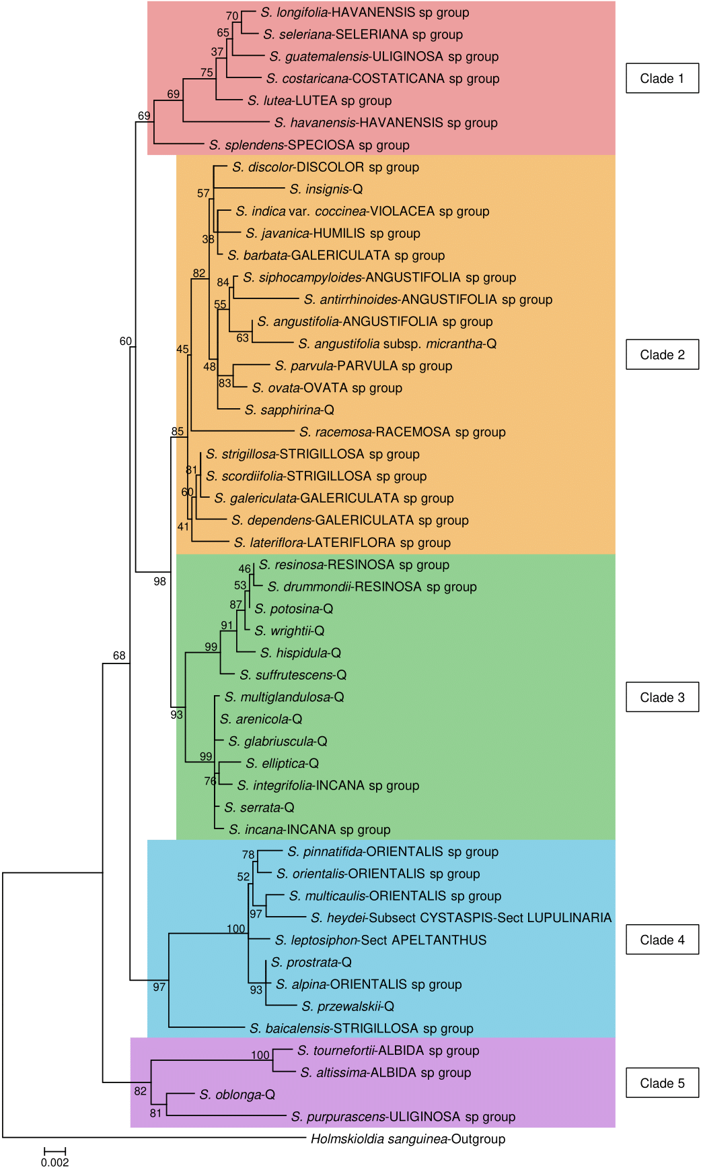
Figure 1. Maximum likelihood phylogenetic tree inferred from 3 chloroplast genome regions for 51 species of Scutellaria and 1 outgroup. The current infrageneric classification system suggested by Paton (1990) is indicated directly to the right of each species’ name. A “Q” indicates that the species is not included in the current infrageneric classification system. To facilitate downstream analysis, the tree is subdivided into 5 color-coded clades based on grouping of species within the tree.

Slide 2
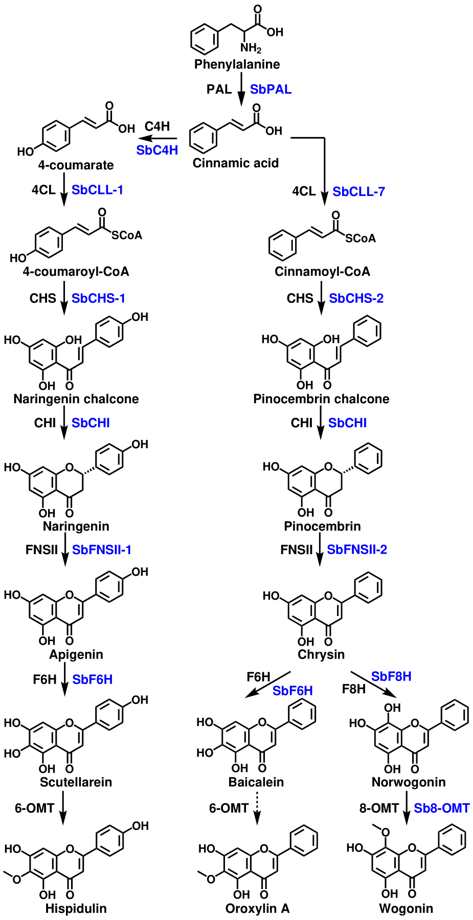
Figure 2. Proposed 4´-hydroxyflavone and 4´-deoxyflavone pathway with aglycones only. Enzyme names in blue are specific isoforms that have been identified in S. baicalensis, and enzyme names in black are general names.

Slide 3
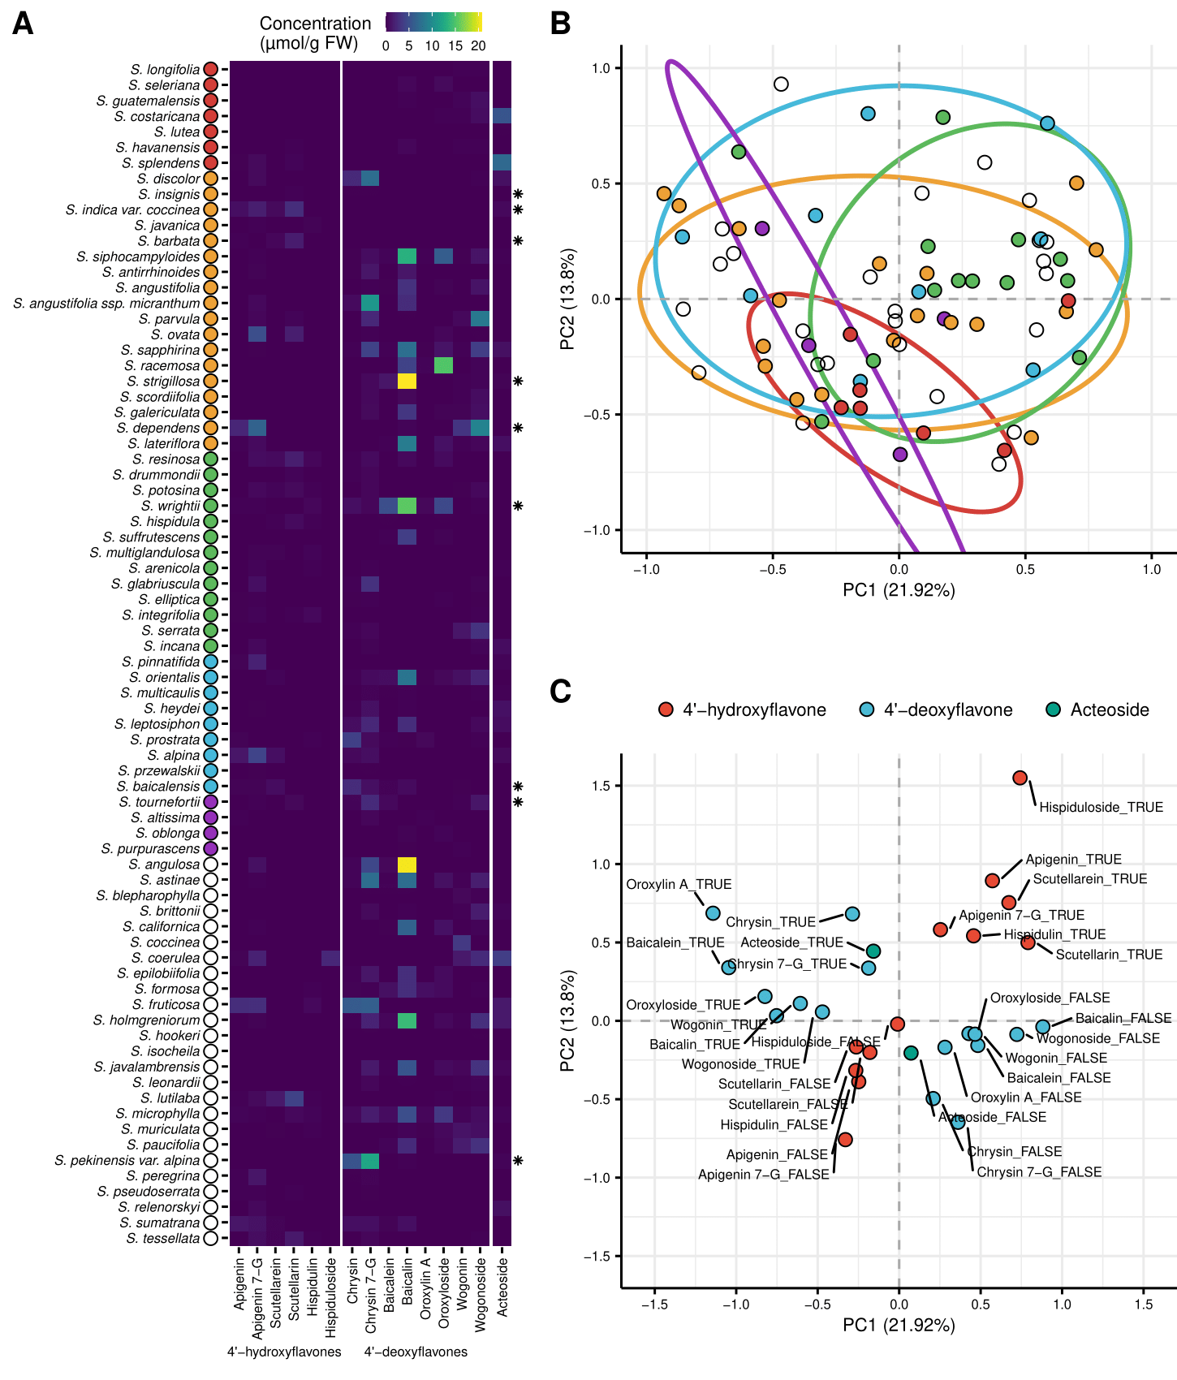
Figure 3. Aerial metabolite concentrations measured with High Performance Liquid Chromatography (HPLC) compared to phylogeny for 76 species of Scutellaria. (A) Heatmap of collected data. Data is shown in units of µmol/g fresh weight. Fresh weight of herbarium samples was estimated by multiplying their dry weight by a factor of 10. Species for which fresh tissue was used are indicated by an asterisk on the right side of the heatmap. Samples for all other species were prepared from herbarium vouchers. Colored circles next to species names indicate phylogenetic clade, as shown in Fig. 1. An empty circle indicates that the species was not included in the tree from Fig. 1. (B) Multiple Correspondance Analysis (MCA) individual results with overlaid 80% confidence ellipses generated from binarized metabolite data. Each colored circle represent a species, and the color of the circle represents phylogenentic clade, as shown in Fig. 1. The percentage of total variance explained by each principal component is shown next to each axis title. (C) Variable loadings from MCA. Each variable represents the prescence (indicated with “TRUE) or absence (indicated with “FALSE) of a metabolite, and are color-coded according to metabolite class.

Slide 4
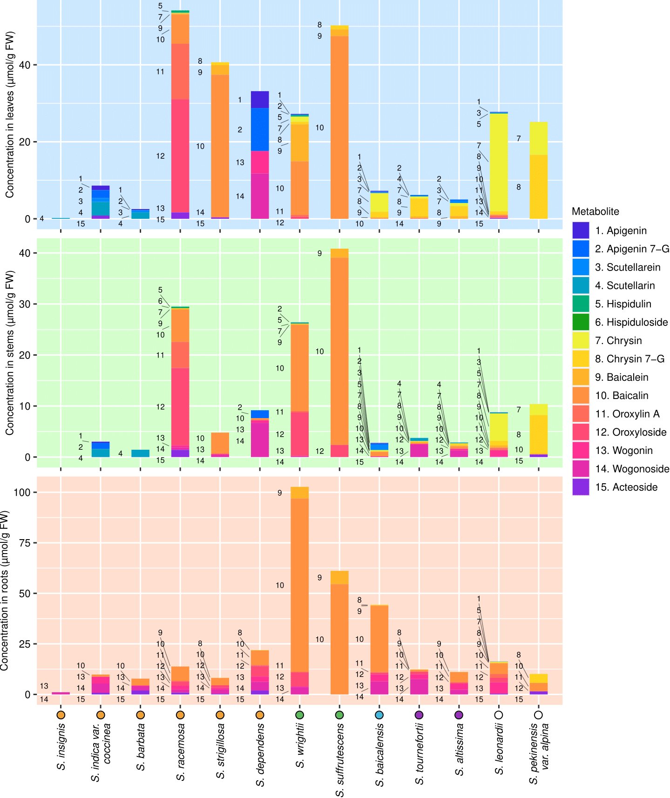
Figure 4. Organ-specific metabolite data collected from 13 Scutellaria species via High Performance Liquid Chromatography (HPLC). Samples were taken in biological triplicate, and the average concentration of each metabolite calculated. Species on x-axis are ordered based on phylogenetic relationship determined from chloroplast genome data, and colored circles next to species names indicate phylogenetic clade, as shown in Fig. 1. An empty circle indicates that the species was not included in the tree from Fig. 1.

Slide 5
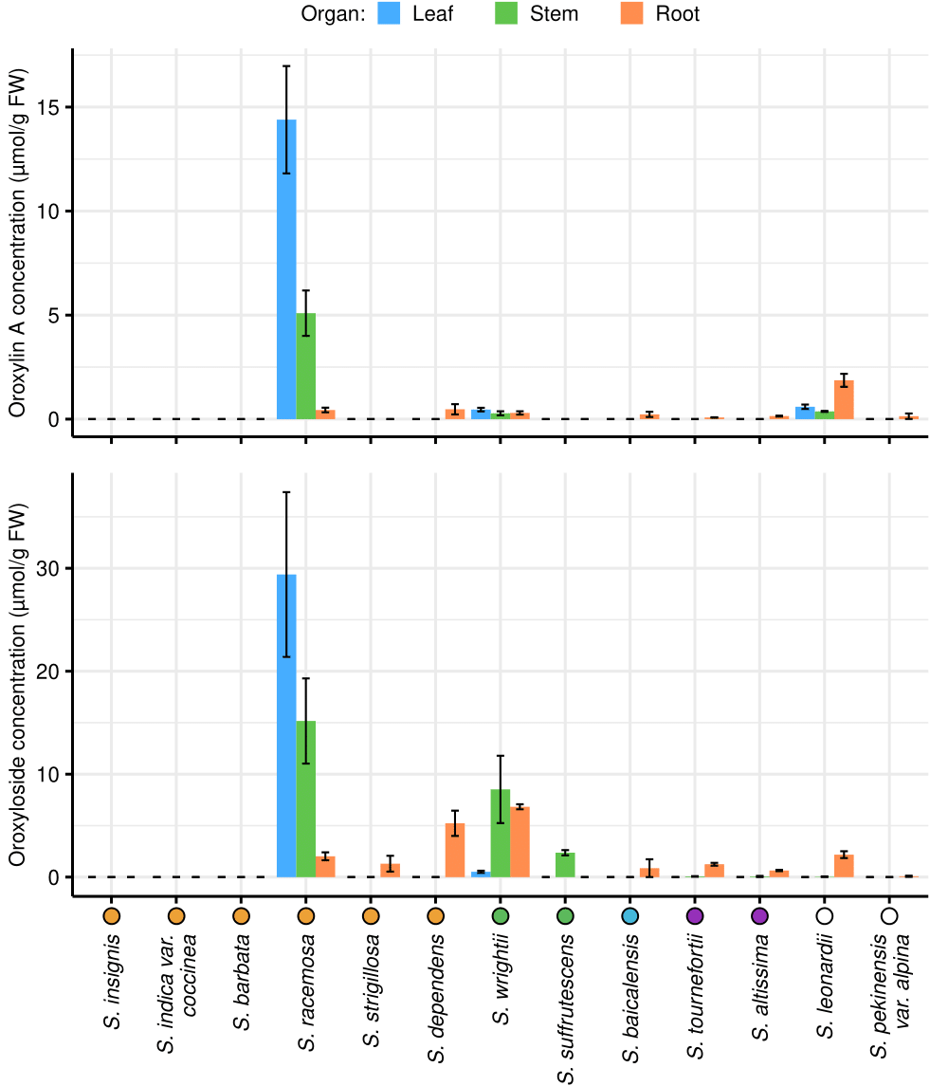
Figure 5. Organ-specific oroxylinA (bottom) and oroxyloside (top) concentrations in 13 Scutellaria species, as determined via High Performance Liquid Chromatography (HPLC). Concentrations were averaged from tissue samples taken from 3 biological replicates, and error bars represent standard error. Species are ordered based on phylogenetic relationship determined from chloroplast genome data, and colored circles next to species names indicate phylogenetic clade, as shown in Fig. 1. An empty circle indicates that the species was not included in the tree from Fig. 1.

