Slide 1
Review previous publication disproving isoscutellarin

Slide 2
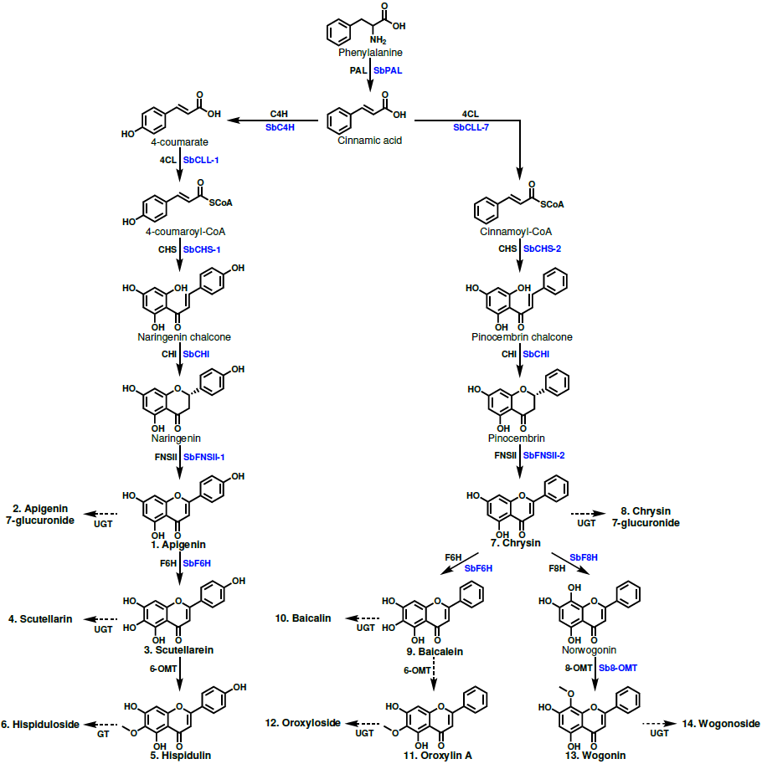
Figure 1. Proposed 4´-hydroxyflavone and 4´-deoxyflavone pathway. Structures of glycosylated metabolites are not shown to save space but are included in Appendix S1. Enzyme names in blue are specific isoforms that have been identified in S. baicalensis, and enzyme names in black are general names. Metabolites that were quantified have names in bold and are numbered to match the labeling of Figure 2.

Slide 3
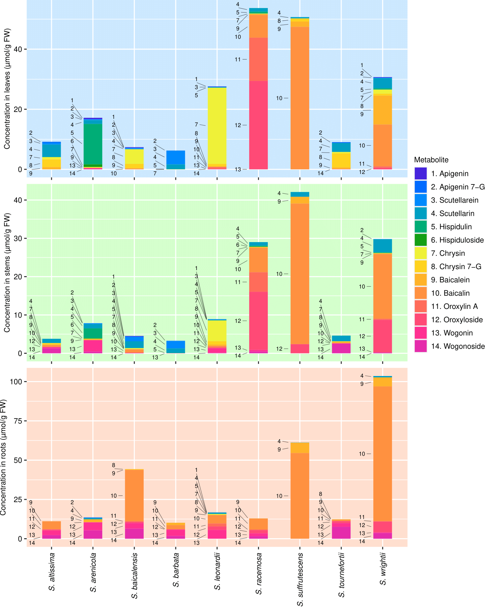
Figure 2. Organ-specific metabolite data collected from 9 Scutellaria species via High Performance Liquid Chromatography (HPLC). Samples were taken in biological triplicate, and the average concentration of each metabolite calculated. Metabolites are numbered to match their order of occurrence in the flavone pathway, shown in Figure 1.

Slide 4
A.
100
%
80
60
294.30
40
273.08
330.34
20
0
nm
-10
200
300
400
500
B.
100
%
80
60
210.74
40
293.87
20
354.02
0
nm
-10
200
300
400
500
C.
100
%
80
60
270.65
333.11
40
20
0
nm
-10
200
300
400
500
Figure 3. Selected HPLC chromatograms and peak spectra from (A) S. barbata leaves, (B) S. baicalensis leaves, and (C) S. tournefortii stems. Chromatograms (left) indicate absorbance of the tissue sample at 276 nm, with the unknown peak of interest highlighted in red. Peak spectra (right) illustrate the absorbance spectra of the highlighted peak in each sample.

Slide 5
Chromatogram + spectra for young baicalensis leaves
Chromatogram + spectra for young barbata leaves
Chromatogram + spectra for isolated standard sent for LC-MS + NMR

Slide 6
