Slide 1
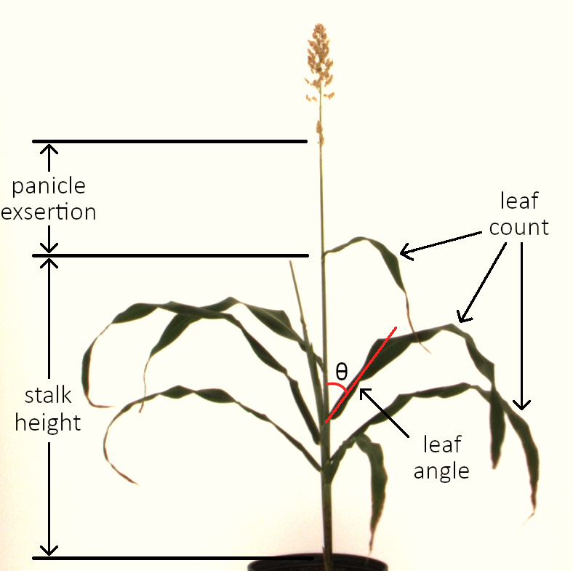
Computer vision & QTL mapping overview
417 mature sorghum plants from BTx623 x IS3620C RIL family
RIL family info - https://npgsweb.ars-grin.gov/gringlobal/descriptordetail.aspx?id=289007
371 unique lines
21 BTx623
RGB images taken from 5 angles, 36° apart
Objectives:
Develop computer vision method to automatically measure phenotypes from images
# of leaves
Stalk height
Panicle exsertion
Average leaf angle
Correlate plant phenotypes with genotypes to identify genomic regions controlling variation in traits
Genotype data - https://www.ncbi.nlm.nih.gov/pubmed/29853656
Analysis with R/qtl package in R

Slide 2
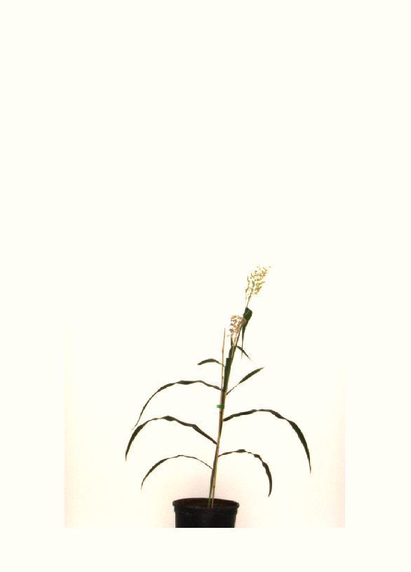
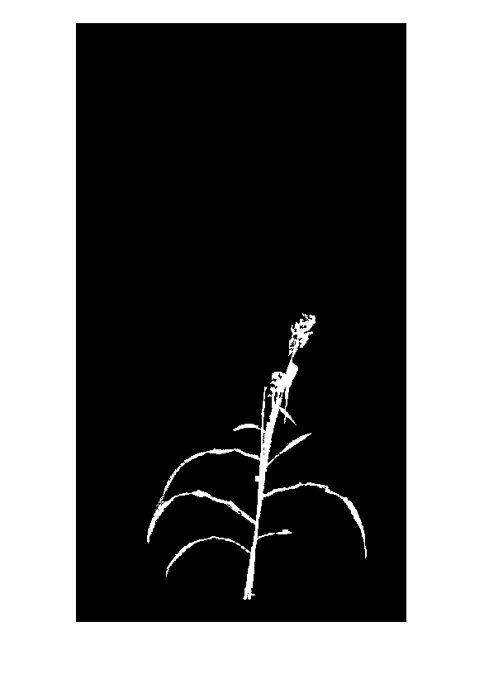
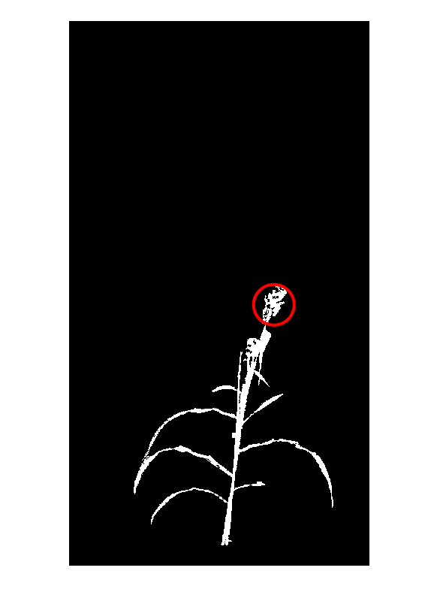
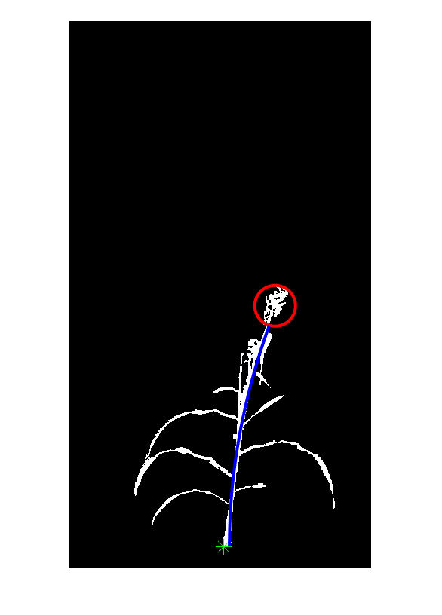
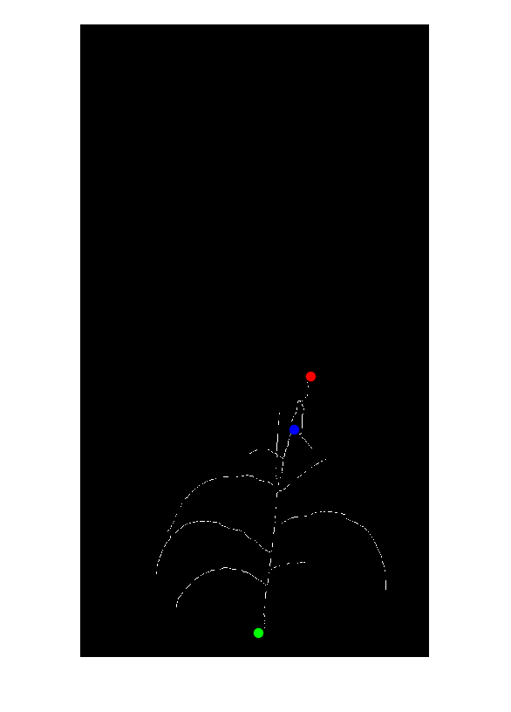

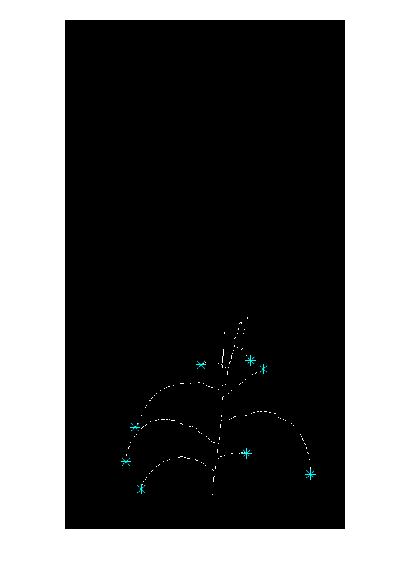
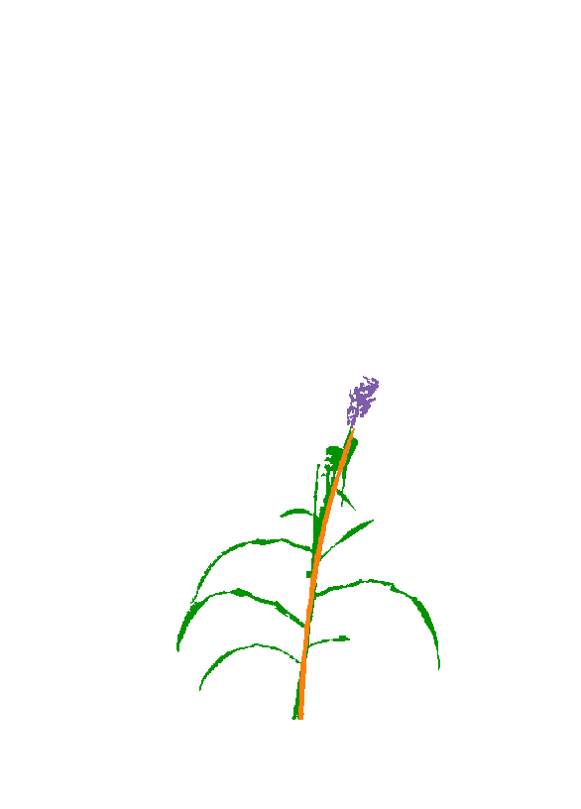
Computer vision example
Original image
Initial processing – background removal via thresholding in L*a*b* color space
Panicle identification – iterative color thresholding & bounding area search
Stalk identification – curve fitting to shortest path connecting stalk bottom to panicle base
Stalk height & panicle exsertion – vertical distance from flag leaf node to stalk bottom & panicle base
Leaf angle – skeleton tracing from leaf tips and identification of smoothest path
Leaf counting – skeletonization of image and identification of leaf tips
Image segmentation – separation of leaf, stalk, panicle, and stake pixels

Slide 3
Computer vision workflow
RGB_image_analysis
x5
(for each camera angle)
No plant detected
Successful stake segmentation, or no stake was detected
stake_segmentation
No panicle detected
panicle_identification
Successful panicle identification
No stalk detected
stalk_identification
Successful stalk identification
Unsuccessful segmentation
image_segmentation
Successful plant segmentation
remove_pot
leaf_counting_v2
Use camera angle w/ greatest # of leaves
leaf_angle_v2
At least 1 angle has >0 leaves
No angles have >0 leaves
Calculate stalk height and panicle exsertion
Save phenotype data into .csv file

Slide 4
Computer vision functions
RGB_image_analysis
Set directory containing sorghum images with ‘total_folder_name’
Set ‘L_threshold’ and ‘b_threshold’ used to separate plant from background
Loops through all plants and images
Calls all supporting functions
Calculates stalk height and panicle exsertion based on output of ‘leaf_angle_v2’
stalk height = stalk bottom – flag leaf node
panicle exsertion = flag leaf node – panicle base
If panicle exsertion is negative, don’t use measurement
Saves all phenotype measurements to a .csv file in folder with code

Slide 5
Computer vision functions
stake_segmentation
Inputs –
filename – path to image
b_threshold – max b* value for pixel to be classified as background
L_threshold – min L* value for pixel to be classified as background
Outputs –
image – cropped image in L*a*b* color space
all_plant – binary image (1’s are plant, 0’s are background)
stake – binary image of stake detected
Method:
Convert image from RGB to L*a*b* color space
Color thresholding to remove background pixels, then clean up detected plant pixels
Color thresholding to identify stake pixels
Fit 2° polynomial to median stake pixels in each row
Delete any pixels too far away from line
Count # of stake pixels to determine if plant is staked – min # required is determined from overall plant height

Slide 6
Computer vision functions
panicle_identification
Inputs –
all_plant – binary image (1’s are plant, 0’s are background)
image – cropped image in L*a*b* color space
stake – binary image of stake detected
Outputs –
panicle_row – row of panicle center
panicle_col – column of panicle center
circle_rows – row coordinates for circle centered around detected panicle
circle_cols – column coordinates for circle centered around detected panicle
Method:
Loop through 5 different thresholds to identify panicle pixels
In each loop:
Fit a square window of gradually increasing size to site with greatest number of panicle pixels
Plot window size against panicle pixels detected in best window
Select optimal window size – minimum slope, or first point with a slope <0.008 (indicates window is large enough to surround entire panicle)
If # of panicle pixels in window / window area < 0.035, no panicle is detected – min density requirement is not met
If # of panicle pixels in window / window area > 0.035, panicle is detected – draw circle with center at center of optimal window and radius = window size/2
If a panicle is found with >1 thresholds, select highest panicle identified as the true panicle

Slide 7
Computer vision functions
stalk_identification
Inputs –
all_plant – binary image (1’s are plant, 0’s are background)
image – cropped image in L*a*b* color space
panicle_row – row of panicle center
panicle_col – column of panicle center
circle_rows – row coordinates for circle centered around detected panicle
circle_cols – column coordinates for circle centered around detected panicle
Outputs –
all_plant
stalk_line
stalk_bot
panicle_base
Method:

