Slide 1
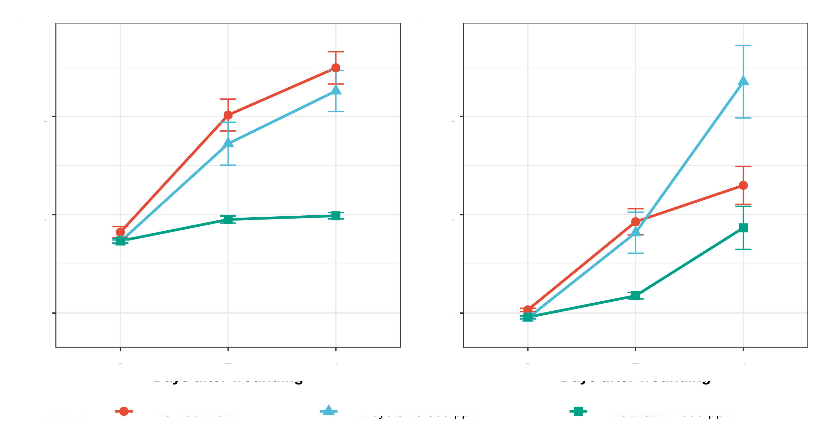
Figure #. Mean a* of cut sites measured via digital imaging method from (A) iceberg and (B) romaine ribs over 4-day experimental period.

