Slide 1
Method
The degree of pinking was measured quantitatively with a digital imaging-based method. RGB Images of wounded ribs were taken at 0, 2, and 4 days after wounding. Lighting conditions and camera settings were carefully controlled to ensure consistent imaging. GNU Image Manipulation Program (GIMP, version 2.10.14; https ://www.gimp.org/) was used to crop out background pixels from each rib, and extract pixels from an area 1 mm in height centered at the cut site, for each cut site in an image. Extracted pixels for each cut site were then exported into separate images. To allow for direct comparison of each cut site to its state at previous time points, each cut site was assigned a label at day 0 based on the identity of the rib and its location on the rib.
R (version 4.0.0; R Core Team, 2020) was used to convert cut site images from the RGB to the L*a*b* color space, calculate the mean a* for each cut site image, and subset the data. Data subsetting was applied to ensure that the cut sites chosen for further analysis had similar initial color. Subsetting was accomplished by defining a range of values which the mean a* of the cut site at 0 days after wounding must fall within to be considered. For iceberg, the range chosen was -3 to 0. For romaine, -6 to -3. To equalize the number of cut sites considered from each treatment group, cut sites with an initial mean a* differing the most from the average initial mean a* of the smallest group were recursively removed until the number of cut sites in each treatment group were equal. For iceberg, this left 5 cut sites from each treatment method. For romaine, 3. The results of this digital imaging method are shown in Figure #.

Slide 2
Citations
R Core Team. 2019. R: A language and environment for statistical computing. R Foundation for Statistical Computing, Vienna, Austria
(GIMP may or may not need a citation depending on the journal)

Slide 3
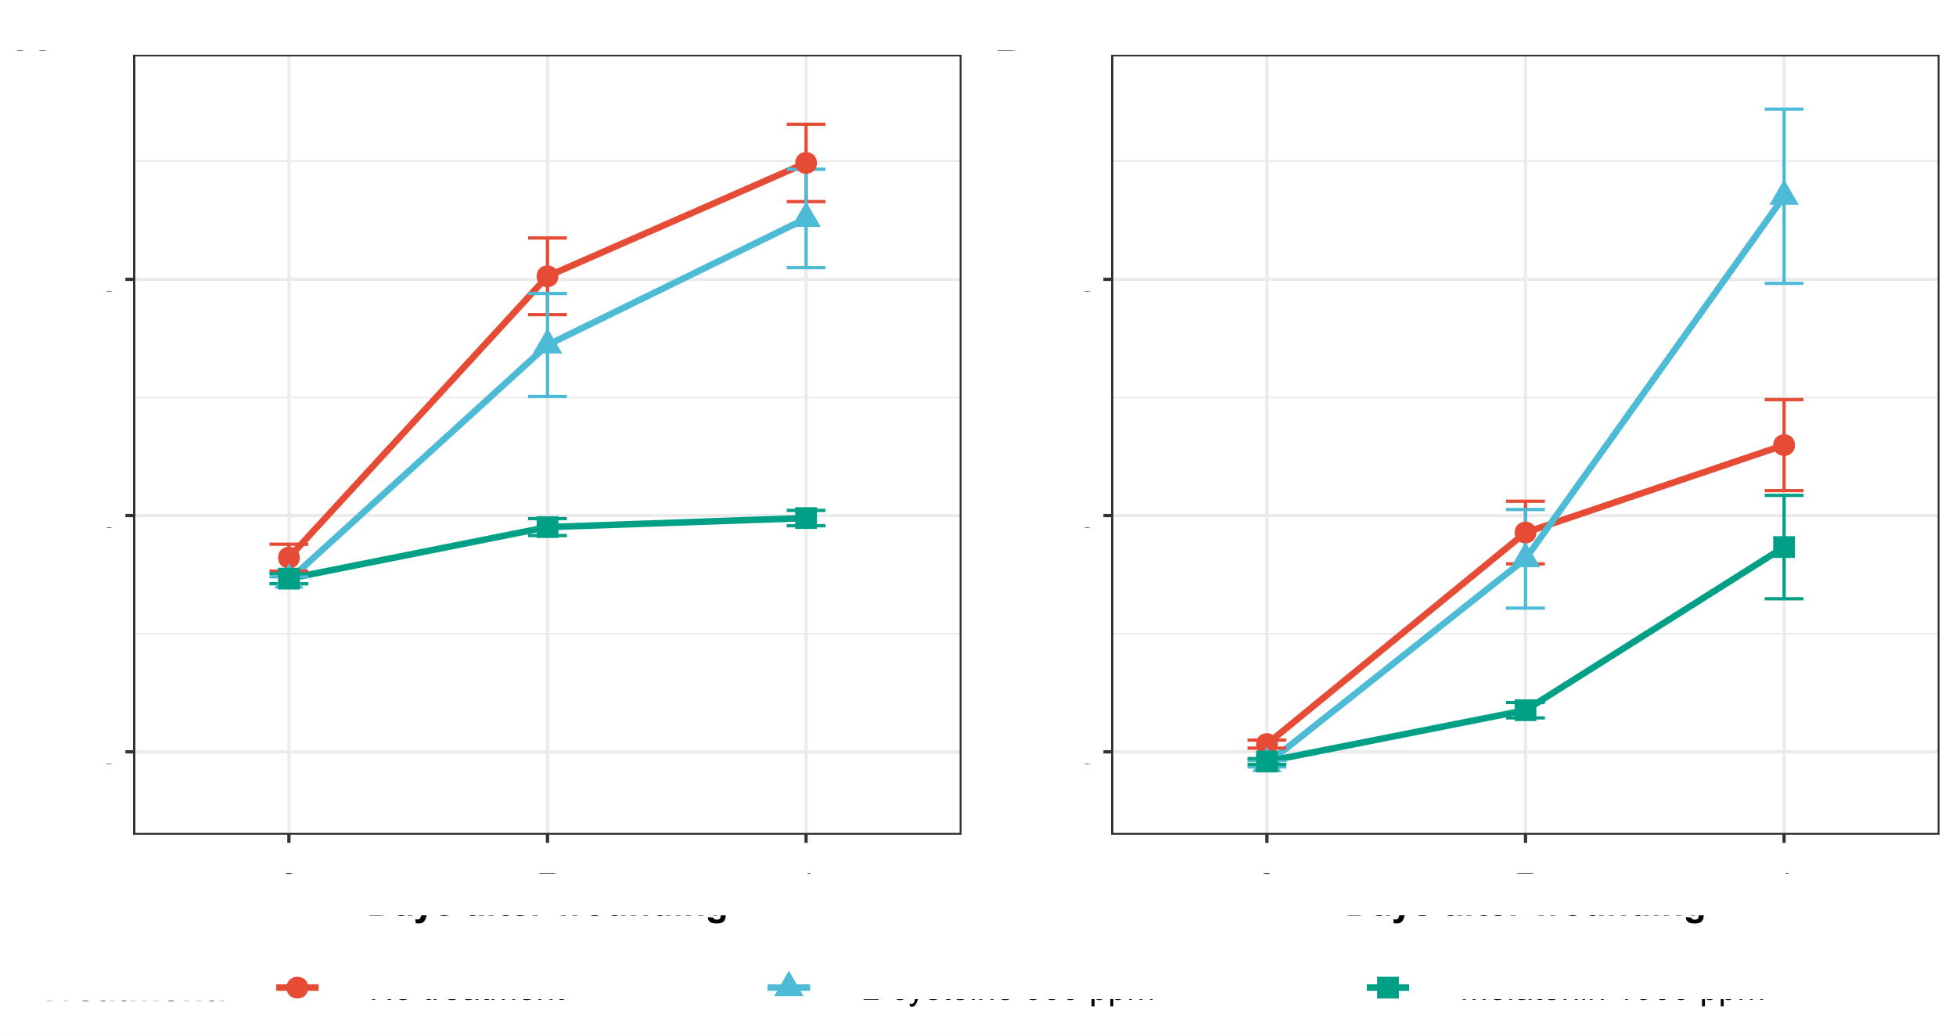
Figure #. Mean a* of cut sites measured via digital imaging method from (A) iceberg and (B) romaine ribs from each treatment group over 4-day experimental period.

Slide 4
Raw data - iceberg
Variety | Treatment group | Day | Average mean a* | Standard error
Iceberg | No treatment | 0 | -0.89068107 | 0.2838299
Iceberg | No treatment | 2 | 5.06335895 | 0.8106018
Iceberg | No treatment | 4 | 7.46215035 | 0.8185934
Iceberg | L-cysteine 500 ppm | 0 | -1.36811893 | 0.0719265
Iceberg | L-cysteine 500 ppm | 2 | 3.60861442 | 1.0906820
Iceberg | L-cysteine 500 ppm | 4 | 6.28711577 | 1.0413093
Iceberg | Melatonin 1000 ppm | 0 | -1.33501952 | 0.1073516
Iceberg | Melatonin 1000 ppm | 2 | -0.24422154 | 0.1790481
Iceberg | Melatonin 1000 ppm | 4 | -0.05323939 | 0.162664

Slide 5
Raw data - romaine
Variety | Treatment group | Day | Average mean a* | Standard error
Romaine | No treatment | 0 | -4.8364370 | 0.08532724
Romaine | No treatment | 2 | -0.3596783 | 0.66237222
Romaine | No treatment | 4 | 1.4908743 | 0.96242701
Romaine | L-cysteine 500 ppm | 0 | -5.2519584 | 0.06845061
Romaine | L-cysteine 500 ppm | 2 | -0.9154238 | 1.04300430
Romaine | L-cysteine 500 ppm | 4 | 6.7562559 | 1.84315056
Romaine | Melatonin 1000 ppm | 0 | -5.2044737 | 0.06216506
Romaine | Melatonin 1000 ppm | 2 | -4.1194570 | 0.16293058
Romaine | Melatonin 1000 ppm | 4 | -0.6669802 | 1.09382682

