Slide 1
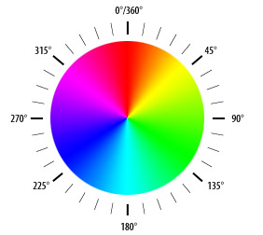
Overview of hue method
Convert cut site image to HSV color space
H – hue
S – saturation
V – value
Calculate average hue angle of pixels at/close to cut site
Smaller hue angle = more pink/red
Larger hue angle = more green
Note: all pixel hue angles ranged between 0° and ~100°

Slide 2
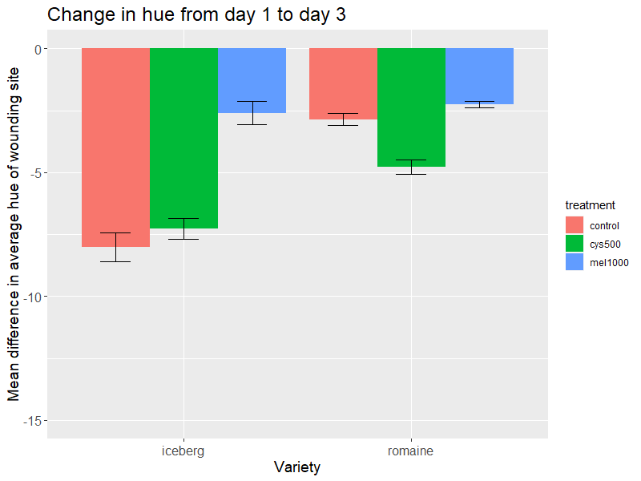
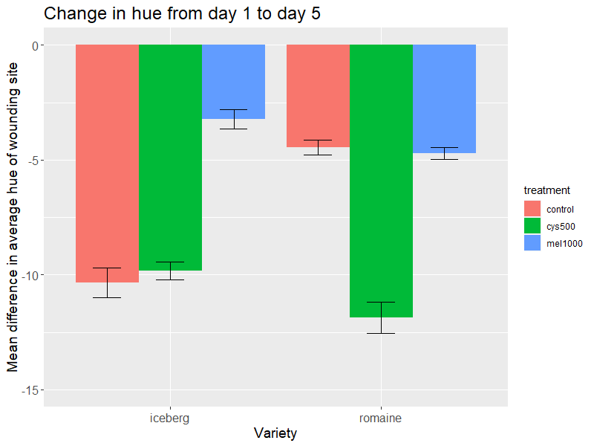

Slide 3
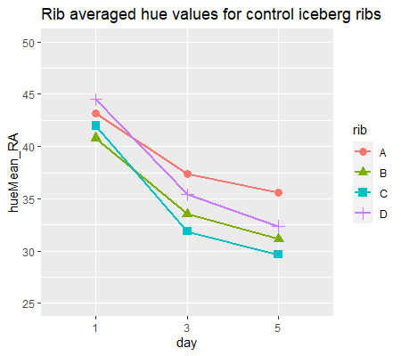
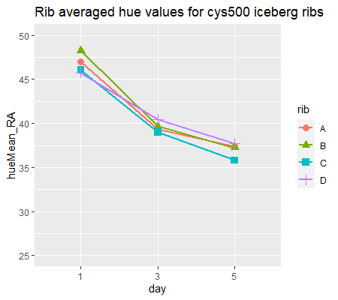
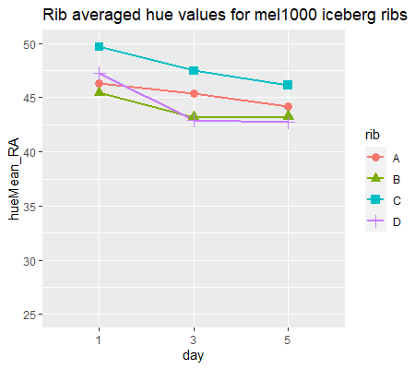

Slide 4
