Slide 1
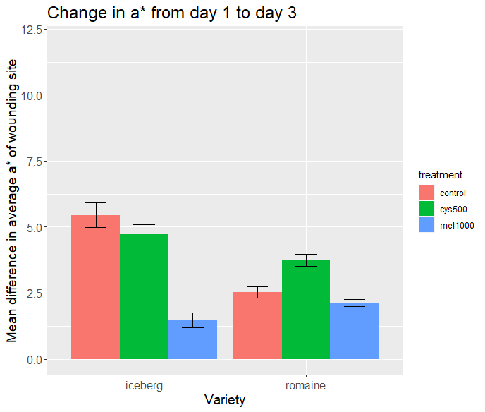
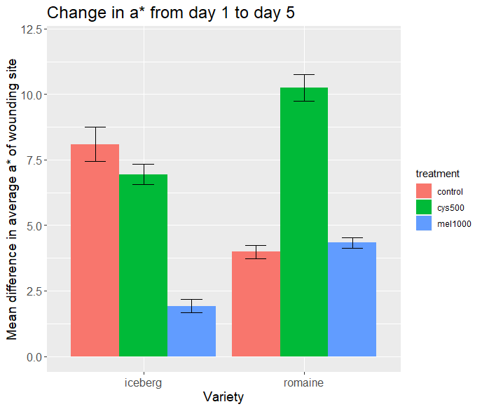

Slide 2


Iceberg, control, day 1
Iceberg, control, day 5

Slide 3
