Slide 1
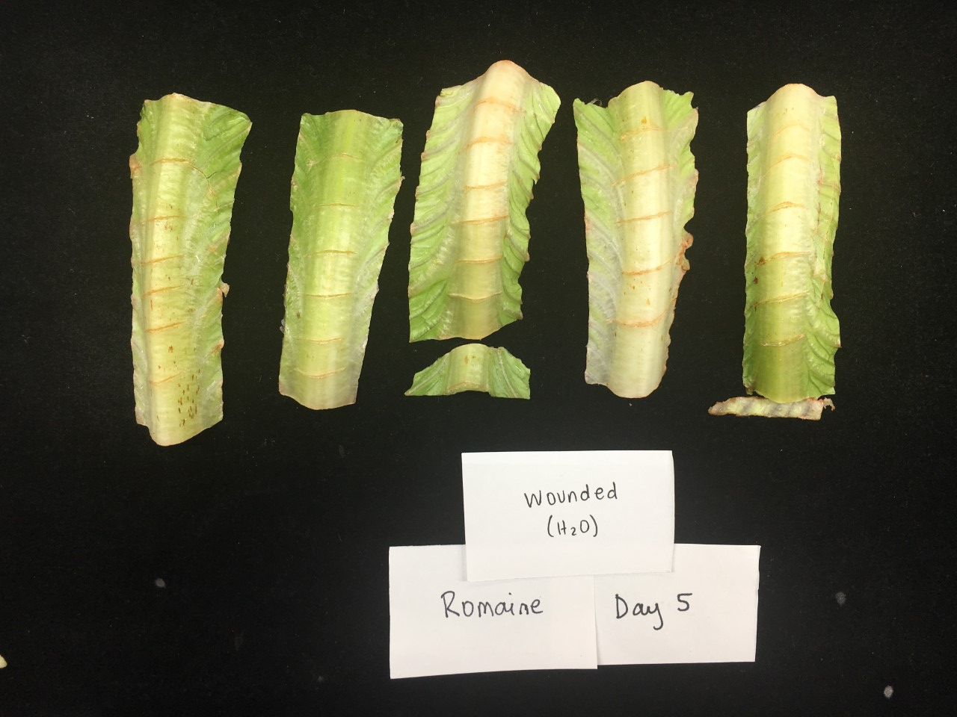
Proposal for quantifying wounding response
Bryce Askey

Slide 2
General approach
Analyze pixel RGB values @ wounding site
Use pixels from control treatment to develop RGB pixel threshold
Apply threshold to all images to determine % of pink pixels

Slide 3
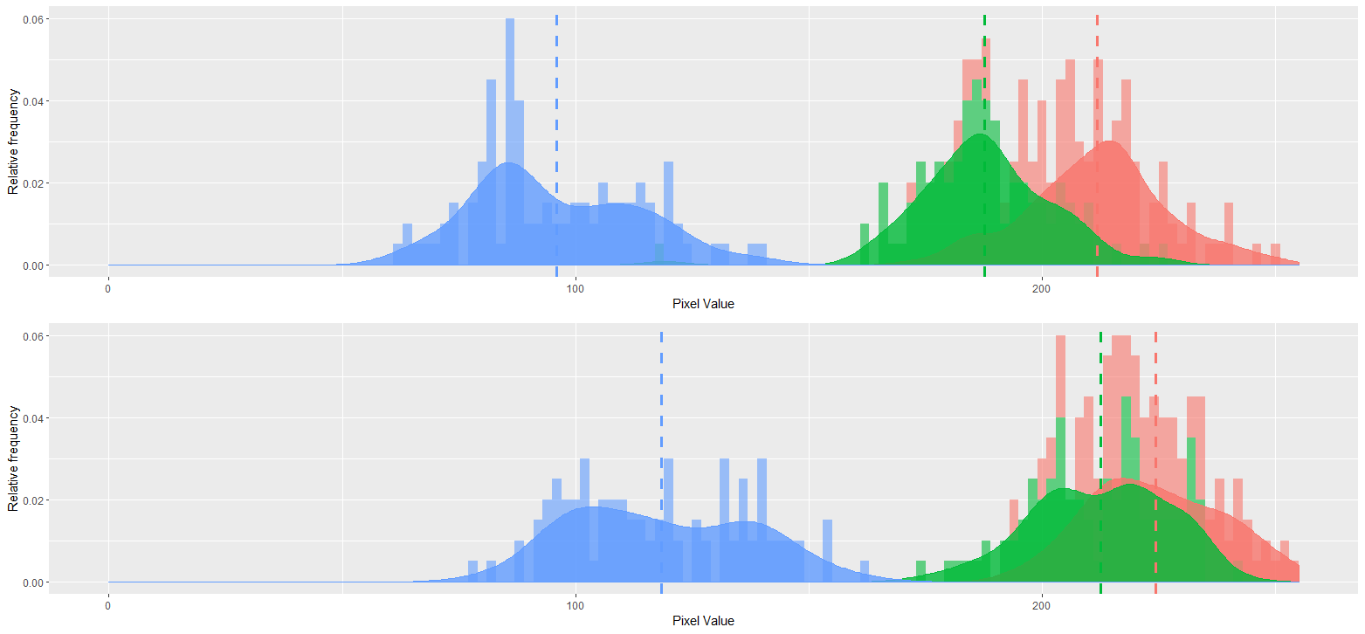
Differences in RGB profiles
Control
Melatonin 1000 ppm

Slide 4
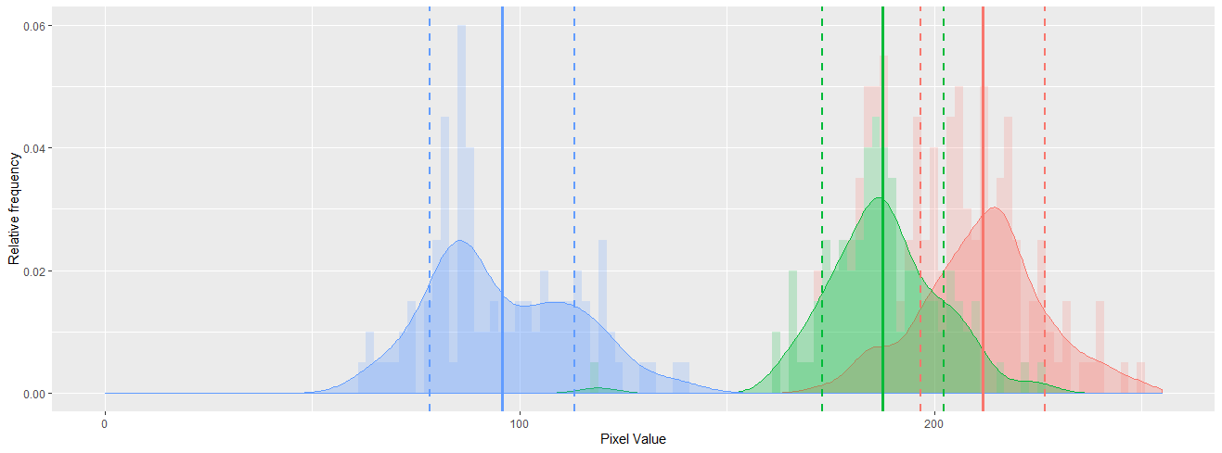
Threshold RGB values for pinking

Slide 5
Quantifying pinking response
Calculate % of pixels that meet threshold to be considered pink:
Standardize area considered
Count pixels in area that meet threshold

Slide 6
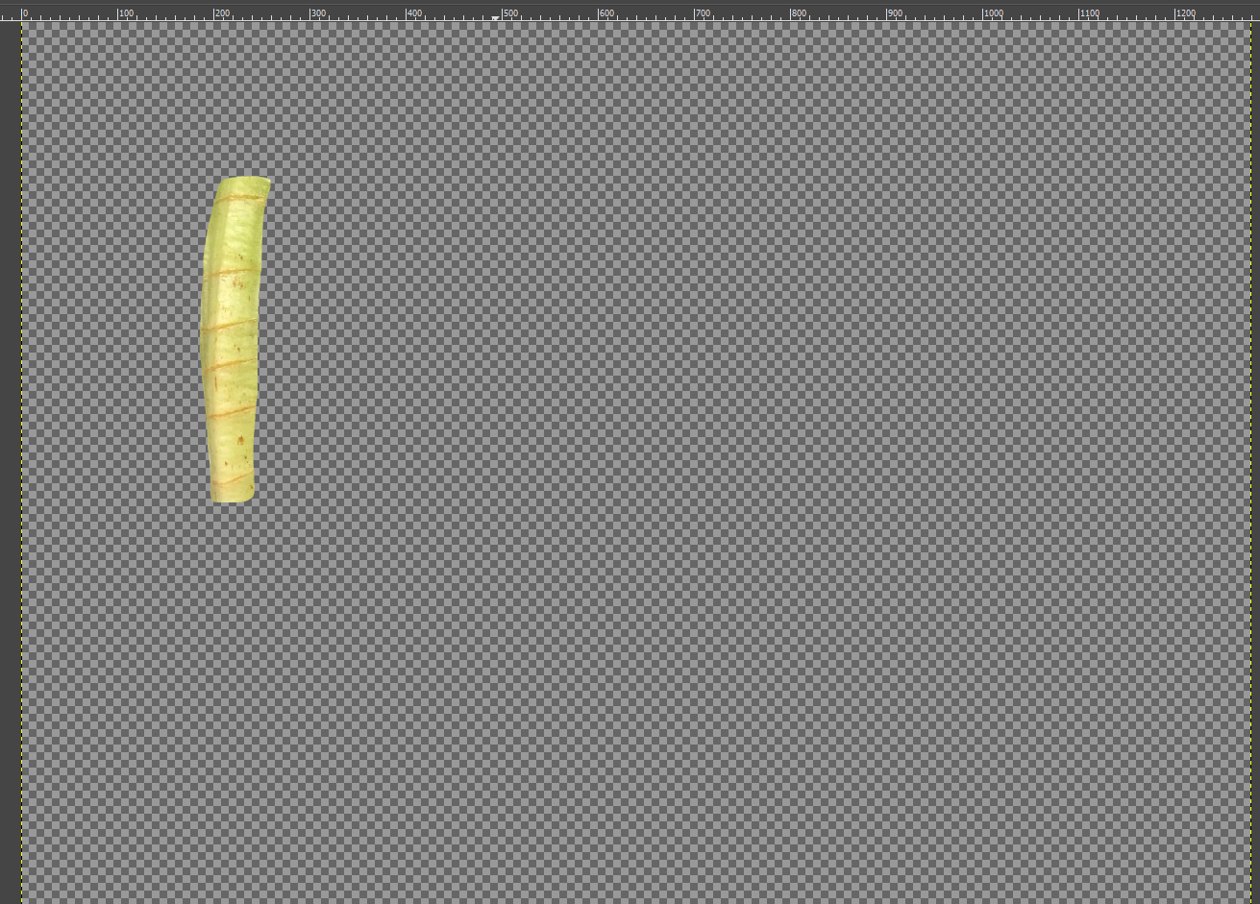
Image processing in GIMP

Slide 7
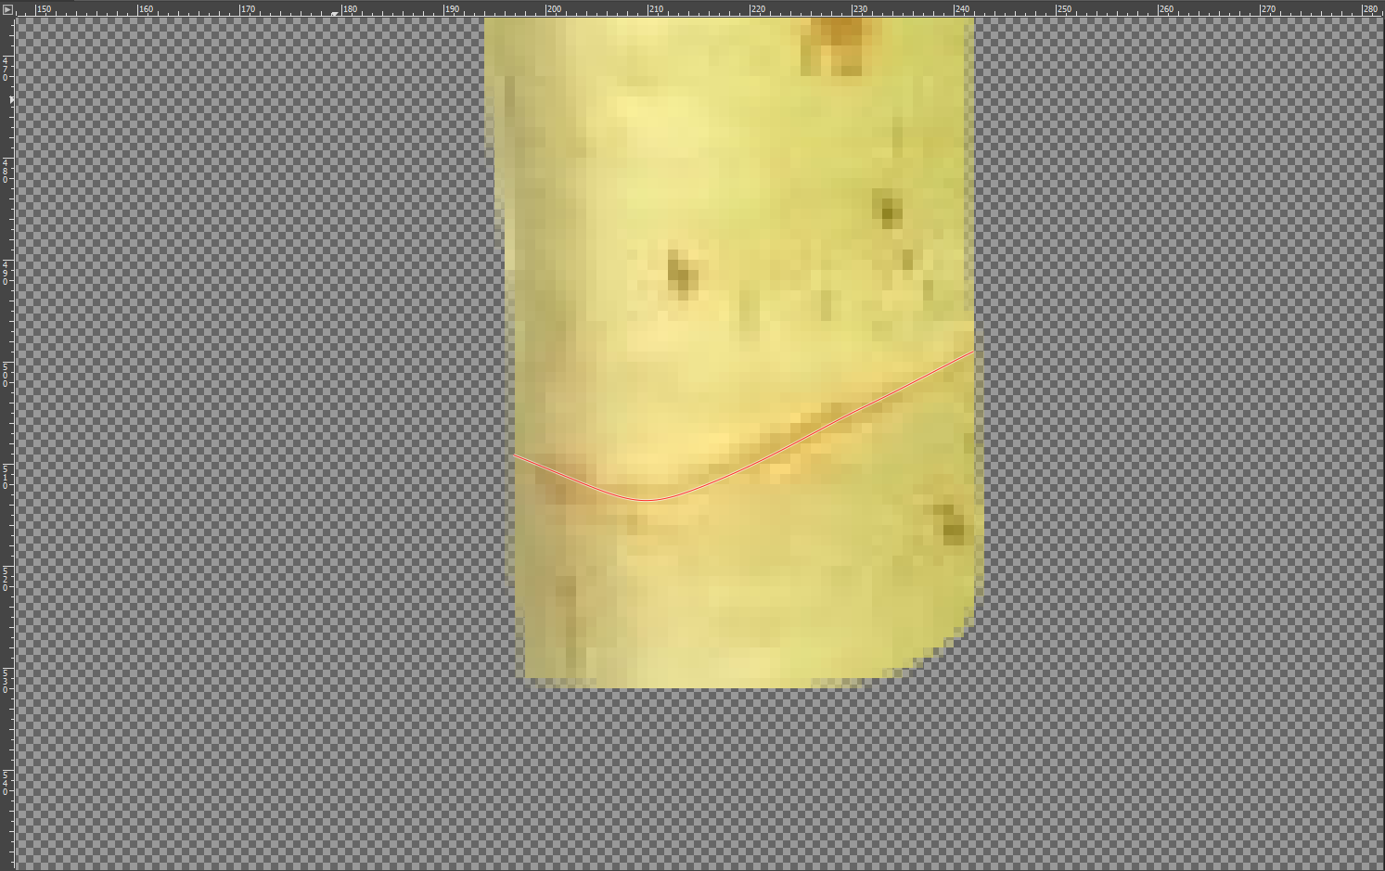
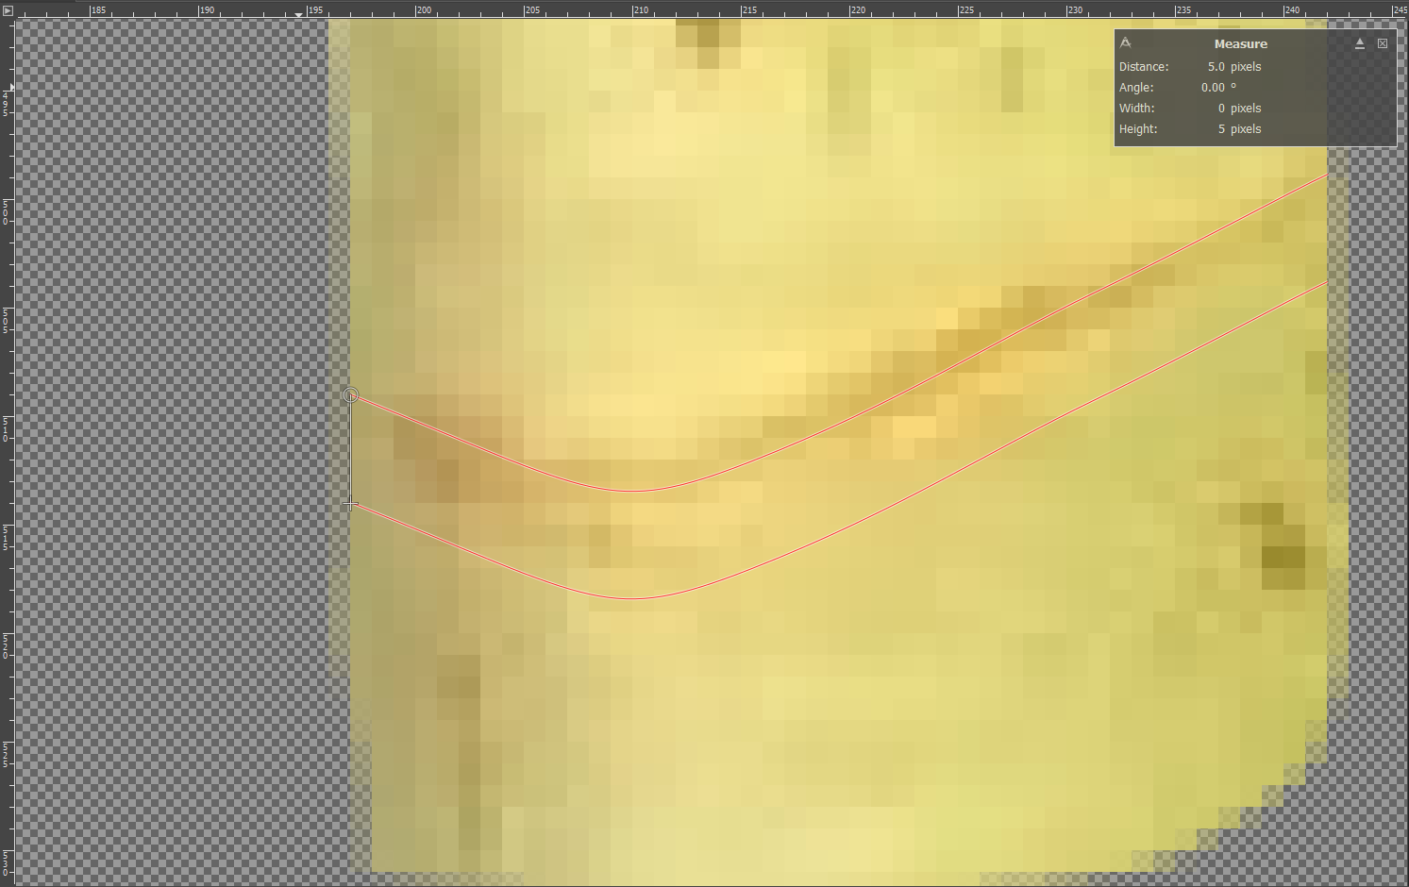
Image processing in GIMP

Slide 8
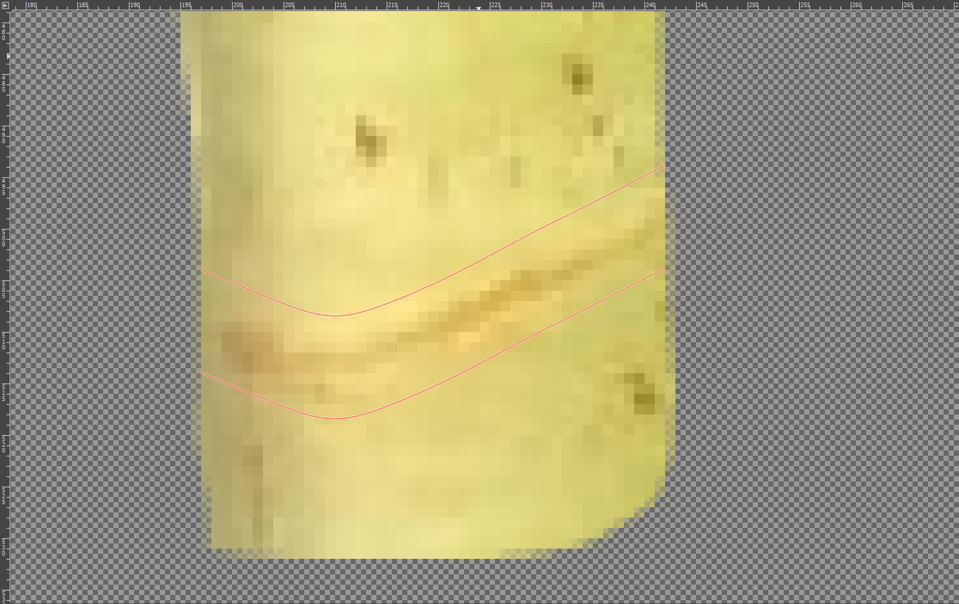
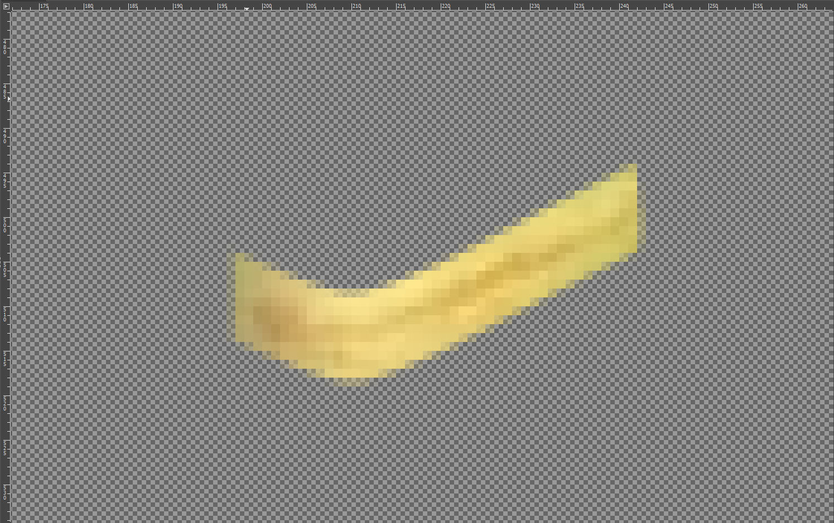
Image processing in GIMP

Slide 9
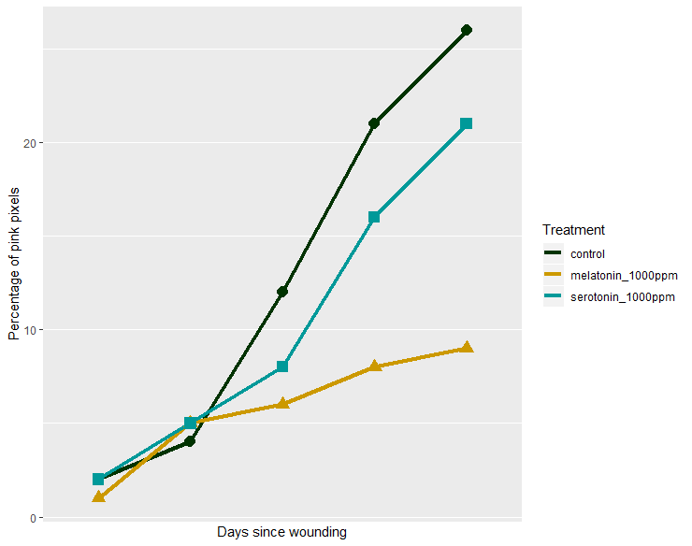
Output
Calculate % pink pixels for each wounding site
Standard deviation and significance of treatments

