Slide 1
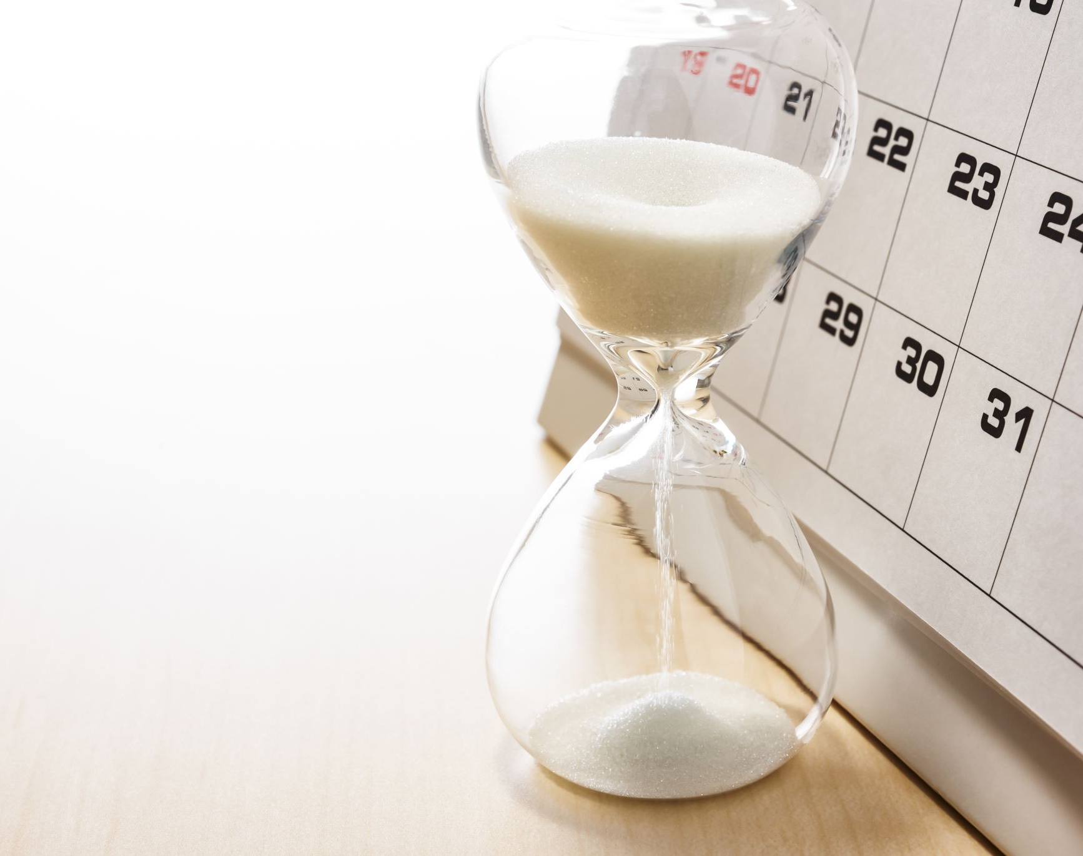
Time Tracker
Bryce Bien

Slide 2
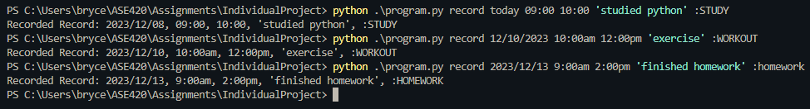
Record Activities
Record activities simply and quickly through CUI
Flexibility in date format
Flexibility in time format

Slide 3
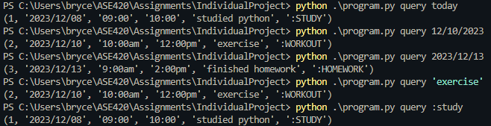
Query Activities
Query by Date, Task, Tag
Flexibility in format

Slide 4
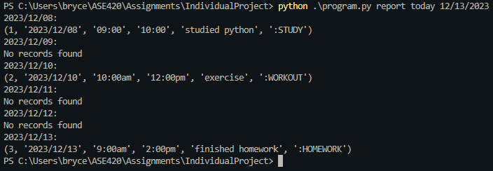
Report Activities
Print activities you completed in a date range
Flexibility in date format

Slide 5

Priority Activities
See a report of activities that took most of your time
Simple ‘priority’ command

Slide 6
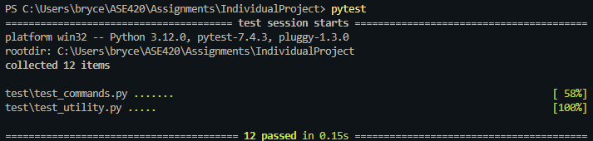
Testing
12-unit tests
1 regression test

