Slide 1
Predicting Diabetes from Health, Lifestyle, and Socioeconomic Related Factors in the U.S.
Ishaan Karvir, Bryce Cordill, Ryan Shintaku, Sam Wathen

Slide 2
Diabetes Background
Type 1 Diabetes
Thought to be caused by autoimmune reaction that stops body from making insulin
5-10% of people with diabetes have type 1
No known ways to prevent type 1
Type 2 Diabetes
Body doesn’t use insulin well and can’t keep blood sugar at normal levels
90-95% of people with diabetes have type 2
Can be prevented or delayed with healthy lifestyle choices
Notes:
Ishaan

Slide 3
Data Set Background
Focuses only on type 2 diabetes
Survey conducted by CDC to determine factors related to diabetes
Original dataset contains over 250,000 survey results
Contains 21 separate factors that could contribute to diabetes risk
Target variable is binary (0 - not diabetic, 1 - diabetic)
Most results were from people without diabetes
Notes:
Ishaan

Slide 4
Variables From Dataset
Categorical Data encoded to numeric values
High Blood Pressure
High cholesterol
Cholesterol Check
BMI
Smoker
Heart Disease
Physical Activity
Eats Fruits
Eats Vegetables
Heavy Alcohol Consumption
Healthcare
Visited Doctor Recently
General Health Levels
Mental Health
Physical Health
Difficulty Walking
Male or Female
Age
Education
Income
Stroke
Notes:
Ishaan

Slide 5
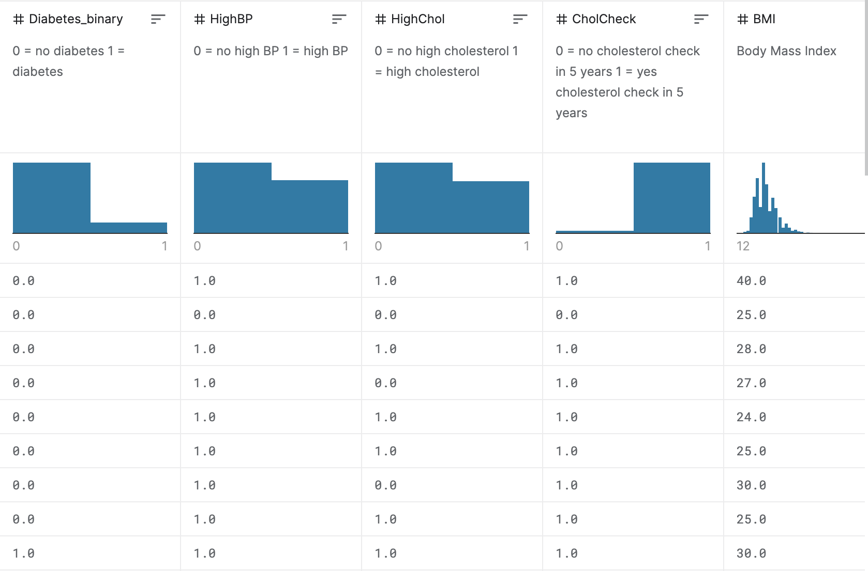
Example Data from the Dataset
Categorical Data encoded to numeric values
Notes:
Ishaan

Slide 6
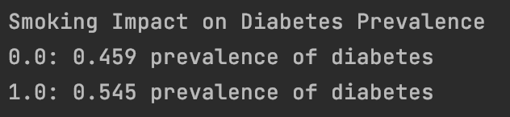
Preliminary Analysis: Analyzing Individual Variables for Diabetes Prevalence
Found the probabilities of diabetes given someone’s answer for each individual variable
Tried to find significant differences in percentage with diabetes between groups within individual variables
Example Output:
Notes:
Bryce

Slide 7
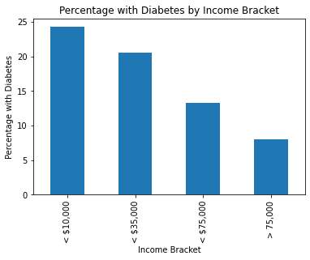
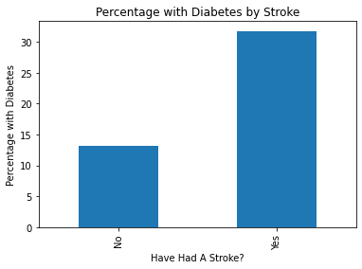
Preliminary Analysis: Plots of Diabetes Prevalence Based on Various Factors
Notes:
Bryce

Slide 8
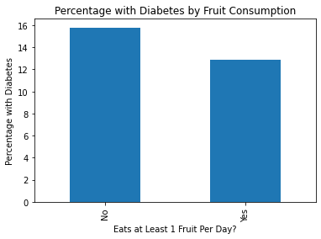
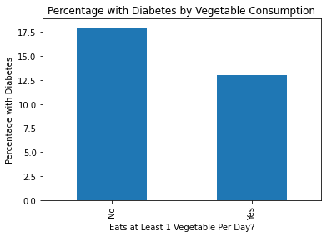
Preliminary Analysis: Plots of Diabetes Prevalence Based on Various Factors Continued
Notes:
Bryce

Slide 9
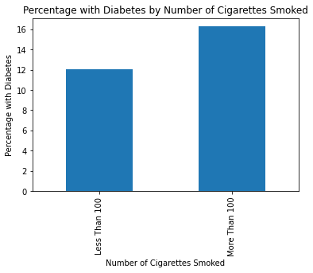
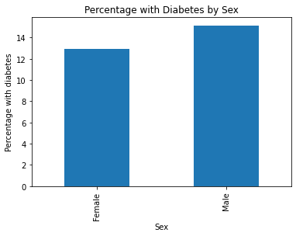
Preliminary Analysis: Plots of Diabetes Prevalence Based on Various Factors Continued
Notes:
Bryce

Slide 10
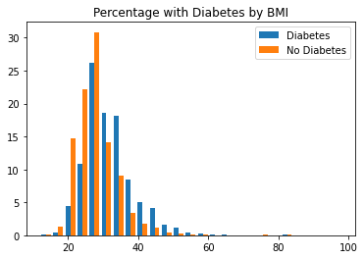
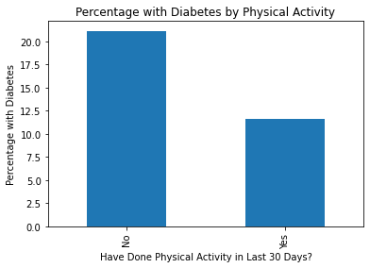
Preliminary Analysis: Plots of Diabetes Prevalence Based on Various Factors Continued
Notes:
Bryce

Slide 11
Significant Features from Preliminary Analysis
Income
High cholesterol
Body Mass Index (BMI)
Smoking
Previously had a stroke
Notes:
Bryce

Slide 12
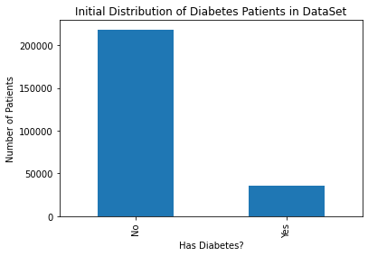
Resampling
Data initially very unbalanced
Took a subset from the data for KNN model
Total of 10,000 entries
Equal 50/50 split between those with diabetes and those without
Made our code run in a reasonable timeframe
Notes:
Bryce

Slide 13
Methodology to Predict Diabetes (KNN)
Implemented the k-nearest neighbors algorithm with k set to 11
Randomly split data into 80% training and 20% testing
Use knn on significant features determined from preliminary analysis
Use knn on other various groups of features to compare accuracy
Notes:
Ryan

Slide 14
Input Data to KNN Function Example
Key is the line number
First item in the value is whether the person has diabetes
Second item in the value is a list of the various factors and their values
Notes:
Ryan

Slide 15
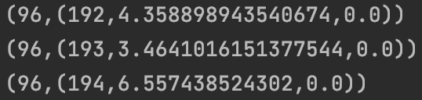
Our K Nearest Neighbors Implementation
Takes the cartesian product of the testing and training data
Calculates the euclidean distance between each row of testing data to every row in training data
Result mapped to a tuple where first element is the index of the testing row, and the second element is a tuple containing the index of the training row, the euclidean distance, and the training row’s classification
Notes:
Ryan

Slide 16
More on Our K Nearest Neighbors Implementation
Result from previous slide is then grouped by the key
Values are then sorted in ascending order
Take the first K values for each key
Key is the index from testing set, Value is a list of the classification of index 1’s K closest neighbors from the training set
Notes:
Ryan

Slide 17
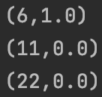
More on Our K Nearest Neighbors Implementation
Classify testing row based on mode of labels (0 for not diabetic, 1 for diabetic) of K nearest neighbors from training set
Notes:
Ryan

Slide 18
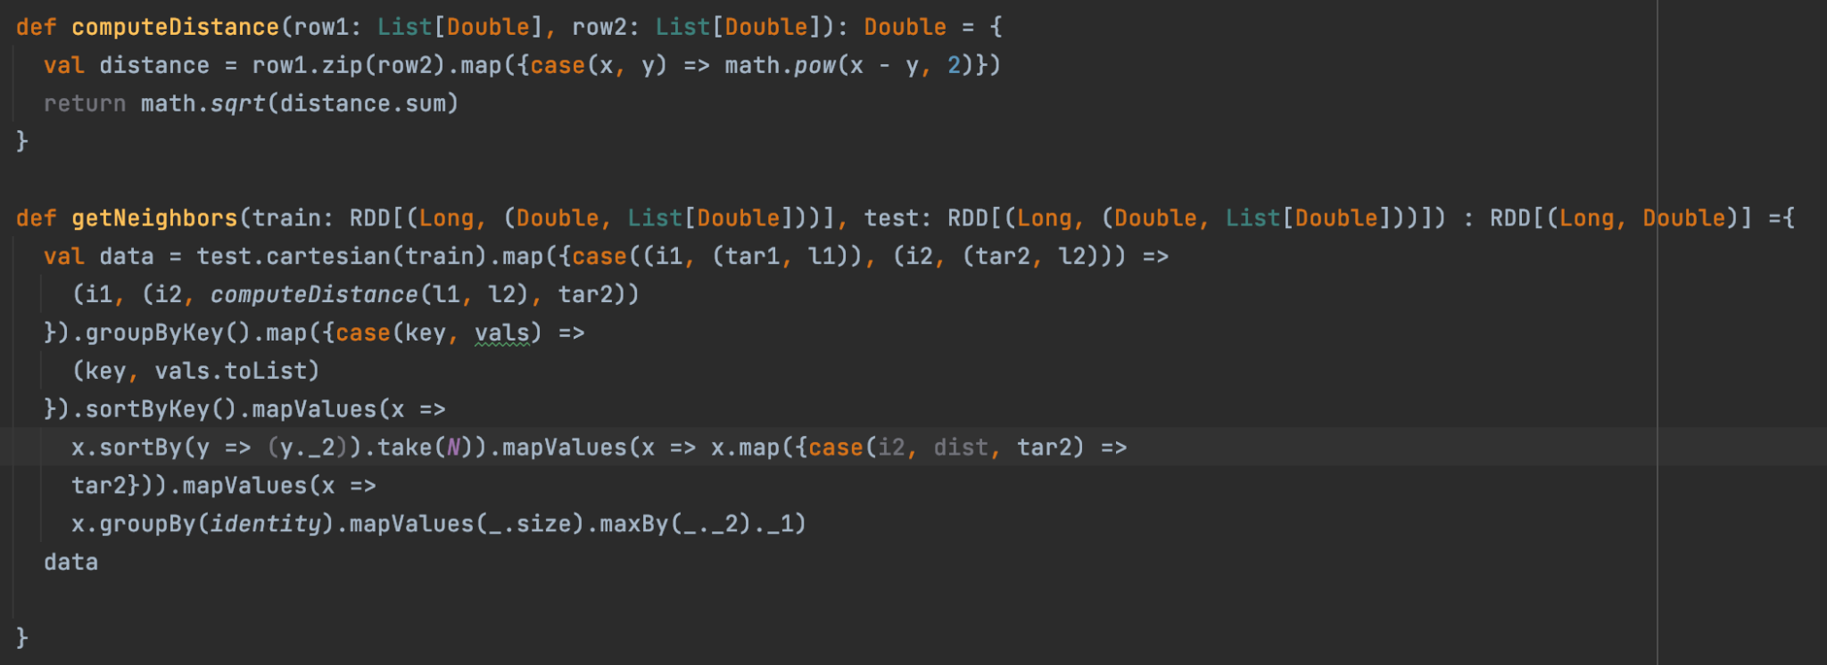
Full K Nearest Neighbors Implementation
Notes:
Ryan

Slide 19
Accuracy Predicting Diabetes Using Different Sets of Variables
Significant factors from preliminary analysis: 62% accuracy
Non-health factors (age, sex, income, education): 64% accuracy
Health factors(high blood pressure, high cholesterol, BMI, stroke, heart disease): 54% accuracy
Combination of non-health and health factors: 74% accuracy
All risk factors: 72% accuracy
Notes:
Ishaan

Slide 20
Results
Able to successfully train a model on the data to predict if someone will have diabetes based on their responses to the survey questions.
KNN performed best when using combination of non-health factors and health related factors: ~74% accuracy
Notes:
Ishaan

Slide 21
Problems we had
Our algorithm required a cartesian between our test and training data
Made the program run very slowly
Had to reduce data set to 10,000 entries from ~250,000
As mentioned earlier, the data is heavily skewed towards people without diabetes, as that is representative of the general population
Used a subset of the data with 50/50 diabetes and no diabetes to train our model
Notes:
Ishaan

Slide 22
What we learned
All risk factors which include a combination of health related factors and non health related factors provided the best accuracy in predicting diabetes
K Nearest Neighbors is slow to run with large amounts of data
Scala not very good for creating visuals/plots
Notes:
Ishaan

Slide 23
Thank You

